Slide 1
Agricultural Market Decision Support
Onion · Potato · Wheat — prices, arrivals and production from Indian open government data
CSE 3712 Big Data Analytics · Project end-term
[Team members · roll numbers]
Notes:
Introduce the team and the one-sentence goal: evidence for where and when to trade three staple crops.

Slide 2
Three public sources, one decision question
1
Mandi prices & arrivals
2
APY district production
3
Open-Meteo weather
4.5 GB
455k rows
46 sites
325 CSV files · 7.98M rows for 3 crops
CSV + Excel codebook · DES, Govt. of India
REST API (JSON) · 2001–2022, verified geocoding
Question:
Where and when should a trader buy and sell? We build honest, leakage-safe evidence for that decision, without claiming an optimiser we have not built.
Notes:
Explain each source and its format. The mandi files are the big-data part; APY gives district production; the weather API gives climate covariates.

Slide 3
A tested pipeline from raw files to decisions
4
5
6
7
8–9
10
Integrate
Clean
Features
EDA
Forecast
Context
reviewed crosswalk, July–June year
flag, never delete
leakage-safe, t−1 cutoff
seasonality, persistence
prices & arrivals vs persistence
district production + PQ-1 flags
Evaluation protocol
Chronological: train 2002–2018 · validate 2019–2020 · one-time test 2021–2022 · 2023+ holdout still unscored
Every model is compared with persistence; bootstrap intervals; selections frozen by hash
Notes:
Walk left to right. Each step is a tested module with a decision log; selections are frozen by hash.

Slide 4
PySpark ETL reproduces the pandas pipeline exactly
7.98M
16,673
0
109 s
raw rows read (explicit schema)
district-years compared
parity mismatches vs pandas
end-to-end, local[8], one machine
What the ETL does
Exact header check → explicit schema → malformed-row and date counts (0 / 0)
July–June agricultural year; window ≤ 2020-06-30 (before test and holdout periods)
Quality counts only: duplicate keys, min > max price, zero modal price, unmatched districts
Results written by pandas; two runs produce byte-identical files
Notes:
Spark reads all raw rows with an explicit schema. Spark SQL district-year totals equal the Phase 4 pandas output on every district-year — zero mismatches. Runtime is one machine, not a cluster.

Slide 5
Spark SQL and a MapReduce-style pattern
SELECT m.crop, c.apy_district, m.apy_year,
COUNT(*) AS mandi_records,
COUNT(DISTINCT m.market) AS mandi_markets,
COALESCE(SUM(m.arrivals_tonnes),0) AS arrivals,
percentile(m.modal_price, 0.5) AS median_price
FROM mandi m JOIN crosswalk c ON ...
WHERE c.apy_district IS NOT NULL
GROUP BY m.crop, c.apy_district, m.apy_year
map → reduceByKey
((crop, state), (1, arrivals)) summed per key — equals the SQL GROUP BY
Word count over variety names (topic C7)
Honest label
Spark RDD MapReduce-style pattern in local mode — not Hadoop MapReduce, not a cluster.
Hadoop / HDFS: pending instructor guidance.
Notes:
Show the Q1 query. Then the RDD map/reduceByKey job, which equals the SQL GROUP BY. Be explicit: this is a Spark pattern in local mode, not Hadoop MapReduce.

Slide 6
Prices: persistence is hard to beat
8 of 9 cells
persistence selected on validation
Onion h = 1
-1.58% on the combined test — the model did worse
Weekly mandi prices are highly persistent (EDA: within-series correlation ≈ 0.95).
Notes:
Persistence was selected for eight of nine cells on validation. The one learned model, Onion one week ahead, passed validation but was worse than persistence over the combined test period.

Slide 7
Arrivals: the model beats persistence in all 18 test cells
18 / 18
test cell-years better than persistence
2.3–13.5%
range of improvement
Two test years only; intervals do not cover nationwide shocks.
Notes:
Conservative gradient boosting, selected on validation, beat persistence in every crop × horizon × test year. Gains are modest and largest for Wheat. Arrivals are a supply-side activity measure, not demand.

Slide 8
Production context: descriptive, flagged, never repaired
31,694
t − 2
Integrity rules
Rules designed on source years ≤ 2018-19 only
2019-20 … 2021-22 built after a hash freeze; shown as counts only
37 West Bengal / Gujarat Potato 1997-98 rows marked 'review'; no cause asserted
No forecasting model, no procurement cap, no marketable-surplus estimate
district-year rows (contract v1)
APY year informing decision year t — an assumption
4
9 / 1 / 5
comparability classes, never merged
PQ-1 rules active / diagnostic / blocked
Notes:
District APY values two years back, as published. Four comparability classes are never merged. Quality rules only flag. The two-year lag is a policy assumption. R13 rows await a provider answer.

Slide 9
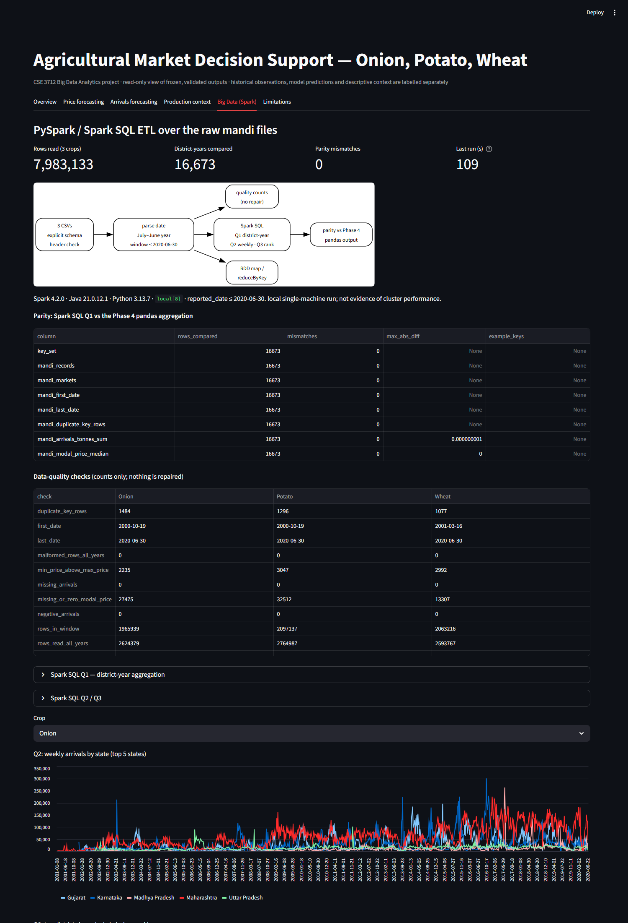
The functional application: a read-only dashboard
Six tabs
Overview — problem, sources, what is built
Prices — observed vs persistence vs model; test metrics
Arrivals — crop / horizon / period filters
Production — class and quality filters; reserved years as counts
Big Data — Spark workflow, SQL, parity, quality, runtime
Limitations — what the evidence cannot support
Streamlit 1.57 · local · free; usage statistics disabled
Notes:
Live demo here. Six tabs; the data layer enforces the boundaries: validation and test only, no holdout, production values only through 2018-19, no file writes.

Slide 10
Verification: tests, hashes and frozen evaluations
268 + 36
62
3
1×
tests passing (project + Spark/app env)
protected input hashes verified
frozen selections verified (D-42, D-45, Phase 10)
each test period scored, once
How the evidence stays honest
Synthetic-fixture parity against Phase 4's own pandas code; real-data parity 0 mismatches
Dashboard tests: no reserved production value, no holdout row, no file writes
Selections fixed on validation before any test; the 2023+ holdout remains unscored
Notes:
Explain run-once guards and hash freezes: test periods were scored exactly once, and nothing in the dashboard or Spark job can rerun them.

Slide 11
Limits and next steps
What the evidence cannot support
Price models add little over persistence
Arrivals ≠ demand; two test years only
APY lag is an assumption; single 2023 vintage
Spark is local-mode; Hadoop pending guidance
No routing or optimiser: cost data missing
Next
Route costs once distance and cost data are sourced
LP / MILP decision model on those inputs
Rolling historical backtest
Score the 2023+ holdout once, under its protocol
Notes:
Close with the honest limits and the concrete next steps, then hand over to Q&A and the contribution matrix.

