Slide 1
National Rural Drinking Water Programme (NRDWP)
A DATA MINING TERM PROJECT
Under the supervision of:Dr Manik Gupta

Slide 2
PROJECT OVERVIEW
This Project aims to determine the distribution of potable drinking water across Districts and States of India. And to compare the effect of location-wise and category-wise Distribution.
This analysis will help us to find solid proofs (if any) to the common myth that water availability depends upon population distribution(category wise) across india and is comparatively better for general class people than other categories.
The dataset is provided under NRDWP a Government of india’s flagship rural drinking water supply scheme.The scheme aims to provide safe and adequate drinking water across rural India.The dataset has data of each and every state and gives information about the village name and its location(i.e. State name,district name,block name) and the population their having access to potable drinking water(category wise).

Slide 3
DATASET OVERVIEW
Dataset consists of 4 files in in total,one for each year from 2009-2012.
Each file consists of various attributes to define location of a village(state name,district,block name etc) and other attributes like SC current,SC covered(similarly 2 attributes each for ST and General category),SC concentrated,St concentrated etc.
Dataset was same for all the four years i.e. having same attribute values for a village for all the four years.

Slide 4
PREPROCESSING
● DATA CLEANING
Removing noisy Data: Rows which had negative entries in any of the column attributes or the total current population was zero were removed. Also, rows having covered population greater than current population were removed.
Regular expression was also used to remove noise in the names of district, states, habitation name and village name.
Removing Duplicate Entries : The raw dataset had some duplicate entries which need to be removed
● DATA REDUCTION
Dimensionality Reduction: Selecting a useful subset of attributes out of all the different attributes(Attribute subset selection),certain data attributes were dropped.
● DATA TRANSFORMATION
Feature Construction : Certain new attributes were constructed using the given attributes to make some useful observation and to be able to do a better analysis of the given dataset.
Aggregation: The Dataset was grouped by various level like village, district and state level for analysis. Also, the data of four years was also grouped together so as to analysis time series changes(if any).

Slide 5
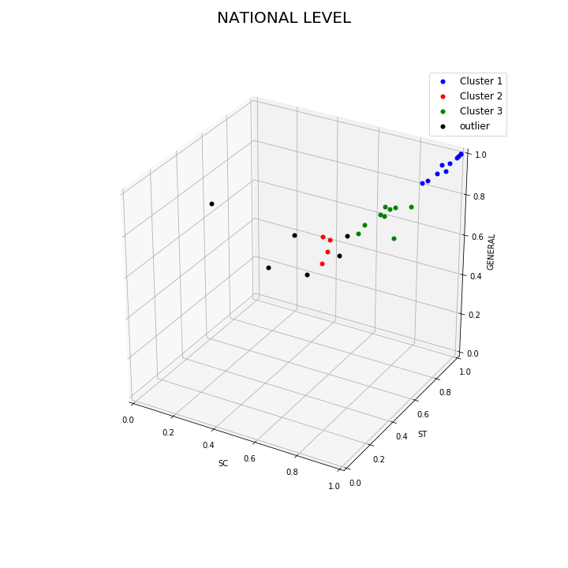
NATIONAL LEVEL
This is a cluster plot of all the States and UTs of India.
There are 3 clusters in total and 6 outliers.
CLUSTER1:Goa,Gujarat,Haryana,Jharkhand,Kerala,Tamil Nadu,UP,Uttarakhand,WB
CLUSTER2:Arunachal Pradesh,Assam,Manipur,Mizoram
CLUSTER3:Bihar,Chattisgarh,Himachal Pradesh,Karnataka, Maharashtra,Madhya Pradesh,Orissa,Rajasthan,Sikkim
OUTLIERS:J&K,Meghalaya,Nagaland,Puducherry,Punjab, Tripura

Slide 6
CLUSTER1
Cluster1 is a group of states having high fraction values for all the three categories indicating no appreciable category wise distribution (on state level after aggregation). To get a better insight of distribution (if any) we studied two states of cluster1 Uttarakhand and West Bengal.
We will Discuss Uttarakhand and West Bengal in detail.

Slide 7
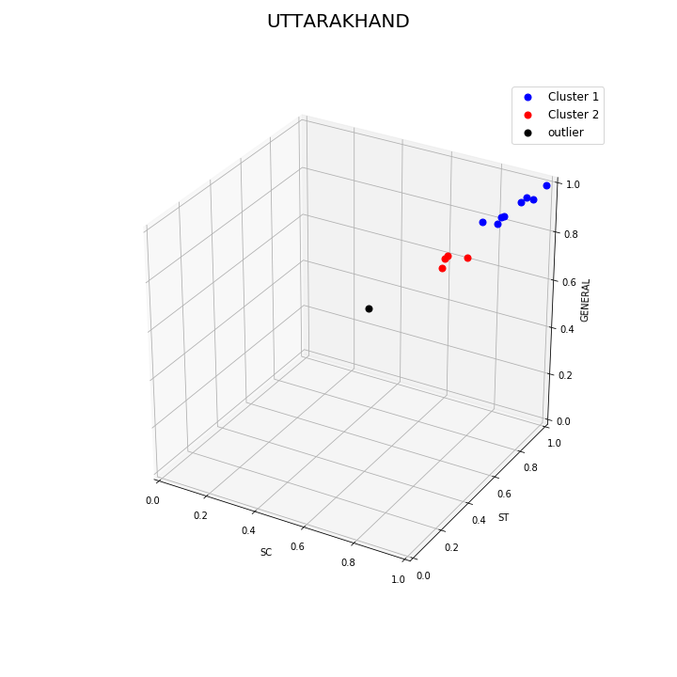
UTTARAKHAND
This graph shows the scatter plot of various district in Uttarakhand.
DBSCAN was applied on this plot and it resulted in 2 clusters and one outlier.
For every district in cluster1 values of the all three fractions lie in the range (0.75-0.95) whereas values of fractions for district in cluter2 lies in the range (0.55-0.7).

Slide 8
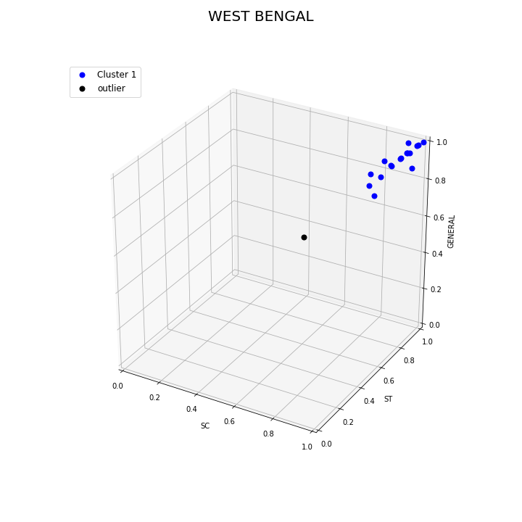
WEST BENGAL
This graph shows the scatter plot of various districts in West Bengal.
DBSCAN was applied on this plot and its resulted in 1 cluster and a outlier point.
All the districts of West Bengal have high values for all the three fractions in the range (0.75-1.0).
There is no significant difference between the values of all the districts hence there is no possibility of any sort of category-wise or location-wise distribution.
For graphs/plots of other states belonging to cluster1 click here

Slide 9
CLUSTER2
Cluster2 is a group of states having low fraction of total population having access to water in state(Total covered population/Total current population) with no appreciable category wise distribution(on state level after aggregation).
But this cluster does have high inter cluster similarity between all four states viz. Arunachal Pradesh, Assam, Manipur and Mizoram as all of them have very low percentage of people having access to potable drinking water(State-level).
To get a better insight of distribution (if any) we studied Assam's distribution on state level.

Slide 10
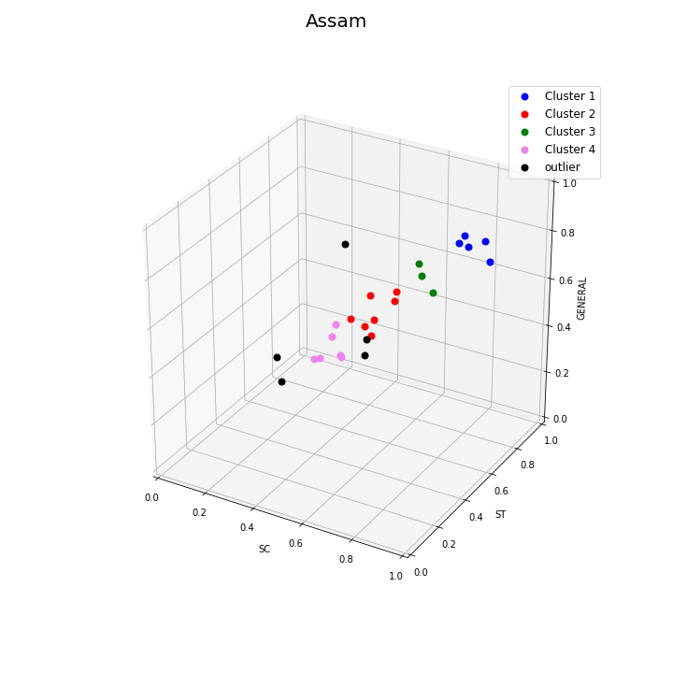
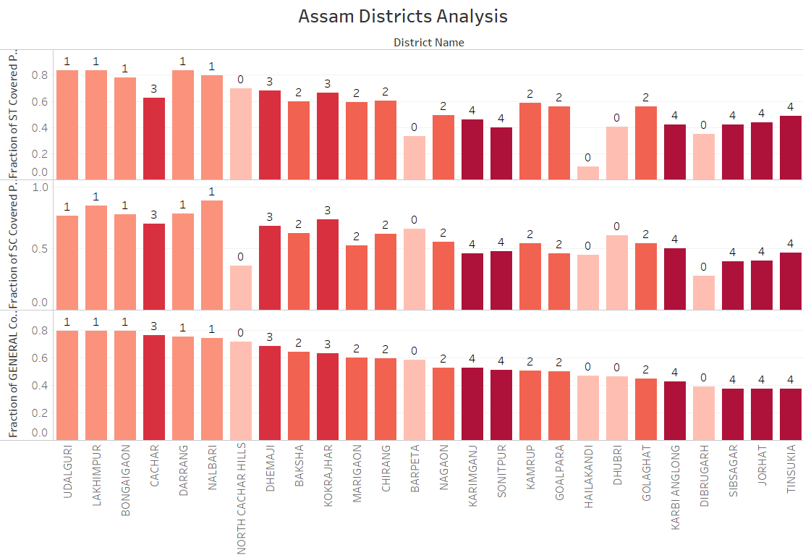
ASSAM
This graph shows the scatter plot of various districts in Assam.
DBSCAN was applied on this plot and it resulted in 4 clusters and 5 outliers.

Slide 11
The above Bar Graph shows the fraction of SC population (Total SC covered/Total SC current) and similarly ST population and General population for each District.
Bar graphs with label 0 denotes outlier districts and with label 1,2,3,4 denotes cluster 1,2,3,4 respectively.
For graphs/plots of other states belonging to cluster2 click here

Slide 12
CLUSTER3
It consists of states with value of total fraction(Total current population/Total covered population) higher than cluster2 but lower than cluster1,with values is in range (0.65-0.80).
This cluster is the second best performing cluster on national level.
These states have very less difference in values of fraction of all three categories (State level average).
For a better insight, Bihar was analyzed on district level.

Slide 13
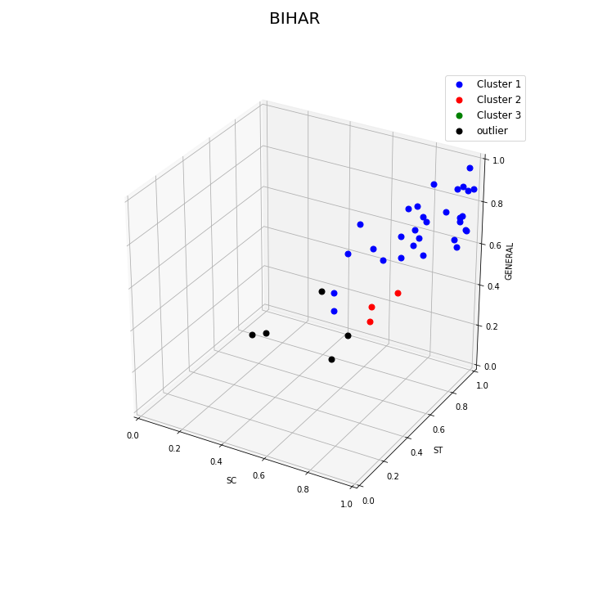
BIHAR
The shown graph is a scatter plot of all the districts in Bihar.
DBSCAN was applied on this plot, which resulted in two cluster and 5 outliers.
These two cluster differ mainly on the grounds of total fraction value.
Plots of other states belonging to cluster3 are attached here

Slide 14
OUTLIERS
6 outliers were there after DBSCAN was applied on National level namely, J&K, Meghalaya, Nagaland, Puducherry, Punjab, Tripura.
Some of them were due to the fact, that one category being heavily dominated by other two categories in terms of fraction of people having access to potable water in that particular category, examples of this are Meghalaya, Nagaland, Puducherry, Punjab.
J&K and Tripura were outliers because they had the lowest total fraction (Total population covered/Total current population) in the country.

Slide 15
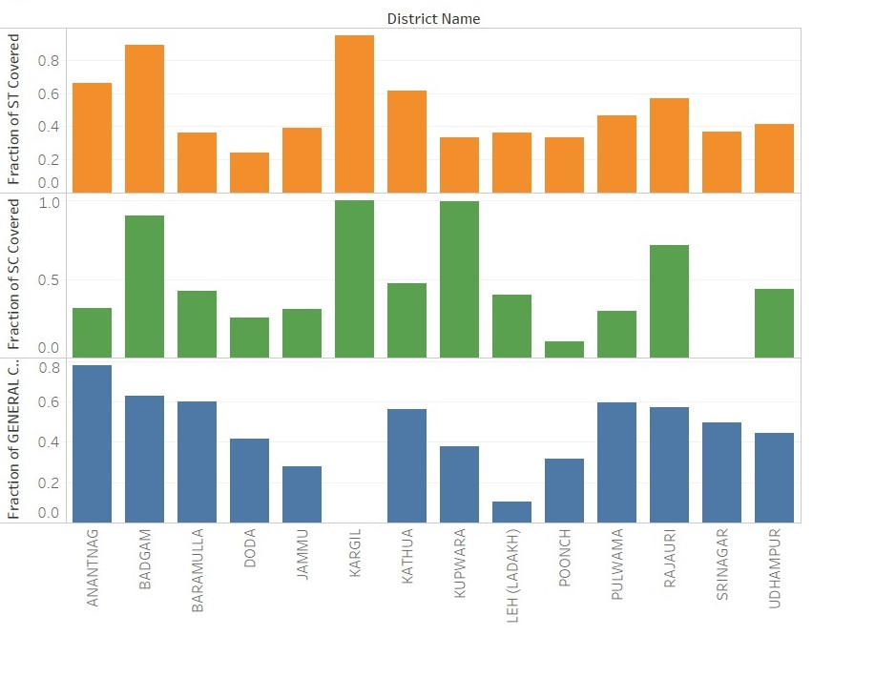
JAMMU & KASHMIR
Shown here is a Bar graph of three fractions of various districts of J&K. State level average value of fraction of SC (0.36), ST (0.48), General (0.51) indicate a very light effect of category wise distribution in state.
Values of the three fractions for different districts differ greatly.
Hence, overall availability of potable drinking water in J&K is dependent on category-wise distribution.

Slide 16
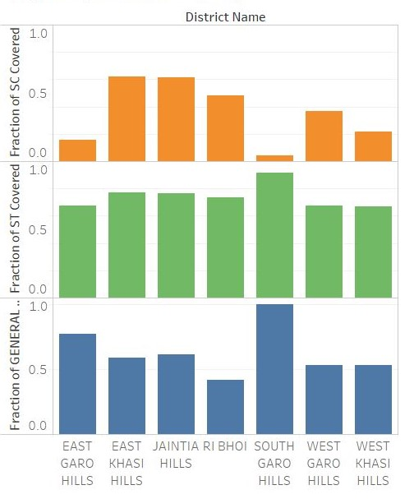
MEGHALAYA
Shown is a Bar graph of three fractions of various districts of Meghalaya. On state level Fraction of ST(0.72) and Fraction of general(0.55) having access to potable drinking water was almost double than that of SC(0.35).
But when we had a closer look of different districts 5 out of 7 had particularly high values of fraction of ST, followed by fraction of General and then by Fraction of SC.
Plots of other states belonging to outlier are attached here

Slide 17
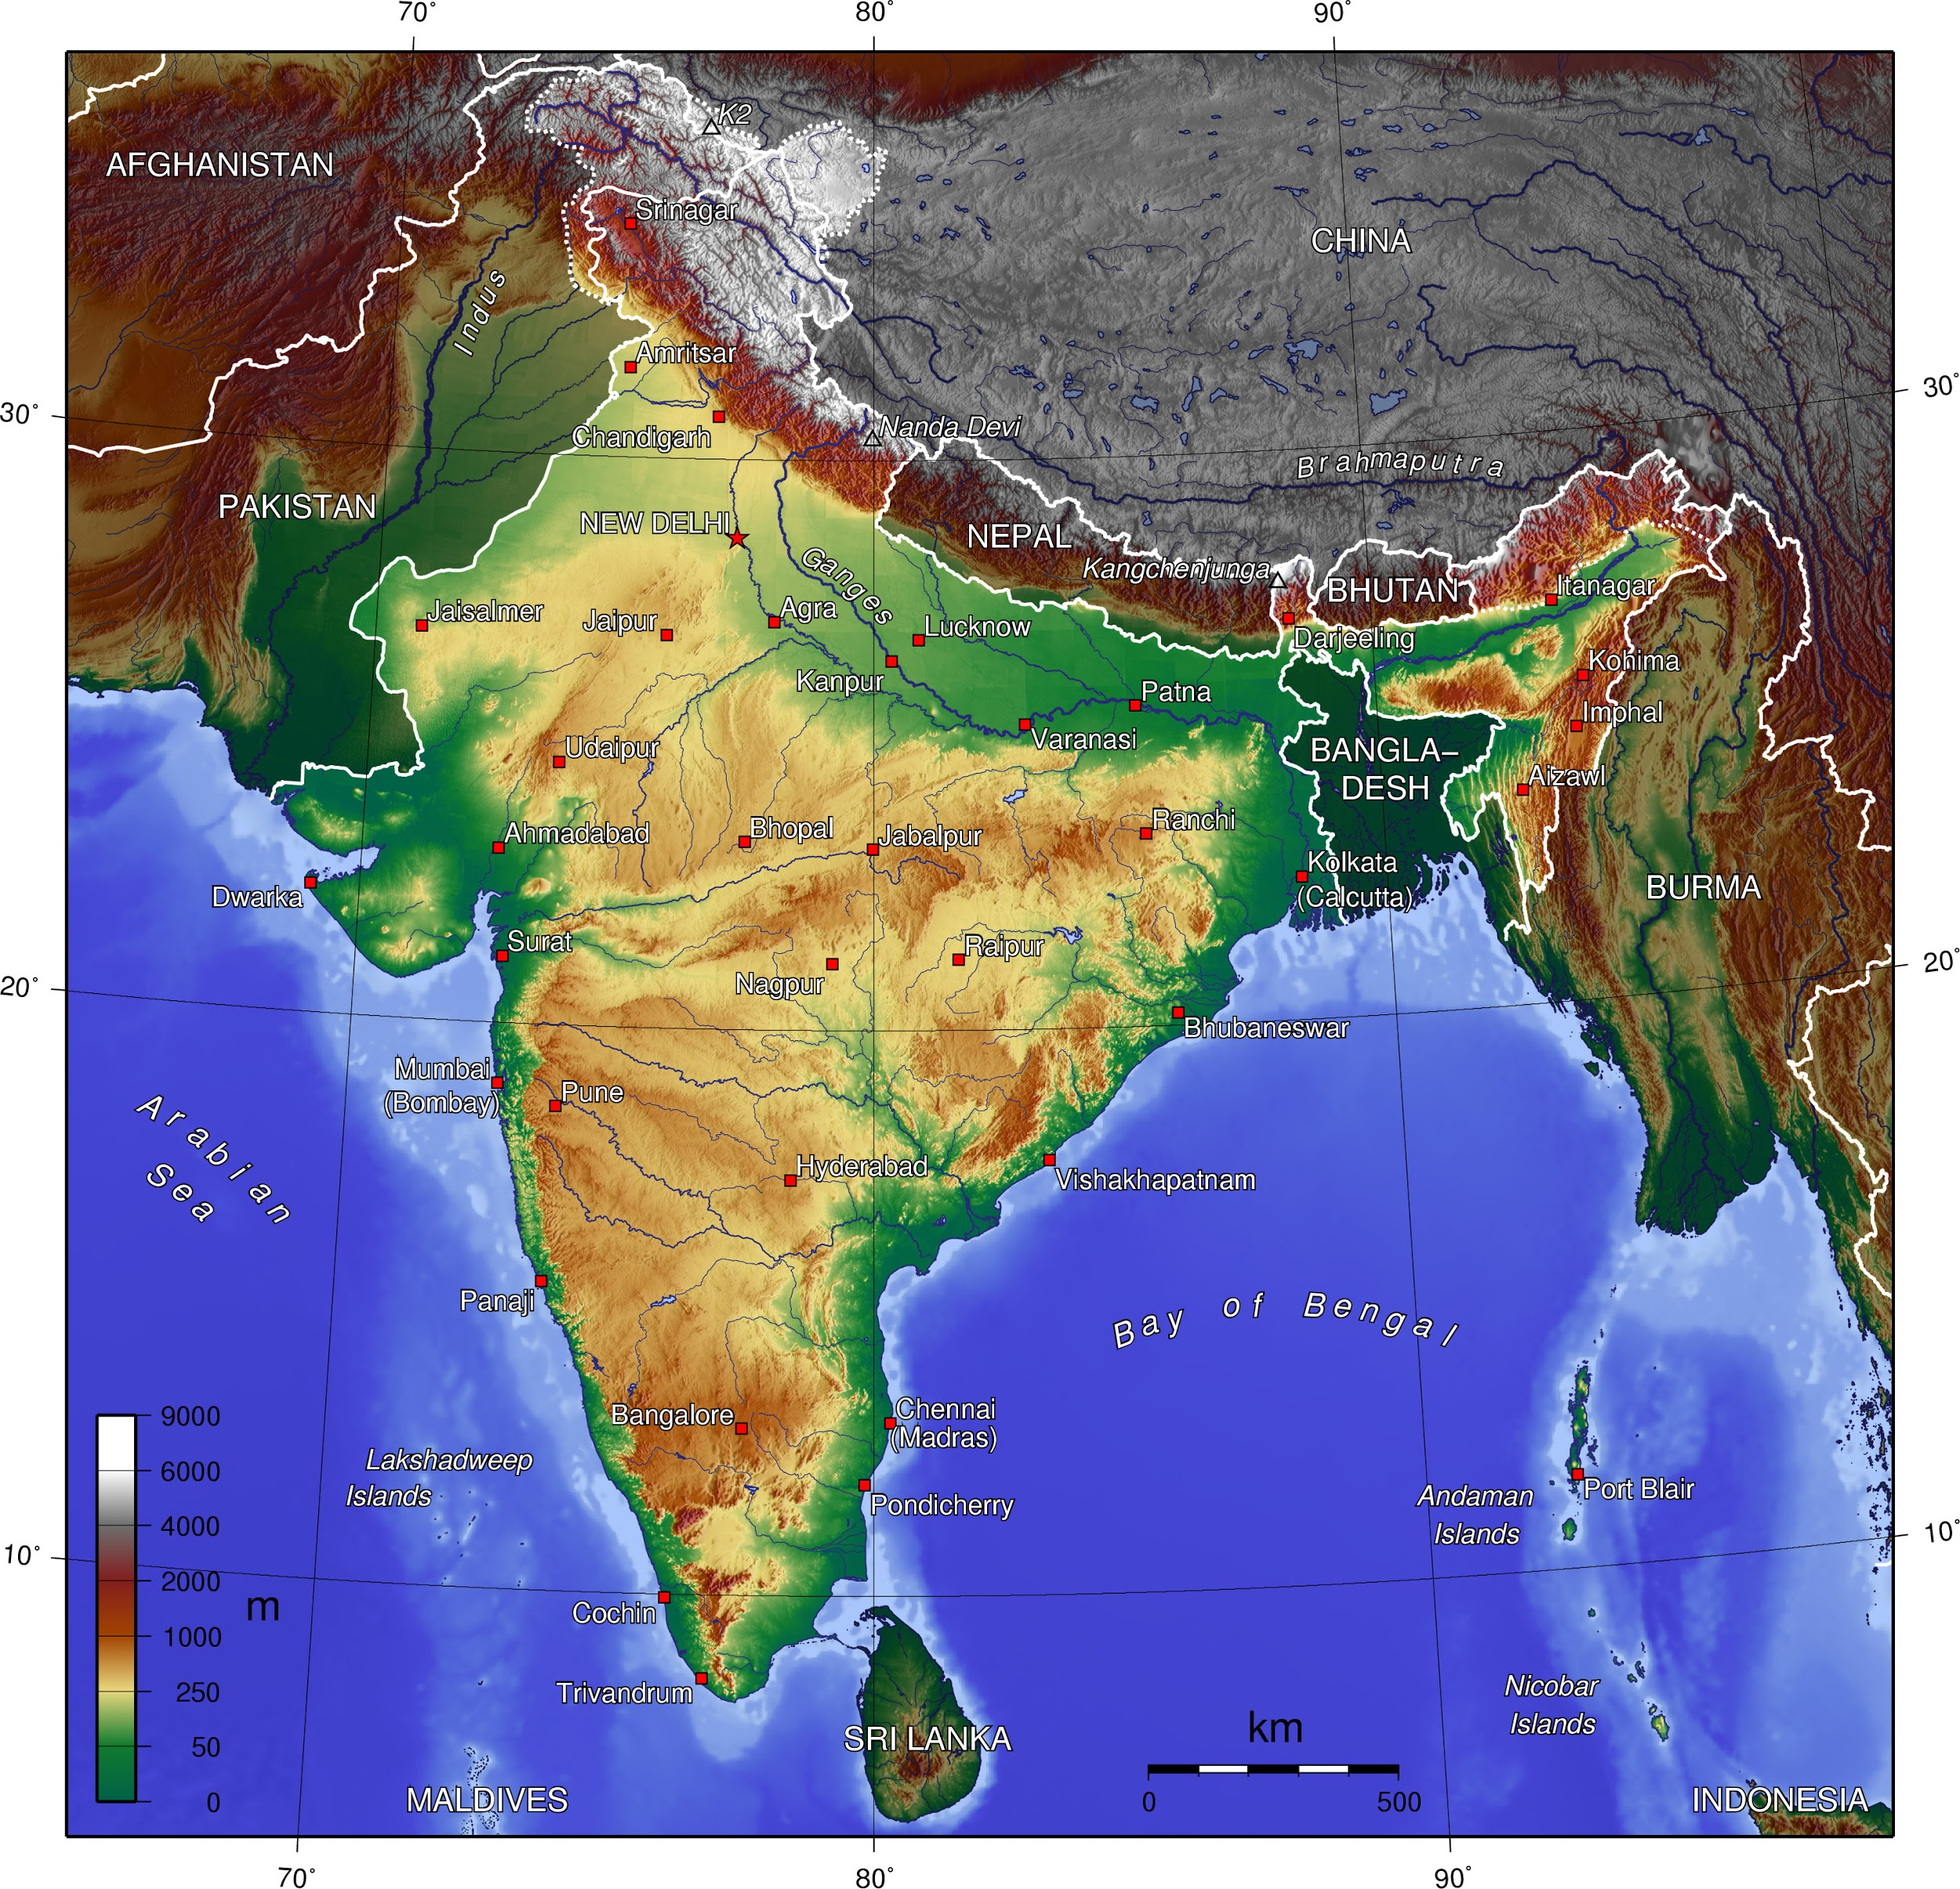
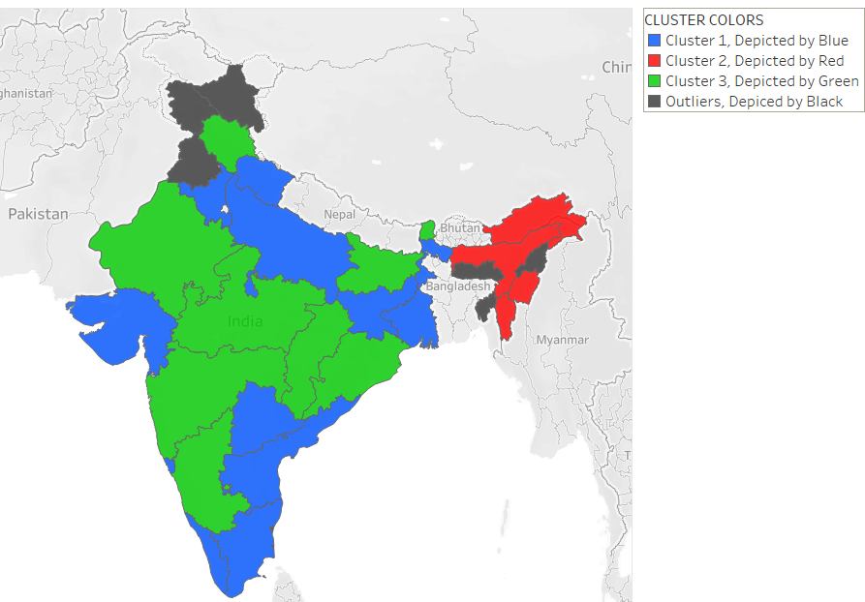
CONCLUSION
So, after all this analysis it is quite evident that there is a significant location-wise distribution in availability of potable drinking water in India.
Shown is a Topological map of India, on comparison with the cluster map shown , it is visible that the cluster formed do coincide with the topological map.
There is very low category-wise Distribution in India on National level.other than that in Meghalaya and J&K water availability is significantly dependent on category-wise Distribution.

Slide 18
WORK DIVISION
AKSHAT GUPTA(2017A7PS1699H)
Plotting of graphs using Tableau.
Code Development( Aggregation of data, preprocessing)
ABHISHEK BHARDWAJ(2017A7PS1497H)
Code Development( clustering, python plots)
Dataset Research
ARUN INANI(2017A7PS0085H)
Code Development(preprocessing)
Documentation
Dataset Research

Slide 19
THANK YOU

