Slide 1

Titanic: Machine Learning from Disaster

Slide 2
Problem Statement
To predict if a passenger survived the sinking of the Titanic or not using data mining algorithms.
●

Slide 3
Introduction
On April 15, 1912, during her maiden voyage, the Titanic sank after colliding with an iceberg, killing 1502 out of 2224 passengers and crew. Translated 32% survival rate.
One of the reasons that the shipwreck led to such loss of life was that there were not enough lifeboats for the passengers and crew.
Although there was some element of luck involved in surviving the sinking, some groups of people were more likely to survive than others, such as women, children, and the upper-class.
●
●
●

Slide 4
Evaluation
Goal: It is our goal to predict if a passenger survived the sinking of the Titanic or not. For each PassengerId in the test set, we predict a 0 or 1 value for the Survived variable.
Metric: Our score is the percentage of passengers correctly predicted. This is known simply as "accuracy”.
Output: The file should have exactly 2 columns: PassengerId (sorted in any order)
Survived (contains your binary predictions: 1 for survived, 0 for deceased)
●
●
●
➢
➢

Slide 5
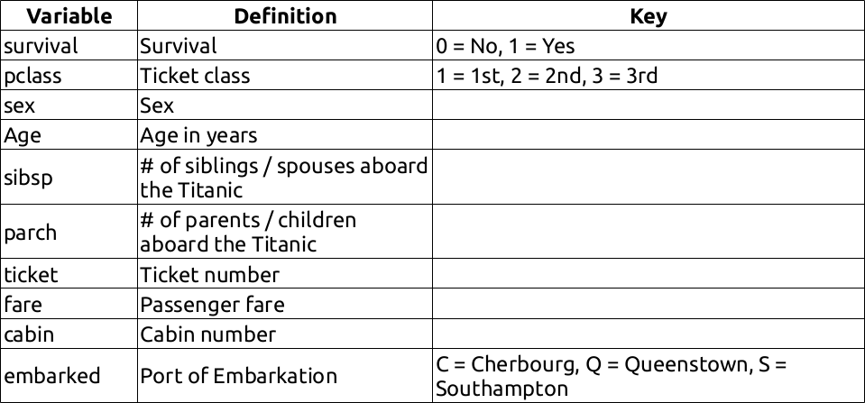
Training Features

Slide 6
Workflow Stages
Classifying Correlating Converting Completing Correcting Creating
●
●
●
●
●
●

Slide 7
Algorithm
●
Logistic Regression:
Logistic regression measures the relationship between the categorical dependent variable (feature) and one or more independent variables (features) by estimating probabilities using a logistic function, which is the cumulative logistic distribution.
●
Support Vector Machine:
“Support Vector Machine” (SVM) is a supervised machine learning algorithm which can be used for both classification or regression challenges. However, it is mostly used in classification problems.
●
KNN:
In pattern recognition, the k-Nearest Neighbors algorithm (or k-NN for short) is a non- parametric method used for classification and regression. A sample is classified by a majority vote of its neighbors, with the sample being assigned to the class most common among its k nearest neighbors (k is a positive integer, typically small). If k = 1, then the object is simply assigned to the class of that single nearest neighbor.

Slide 8
Algorithm
●
Decision Tree:
The goal is to create a model that predicts the value of a target variable based on several input variables. Each interrior node corresponds to one of the input variables; there are edges to children for each of the possible values of that input variable. Each leaf represents a value of the target variable given the values of the input variables represented by the path from the root to the leaf.
●
Random Forest:
Random forests or random decision forests are an ensemble learning method for classification, regression and other tasks, that operate by constructing a multitude of decision trees at training time and outputting the class that is the mode of the classes (classification) or mean prediction (regression) of the individual trees. Random decision forests correct for decision trees' habit of overfitting to their training set.

Slide 9
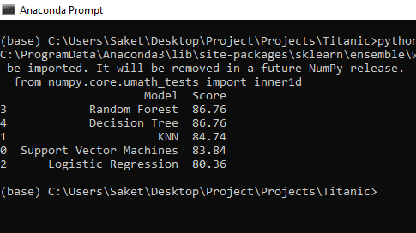
Experimental Result
●
While both Decision Tree and Random Forest score the same, we choose to use Random Forest as they correct for decision trees' habit of overfitting to their training set.

Slide 10
Conclusion
As a result of our work, we gained valuable experience of building prediction systems and achieved our best score:
86.76% of correct predictions.
We performed featured engineering techniques
Changed alphabetic values to numeric Calculated family size
Extracted title from name and deck label from ticket number Used linear regression algorithm to fill in missing ages
We used several prediction algorithms in python Logistic Regression
Random Forest
Decision Tree KNN
SVM
We achieved our best score 86.76% correct predictions

Slide 11
Thank You

