Slide 1
Weather Monitoring System
By: Akshat Khare

Slide 2
Contents
Purpose and Requirement Specification
Process Model Specification
Domain Model Specification
Information Model Specification
IOT Level Specification
Functional View Specification
Operational View Specification
Device and Component Integration
Application Development
Conclusion And References

Slide 3
Purpose and Requirement Specification
Purpose-
The purpose of this system is to design a system which can monitor temperature and humidity of a particular room or place.
Requirement Specification-
The IoT system should provide some remote monitoring functions as well as local analysis of data.

Slide 4
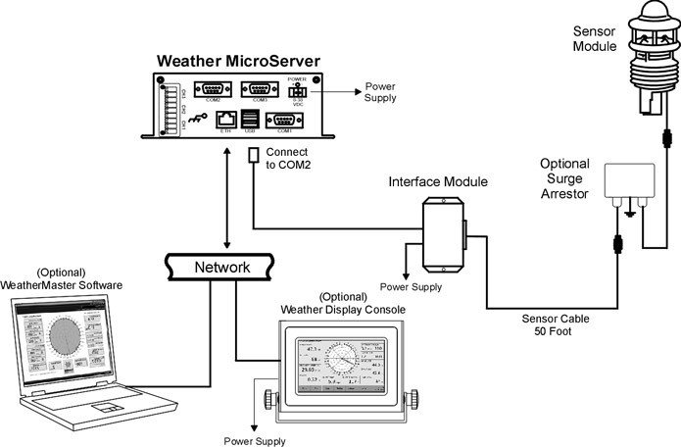
Process Model Specification
The Process model of weather monitoring system consist of process flow diagram.

Slide 5
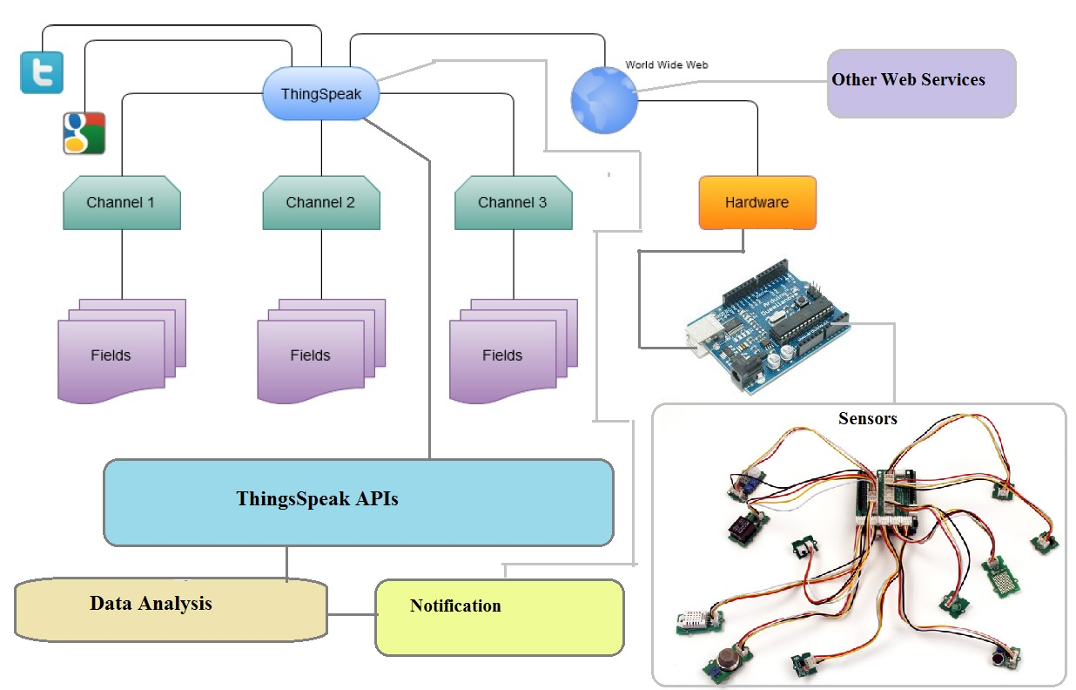
Domain Model Specification
It consist of concepts,entities and objects in the domain of weather monitoring system

Slide 6
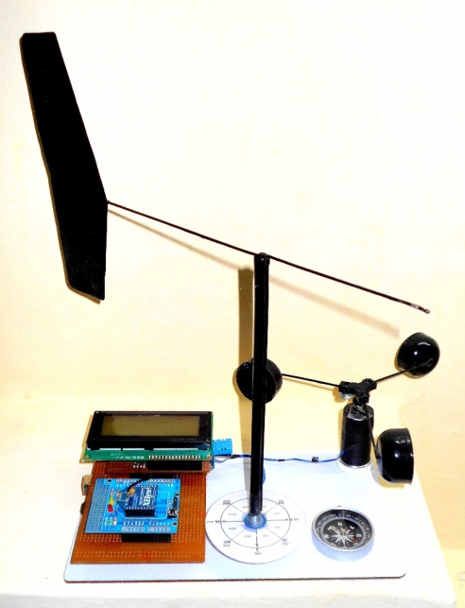
Information Model Specification
The proposed system measures the real time weather parameters automatically.
It uses low cost high precision calibrated digital sensors for accurate data measurements.
This system can record the data and host it on the internet for remote viewing of weather conditions.
And it generates the short term local alerts based on current weather conditions.

Slide 7
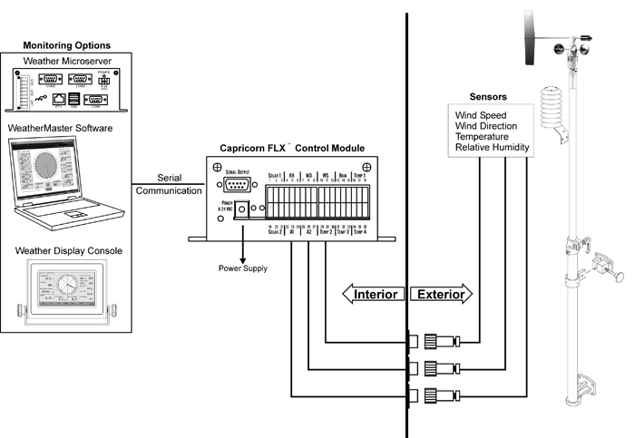
Service Specification
In this various services used in the system is described like monitoring service,cloud service etc.

Slide 8
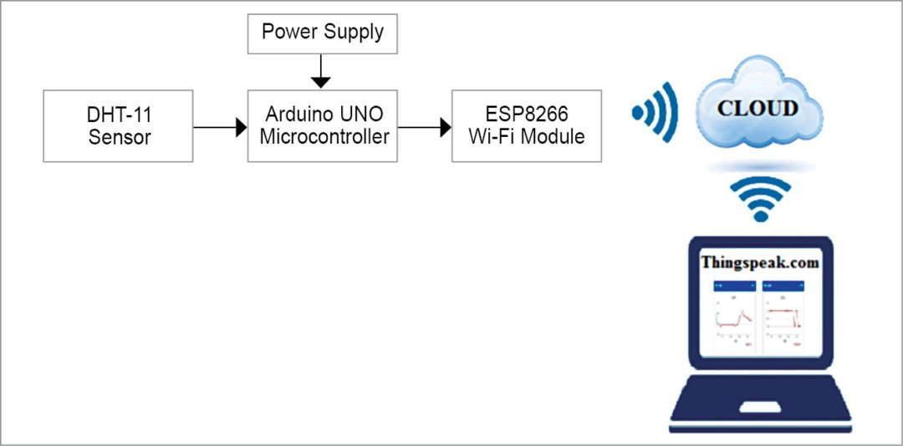
IoT level Specification

Slide 9
Functional view specification
Temperature Sensor: This sensor is used for reading the temperature and also to calculate humidity.
Wifi Module:ESP8266 was used to connect the system to cloud.

Slide 10
Operational View Specification
Devices used-
Arduino uno,DHT 11 temperature sensor,ESP8266 wifi module.
Applications used-
Thing Speak cloud server,Zapier zap service to send notifications.

Slide 11
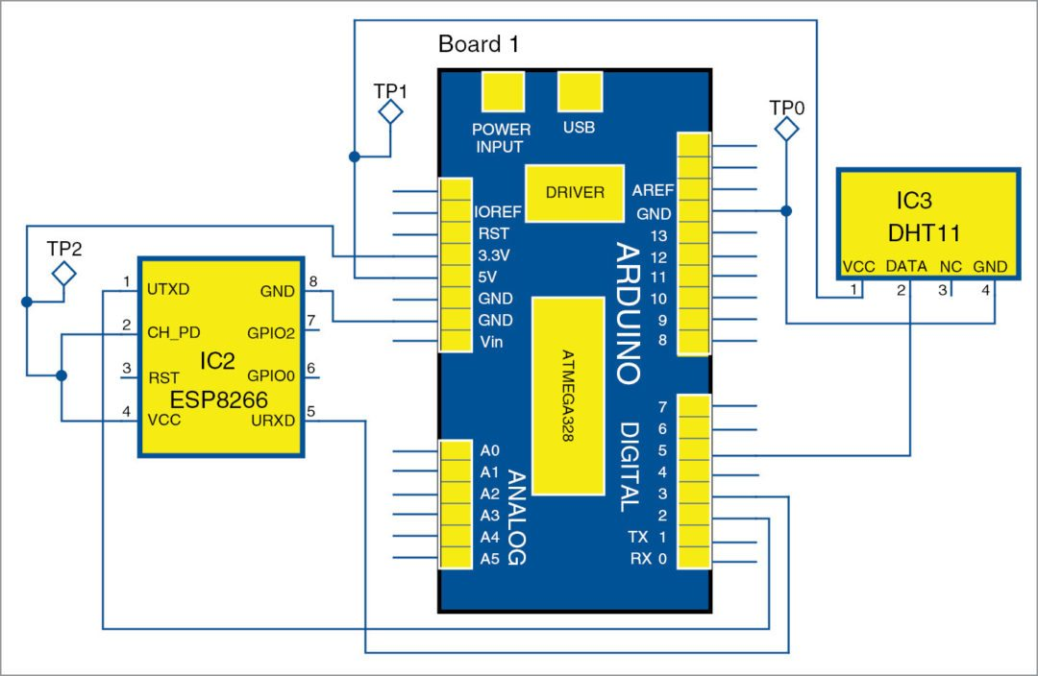
Device and Component Integration

Slide 12
Application Development
The weather monitoring system application was developed which measures the real time weather parameters automatically. It uses low cost high precision calibrated digital sensors for accurate data measurements.This system can record the data and host it on the internet for remote viewing of weather conditions.And it generates the short term local alerts based on current weather conditions.

Slide 13
Conclusion
This concludes that the present work was a success and it will provide a competent method for recording real time weather readings and help farmers whose livelihood depends on the weather in a country like India to produce better quality crops. It can be used to gather information about the requirements for each area over the years. The gathered information is used to determine the optimal conditions for plants to grow and the farmer can modify the environment suitable for the growth of the plant.
Limitations of the weather system is mentioned below
This system is developed for Small area.

Slide 14
References
1. Satoh. F, Itakura. M, “Cloud-based Infrastructure for Managing and Analyzing Environmental Resources”, SRII Global Conference, pp.325- 334, 201.
2. Kurschl. W, Beer W, “Combining cloud computing and wireless sensor networks”, International Conference on Information Integration and Web-based Applications and Services, pp.512-518, 2009.

