Slide 1




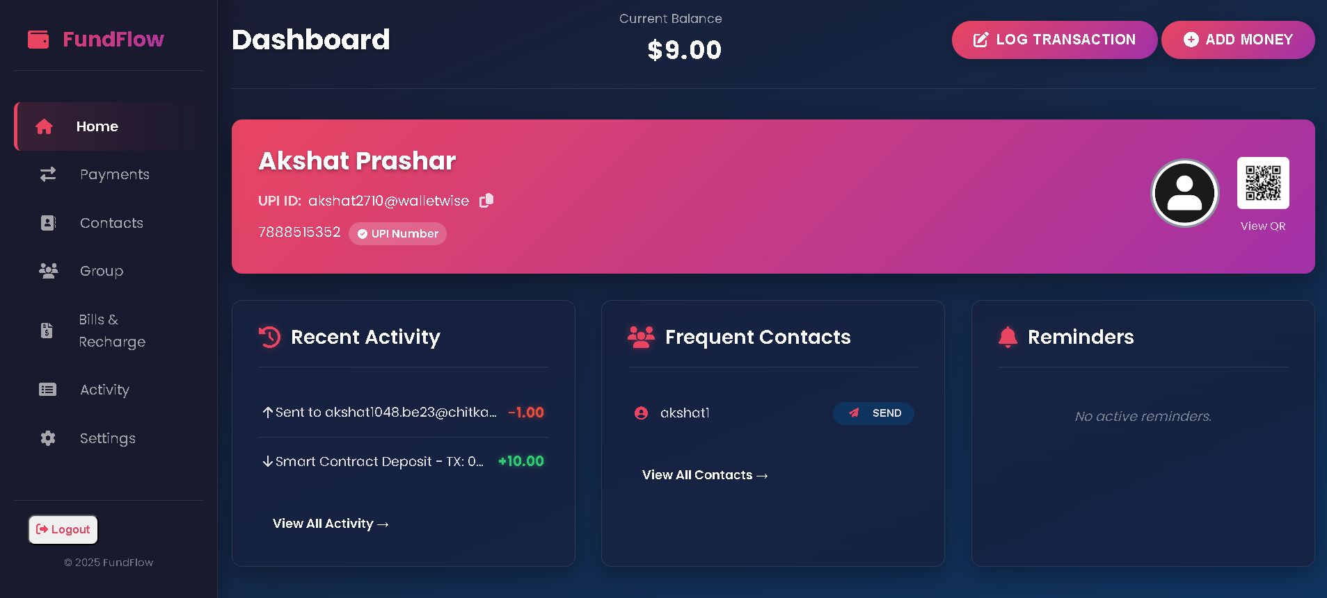
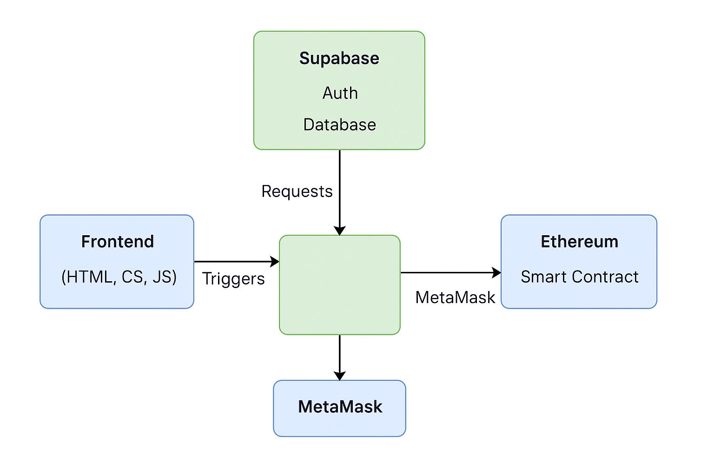

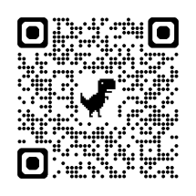
Problem Overview
Explorihibit 4.0
WalletWise
Student IDs: 2311981009, 2311981048
Under the Supervision of : Dr. Navneet Kaur
System Overview
Impact & Results
Problem Statement:
Many users find existing digital wallets complex and desire a simpler, secure application focused on core functionalities: managing balances, simulated P2P transfers, fund addition, and transaction history. MetaPurse addresses this by offering a clean web interface and simulated backend, providing a learning model for digital wallet creation without real-world financial system complexities.
Motivation:
To simplify digital finance management with a user-focused platform offering clear and secure financial operations.
To explore and demonstrate the integration of modern backend (Supabase) and decentralized payment technologies (MetaMask/Ethereum) in a practical learning environment.
System Architecture
Novelty / Innovation :
Integration of Supabase for real-time backend services with a client-side Ethereum payment simulation via MetaMask, offering a practical BaaS and Web3 learning model.
Focus on a streamlined, core-functionality digital wallet experience, contrasting with feature-heavy commercial alternatives, emphasizing ease of use and understanding for foundational financial operations.
Users authenticate via Supabase, view real-time balances, interact with MetaMask on Holesky for simulated transactions, and manage contacts with all activity logged in Supabase.
Prototype with simulated P2P and testnet ETH, dependent on MetaMask, lacking 2FA and real-world payment integrations.
Enable real P2P via RPC, add ERC-20 and fiat options, integrate budgeting, analytics, notifications, and decentralized identity.
QR Code : Link to GitHub and Video

