Slide 1
Clinical Decision Making and
Pattern Recognition in Health Care
Treatment
A TPO Strategy for Cotiviti
Payment
ClaimGuard: Explainable Claims Review Prioritization
Operations
Prioritized, explainable evidence
Akshat Paras Mehta | Rochester Institute of Technology | Temp Intern — GenAI Sci Role
Notes:
“Hello, I’m Akshat Mehta. This presentation examines clinical decision making and pattern recognition across Treatment, Payment, and Operations, followed by ClaimGuard, my payment-focused proof of concept.”

Slide 2
From Healthcare Data to Expert Action
Clinical decision making and pattern recognition convert healthcare data into prioritized, explainable evidence that supports human action.
Treatment
Payment
Operations
Identify patient risk and deterioration
Organize evidence for care planning
Support clinician decision-making
Detect coding and utilization mismatches
Surface duplicate and unusual claim patterns
Prioritize cases for expert review
Forecast service demand
Anticipate staffing pressure
Support capacity and resource planning
Key principle: Direct the right expert to the right case at the right time—not replace expert judgment.
Methods considered across TPO: chain reasoning, agentic generative AI, classification, prediction, inference, clustering, and time-series anomaly detection.
Sources: Gomez-Cabello et al. (2024); du Preez et al. (2025); Blanco et al. (2026).
2
Notes:
““To first establish the scope, pattern recognition supports decisions across Treatment, Payment, and Operations.
Pattern recognition converts healthcare data into prioritized evidence for expert action.
In Treatment, it supports patient-risk and care decisions.
In Payment, it surfaces unusual claim patterns.
In Operations, it supports demand, staffing, and capacity planning.
The goal is to support experts, not replace them.”

Slide 3
What Is Changing—and Why It Matters
Three shifts are moving healthcare analytics from isolated scoring to governed, evidence-linked decision support.
WHAT IS CHANGING
WHY IT MATTERS
Context-Rich Pattern Recognition
Opportunities
1
Compare each case with prior services, peer behavior, eligibility, contracts, and temporal patterns—not only an isolated score.
Earlier intervention
Faster, better-targeted review
Fewer low-value review touches
Better use of clinical, coding, and investigative expertise
Bounded Agentic Workflows
2
Retrieve supporting evidence and call approved tools while preserving human decision authority.
Threats to Manage
False positives, bias, and data/model drift
Governance by Design
Privacy risks and weak data lineage
3
Automation bias
Build documentation, monitoring, drift detection, evaluation, oversight, and rollback into the delivery lifecycle.
Hallucination and unsafe tool use
Unclear accountability
Strategic implication: Pair stronger pattern recognition with explicit human authority, monitoring, and rollback.
Sources: Cotiviti (n.d.); Autio et al. (2024); Collaco et al. (2026).
3
Notes:
““Based on these trends, I identified three strategic options for Cotiviti..
They are
richer contextual analysis, bounded agentic workflows, and governance by design.
These can enable earlier intervention and better-targeted review,
but they also create risks including false positives, drift, privacy exposure, and automation bias.”

Slide 4
Three Strategic Options for Cotiviti
01
BUILD
02
ASSIST
03
VALIDATE
Extend the Analytics
Foundation
Develop an Evidence-Linked Review Copilot
Productize Evaluation
2
Create reusable cross-TPO capabilities that can support multiple workflows.
Bring the evidence a reviewer needs into one expert-facing view.
Make evidence, safety, and rollback part of delivery—not an afterthought.
SHARED SERVICES
EVIDENCE
VALIDATION PATH
Temporal pattern analysis
Relevant policy
Case history
Temporal holdouts
Peer-group comparisons
Model drivers
Contradictory evidence
Shadow-mode pilots
Rules and anomaly signals
HUMAN AUTHORITY
Outcome scorecards
Explanations and drift monitoring
Final authority remains with the clinician, coder, auditor, or investigator.
Rollback criteria + continuous monitoring
Outcome: a shared intelligence layer
Outcome: faster, evidence-grounded review
Outcome: measurable, reversible deployment
Recommended position:
Build shared intelligence → support expert review → validate safely
4
Notes:
“I recommend a Build, Assist, and Validate strategy.
Build reusable cross-TPO analytics.
Assist reviewers with evidence-linked policy, history, and model explanations.
And Then validate deployments through shadow-mode pilots, outcome scorecards, monitoring, and rollback criteria.”

Slide 5
PROOF OF CONCEPT
ClaimGuard: A Focused Payment Proof of Concept
The research examines Treatment, Payment, and Operations; the POC intentionally focuses on Payment as a narrow, testable implementation.
HOW IT WORKS
1
2
3
4
5
1,000 Synthetic
Claims
Five Rules +
Isolation Forest
65% Rule Score +
35% Anomaly Score
Priority +
Explanation
Human Review
Controlled input
Hybrid detection
Combined priority
Reason for review
Final authority
TECH STACK
RESPONSIBLE-USE GUARDRAILS
CORE TAKEAWAY
Synthetic dataset
No label leakage
Transparent hybrid scoring prioritizes review candidates and explains why they were surfaced.
Python
pandas
scikit-learn
Streamlit
Fixed seed for reproducibility
Evaluation labels excluded
No fraud determination
No automatic decision
Simple stack · reproducible workflow · interactive review dashboard
Prioritization only
Human review remains final
Human review remains final
Method: Isolation Forest (Liu et al., 2008).
Notes:
“To demonstrate the idea in practice, I developed ClaimGuard as a focused Payment proof of concept..
It analyzes 1000 synthetic claims using five transparent rules and Isolation Forest.
The final score combines 65% rule score and 35% anomaly score, then generates a priority and explanation for human review.
It does not determine fraud or make payment decisions.”

Slide 6
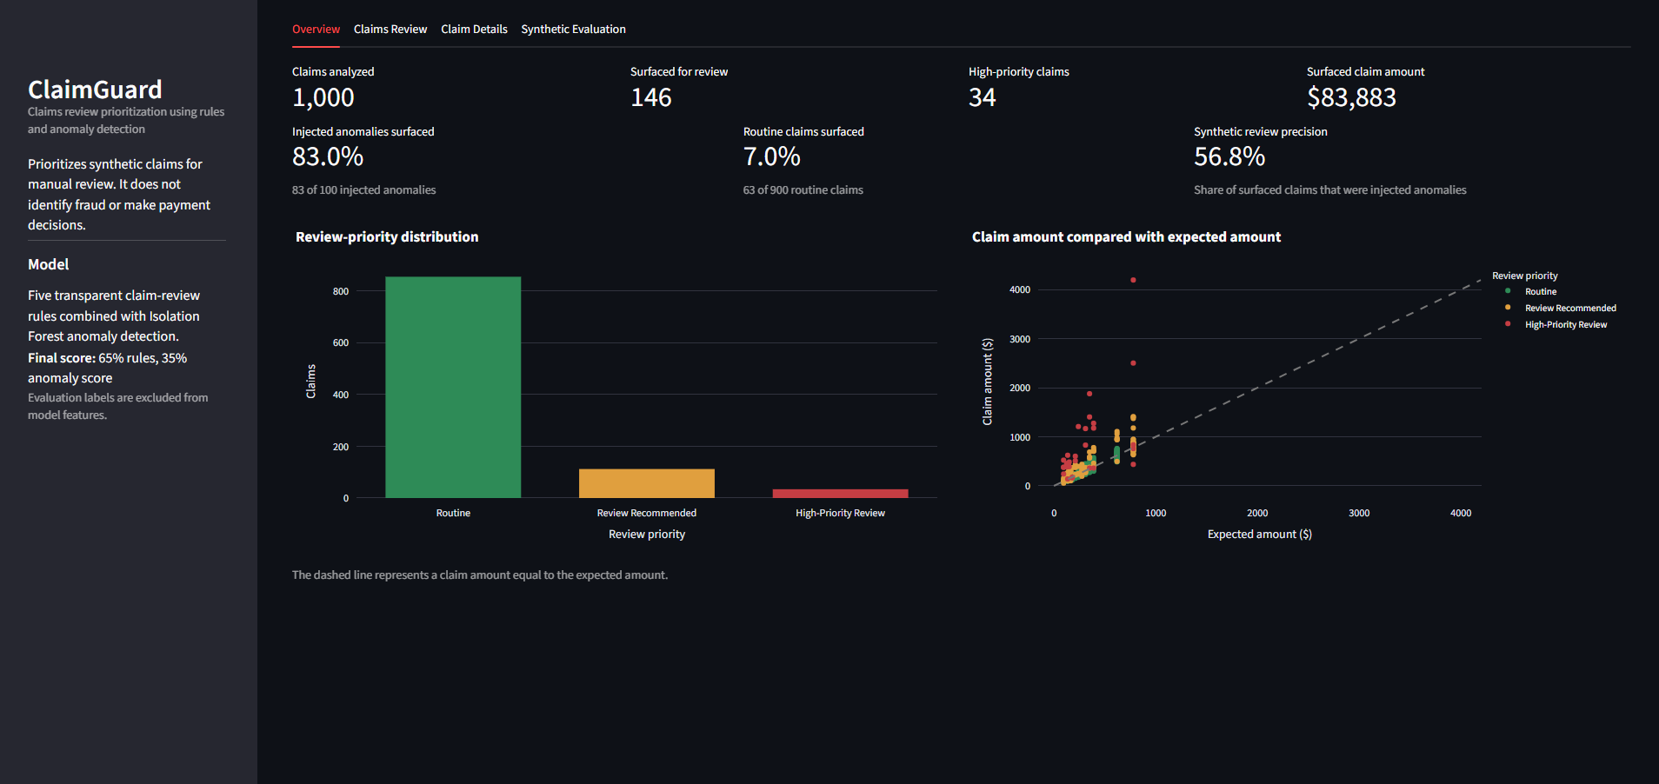
From Synthetic Claims to a Prioritized Work Queue
1,000
146
34
$83,883
Claims Analyzed
Surfaced for Review
High-Priority Claims
Surfaced Claim Amount
Rules and anomaly detection convert the synthetic dataset into a ranked, reviewable work queue.
Notes:
“This is the working ClaimGuard dashboard.
““Starting with the dashboard overview,
we can see how the full dataset is converted into a prioritized work queue.”
The dashboard analyzed 1000 claims and surfaced 146 for review, including 34 high-priority claims.
This converts the full dataset into a smaller, ranked work queue.”

Slide 7
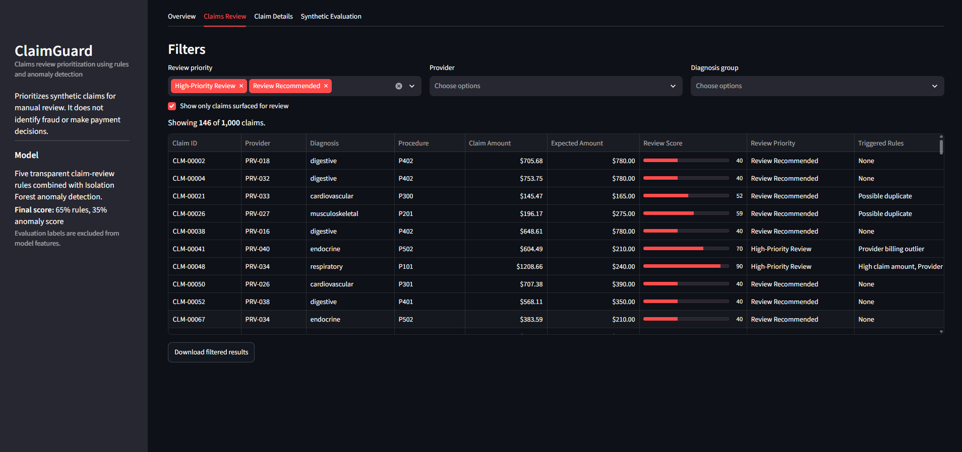

WORKFLOW
A Focused, Filterable Review Queue
REVIEWER CAPABILITIES
Filter by review priority, provider, and diagnosis
Focus on the surfaced claims
Compare scores, priorities, and triggered checks
Export filtered results for downstream review
Core Principle: ClaimGuard creates a focused review queue — it does not make the payment decision.
Notes:
“On the Claims Review page, I can show only surfaced claims and filter by priority, provider, or diagnosis. Reviewers can compare scores, triggered checks, and export the filtered queue.”

Slide 8
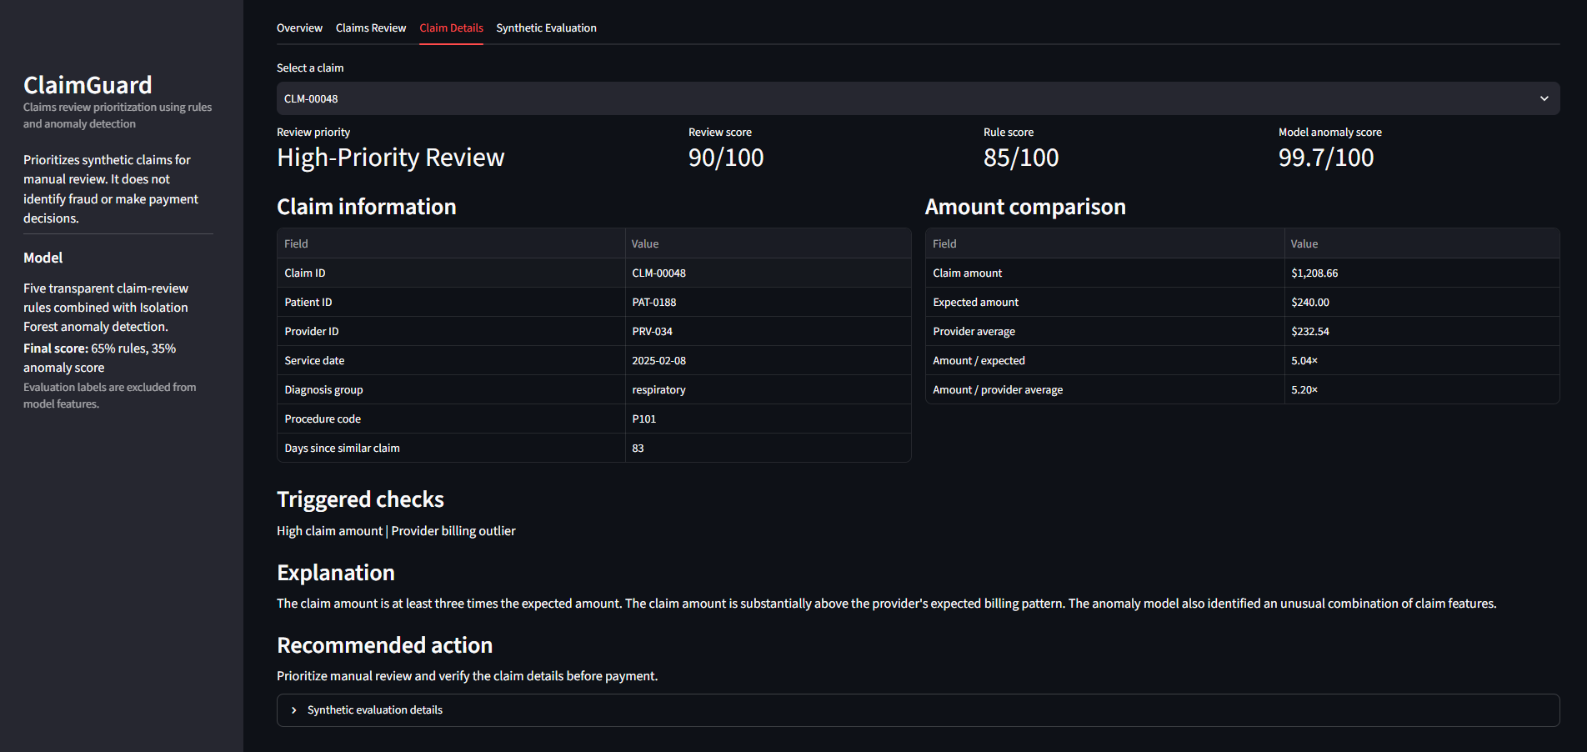
Every Priority Is Linked to Evidence and Human Action
CLM-00048
High-Priority Review
90/100
Review Score
Rule Score 85/100
Anomaly Score 99.7/100
Claim Amount
$1,208.66
Expected
$240.00
5.04× expected
Recommended action: Prioritize manual review and verify the claim details before payment.
Notes:
To show how the prioritization remains explainable, this page can examine one specific claim
“Here is claim CLM-00048.
It has a review score of ninety, a rule score of eighty-five, and an anomaly score of ninety-nine point seven.
The page explains the amount difference, triggered checks, and recommended action, giving the reviewer an auditable reason for escalation.”

Slide 9
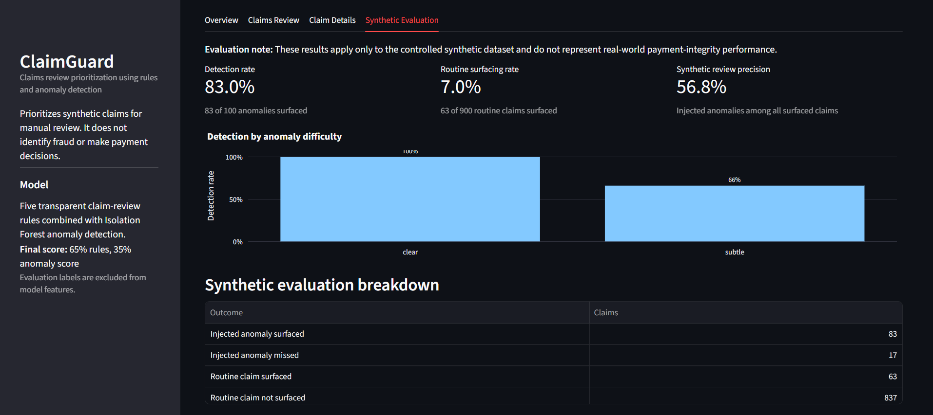
Controlled Results Demonstrate Feasibility—not Production Accuracy
83 of 100
Injected Anomalies Surfaced
63 of 900
Routine Claims Surfaced
56.8%
Synthetic Review Precision
Clear anomalies: 100%
Subtle anomalies: 66%
Interpretation
Recommended next step
The controlled results demonstrate workflow feasibility.
They do not represent real-world payment-integrity accuracy.
Run a narrow shadow-mode pilot with human review, prospective validation, subgroup analysis, rollback criteria, and outcome monitoring.
Notes:
Finally, the Synthetic Evaluation page shows how the approach performed on the controlled dataset
“The evaluation page shows the 83 percent anomaly-detection rate, 7 percent routine-claim surfacing rate, and 56.8 percent synthetic precision.
These results apply only to this controlled synthetic dataset.”

Slide 10
References
Autio, C., Schwartz, R., Dunietz, J., Jain, S., Stanley, M., Tabassi, E., Hall, P., & Roberts, K. (2024). Artificial intelligence risk management framework: Generative artificial intelligence profile (NIST AI 600-1). National Institute of Standards and Technology. https://doi.org/10.6028/NIST.AI.600-1
du Preez, A., Bhattacharya, S., Beling, P., & Bowen, E. (2025). Fraud detection in healthcare claims using machine learning: A systematic review. Artificial Intelligence in Medicine, 160, 103061. https://doi.org/10.1016/j.artmed.2024.103061
Blanco, J., Ferreras, M., & Cosido, O. (2026). Predictive modeling of hospital emergency department demand using artificial intelligence: A systematic review. International Journal of Medical Informatics, 207, 106215. https://doi.org/10.1016/j.ijmedinf.2025.106215
Gomez-Cabello, C. A., Borna, S., Pressman, S., Haider, S. A., Haider, C. R., & Forte, A. J. (2024). Artificial-intelligence-based clinical decision support systems in primary care: A scoping review of current clinical implementations. European Journal of Investigation in Health, Psychology and Education, 14(3), 685–698. https://doi.org/10.3390/ejihpe14030045
Collaco, B. G., Haider, S. A., Prabha, S., Gomez-Cabello, C. A., Genovese, A., Wood, N. G., Bagaria, S. P., Gopala, N., Tao, C., & Forte, A. J. (2026). The role of agentic artificial intelligence in healthcare: A scoping review. npj Digital Medicine, 9, 345. https://doi.org/10.1038/s41746-026-02517-5
Liu, F. T., Ting, K. M., & Zhou, Z.-H. (2008). Isolation forest. In 2008 Eighth IEEE International Conference on Data Mining (pp. 413–422). IEEE. https://doi.org/10.1109/ICDM.2008.17
Cotiviti. (n.d.). Healthcare claim payment accuracy solutions. Retrieved August 5, 2026, from https://www.cotiviti.com/solutions/payment-accuracy
Notes:
ClaimGuard demonstrates an explainable, human-centered approach to Payment that could be extended responsibly across Treatment, Payment, and Operations.
“Finally, these are the sources supporting the research, recommendations, and technical method
Now I’ll briefly demonstrate the working ClaimGuard application

