Slide 1
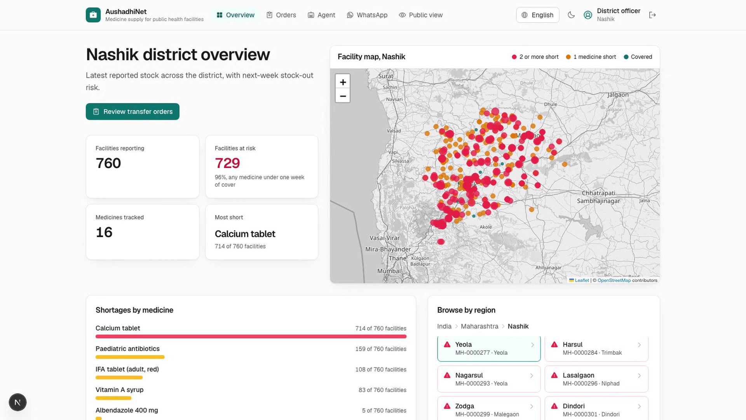
Build with AI: Code for Communities · Problem Statement 03
AushadhiNet
Early warning and rebalancing for public-health medicine supply, reported over WhatsApp.
Live: aushadhinet-frontend.onrender.com
Code: github.com/akshat333-debug/AushadhiNet

Slide 2
The problem
Clinics run dry while neighbours hold spare stock
Primary health centres run out of ORS, zinc, iron tablets and antibiotics.
Stock is reported late, on paper, and rarely compared across facilities.
Shortage and surplus sit a few kilometres apart; nobody sees both in time.
Frontline nurses won't adopt yet another app.

Slide 3
How it works
Report → Forecast → Rebalance → Human approves
1 Report
2 Forecast
3 Rebalance
4 Approve
Nurse sends stock on WhatsApp in 7 languages; unsure reads are confirmed first.
LightGBM predicts next-week demand and stock-out probability per medicine.
Google OR-Tools proposes transfers from nearby surplus to at-risk facilities.
Officer approves; both facilities notified. The AI agent can explain and draft, never approve.

Slide 4
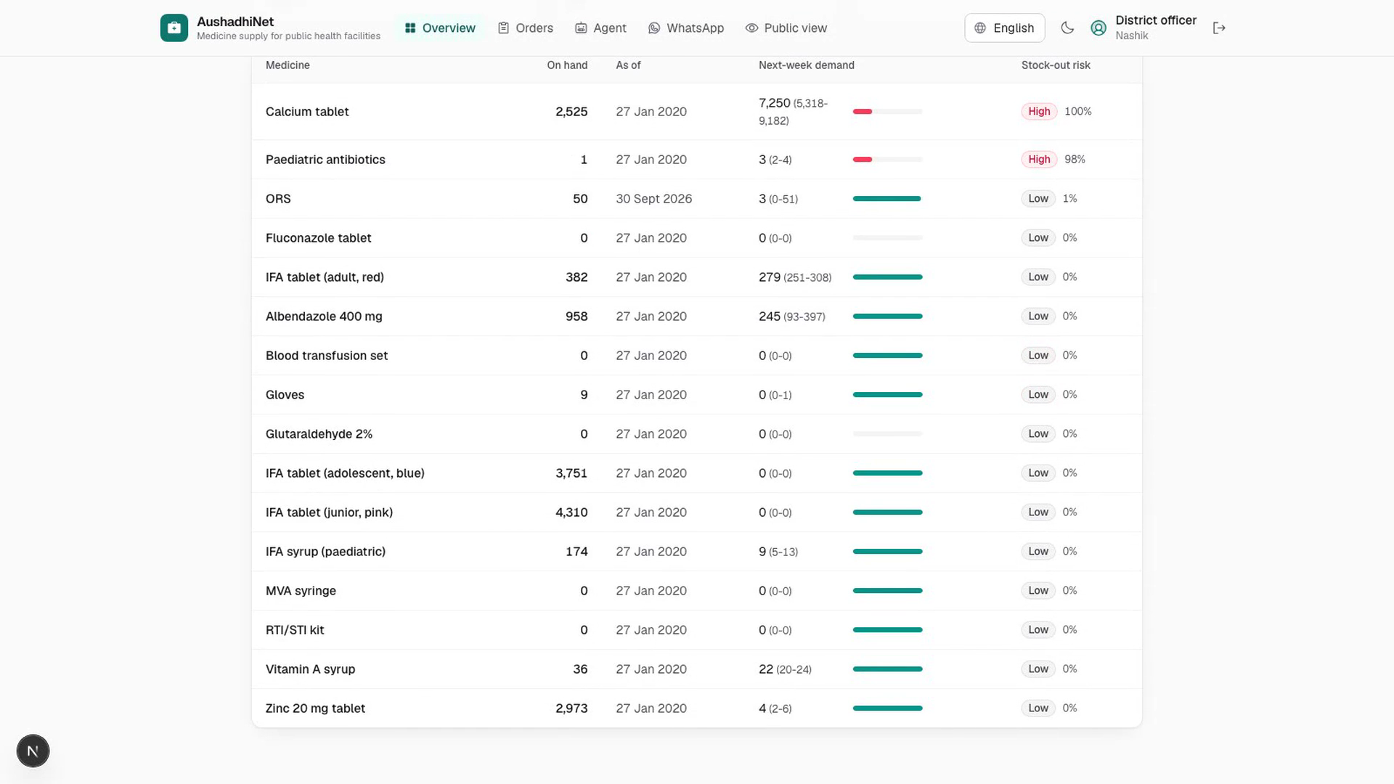
Nurse channel
WhatsApp, no new app
Plain text, any script, native digits
Low-confidence reads need a Confirm tap
Nothing unconfirmed reaches the forecast

Slide 5
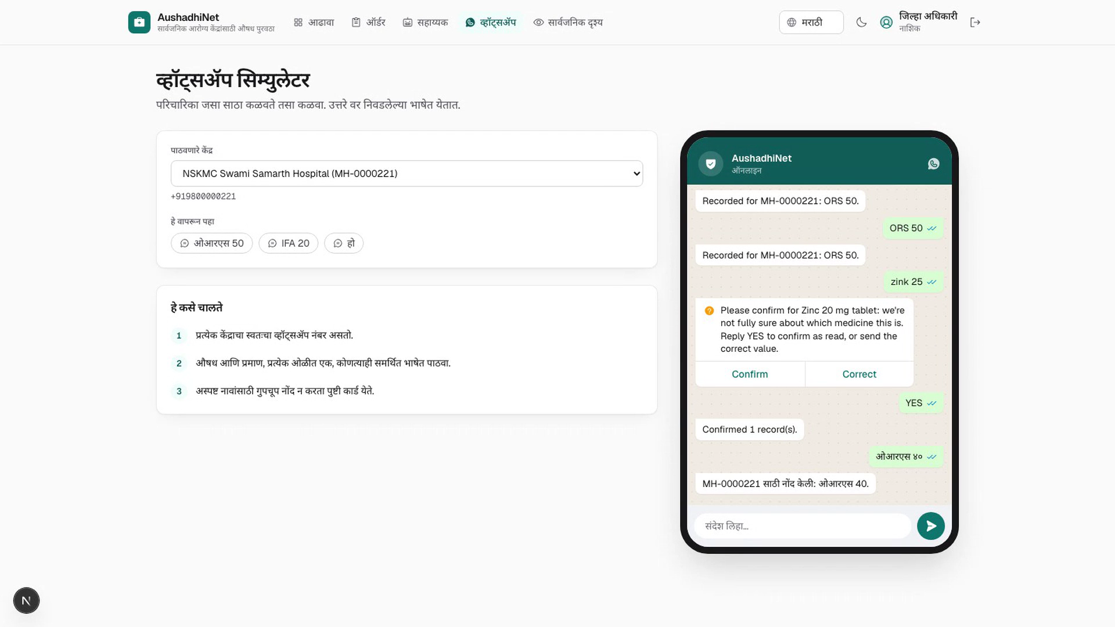
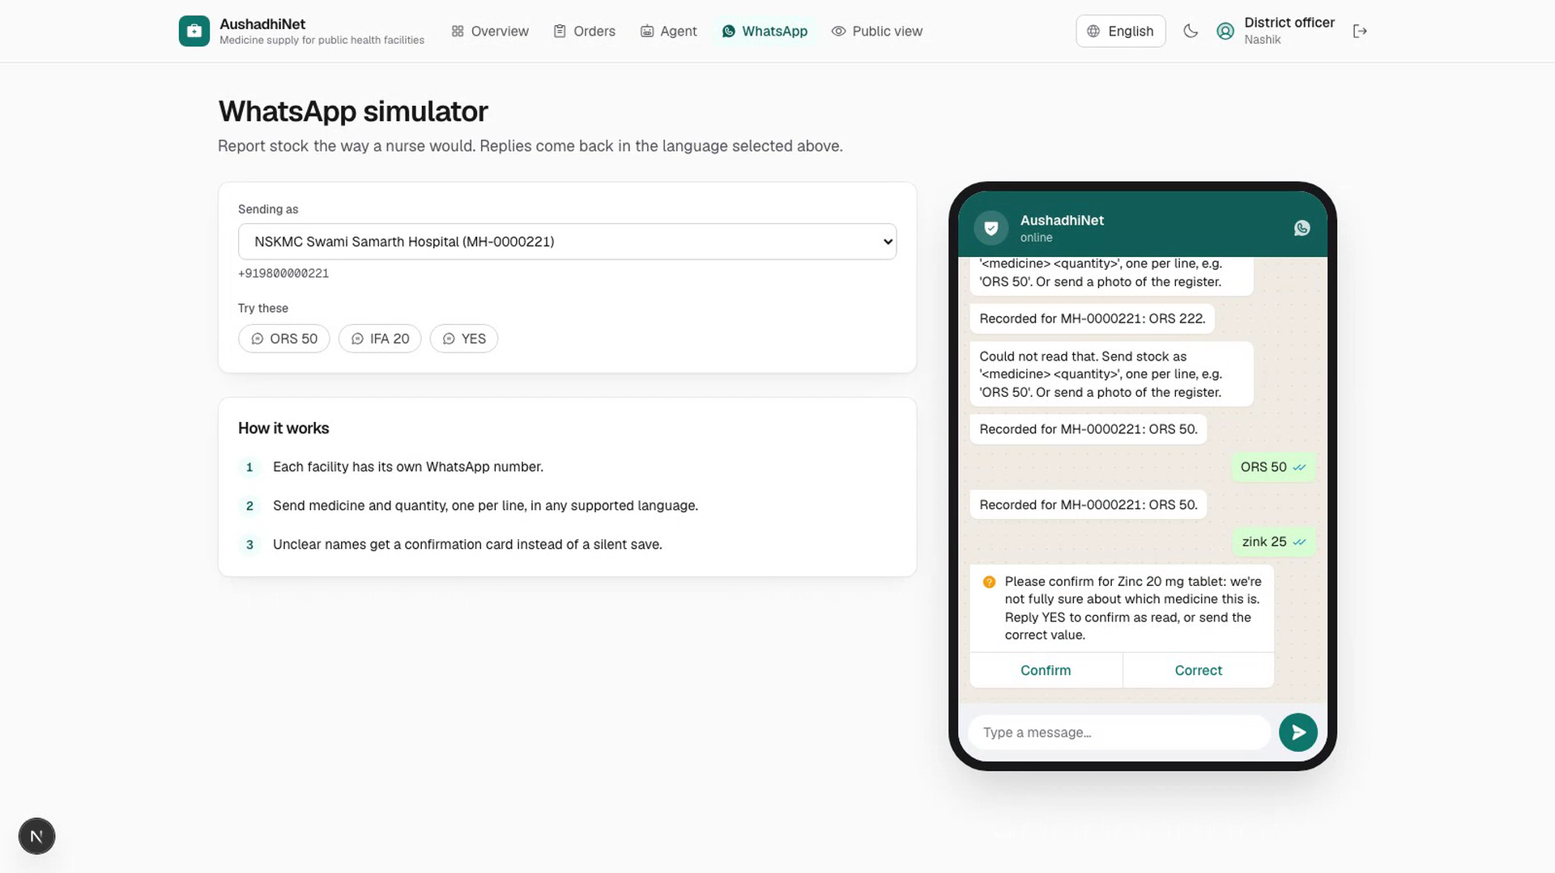
Multilingual
Seven Indian languages
English, Hindi, Marathi, Bengali, Tamil, Telugu, Kannada
UI, medicine names, replies and agent answers
Translations need native-speaker review

Slide 6
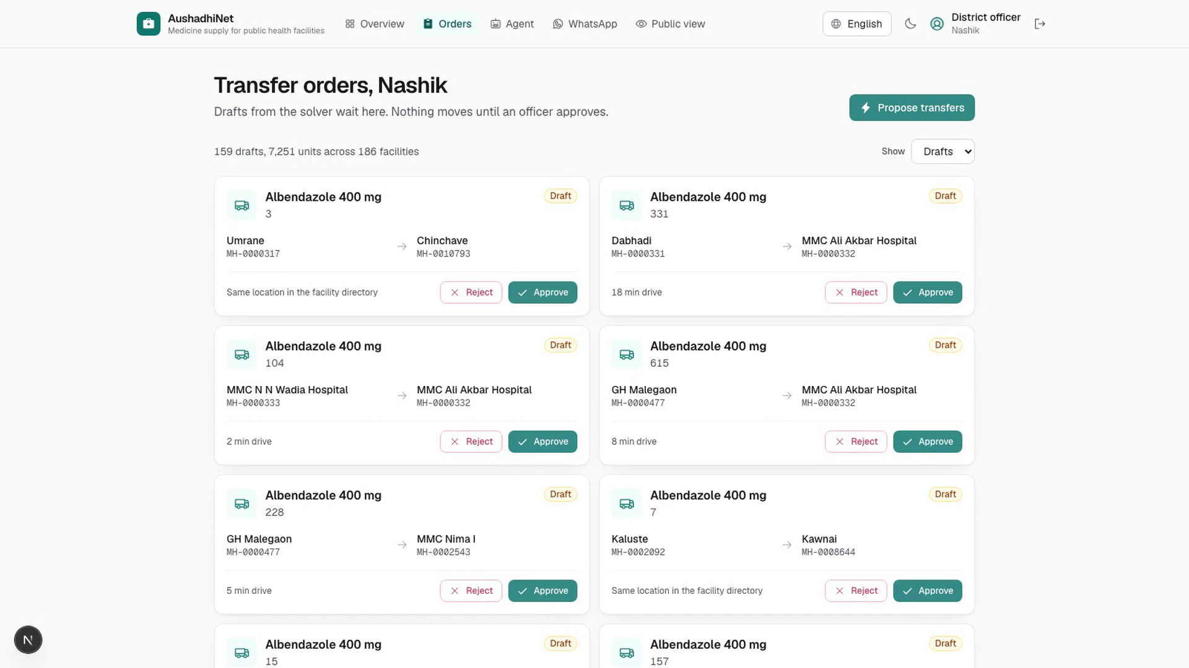

Officer view
Transfer orders, human in the loop
Solver drafts transfers (OR-Tools)
Officer approves or rejects each
Orders are signed; both ends notified

Slide 7
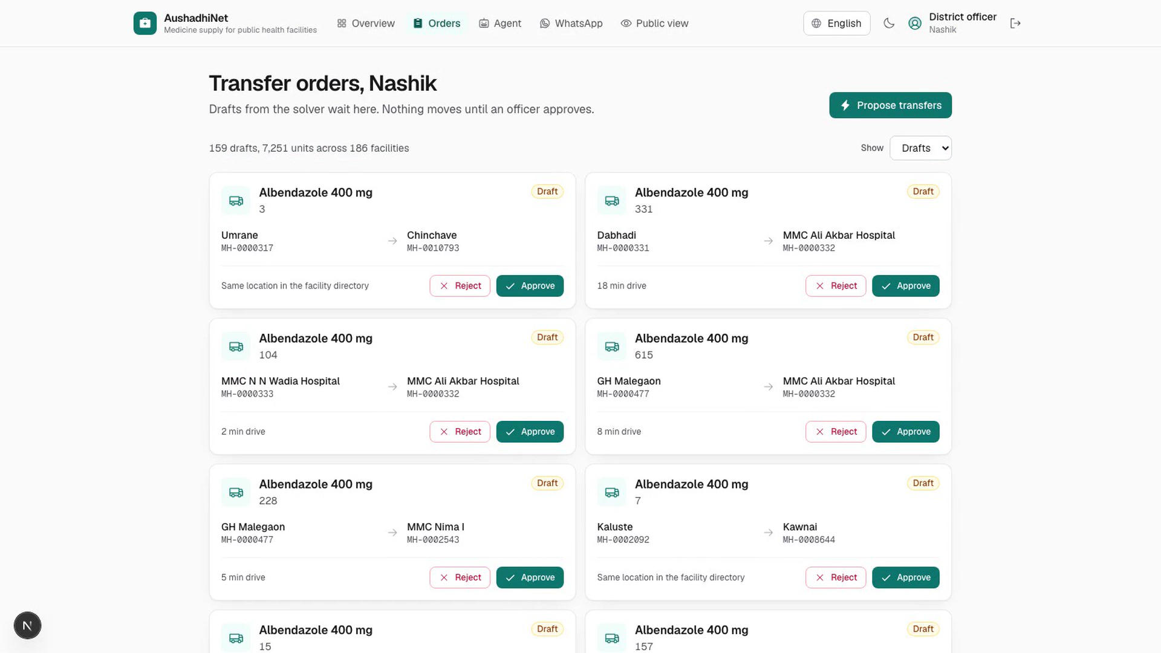
Guardrailed agent
Explains, never acts
Answers from real forecast and stock data
Jurisdiction-scoped per officer
Refuses prompt-injection to approve orders

Slide 8
Results
Measured on a frozen, held-out protocol
0.871
−6.0%
760
7
Forecast WAPE on real HMIS data
vs 1.078 naive (19% better)
Stock-out weeks in 26-week replay
(synthetic Nashik ledger)
Nashik facilities × 16 HMIS
medicines in the pilot
Languages end to end
Test window frozen before tuning; first model (L2) lost to naive and stays in the run log.

Slide 9
Impact
AushadhiNet by the numbers
760
16
729
facilities monitored in Nashik pilot
essential HMIS medicines tracked
facilities flagged at risk before stock-out
159
7,251
19%
transfer orders drafted by OR-Tools
units rebalanced across 186 facilities
lower forecast error than naive (WAPE 0.871)
−6%
7
362
stock-out weeks in 26-week replay
Indian languages, end to end
automated tests passing (349 backend + 13 E2E)

Slide 10
Tech
Built on Google
Google OR-Tools · Gemini (provider seam) · Firestore / Cloud Run (scripted)
LightGBM · FastAPI · Next.js 15 · Leaflet + OpenStreetMap
348 backend tests · 13 Playwright E2E, passing on the live deployment

Slide 11
Thank you
Earlier warnings. Smarter sharing. People in control.
Live: aushadhinet-frontend.onrender.com
Next: pilot in one Nashik block with real registers.

