Slide 1
Agentic AI for EV Charging Networks
SOC / OP_26 Analytics — Dynamic Tariff Optimization
UrbanEV (Shenzhen) + Demand Prediction

Slide 2
Problem & Objective
EV charging networks face uneven utilization (peak congestion vs idle off-peak).
Flat pricing (₹15/kWh baseline) leaves revenue and grid efficiency on the table.
Build a demand-prediction agent + dynamic pricing policy to maximize revenue responsibly.

Slide 3
Datasets
UrbanEV — 247 districts, 1,706 stations, 5-min resolution (occupancy, volume, price, duration).
ACN sessions (optional) — campus charging logs for session-duration EDA.
Chronological train/test split to avoid leakage in time-series forecasting.

Slide 4
Methodology
EDA: hourly demand, heatmaps, station rankings, revenue by hour.
Features: lags, rolling means, peak-hour flags, utilization & congestion scores.
Model: XGBoost / Random Forest regressor for next-step utilization.
Agent: surge (+50%) if predicted util > 80%; discount (−30%) if util < 30%.

Slide 5
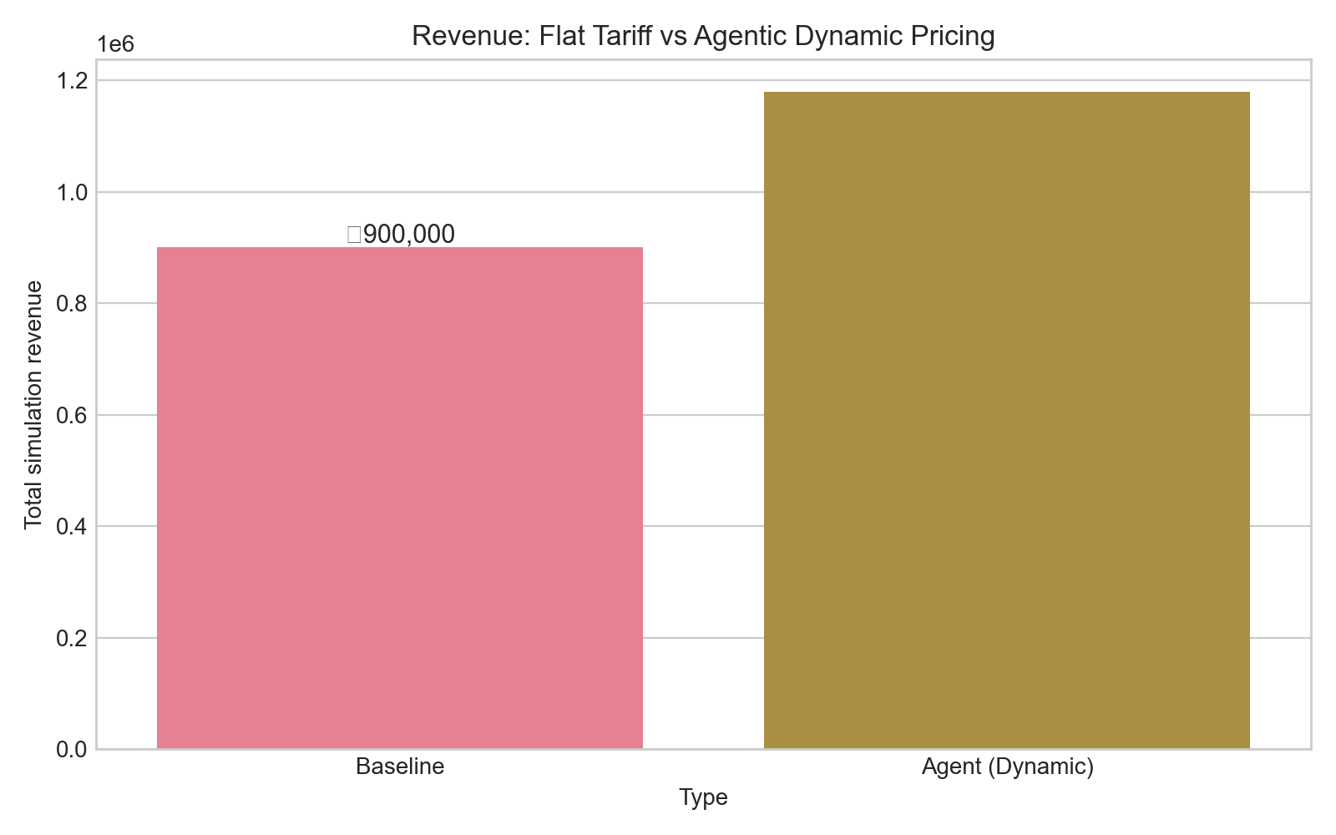
01 Revenue Comparison
Business outcome — +31% revenue vs baseline

Slide 6
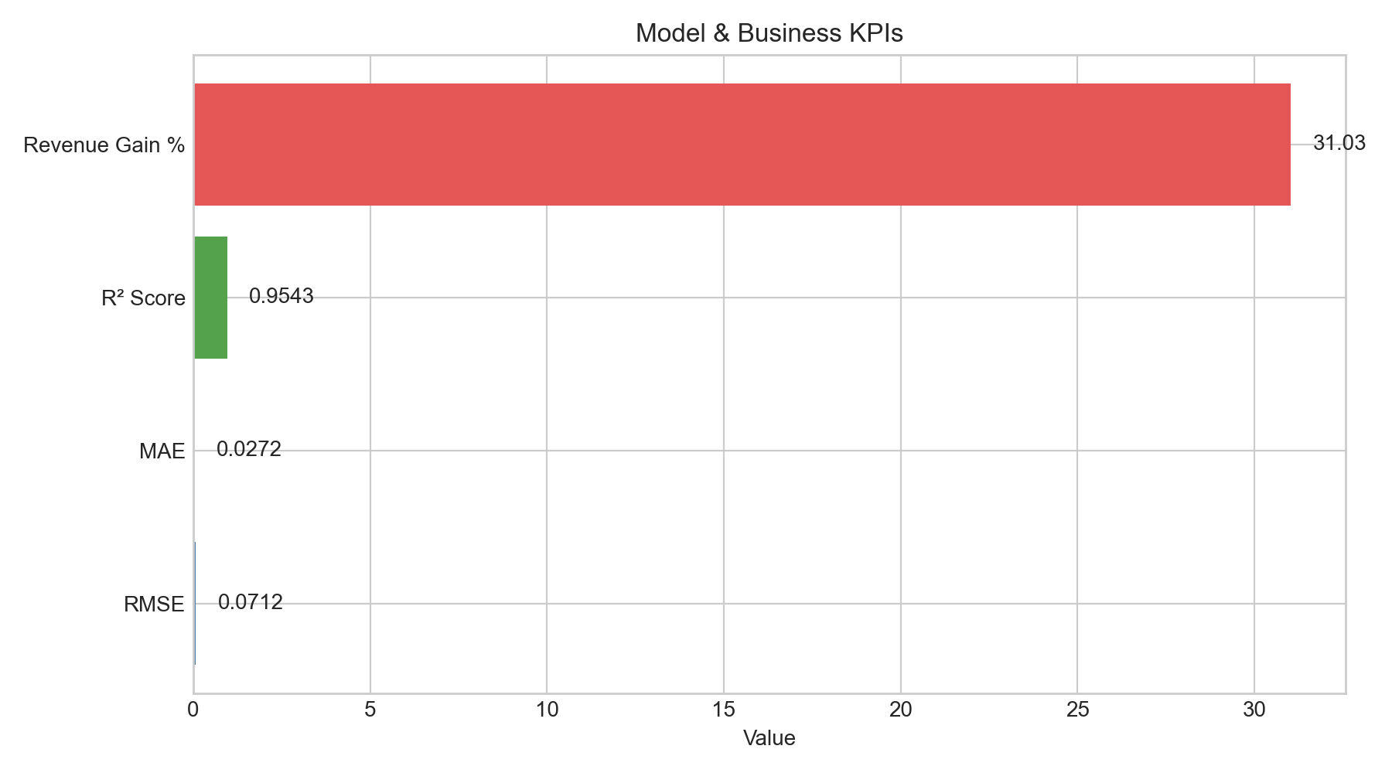
02 Kpi Summary
Monitoring KPIs (RMSE, MAE, R², revenue gain)

Slide 7
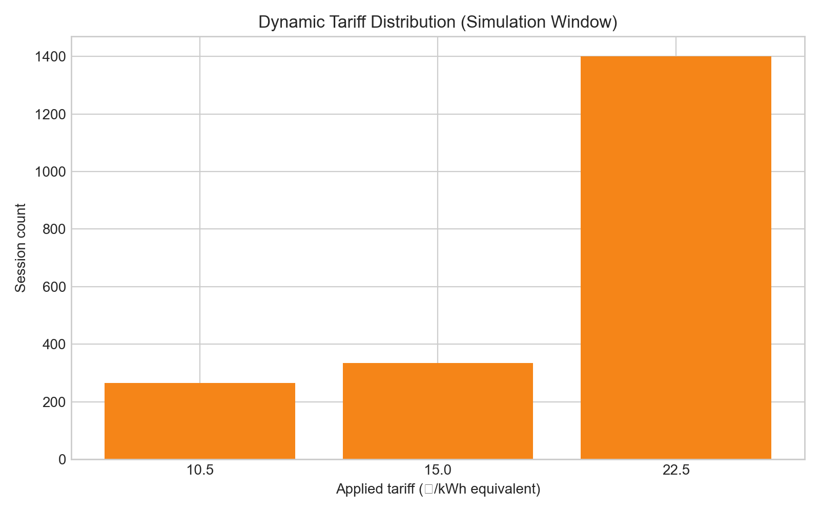
03 Tariff Distribution
How often each tariff tier was applied

Slide 8
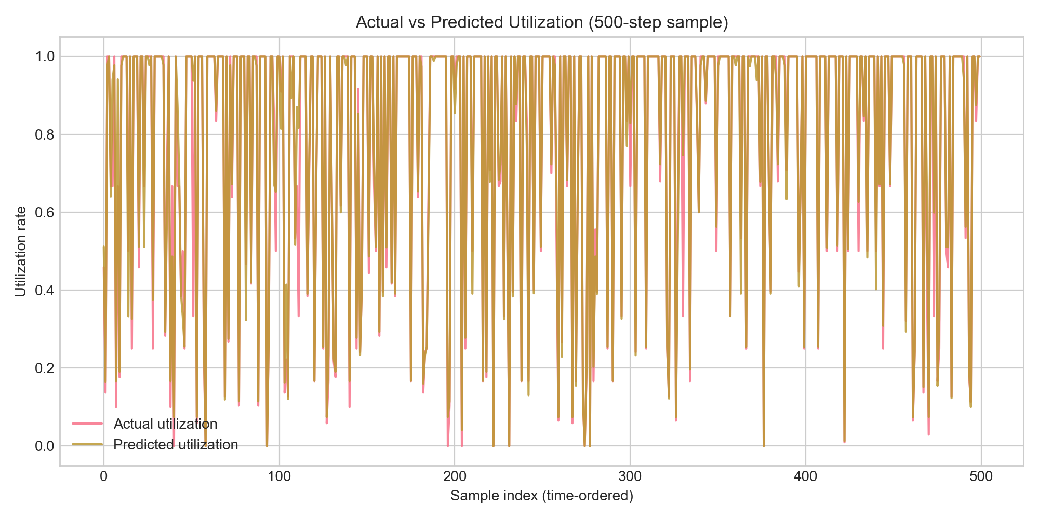
04 Actual Vs Predicted
Model tracks actual utilization

Slide 9
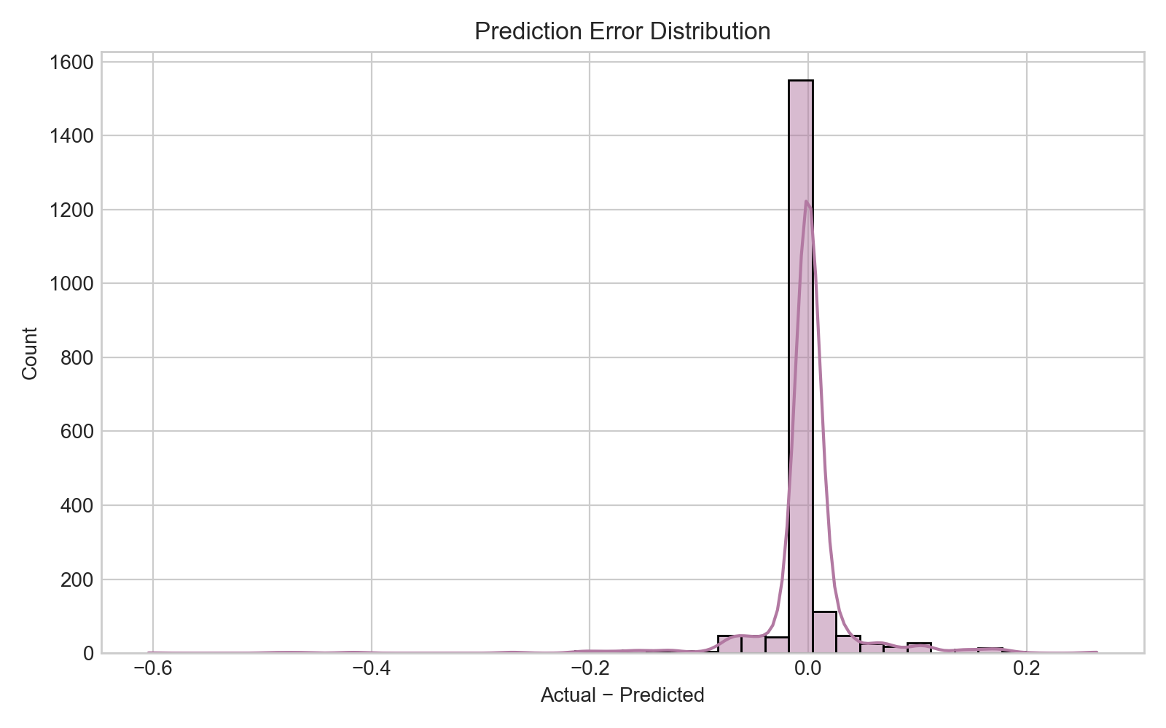
05 Error Distribution
Prediction errors are centered near zero

Slide 10
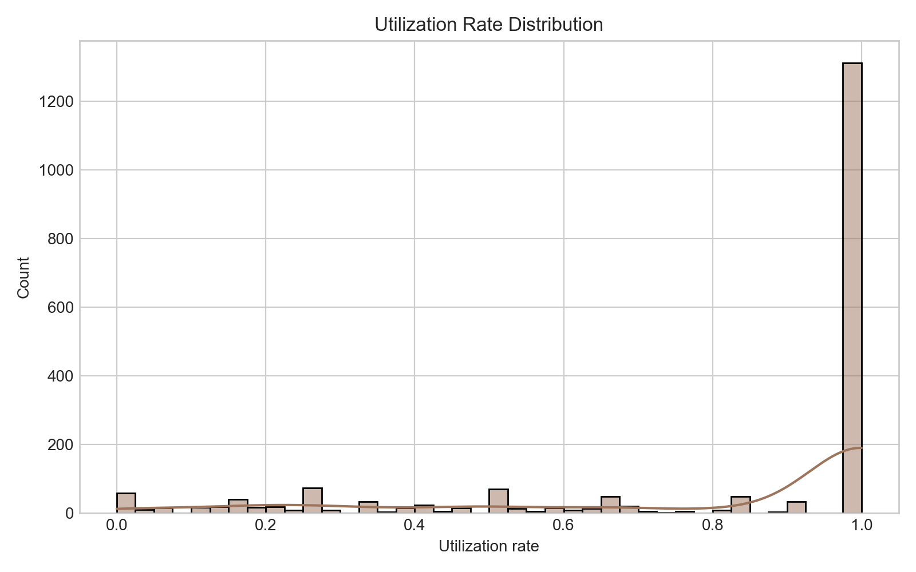
06 Utilization Distribution
Utilization spread across the network

Slide 11
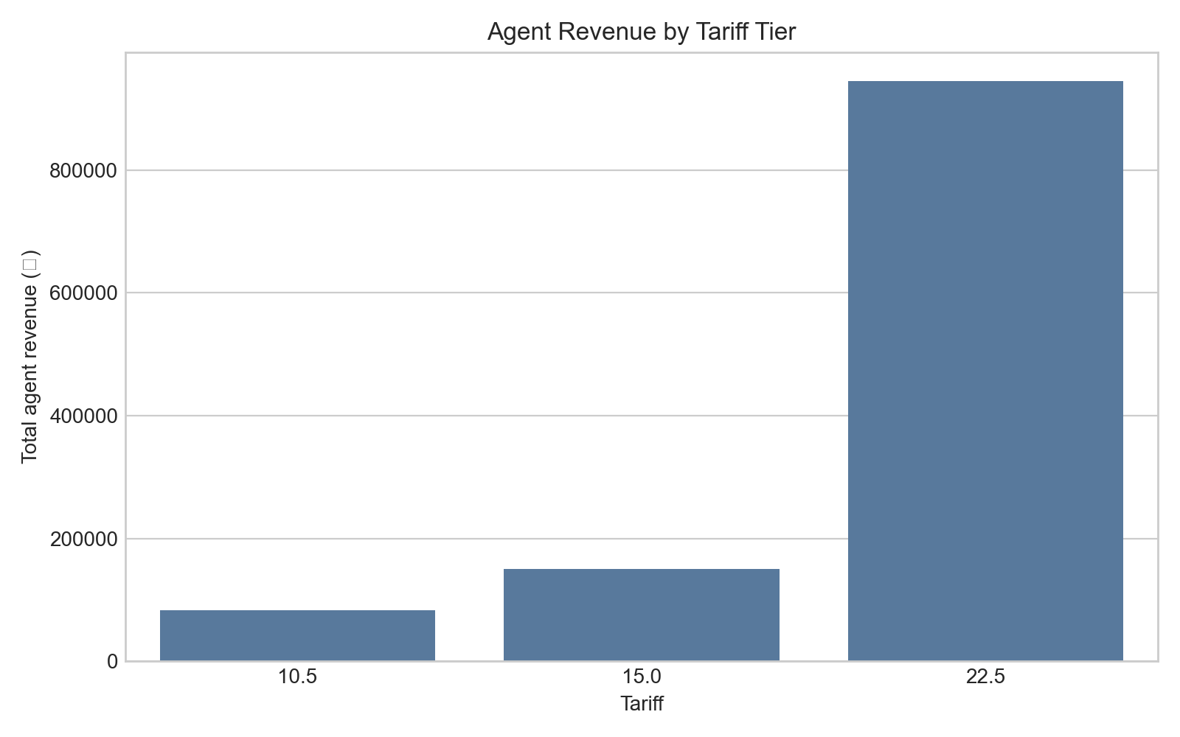
07 Revenue By Tariff
Revenue contribution by tariff band

Slide 12
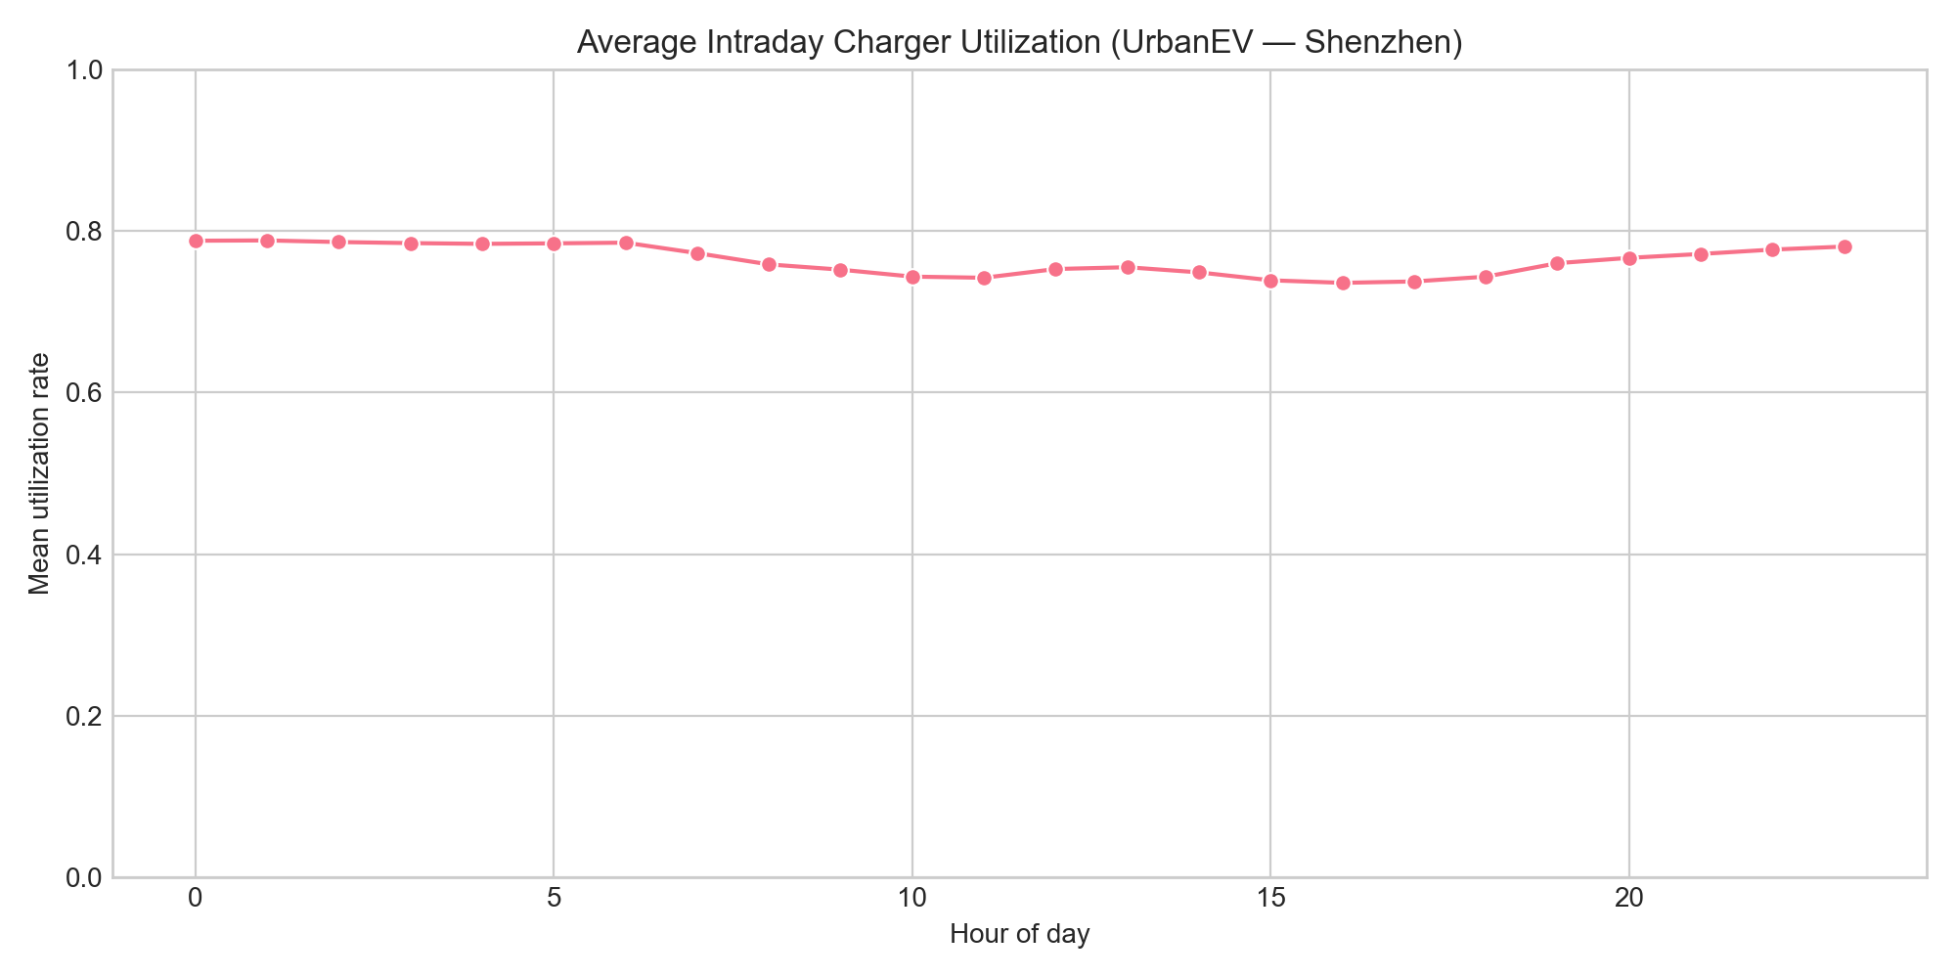
08 Intraday Utilization
Intraday utilization pattern (UrbanEV)

Slide 13
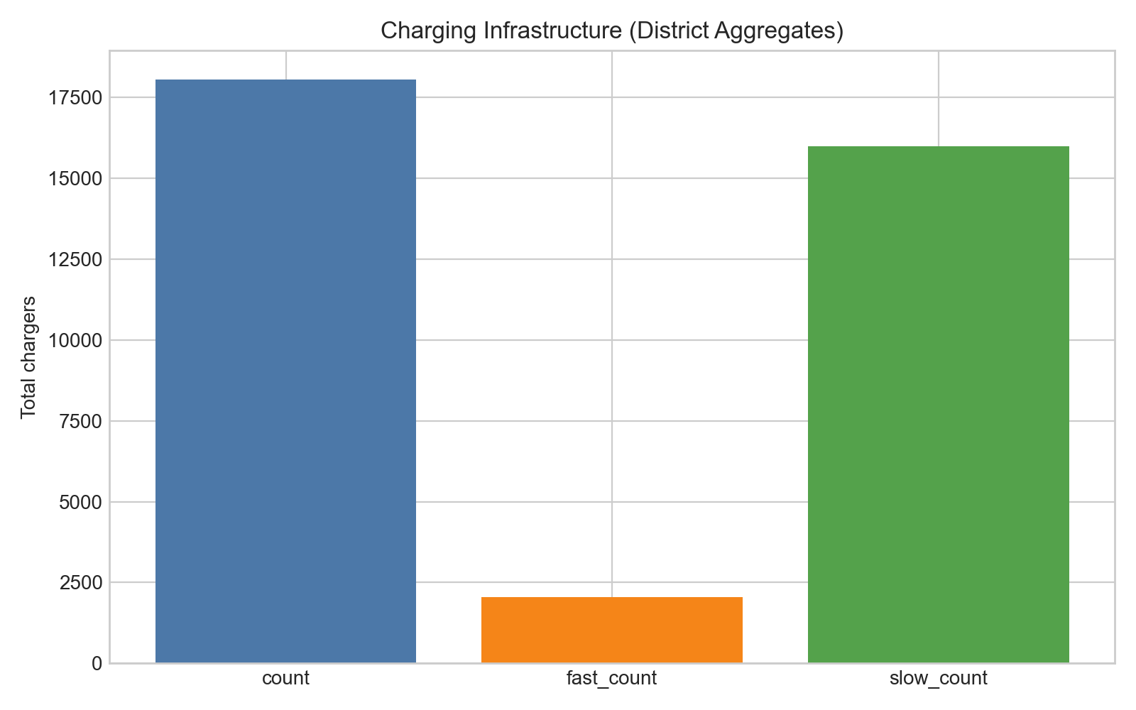
09 Infrastructure
Charger infrastructure scale

Slide 14
Results Summary
R² = 0.9543 on held-out utilization forecast.
Simulated revenue gain: 31.03% (₹900,000 → ₹1,179,225).
265 off-peak discount sessions — shifts demand to under-used windows.
Deliverables: simulation_results.csv, monitoring_results.csv, business_metrics.csv.

Slide 15
Next Steps
Deploy agent as API on live station telemetry with guardrails (min/max tariff).
A/B test against flat pricing on a pilot subset of stations.
Incorporate grid carbon intensity and driver SLA constraints.

