Slide 1

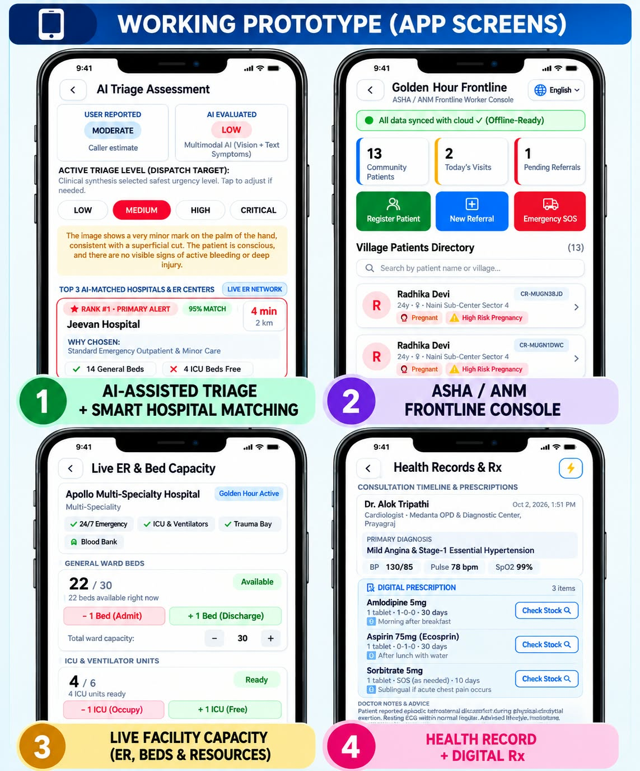

STARTUP CONFLUENCE 2026 | INNOVATION & INVESTOR PITCH DECK
STAGE: MVP READY
Golden Hour
AI-Powered Emergency Care Coordination & Connected Healthcare Platform
• Industry / Domain : HealthTech • Emergency Response • B2B/B2G SaaS
• Target Market : 50,000+ Rural/Semi-Urban PHCs & 70,000+ Private Hospitals
• Core Innovation : Multilingual Voice AI Triage, Live Telemetry & ABDM Sync
• Product Stage : Fully Functional MVP (Android APK + Cloud Telemetry Engine)
• Founder & Lead : Akshat Srivastava (Founder & Lead Developer)
• Team Name : Life Line Coders
• Key Deliverables : Working APK | Demo Video | User Manual | GitHub Code
Contact: akshatsrivastava912@gmail.com | GitHub: akshat9335/GoldenHourApp

Slide 2

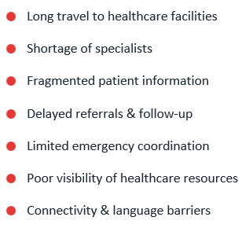
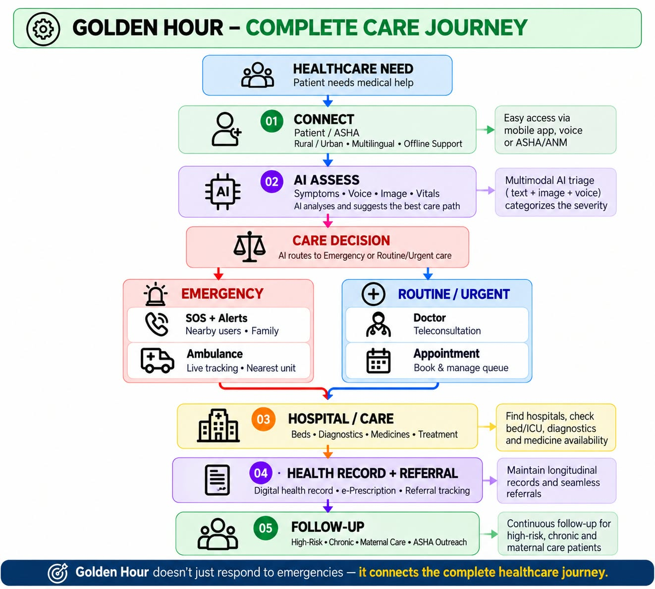
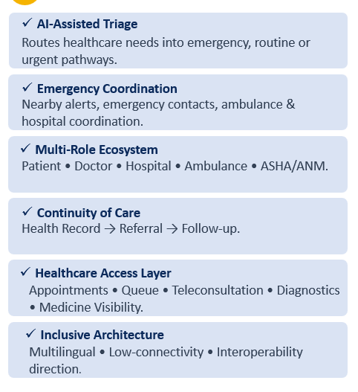
Golden Hour
Life Line Coders
Proposed Solution
!
THE PROBLEM
?
GOLDEN HOUR: The Complete Care Solution
INNOVATION & UNIQUENESS
?
Patients often move between healthcare services without one connected care journey.
Golden Hour doesn’t just respond to emergencies — it connects the complete healthcare journey.

Slide 3
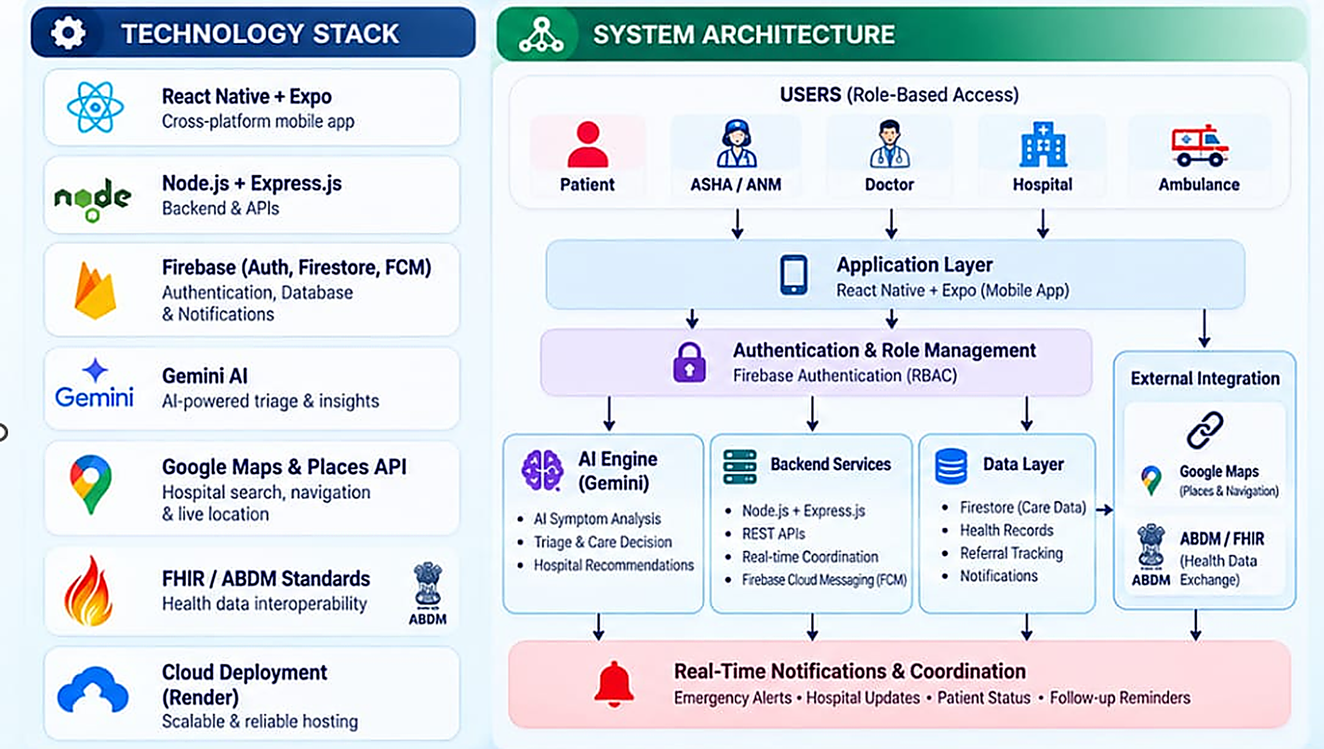
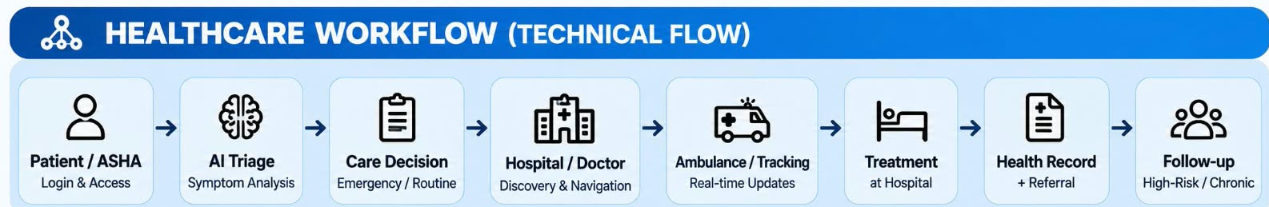

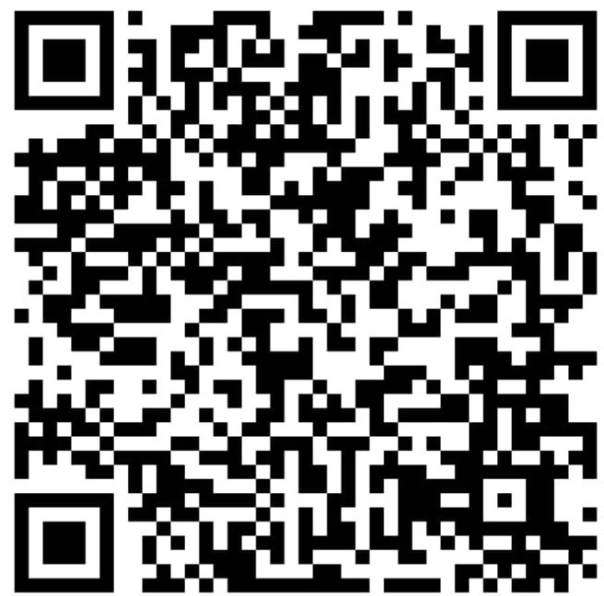
Life Line Coders
TECHNICAL APPROACH
Gemini
HEALTHCARE WORKFLOW
LIVE APP
LIVE DEMO
DEMO VIDEO FLOW
1. Patient Login
2. SOS / Emergency
3. Al Triage
4. Nearby Emergency Alert
5. Emergency Contact Alert
6. Hospital / Ambulance Coordination
7. Live Tracking
8. Hospital / Doctor
Scan QR to watch
the working prototype
Scan QR to
download the APK
METHODOLOGY | Role-Based Workflows → AI-Assisted Triage → Cloud-Backed Coordination → Real-Time Notifications
Real People Real Care Right Time

Slide 4
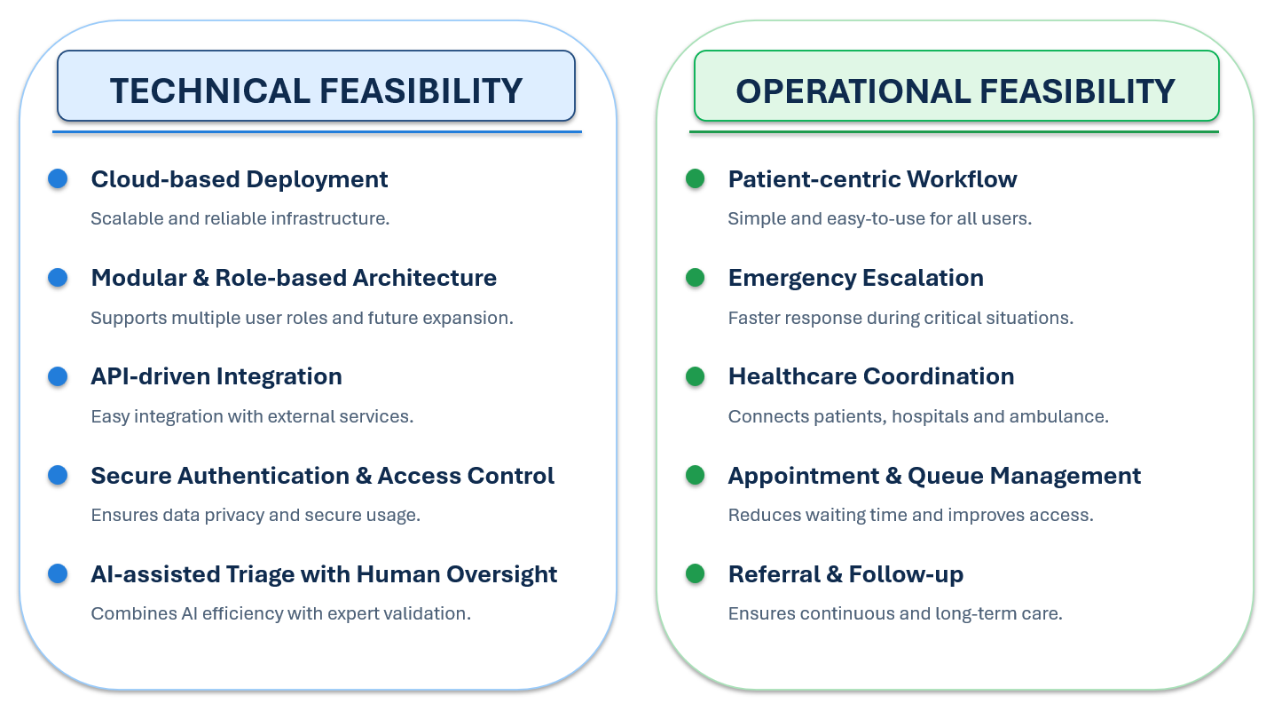
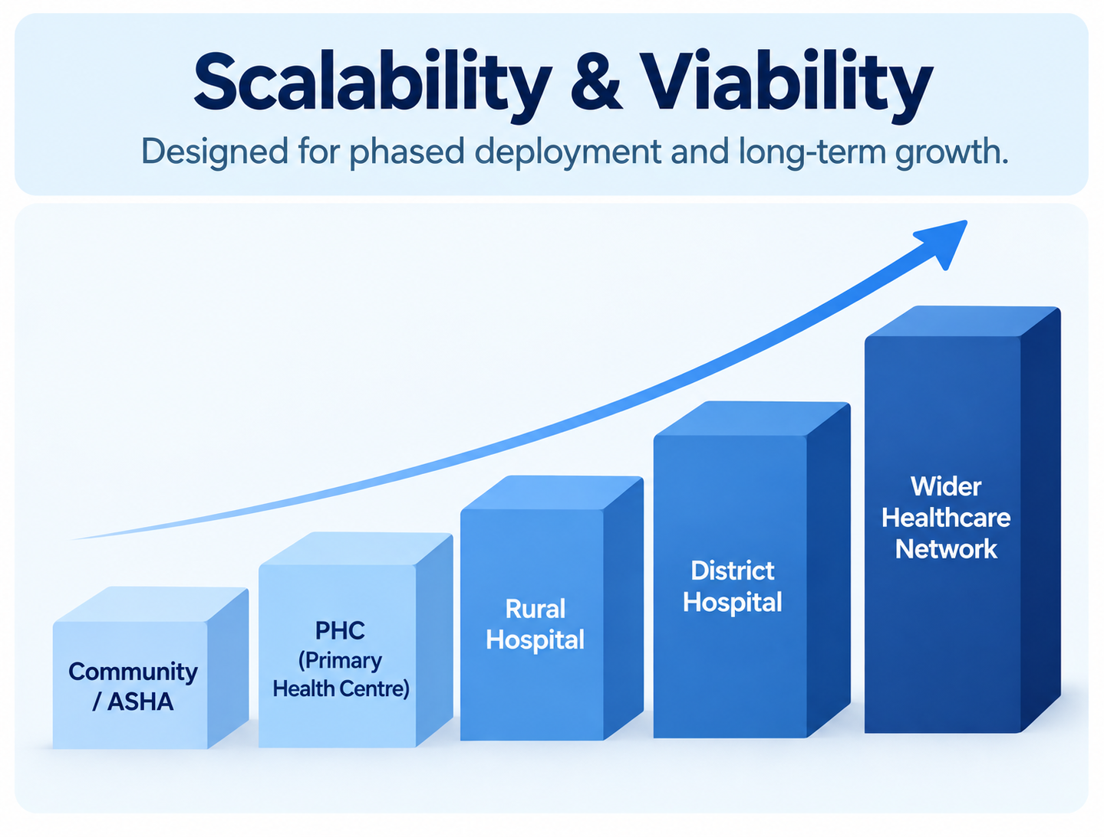
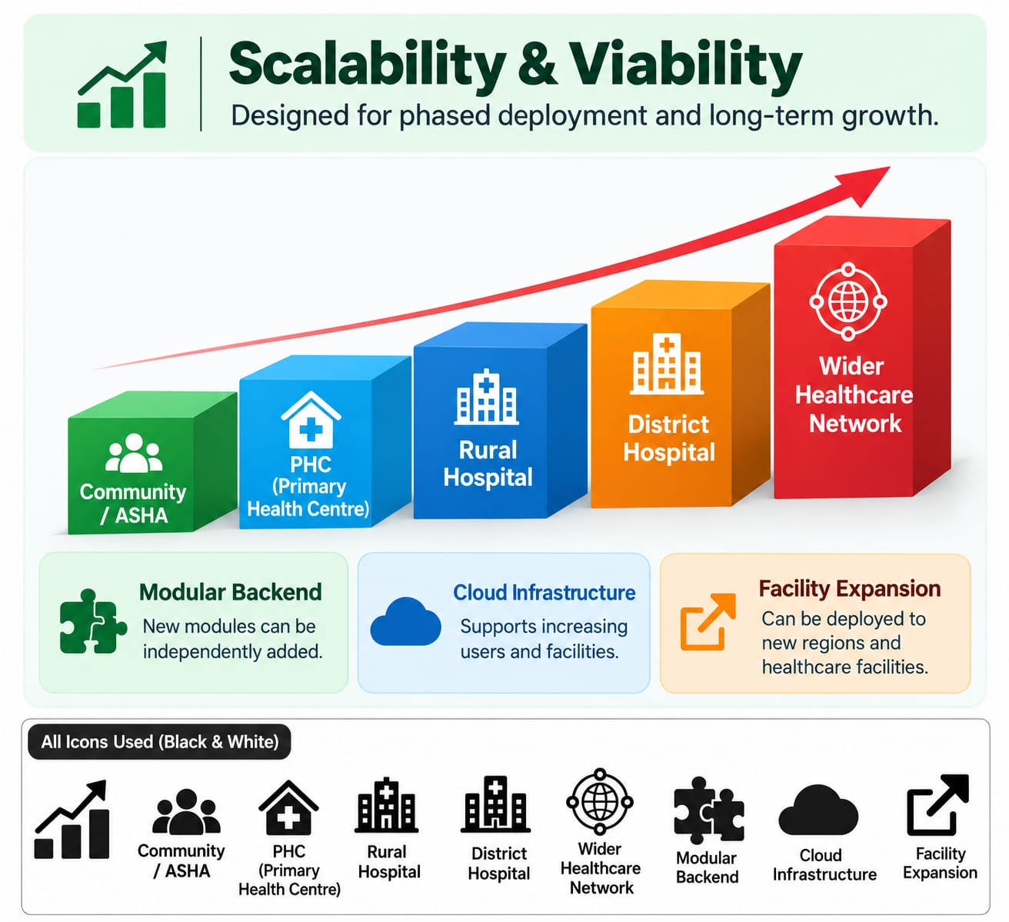
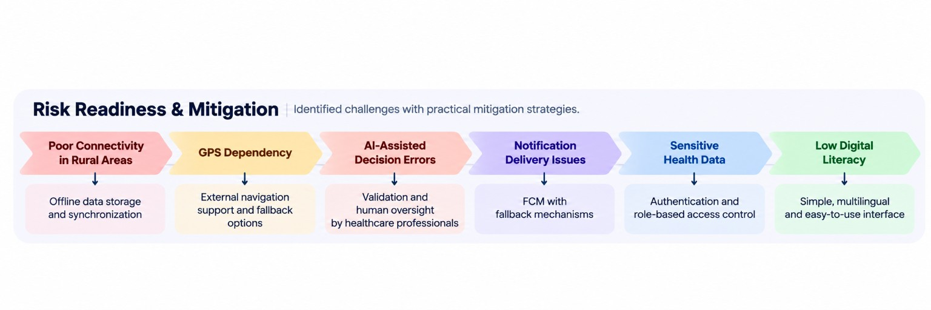
Life Line Coders
FEASIBILITY AND VIABILITY
Golden Hour is designed as a modular platform that can evolve from emergency coordination into a broader public-health access ecosystem.

Slide 5
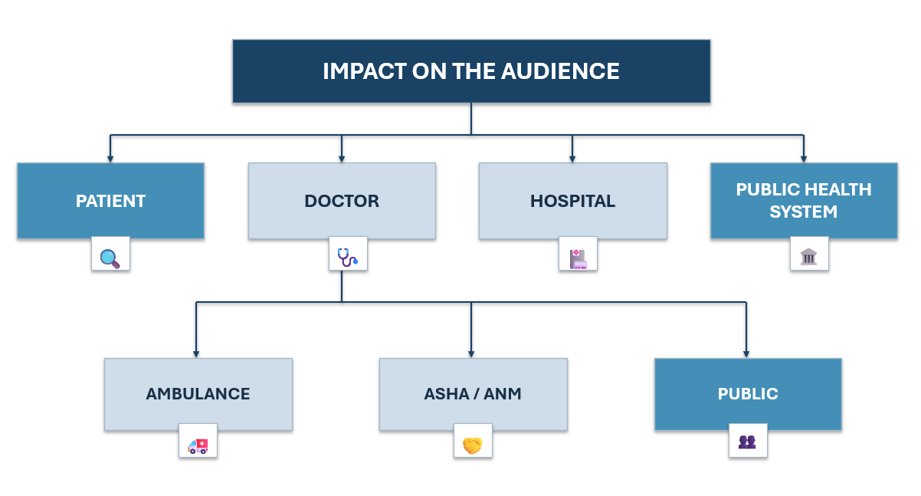
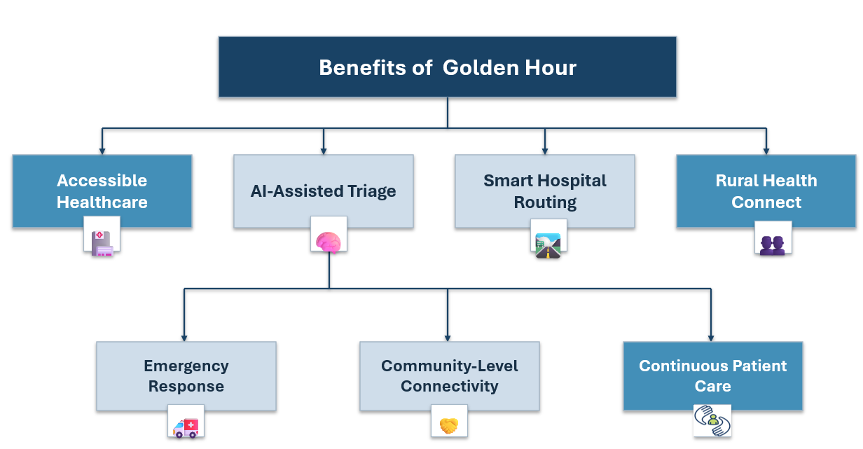
Life Line Coders
IMPACT AND BENEFITS
✦ IMPACT ON THE AUDIENCE
✦ BENEFITS OF THE SOLUTION
Patient — Faster healthcare access; nearby emergency alerts; emergency-contact alerts; emergency & hospital coordination; doctor/appointment access
Social — Better healthcare access and coordinated emergency response across patients, frontline workers, doctors, hospitals and emergency services.
Doctor — Better patient information; appointment / queue visibility; referral coordination; digital consultation support.
Emergency — Nearby alerts, emergency-contact alerts, ambulance and hospital coordination.
Hospital — Incoming emergency coordination; patient / referral visibility; diagnostic coordination; medicine / resource visibility.
Operational — Connected provider workflows for appointments, queues, referrals and emergency coordination.
Ambulance — Emergency assignment; patient pickup information; destination visibility; trip status.
Continuity — Health Record → Referral → Follow-up after treatment.
ASHA / ANM — Community healthcare support; access assistance; follow-up support; low-connectivity workflow.
Access — Provider discovery, doctor / appointment access and broader healthcare access modules.
Public Health System — Coordination across facilities; referral visibility; continuity of care; digital workflows; scalable healthcare ecosystem.
Scalability — Community → PHC → Rural → District → wider healthcare network.
From emergency response to continuity of care, Golden Hour connects the people and services involved in a patient's healthcare journey.

Slide 6
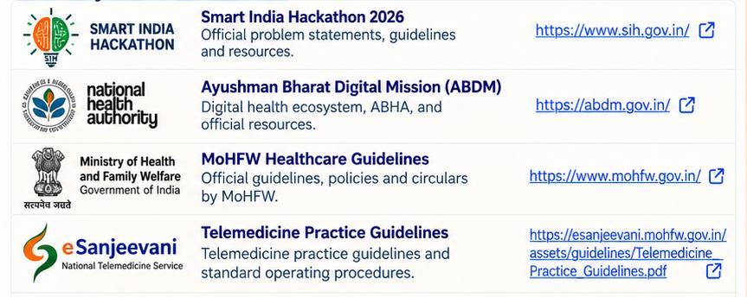
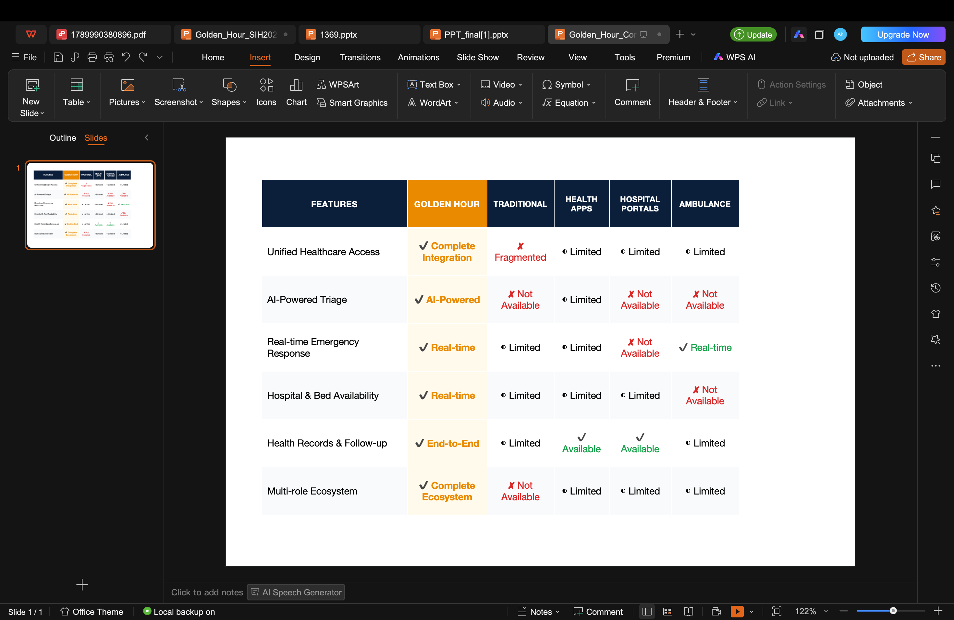
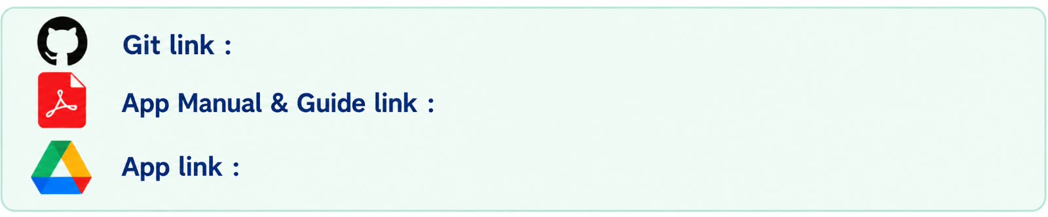
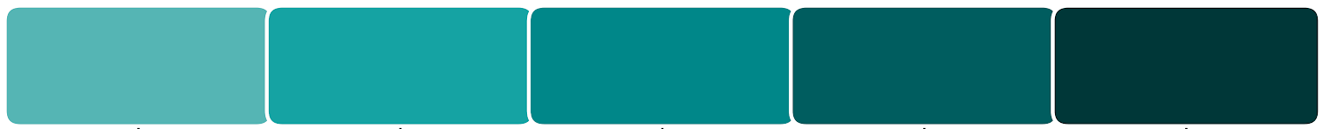
Life Line Coders
RESEARCH AND REFERENCES
References
Comparison with the existing System
Primary Data Sources
Smart India Hackathon 2026 - View Source ↗
Ayushman Bharat Digital Mission (ABDM)- View Source ↗
MoHFW Healthcare Guidelines - View Source ↗
Telemedicine Practice Guidelines- View Source ↗
Government & Public Health Research- View Source ↗
https://github.com/akshat9335/GoldenHourApp.git
https://drive.google.com/file/d/13T6n8MtCcO78936hAwHKXWWar8z5qT0l/view?usp=drivesdk
https://drive.google.com/file/d/1DjNVllfmDO0dMCmqSco1yLzNUFJ_s1Ie/view?usp=drivesdk
Research Workflow
Problem Analysis
Review of Current
Efforts
Solution Blueprint
Challenge
Assessment
Actionable Roadmap
Rural & underserved healthcare gaps
Existing digital-health & healthcare workflows
AI-assisted connected healthcare journey
• Connectivity
• Safety • Data • Adoption
• Low-connectivity
• Healthcare-network expansion
“From the first healthcare need to follow-up, Golden Hour connects the journey.”

