Slide 1

G2M Case Study
Virtual Internship—14/07/2025
AKSHATA Atpadkar - LISUM47

Slide 2
Background –G2M(cab industry) case study
XYZ is a private equity firm in US. Due to remarkable growth in the Cab Industry in last few years and multiple key players in the market, it is planning for an investment in Cab industry.
Objective : Provide actionable insights to help XYZ firm in identifying the right company for making investment.
The analysis has been divided into four parts:
Data Understanding
Forecasting profit and number of rides for each cab type
Finding the most profitable Cab company
Recommendations for investment

Slide 3
Data Exploration
24 Features( including 9 derived features)
Cab data is from 2016-01-01 to 2018-01-02
Total data points : 359391
Assumptions:
The user count in the City table is likely total users in that city not necessarily unique customers in your ride dataset.
2. Price charged could be influenced by:
Distance (KM Travelled)
City-specific pricing strategies
Company (Pink vs Yellow)
3. Prices might be higher in one city not because of company behavior, but because rides are longer..

Slide 4
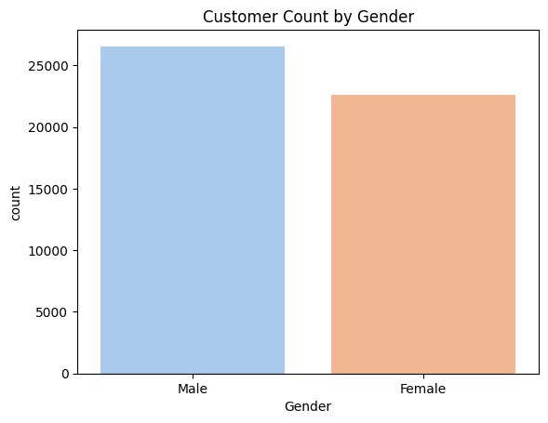
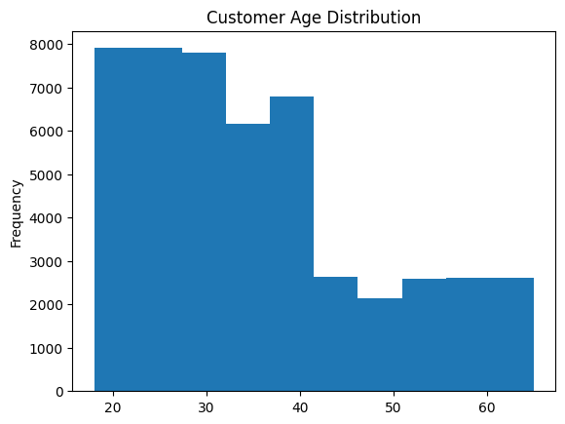
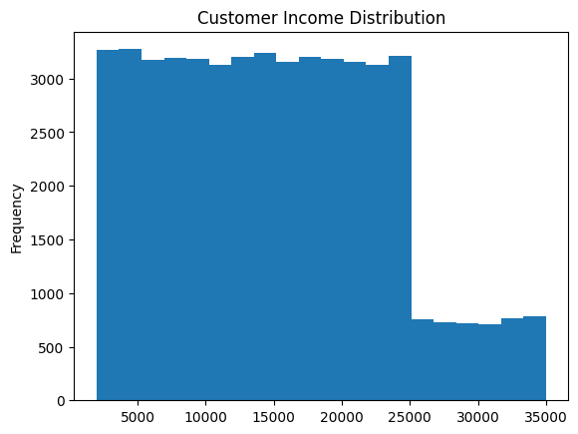
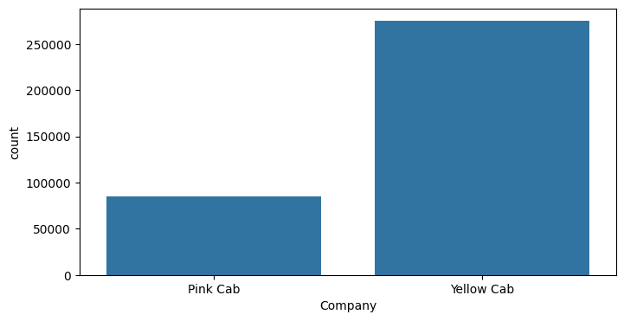
Profit Analysis
Descriptive Analysis (Customer Categories by Their Sex, Age, Distribution, and Lastly, Count of ride per Company)

Slide 5
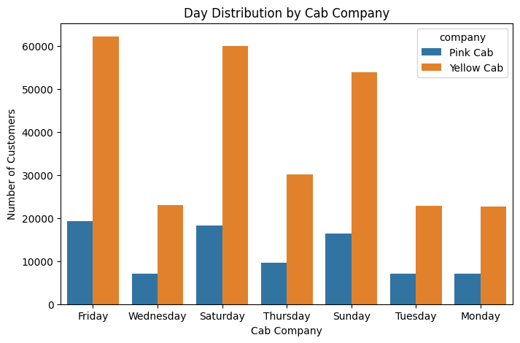
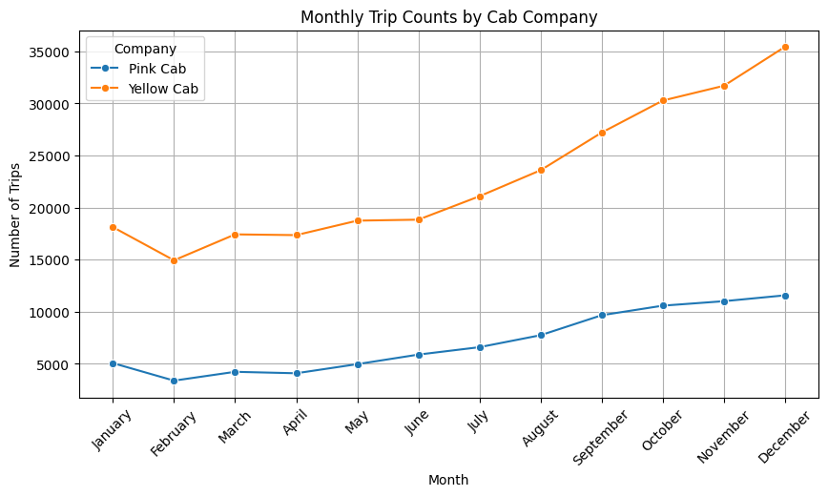
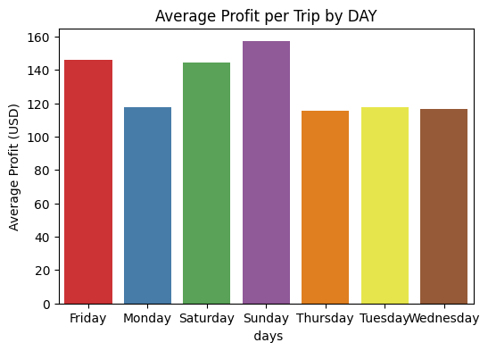
CAB - Distribution

Slide 6
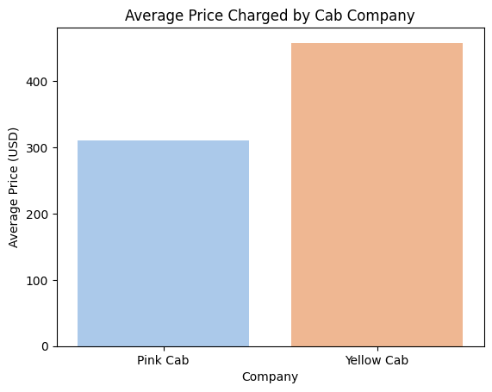
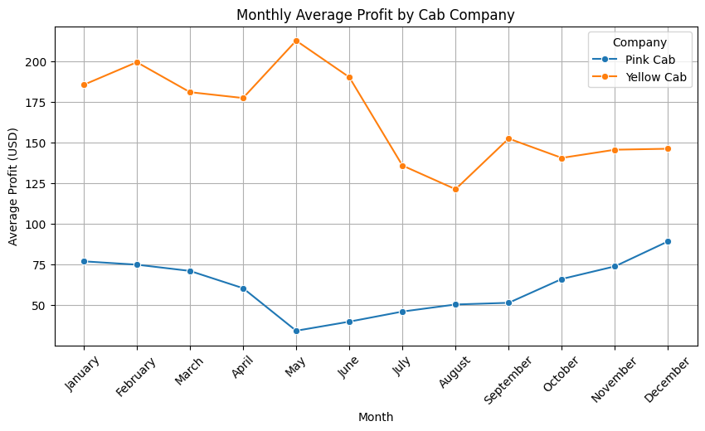
Price Charged and Profit Gained
Travel_Year Company profit_per_unit
0 2016 Pink Cab 68.321819
1 2016 Yellow Cab 169.347821
2 2017 Pink Cab 67.070839
3 2017 Yellow Cab 168.817057
4 2018 Pink Cab 53.229689
5 2018 Yellow Cab 143.416122

Slide 7
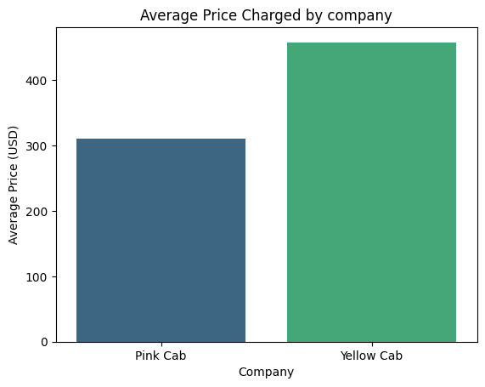
Hypothesis Testing - price Charged
Hypotheses:
H₀ (Null): There is no difference in average price charged (μ₁ = μ₂)
H₁ (Alt): There is a difference in average price charged (μ₁ ≠ μ₂)
T-statistic: -176.942
P-value: 0.0000
Since the p-value is less than 0.05, you reject the null hypothesis.
This means:
There is a statistically significant difference in the average price charged by Pink Cab and Yellow Cab.
Pink Cab Avg Price: 310.80
Yellow Cab Avg Price: 458.18

Slide 8
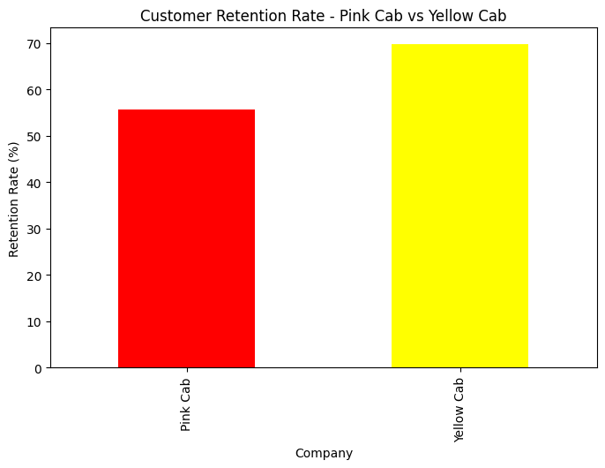
Hypothesis Testing - Customer Retnetion
H₀ (Null Hypothesis): The retention rate is the same for Pink Cab and Yellow Cab.
H₁ (Alternative Hypothesis): The retention rates are different between the two companies.
Chi-squared statistic: 1548.733
P-value: 0.0
Since the p-value < 0.05, we reject the null hypothesis.
There is a statistically significant difference in customer retention rates between Pink Cab and Yellow Cab.

Slide 9
Suggestion
Pink Cab company has the potential to grow.
From the testing and experimentation, we can see it is performing good as per unit profit individually
When compared to the Yellow Cab Company, it is less, as it has a good network and more popularity, it seems, through the data.
To improve this, they can expand the network of cabs
Give some discount to old customers to increase retention rates.

Slide 10
Thank You

