Slide 1

IT Ticket Analysis
Performance, efficiency & staffing insights from 5 years of ticket data
Akshata Likhar
06 JUNE 2016

Slide 2




Agenda
What this presentation walks through
01
Problem Statement
The business question - what management needs to decide.
02
Data Description
The two source sheets and the attributes they hold.
03
Objective Metrics & Visualizations
Answering the factual questions about the data.
04
Subjective Insights
Reasoned recommendations for staffing and investment.

Slide 3




Problem Statement
The question we're here to answer
Find high & low performers
Analyse the IT support ticket system to understand how well our agents perform, how efficiently tickets get resolved, and how satisfied employees are with the service.
Measure resolution efficiency
The goal is to give management the evidence it needs to make confident staffing decisions - where to hire, who to train, and where to invest.
Track employee satisfaction
Guide hiring, training & investment

Slide 4


Data Description
The dataset is built from two linked sheets, joined on Agent ID called Cleaned Data.
Tickets
IT Agents
97,498 rows · 10 attributes
50 rows · 6 attributes
ID Ticket · Date (Fecha)
Employee ID · Agent ID
Request Category · Issue Type
Severity · Priority
Resolution Time · Satisfaction Rate
Agent ID · Full Name
Email address
Year of Birth
Month of Birth
Day of Birth

Slide 5




My Analytical Approach
01
02
03
Clean
Summarise
Analyse
Standardised dates and agent names, checked every column for gaps with Power Query.
Built pivot tables to group tickets by agent, category, priority and year.
Compared resolution times, satisfaction and workload to answer each project question.

Slide 6




OBJECTIVE
Data Quality & Structure
16
0
total attributes (10 in Tickets + 6 in IT Agents)
missing or inconsistent values remaining after cleaning
7
41
categorical columns used for grouping and slicing
average agent age in years (range 29 - 54)
Categorical columns: Quarter, Month, Agent Name, Request Category, Issue Type, Severity and Priority. Severity and resolution time are barely correlated (r ≈ −0.04).

Slide 7



Dashboard: Key Charts & Insights
An interactive Excel dashboard with multiple slicers. The next slides walk through each of its nine charts with the takeaways that matter most.
Multiple slicers
9 linked charts
Live KPI cards

Slide 8

CHART 1
Ticket Volume Trend Over Time
Total tickets logged each year
Key Insights
Annual volume more than doubled (+123%) from 13,051 tickets in 2016 to 29,088 in 2020.
1
Growth accelerated after 2018, with the steepest jump in 2020.
2
Demand is structural, not seasonal, so staffing must scale proactively.
3

Slide 9
CHART 2
Ticket Category Distribution
Share of tickets by request category
Key Insights
'System' is the largest category at 40% (39,002 tickets), with Login Access next at 30%.
1
Together those two make up roughly 70% of all tickets.
2
Hardware is just ~10% of volume but the slowest to resolve, as Chart 7 shows.
3

Slide 10
CHART 3
Ticket Count by Priority
Number of tickets in each priority level
Key Insights
'High' is the biggest bucket (35,549), but 'Unassigned' is a close second at 29,410.
1
Nearly 1 in 3 tickets (30%) enters the queue with no priority set.
2
Untriaged tickets bypass SLA rules, a clear front-end gap to close.
3

Slide 11
CHART 4
Ticket Count by Severity
Number of tickets at each severity level
Key Insights
The vast majority of 91% (88,656) have tickets of 'Normal' severity.
1
Genuinely Urgent or Major tickets are rare, under 7% combined.
2
Severity is too concentrated to drive prioritisation on its own.
3

Slide 12
CHART 5
Tickets by Satisfaction Rate
Number of tickets at each satisfaction score (1-5)
Key Insights
Over half of all tickets (52%, 50,770) receive the top score of 5.
1
Around 80% rate 4 or 5 have overall sentiment strongly positive.
2
A cluster of 1-star ratings (9,907) flags a minority of poor experiences worth probing.
3

Slide 13
CHART 6
Tickets by Resolution Time
Number of tickets grouped by days to resolve
Key Insights
Most tickets close quickly: 42% within 0-2 days and about 83% within 8 days.
1
A long tail of roughly 8,000 tickets takes 12+ days to resolve.
2
Shortening that slow tail would lower the overall average the most.
3

Slide 14
CHART 7
Avg Resolution Time by Category & Quarter
Average days to resolve, split by category across quarters
Key Insights
Resolution time is virtually flat across all four quarters i.e. there is no seasonal effect.
1
It varies enormously by category: Hardware ~7.6 days vs Login Access ~0.3
(a 25× gap).
2
The bottleneck is the type of work, not the time of year, so fixes must be category specific.
3

Slide 15
CHART 8
Avg Satisfaction Rate Over Time
Average satisfaction score each year
Key Insights
Average satisfaction has risen every single year, from 3.98 to 4.16.
1
Quality improved even as ticket volume more than doubled.
2
The team is scaling without sacrificing service which shows a strong and healthy trend.
3

Slide 16
CHART 9
Age Group vs Satisfaction Rate
Average satisfaction score by agent age group
Key Insights
Satisfaction is broadly consistent across all agent age groups (4.02-4.22).
1
The oldest group (47-55) scores highest at 4.22; the 38-46 group is slightly lowest.
2
Age is not a meaningful driver of performance.
3

Slide 17
OBJECTIVE
How Much Each Agent Handles
Tickets handled per agent (50 agents in total). The load is spread fairly evenly.
Busiest agents by volume
~1,950
1
Aurelio Tanori
2,027
tickets handled by a typical agent across the period
2
Jesus Contreras
2,026
3
Elena Velez
2,021
What this means
4
Melinda
2,007
Workload alone doesn't separate good from struggling agents, everyone handles a similar number of tickets. To judge performance, we have to look at satisfaction and resolution speed, not volume.
5
Barbara Grijalva
2,003

Slide 18


SUBJECTIVE
Who Needs Training?
Satisfaction varies far more between agents than the 4.10 average suggests from 3.0 to 4.6.
Top performers
Need support / training
Agent
Sat.
Res.
Agent
Sat.
Res.
Diana Rojo
4.60
3.6d
Alfonso Barraza
3.04
5.0d
Javier D.
4.49
4.1d
A. Trejo
3.59
5.3d
Galindo Guadalupe
4.47
3.7d
Sandra Lujan
3.60
5.2d
Recommendation: Target coaching at the bottom group rather than firing as they carry full workloads, so the issue looks like skill and process, not effort.

Slide 19



SUBJECTIVE
Where Should We Invest?
Comparing the three options against the evidence, hire, train, or upgrade software.
Hire more agents
Improve training
Upgrade software
Lower priority
Best value
Selective
Workload is already even and satisfaction is rising hence capacity isn't the bottleneck yet.
Closes the wide 3.0 - 4.6 satisfaction gap between agents at low cost. Direct, fast impact.
Worth it specifically for self-service login & auto-triage which is not a full platform replacement.

Slide 20

RECOMMENDATION 1
Invest First in Targeted Training
1
RECOMMENDATION
Direct the budget toward coaching the lowest-satisfaction agents before mass hiring or a software overhaul.
WHY - THE DATA
Satisfaction ranges from 3.0 to 4.6 across agents despite similar workloads which is a skill and process gap, not a capacity one.
EXPECTED IMPACT
Lifting the bottom group toward the team average is the cheapest, fastest way to raise the overall 4.10 score.

Slide 21
RECOMMENDATION 2
Automate Login-Access Requests
2
RECOMMENDATION
Roll out self-service password resets and an automated access portal for the Login Access category.
WHY - THE DATA
Login Access is 30% of all tickets (29,000+) and clears in just 0.3 days means high volume, low complexity.
EXPECTED IMPACT
Deflecting these frees agents to focus on Hardware and System tickets, which take 7+ days and need real skill.

Slide 22

RECOMMENDATION 3
Enforce Priority Triage & Scale With Growth
3
RECOMMENDATION
Make priority a required field at intake, and plan hiring against the proven ~15-20% yearly volume growth.
WHY - THE DATA
29,410 tickets (30%) sit 'Unassigned' and drag out to 5.3 days; volume has risen every single year.
EXPECTED IMPACT
Removing the unassigned tier tightens SLAs, and forecast-based staffing protects the rising satisfaction trend.

Slide 23
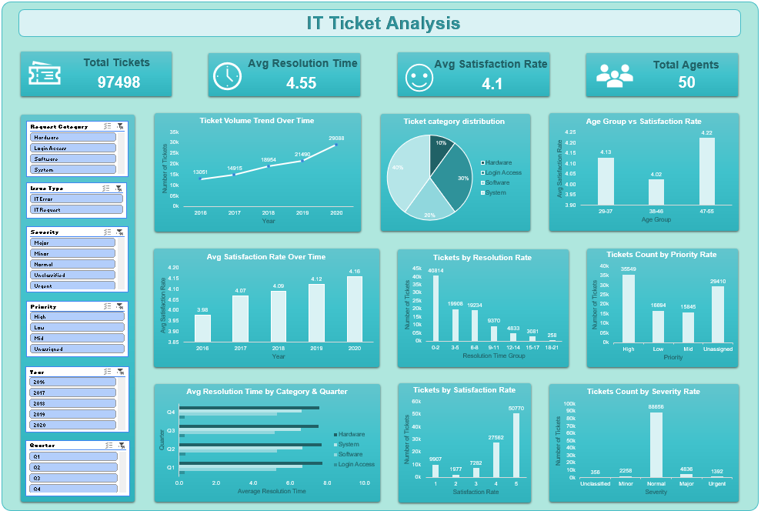



Interactive Performance Dashboard
Built in Excel with Priority, Year and more slicers, so management can explore the data through a long review.
Priority & Year slicers
Filter every metric live during discussion.
KPI cards
Volume, satisfaction and resolution at a glance.
Trend & category charts
Spot peaks, stable periods and slow categories.

Slide 24



CONCLUSION
Conclusion
In three numbers
97,498
A capable team is absorbing fast-growing volume while satisfaction keeps rising.
The gains to chase are a wide agent-to-agent skill gap, slow Hardware/System work, and untriaged tickets.
Invest in training first, automate routine logins, and enforce triage and then scale staffing with growth.
tickets analysed across 5 years
3.0 - 4.6
satisfaction gap between agents
25×
resolution gap between categories

Slide 25



Acknowledgements & References
Data source
IT Tickets Analysis dataset - Tickets & IT Agents sheets, 2016-2020.
Tools used
Microsoft Excel - Excel Formulas, pivot tables, charts, filters, conditional formatting and slicers.
Thanks
To my mentors and reviewers for the chance to present this analysis.
Thank you

