Slide 1
Sales Financial Dashboard - Task 3 DA
Interactive alternative (Plotly HTML) + files for submission

Slide 2
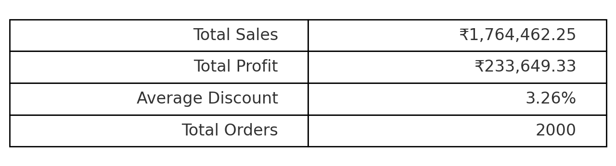
Key KPIs

Slide 3
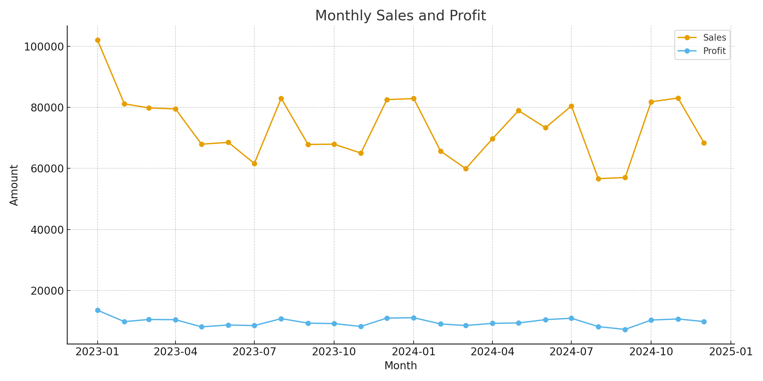
Monthly Sales and Profit

Slide 4
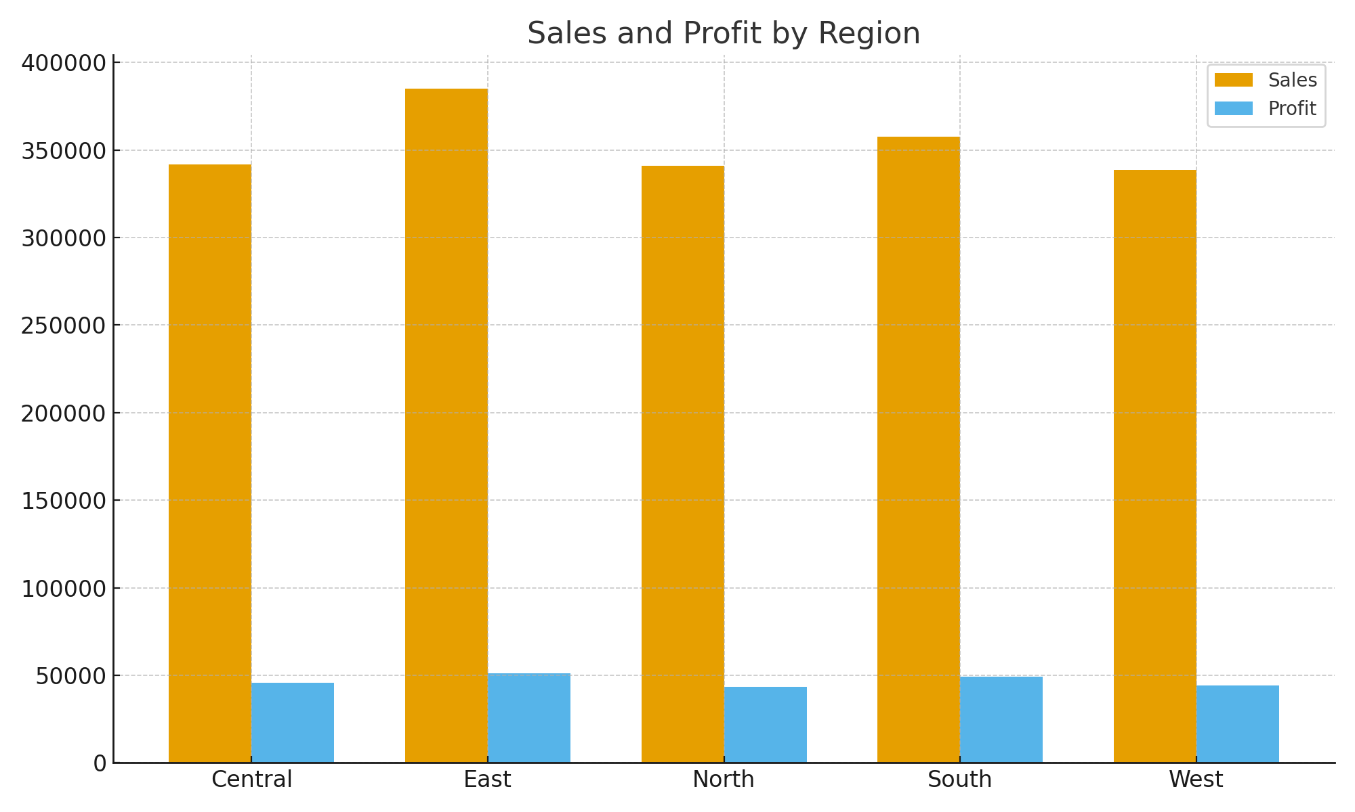
Sales & Profit by Region

Slide 5
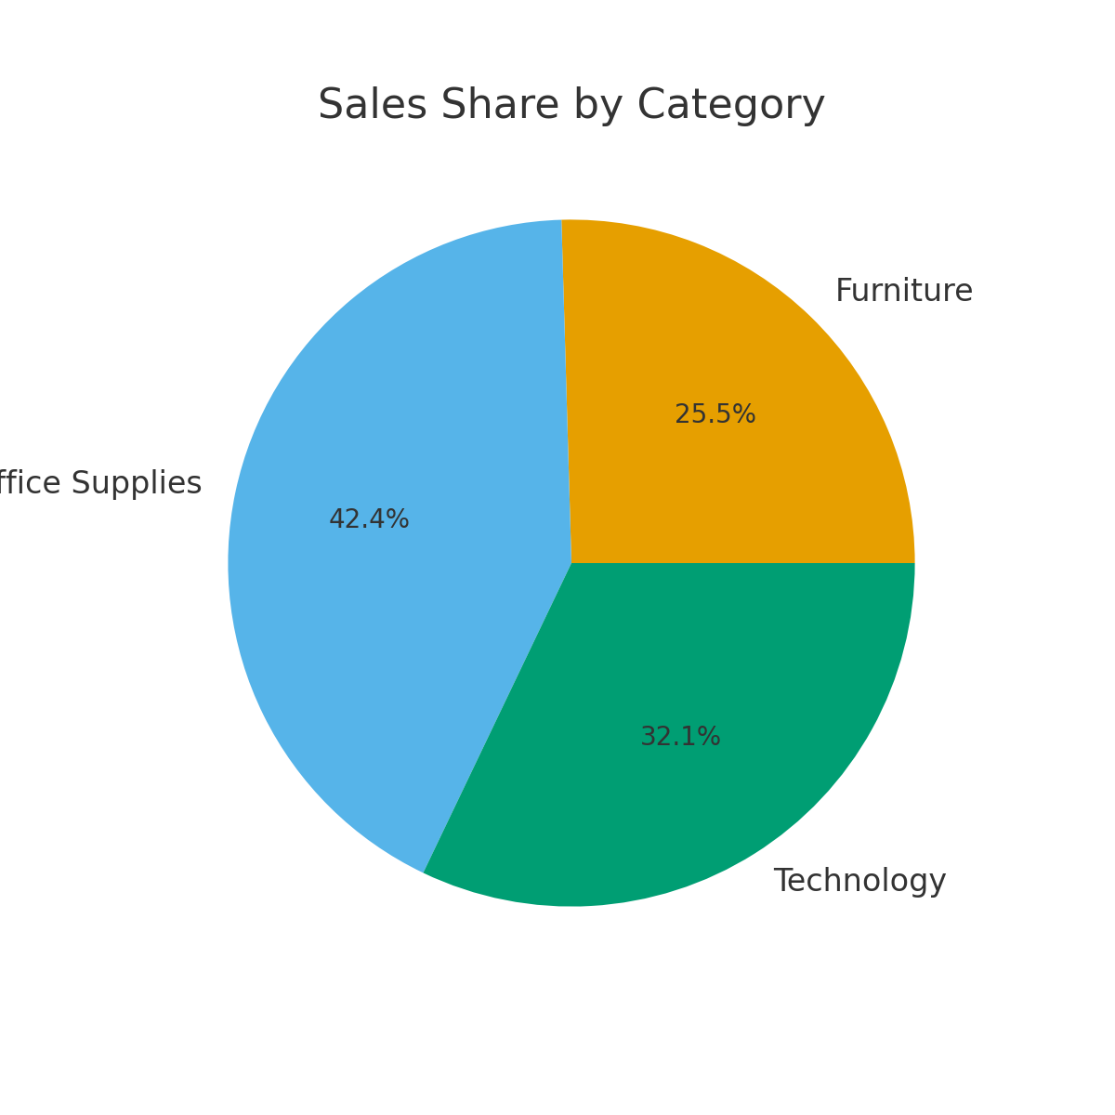
Sales Distribution by Category

Slide 6
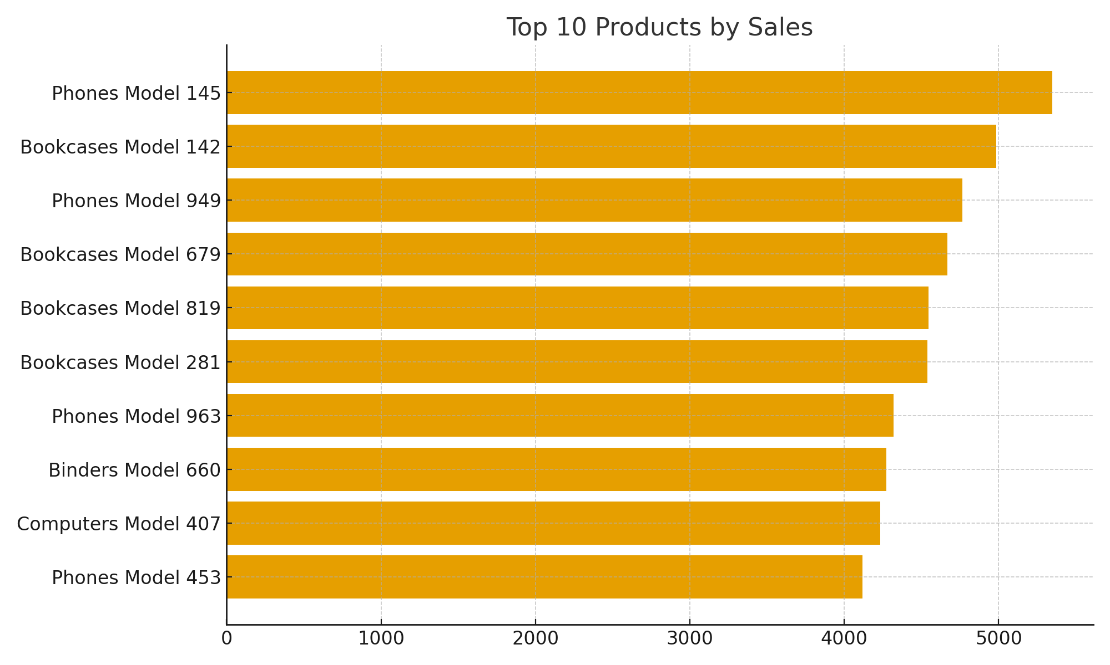
Top 10 Products by Sales

Slide 7
How to replicate in Power BI / Tableau
1. Load `synthetic_sales.csv` and parse OrderDate as Date.
2. Create date hierarchy (Year, Quarter, Month) and use as slicer.
3. Create cards for Total Sales, Total Profit, Avg Discount, Total Orders.
4. Build line chart (Month) for Sales & Profit (dual axis optional).
5. Add bar charts for Region and Top Products; pie for Category.
6. Add slicers: Date range, Region, Country, Category.

