Slide 1

Analyzing 2016 US Presidential Elections
Presented by:
Akshata S Salehittal
Janhavi Chitale
Kanishka Ramamoorthy

Slide 2
Objective
Analyzing the data and producing effective visual representations and descriptive statistics to explain variations in the results of the primary elections based on demographics
Analyzing the different voting trends in the Primaries
Predictive Analysis:
Prediction of the results of Primaries for states and counties where ballots have not yet been conducted
Prediction of the final presidential nominee from the Republican & the Democratic parties

Slide 3
About the Data
Dataset :2016 US Election Kaggle dataset
Dataset contained:
Primary results for 28 states
Demographic data on counties from US census
Directory containing county shapefiles useful for mapping
Original Data Source
Primary Results from CNN
New Hampshire County-Level Results
County Shapefiles
County QuickFacts
Election Process

Slide 4
How the Primaries Work?
Nominating Process
Each party conducts primaries & caucuses individually
Every state has either primaries or causes or both depending upon state legislations
Types of Primaries
Open Primaries
Closed Primaries
Blanket Primaries
Candidates winning the states are awarded delegates to represent them at the National Conventions of the parties
Delegates vote to Decide the final Presidential Nominees

Slide 5
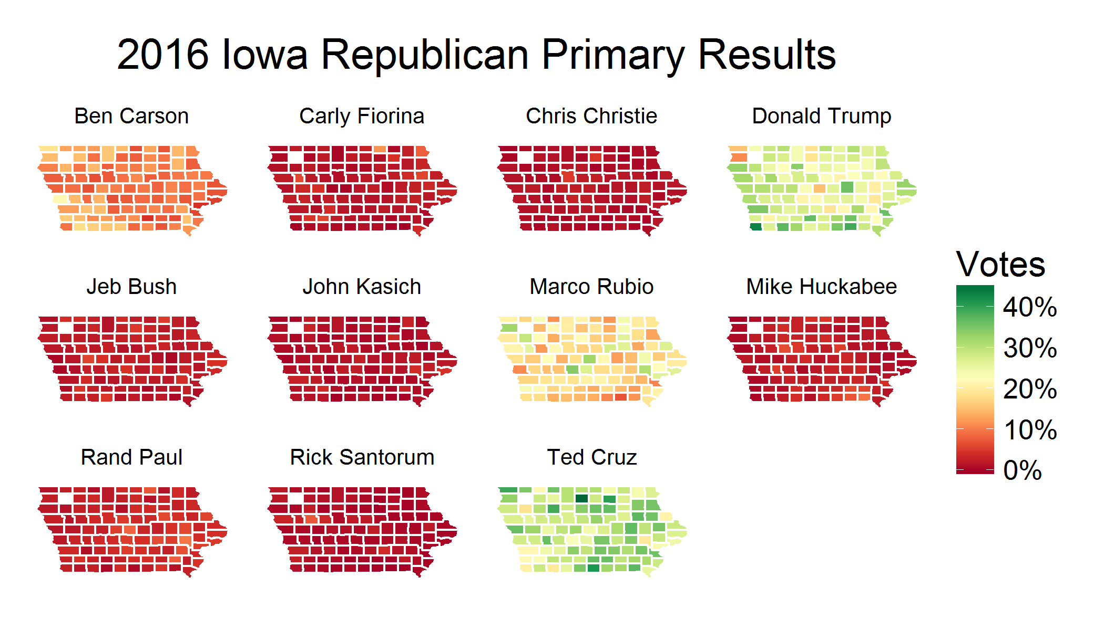
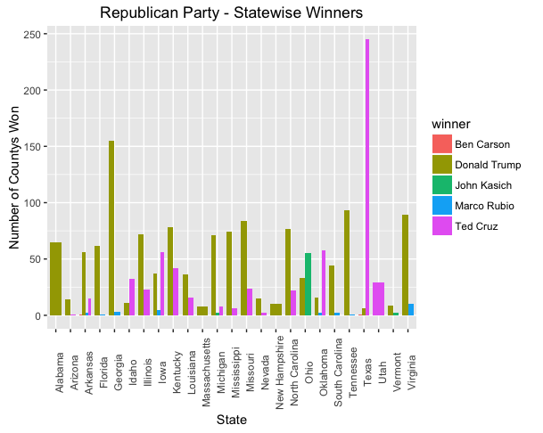
Exploring the data

Slide 6
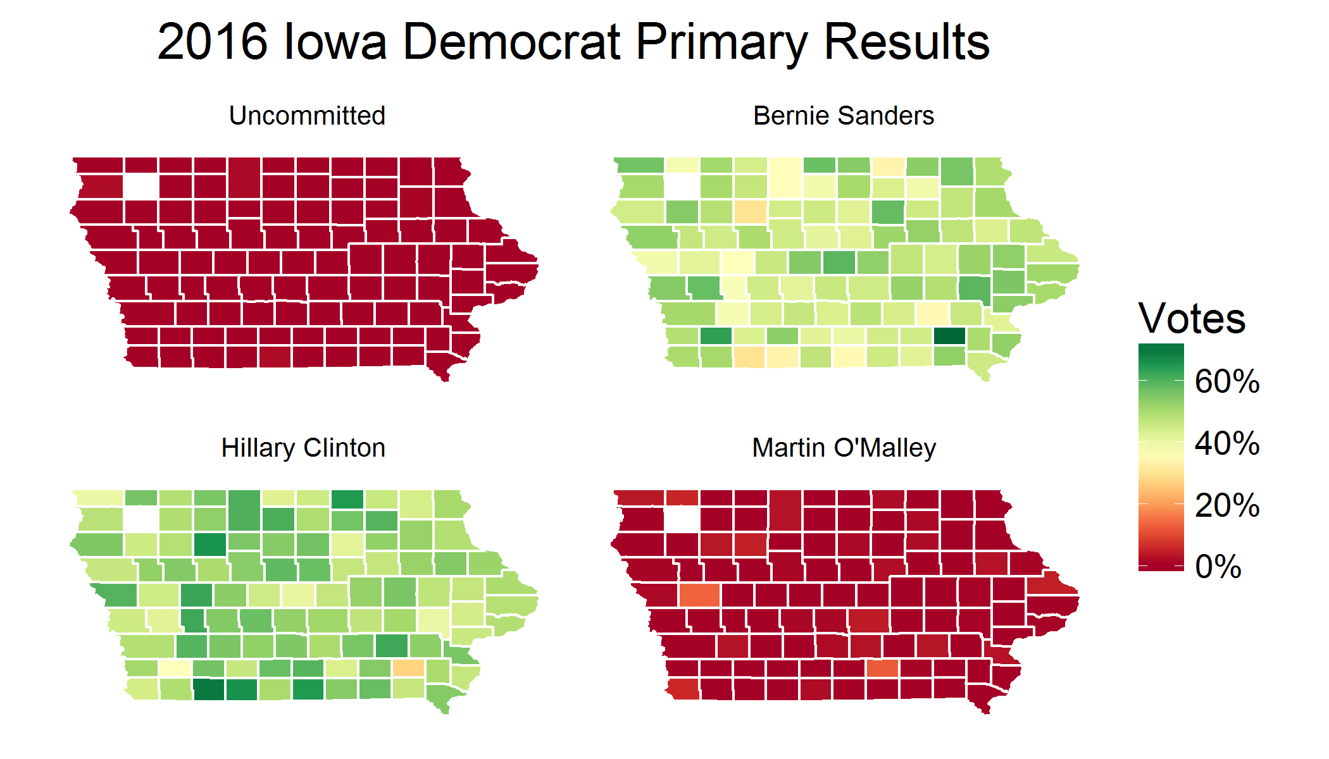
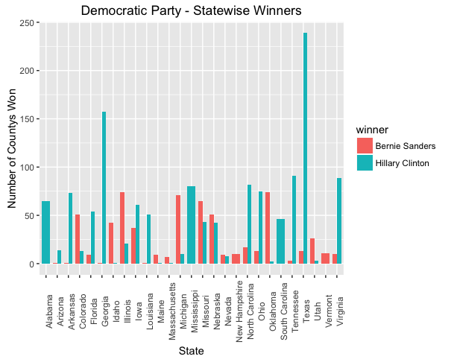
Exploring the data

Slide 7
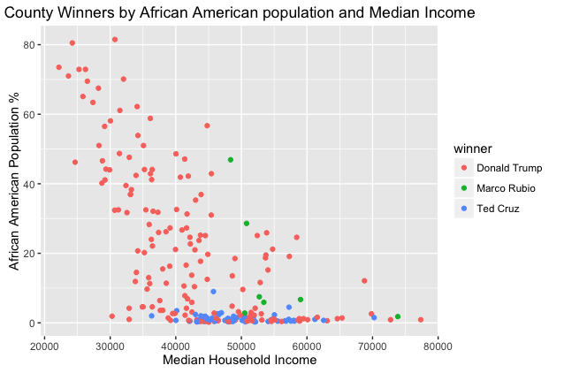
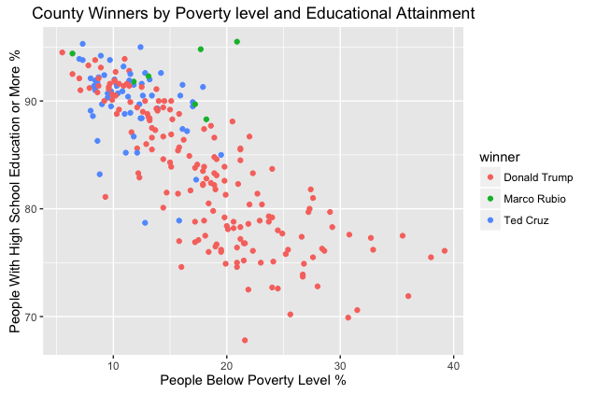
Analysing Trends - Republicans

Slide 8
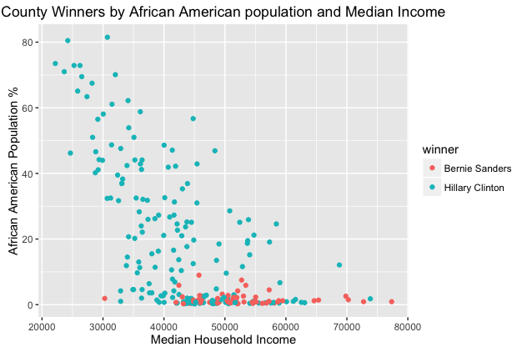
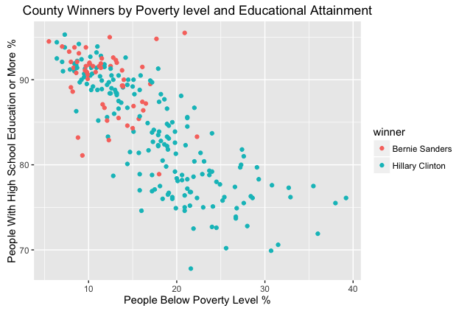
Analysing Trends - Democrats

Slide 9
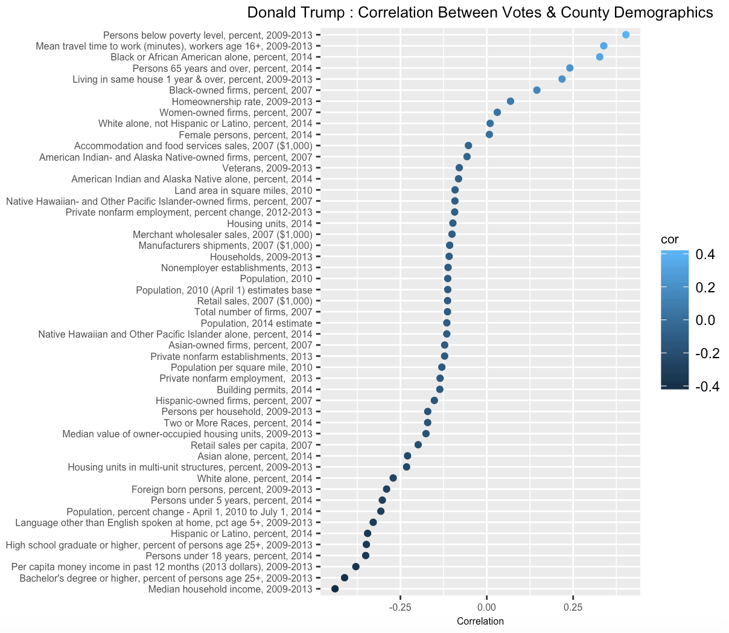
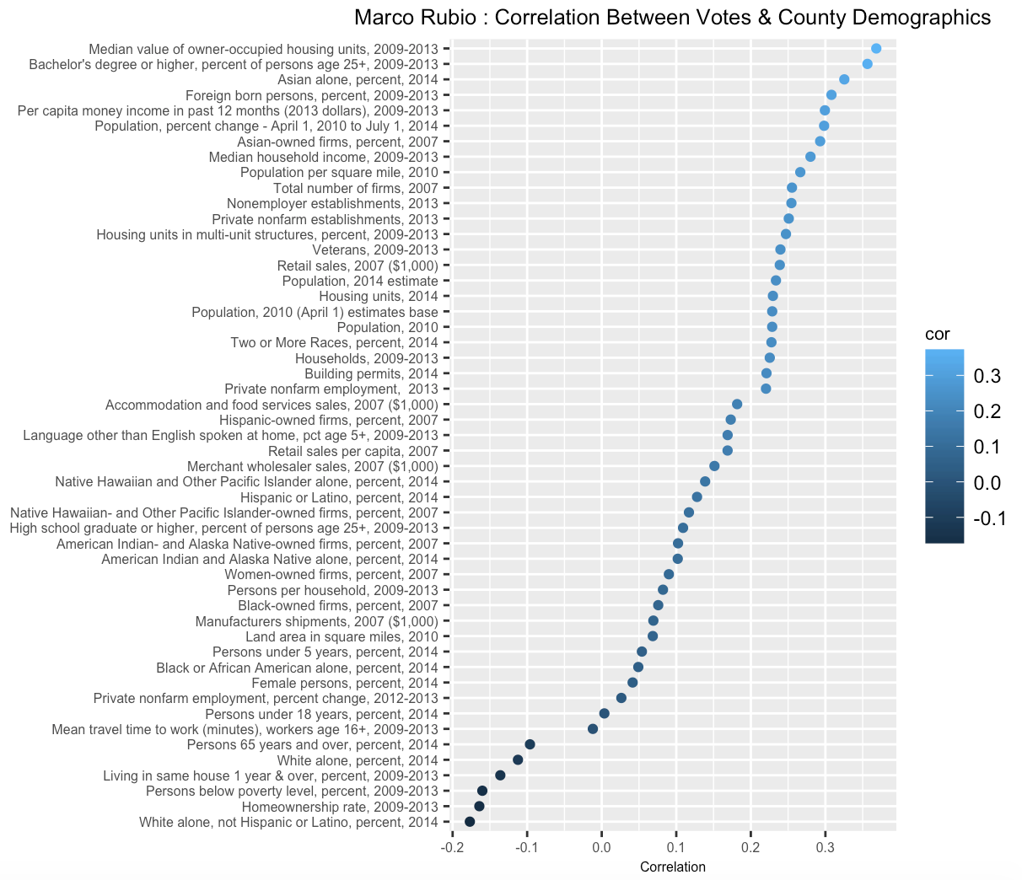
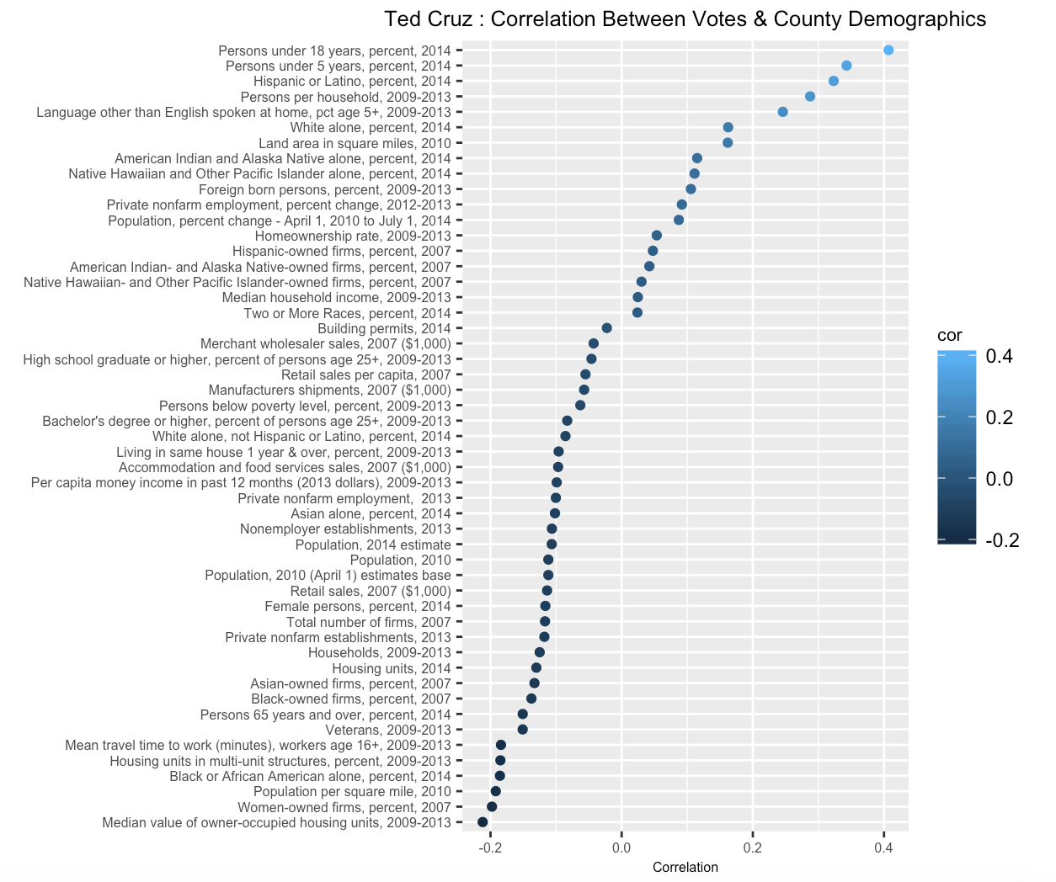
Correlations

Slide 10
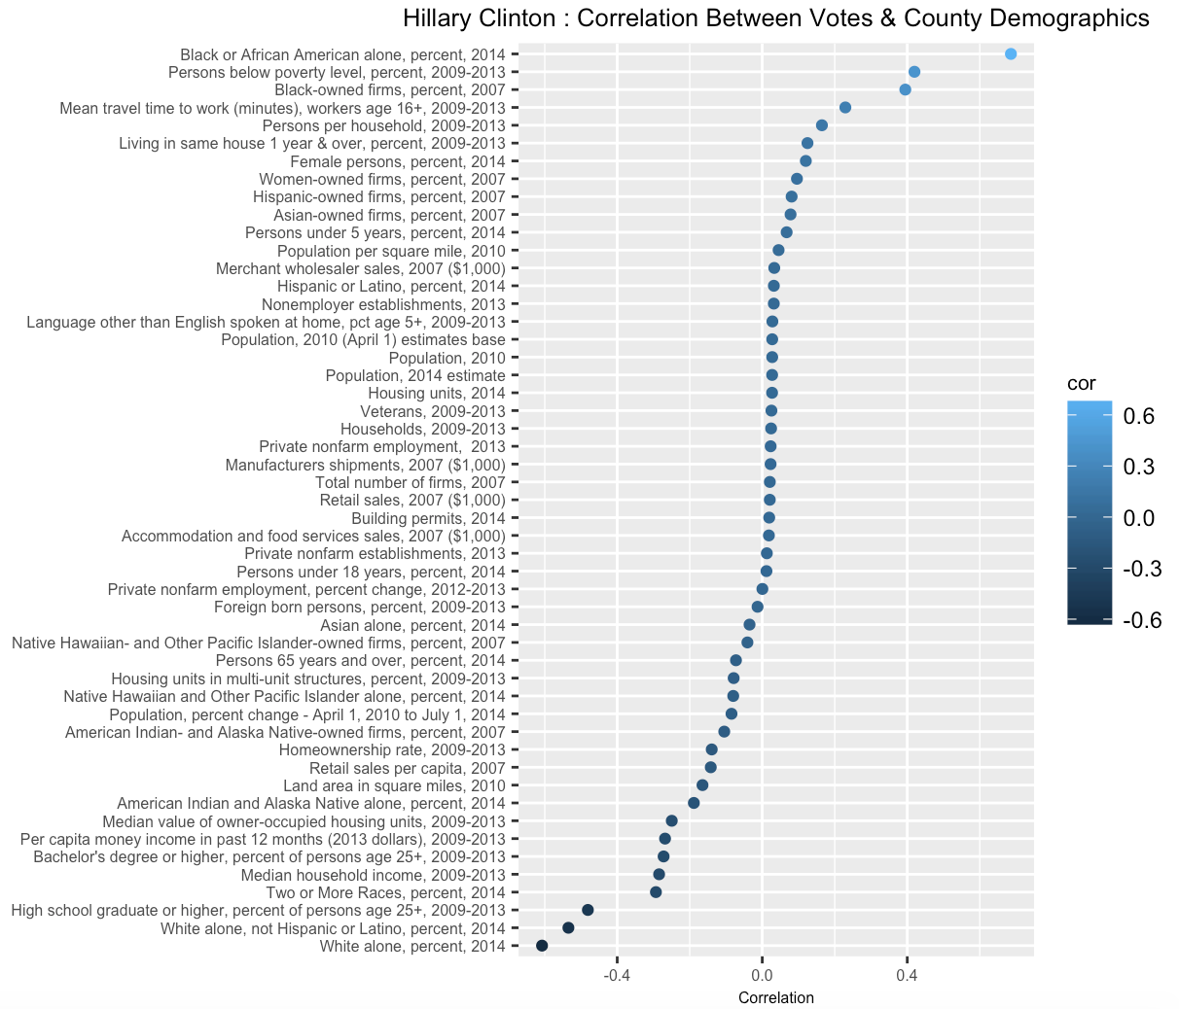
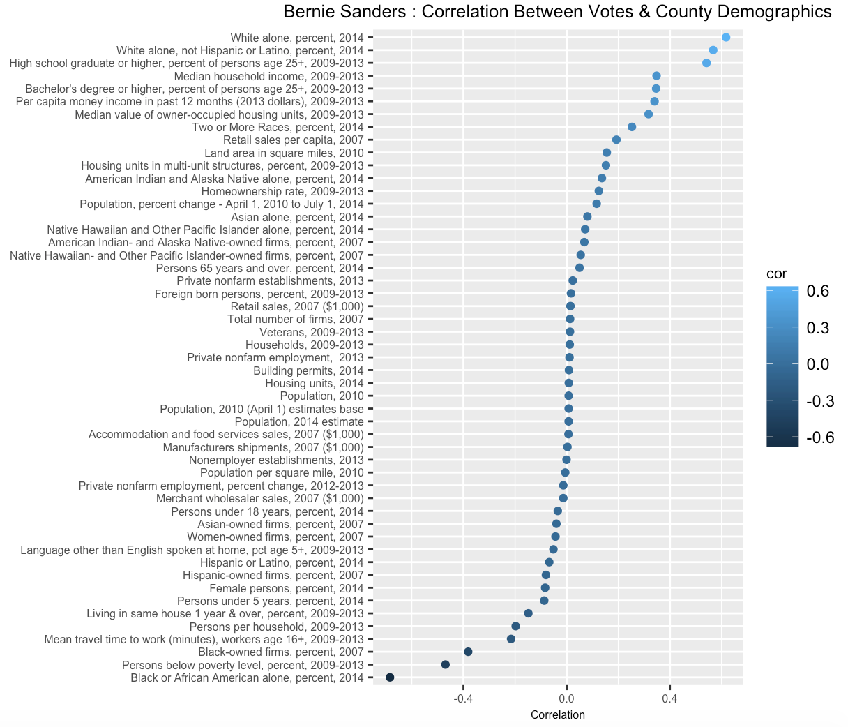
Correlations

Slide 11
Method
Built 2 separate models for the Democrats & Republicans
Separated the data into Republicans & Democrats
Calculated county wise winners for each party, based on the fraction of votes
Merged the new data frame with the demographics to form our train data with ‘Winner’ as the DV
Performed a 80/20 % split to form a train set and a validation set
Test set included demographics of counties in states where primaries were not conducted yet

Slide 12
Republican Accuracy Matrix
Predictors | Logistic Regression | SVM (Radial) | SVM (Linear) | SVM (Laplace) | SVM (Bessel)
White alone + White alone(pop above 18yrs)+ African American + Persons below Poverty Level + High School Graduates, (25 yrs+) + Bachelor’s degree, (25 yrs+) + Under 18yrs + Per capita money income in past 12 months + Median household income | 79.52% | 82.18% | 80.85% | 81.11% | 80.05%
White alone +African American + Persons below Poverty Level + High School Graduates, (25 yrs+) + Bachelor’s degree, (25 yrs+) + Under 18yrs + 65 yrs+ + Per capita money income in past 12 months+ Median household income +Population per Square mile | 78.45% | 81.64% | 80.05% | 81.08% | 78.19%
White alone + African American+White alone(pop above 18yrs) + Persons below Poverty Level + High School Graduates, (25 yrs+) + Bachelor’s degree, (25 yrs+) + 65 yrs+ + Per capita money income in past 12 months | 78.19% | 81.11% | 78.72% | 80.85% | 80.58%
Hispanic or Latino + Persons below Poverty Level + High School Graduates, (25 yrs+) + Bachelor’s degree, (25 yrs+) + Under 18 yrs+ Female persons | 76.62% | 75.26% | 73.13% | 75.53% | 74.46%
White alone(pop above 18yrs) + African American + White alone + Persons below Poverty Level + Bachelor’s degree, (25 yrs+) + High School Graduates, (25 yrs+) + Per capita money income in past 12 months + Median household income | 77.39% | 81.38% | 78.19% | 80.58% | 79.52%

Slide 13
Democrat Accuracy Matrix
Predictors | Logistic Regression | SVM (Radial) | SVM (Linear) | SVM (Laplace) | SVM (Bessel)
White Alone + 65 yrs + Bachelor’s degree, (25 yrs+) + Median household income | 77.92% | 76.86% | 72.60% | 76.06% | 75.79%
White alone + Bachelor’s degree, (25 yrs+) + White alone(Not Hispanic or Latino) | 77.14% | 73.13% | 71.80% | 72.87% | 73.93%
White alone + Bachelor’s degree, (25 yrs+) + 65 yrs | 76.62% | 73.4% | 73.93% | 72.34% | 74.2%
African American + White alone + 65 yrs + Bachelor’s degree, (25 yrs+) + Median household income | 75.88% | 80.85% | 76.32% | 80.05% | 81.11%
White alone + White alone(pop above 18yrs)+ African American+High School Graduates, (25 yrs+) + Bachelor’s degree, (25 yrs+) + Under 18yrs | 82.07% | 82.85% | 82.33% | 81.29% | 82.59%

Slide 14
Final Models
REPUBLICAN:
White alone + White alone(pop above 18yrs)+ African American + Persons below Poverty Level + High School Graduates, (25 yrs+) + Bachelor’s degree, (25 yrs+) + Under 18yrs + Per capita money income in past 12 months + Median household income + Female persons
DEMOCRAT:
White alone + White alone(pop above 18yrs)+ African American+High School Graduates, (25 yrs+) + Bachelor’s degree, (25 yrs+) + Under 18yrs
“Back in December, analysis found that Trump's support skewed male, white, and poor”[1]
“Former Secretary of State Hillary Clinton is gaining increasing popularity among nonwhite voters especially above black voters”[2]
The demographics affected the Republican and Democrat party results differently hence there was a need to build 2 different models. The variables associated with sex,income and education levels seemed to make a significant difference in the accuracy of the Republican predictor models. Income and sex did not have a large enough effect on the accuracy of the Democrat predictor models. However race proved to be an important predictor in the model.
[1]http://www.theatlantic.com/politics/archive/2016/03/who-are-donald-trumps-supporters-really/471714/
[2]http://www.huffingtonpost.com/entry/clinton-sanders-minority-voters_us_56d6f8e3e4b0bf0dab33f4f9

Slide 15
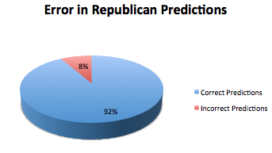
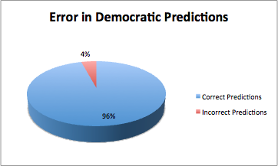
Lets look at Maryland Results

Slide 16
Findings
Race and Education demographics were strong predictors of the target variable for both parties
Our best model (SVM-Radial) predicted with an accuracy of 82.85% on our derived test set
We also found our model predicting with 92% and 96% accuracy in Republican and Democrats, respectively for the state of Maryland.
Limitations
The demographics data lacked information about percentage of registered voters
The scope of the project could not be extended to the predictions of the general elections during due to the variability in the way that Primaries and Caucuses are conducted in each state

