Slide 1
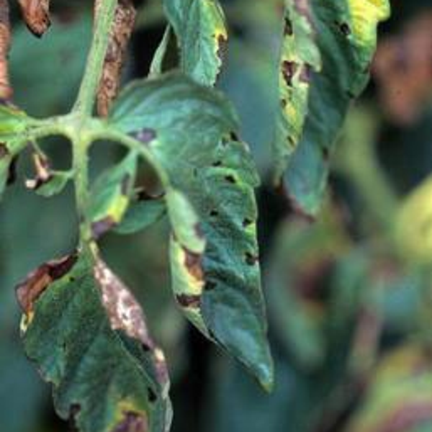
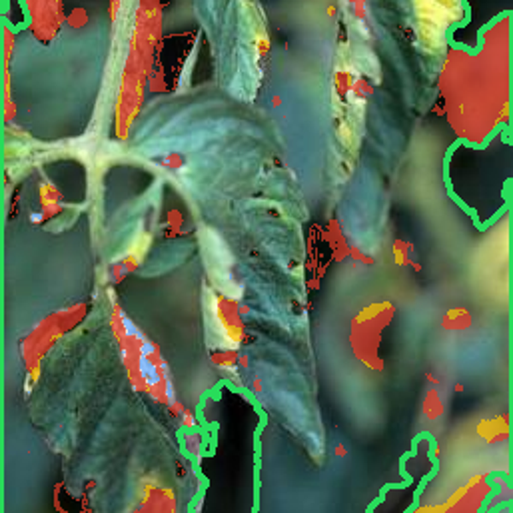
CROP HEALTH INTELLIGENCE · MINOR PROJECT
AgriVision AI
// LIVE OUTPUT FROM OUR TRAINED MODEL
AI-Powered Crop Health Monitoring
& Failure Diagnosis
Input photo
Damage map
Detect crop diseases, pest damage and nutrient deficiencies from a single leaf photograph — on the web or an Android phone.
DETECTED
Tomato — Early Blight
CONFIDENCE
92%
PRESENTED BY
SEVERITY
Mild · health 78 / 100
Akshata Bakre — 23118007
Himanshu Kashyap — 23118043
CAUSE
Fungal infection (Alternaria solani)
GUIDED BY Dr. Sanjay Kumar
ACTION
Remove severely affected leaves; Avoid prolonged leaf wetness
DEPARTMENT OF INFORMATION TECHNOLOGY · NIT RAIPUR
A field photograph from the held-out test set, never seen during training. AI diagnosis is an early-screening aid, not a definitive agricultural verdict.
Notes:
Good morning. We are presenting AgriVision AI, our minor project on crop health monitoring. I am Akshata, and Himanshu will present the technical parts.
The idea in one line: a farmer takes one photo of a crop leaf and our system tells what is wrong, how sure it is, how serious it is, and what to do.
The card on the right is not a mock-up. It is a real output of our trained model on a tomato leaf photographed in a field, from a test set the model never saw. It detects Early Blight with 92% confidence, rates it Mild with a health score of 78 out of 100, shows the damage map, and gives actions.

Slide 2
Damage is usually noticed too late
01 · THE PROBLEM
Farmers often identify crop problems only after the visible damage has already become severe.
WHY IT HAPPENS
01
Diseases look alike in their early stages
02
Nutrient deficiencies mimic disease symptoms
03
Pests spread before they are noticed
Source: Savary et al., Nature Ecology & Evolution, 2019
04
Few agricultural experts are nearby
// IMPACT CHAIN
05
Manual field inspection is slow and tiring
Late
detection
Wrong
diagnosis
Wrong
treatment
Lower
yield
Financial
loss
06
Wrong treatment increases the losses
Each step makes the next one worse — so the intervention must happen at detection.
PRESENTED BY AKSHATA BAKRE
Notes:
The problem: farmers usually notice a crop problem only when the damage is already severe.
Six reasons on the left: diseases look alike early, a plant lacking nutrients can look diseased, pests spread before anyone notices, experts are far away, checking fields by hand is slow, and a wrong treatment makes losses worse.
The chart shows how big this is: a 2019 global study estimated that pathogens and pests destroy about 30% of rice and over 20% of maize, wheat and soybean.
The impact chain at the bottom is the key idea: late detection leads to a wrong diagnosis, wrong treatment, lower yield and money lost. Each step makes the next worse, so we attack the first one - detection.

Slide 3
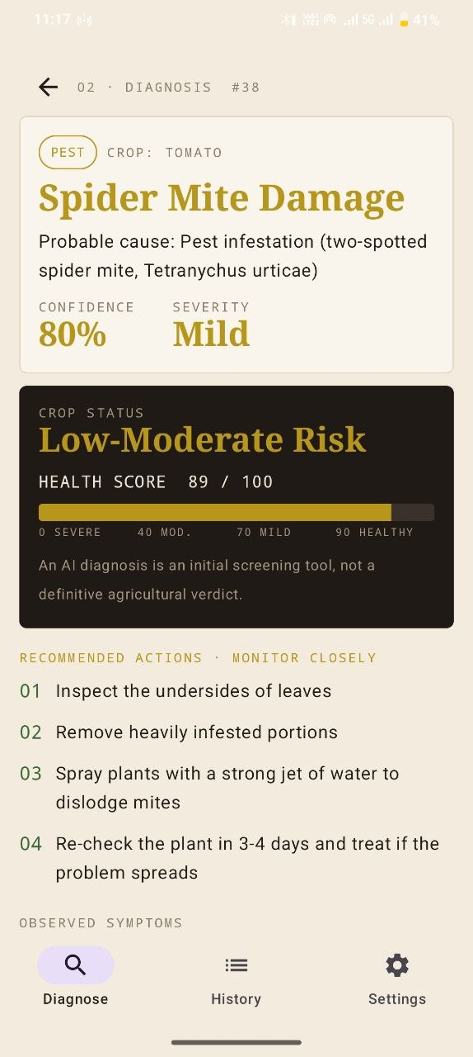
One photograph, seven answers
02 · OUR SOLUTION
WHAT THE FARMER GETS FROM ONE PHOTO
// WORKED EXAMPLE — REAL SYSTEM OUTPUT
1
Is the photo usable?
Blur, lighting and leaf-presence checks
INPUT
Tomato leaf photographed in a field
2
What is wrong?
38 crop conditions across 14 crops
3
What type of problem?
Disease, pest, nutrient deficiency or healthy
AI ANALYSIS
4
How sure is the AI?
Disease
Early Blight
Calibrated confidence; asks for a re-capture if unsure
Confidence
92%
5
How bad is it?
Severity
Mild (health 78/100)
Health score 0–100 and a severity band
6
What should I do?
RECOMMENDATION
Advice that fits the crop, weather and field history
Remove severely affected leaves
Avoid prolonged leaf wetness
Improve plant spacing and airflow
7
A record to keep
PDF report and per-field history
Diagnose screen
PRESENTED BY AKSHATA BAKRE
Notes:
Our solution: one photograph gives seven answers - listed on the left. Is the photo usable, what is wrong, what type of problem it is, how sure the AI is, how bad it is, what to do, and a record to keep.
The dark card is a real example from our system, not an illustration. A tomato leaf photo goes in; the AI says Early Blight with 92% confidence, severity Mild; and the recommendation engine gives concrete actions.
The point from our mid-sem still holds: the farmer never sees a model - they see a verdict, a severity and a next action.
On the right is the Diagnose screen of our Android app.

Slide 4
Six capabilities, one upload
03 · KEY FEATURES
01
02
03
Image-based diagnosis
Disease detection
Pest detection
MobileNetV3 deep-learning model trained on 41,141 lab and 2,578 field photos.
25 diseases: blight, rust, mildew, scab, leaf spots and viruses.
Spider-mite damage is recognised and routed as a pest, with pest-specific advice.
97.9% lab accuracy
14 crops
Category: Pest
04
05
06
Nutrient deficiency
Severity estimation
Recommendations
N · K · Fe/Mg yellowing patterns detected by colour analysis of the leaf.
Damaged leaf area becomes a 0–100 health score: Healthy → Mild → Moderate → Severe.
Advice adapts to severity, weather, growth stage, soil, region and field history.
Confirm with soil test
Damage map shown
39-entry knowledge base
PRESENTED BY AKSHATA BAKRE
Notes:
Six capabilities, all from one upload.
One - diagnosis: a MobileNetV3 deep-learning model trained on about 41 thousand lab photos and 2,600 real field photos; 97.9% accurate on lab test photos.
Two - disease detection: 25 diseases across 14 crops - blights, rusts, mildew, scab, leaf spots and viruses.
Three - pest detection: spider-mite damage is detected and labelled as a pest, so the advice is pest advice, not fungicide.
Four - nutrient deficiency: nitrogen, potassium and iron or magnesium deficiencies have typical yellowing patterns; we detect them by analysing leaf colours and always ask for a soil test to confirm.
Five - severity: we measure how much of the leaf is damaged and convert it to a 0 to 100 health score.
Six - recommendations: advice changes with severity, weather, growth stage and the field's history.

Slide 5
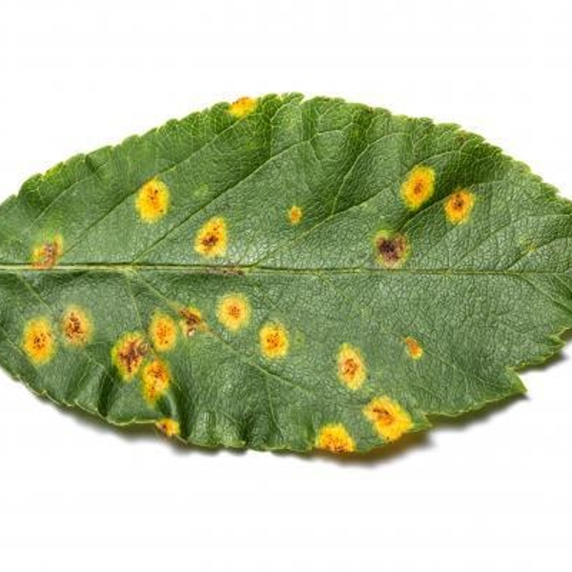
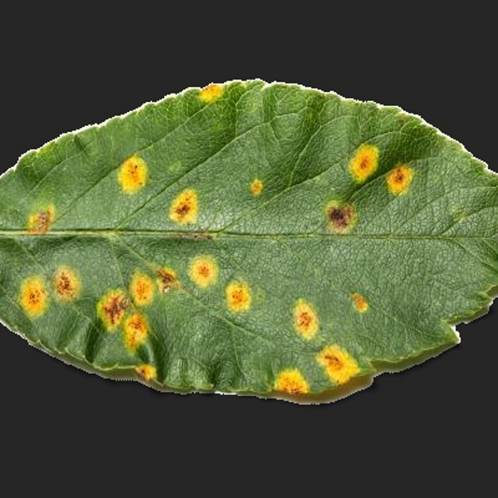
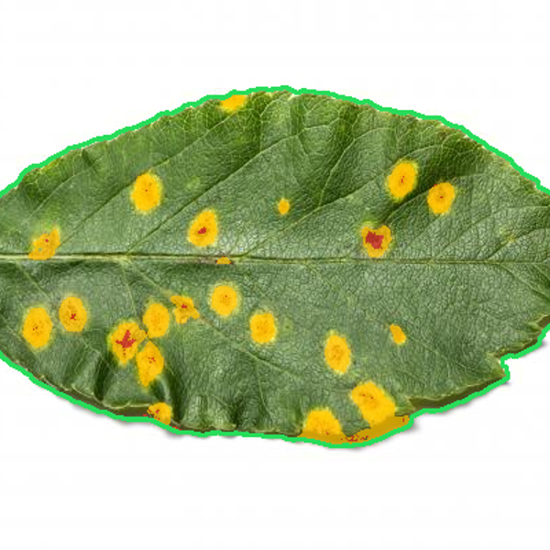
From shutter to report
04 · WORKFLOW & CV PIPELINE
// END-TO-END WORKFLOW
// COMPUTER VISION PIPELINE — REAL IMAGES
1
Capture or upload
Phone camera, gallery or web upload
2
Validate & enhance
Blur, exposure, leaf present; CLAHE for dark photos
3
Find the leaf
Colour threshold, or focus-seeded GrabCut in the field
4
Classify
1 Input photo
2 Leaf isolated
3 Damage map
MobileNetV3 → probabilities for 39 classes
5
Abstain if unsure
BLUR CHECK
EXPOSURE
Below 60% (76% for field photos) → re-capture
Variance of Laplacian must be ≥ 40
Mean brightness between 40 and 225
6
Severity & nutrients
Damaged-area score; N / K / Fe-Mg patterns
MODEL INPUT
DAMAGE COLOURS
7
Advise & report
Resized to 224 × 224, ImageNet-normalised
Red necrotic · yellow chlorotic · blue powdery
Knowledge base + context → screen, PDF, history
PRESENTED BY HIMANSHU KASHYAP
Notes:
This is what happens to one photo, step by step.
First the photo is checked: is it sharp enough, is it too dark or too bright, is there a leaf? Then we find the leaf. For plain-background photos, colour is enough. For field photos, we use GrabCut seeded by focus - the leaf you photograph is sharp, the background is blurred.
Then the MobileNetV3 model classifies the image. If confidence is too low, the app asks for a new photo instead of guessing. Otherwise we measure severity, check nutrient patterns, and generate advice and a report.
On the right are real images from our pipeline: the input, the isolated leaf, and the damage map where red is dead tissue and yellow is weakened tissue.

Slide 6
Transfer learning, deliberately small
05 · AI MODEL
CANDIDATE BACKBONES
HOW WE TRAINED IT
// MODEL OUTPUT
MobileNetV3-L
5.5 M params
Frozen backbone
INPUT
field photo of a tomato leaf
EfficientNet-B0
4.2 M weights reused as-is
5.3 M params
Image → 1,280-number fingerprint
ResNet-50
25.6 M params
computed once per photo, then cached
TOP-3 PREDICTIONS
ConvNeXt-T
Small MLP head (trained)
Tomato – Early Blight
28.6 M params
92.3%
1,280 → 512 → 39 classes · 676 K weights
Tomato – Septoria Leaf Spot
✓ Chosen: fast, small, phone-friendly
Confidence calibration
1.7%
temperature scaling, T = 0.66
Potato – Early Blight
We reuse a network that already learned to “see” from 1.2 million everyday photos (ImageNet) and teach only a small plant-specific part — far less data and compute.
1.3%
≈ 25 min
NEXT
→ Severity engine
→ Recommendation engine
total training on a laptop CPU — no GPU
PRESENTED BY HIMANSHU KASHYAP
Notes:
Which AI model? We compared four well-known backbones and chose MobileNetV3-Large: small, fast, and designed for phones.
We used transfer learning. MobileNetV3 already learned to see shapes and textures from 1.2 million everyday photos. We keep that part frozen - 4.2 million weights unchanged - and train only a small head of 676 thousand weights that maps the image fingerprint to our 39 classes. That is why training took about 25 minutes on a normal laptop CPU.
We also calibrate the confidence, so when the model says 90%, it is right about 90% of the time.
On the right is the real model output for the tomato leaf: its top three guesses with probabilities, which then go to the severity and recommendation engines.

Slide 7
Not every crop problem is a disease
06 · MULTI-CLASS DIAGNOSIS
A routing layer sorts every photo into a category, so the advice fits the problem.
// DEFICIENCY SIGNATURES
Category | What it covers | Classes
Disease | Blight · rust · mildew · scab · leaf spots · viruses | 25
Pest | Spider-mite damage | 1
Nutrient | Nitrogen · potassium · iron / magnesium (colour rules) | 3
Healthy | No visible abnormality — one class per crop | 12
Not a leaf | Rejects photos without a crop leaf | 1
NITROGEN (N)
Uniform yellowing over ≥ 25% of the leaf
POTASSIUM (K)
Yellow / brown scorching at the leaf edge
IRON / MAGNESIUM (Fe, Mg)
Yellow between veins while veins stay green
Important. Colour analysis gives a probable result — confirm with a soil or tissue test before applying fertiliser.
SUPPORTED CROPS
Apple
Bell Pepper
Blueberry
Cherry
Citrus
Grape
Maize
99.4% right category (lab) 89.8% (field)
Peach
Potato
Raspberry
Soybean
Squash
Strawberry
Tomato
PRESENTED BY HIMANSHU KASHYAP
Notes:
Not every crop problem is a disease, so the system first decides the type of problem.
The table shows our categories: 25 disease classes, one pest class (spider mites), three nutrient patterns, 12 healthy classes - one per crop - and a "not a leaf" class that rejects random photos.
Nutrient deficiencies are not in any public photo dataset, so we detect them with rules based on known symptoms, shown on the right: nitrogen - uniform yellowing; potassium - burnt edges; iron or magnesium - yellow between green veins. We always say "probable" and ask for a soil test.
The category is correct 99.4% of the time on lab photos and 89.8% on field photos. This matters because the category decides the type of advice.

Slide 8
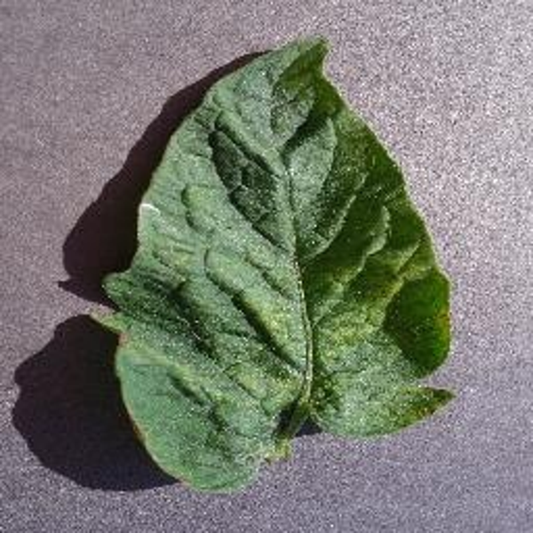
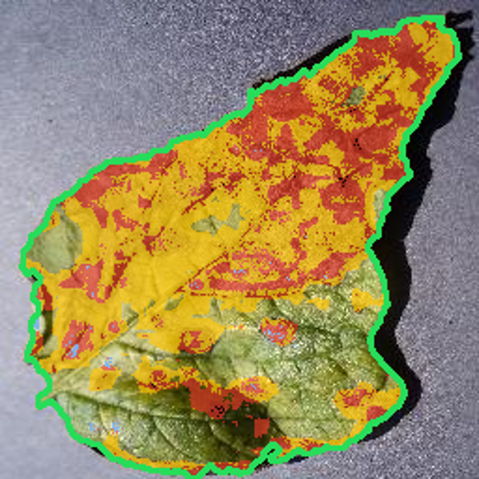
A verdict is useless without a magnitude
07 · PEST DETECTION & SEVERITY
// PEST DETECTION TRACE
// CROP HEALTH SCORE
// WORKED EXAMPLE
DETECTED
Spider Mite Damage
76% confidence · Pest
90–100
HEALTHY
Potato – Early Blight
100% confidence
70–89
MILD
40–69
MODERATE
RECOMMENDATION
0–39
SEVERE
16 / 100
Inspect the undersides of leaves
Remove heavily infested portions
Spray plants with a strong jet of water to dislodge mites
score = 100 × (1 − damaged area)^1.6
A confirmed disease never scores “Healthy”
Late blight and viruses are at least “Moderate”
Citrus greening is always “Severe”
Damaged tissue
69%
Status
SEVERE
Future: an object detector (YOLO) to locate individual insects.
Urgency
Act today
PRESENTED BY HIMANSHU KASHYAP
Notes:
A diagnosis alone is not enough - the farmer needs to know how bad it is.
Left: pest detection. This leaf has spider-mite damage; the model labels it as a pest with 76% confidence and gives pest advice such as inspecting the undersides of leaves.
Middle: the health score. We measure the damaged share of the leaf and convert it with this formula, so the first spots cost few points and heavy damage costs many. Four bands, as planned in the mid-sem. Two safety rules: a confirmed disease is never called healthy, and fast-spreading diseases are at least Moderate.
Right: a real example. This potato leaf has 69% damaged tissue, so its score is 16 - Severe - and the system says "Act today".

Slide 9
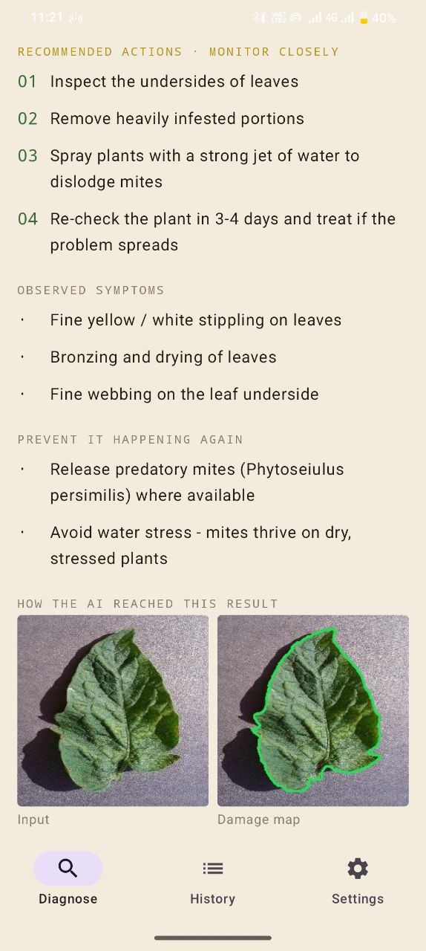
One label is not a recommendation
08 · RECOMMENDATION ENGINE
// RESOLUTION CHAIN
SAME DISEASE, TWO FARMS — REAL ENGINE OUTPUT
AI diagnosis
FARM A
FARM B
Tomato early blight · Mild
no extra details
+ 27 °C · 85% humidity
+ fruiting · seen 2 weeks ago
Disease / pest / nutrient
Remove affected leaves
Avoid long leaf wetness
Improve spacing & airflow
Monitor nearby plants
Re-check in 3–4 days
Remove affected leaves
Avoid long leaf wetness
Improve spacing & airflow
Monitor nearby plants
+ Apply approved fungicide now
+ Weather favours spread — act sooner
+ Check pre-harvest interval (fruiting)
+ Recurring outbreak → consult expert
+ Contact KVK / Kisan Call Centre
Knowledge base · 39 entries
+ crop · severity · growth stage
+ weather · soil · region · history
Recommendation
The model gives a label; the engine turns it into an instruction for this farm, this crop and this week.
Actions in the app
PRESENTED BY AKSHATA BAKRE
Notes:
The AI only gives a label, like "Tomato Early Blight". A label is not advice. Our recommendation engine turns it into instructions.
The chain on the left: diagnosis, then the category, then our knowledge base - a notebook with one entry for each of the 39 classes: cause, symptoms, actions, treatment, prevention and the weather the disease likes. Then the engine adjusts the advice using the farm's context.
The two cards are real outputs of our engine for the same disease. Farm A gave no extra details, so it gets basic actions and "re-check in 3 to 4 days". Farm B is warm and humid, the crop is fruiting, and the field had the same disease two weeks ago. Now the engine adds a fungicide because the weather favours spread, warns about the pre-harvest interval, flags a recurring outbreak, and suggests the Krishi Vigyan Kendra.
Same label - different, farm-specific advice.

Slide 10
Prototype architecture
09 · ARCHITECTURE & STACK
Web app · Streamlit
Android app · Kotlin
TECHNOLOGY STACK — PLANNED AT MID-SEM vs BUILT
LAYER | PLANNED | BUILT
Frontend | React / Streamlit | Streamlit web app + native Android app
Backend | Python + FastAPI | FastAPI REST API ✓
Vision | OpenCV · PIL · NumPy | OpenCV · Pillow · NumPy ✓
ML | PyTorch · EfficientNet / MobileNet · YOLO | PyTorch + MobileNetV3 ✓ (YOLO: future)
Database | PostgreSQL / MongoDB | SQLite (as planned for v1) ✓
Deploy | Docker · cloud | Laptop server + phone hotspot
REST API · FastAPI /analyze /history /report
Vision · OpenCV
validate · segment · damage map
AI · PyTorch
MobileNetV3 classifier
Decision · abstain · route · severity · nutrients
Recommendation engine + knowledge base
Crop health report · screen + PDF
History · SQLite
MID-SEM “RECOMMENDED FIRST VERSION” → BUILT
Python + Streamlit + OpenCV + PyTorch + SQLite — plus an Android app on top.
PRESENTED BY AKSHATA BAKRE
Notes:
This is the architecture we built, layer by layer - like a restaurant.
Customers are the web app and the Android app. The waiter is the REST API built with FastAPI: it receives the photo and returns the answer. The kitchen is OpenCV for image processing and PyTorch for the AI model. Then the decision layer, then the recommendation engine with its knowledge base - the recipe book. Finally the report, and a SQLite database that keeps the history.
Because everything goes through one API, the website and the phone app share the same brain.
The table compares what we planned at mid-sem with what we built. We built exactly the recommended first version - Python, Streamlit, OpenCV, PyTorch and SQLite - and added a native Android app. YOLO for pests and cloud deployment are future work.

Slide 11
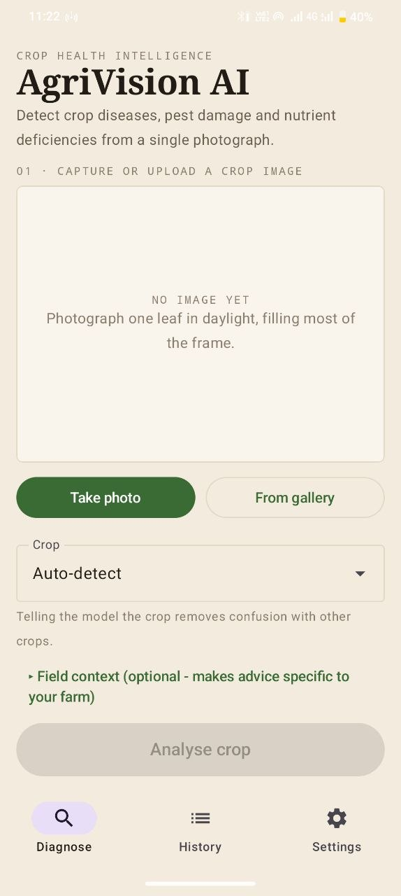
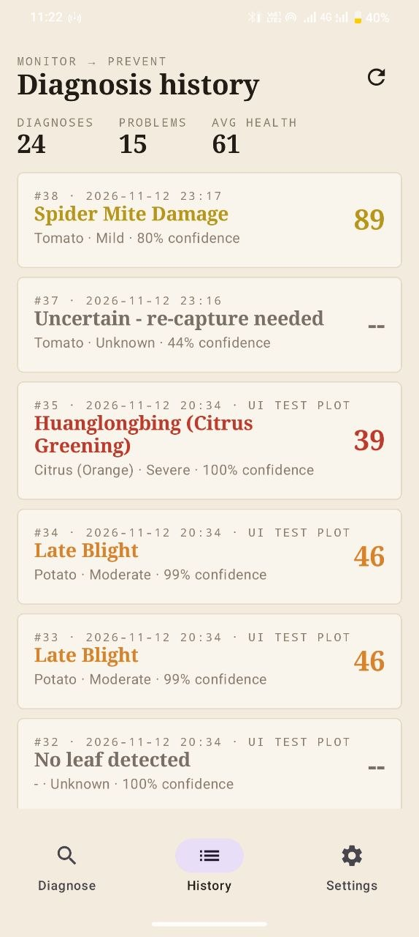
Two buttons is the whole interface
10 · PROTOTYPE UI
DESIGN PRINCIPLES → HOW WE BUILT THEM
One screen, one decision
1
Photo → Analyse crop → read → report. Optional field details stay folded away.
Confidence is always visible
2
Green ≥ 85%, amber, red. Below 60% (76% for field photos) the app asks for a re-capture.
Severity before advice
3
Health score and risk appear first, so mild cases don’t trigger heavy spraying.
Same brain, any screen
4
Web app and Android app call one API — the model never changes.
1 · Diagnose
2 · Result
3 · History
PRESENTED BY AKSHATA BAKRE
Notes:
Our mid-sem said "two buttons is the whole interface", and that is what we built.
Four design principles. One: one screen, one decision - pick a photo, tap Analyse, read the result, tap Report; extra details like weather are hidden unless you need them. Two: confidence is always visible and colour-coded; if the AI is not sure enough, the app asks for a new photo instead of recommending a treatment. Three: severity comes before advice, so a mild case does not cause panic spraying. Four: the website and the Android app use the same API, so the model is the same everywhere.
On the right are screenshots of our Android app: the Diagnose screen, the Result screen and the History screen.

Slide 12
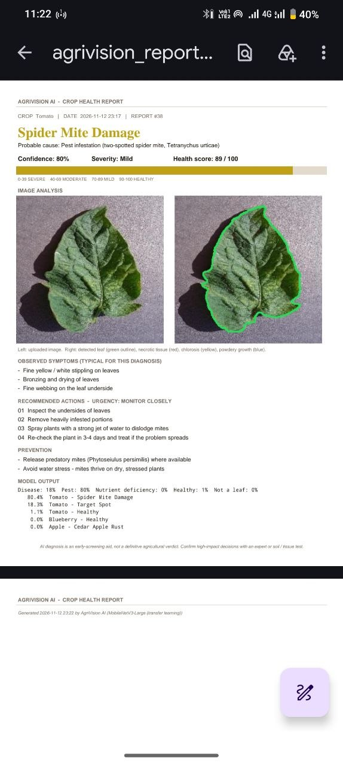
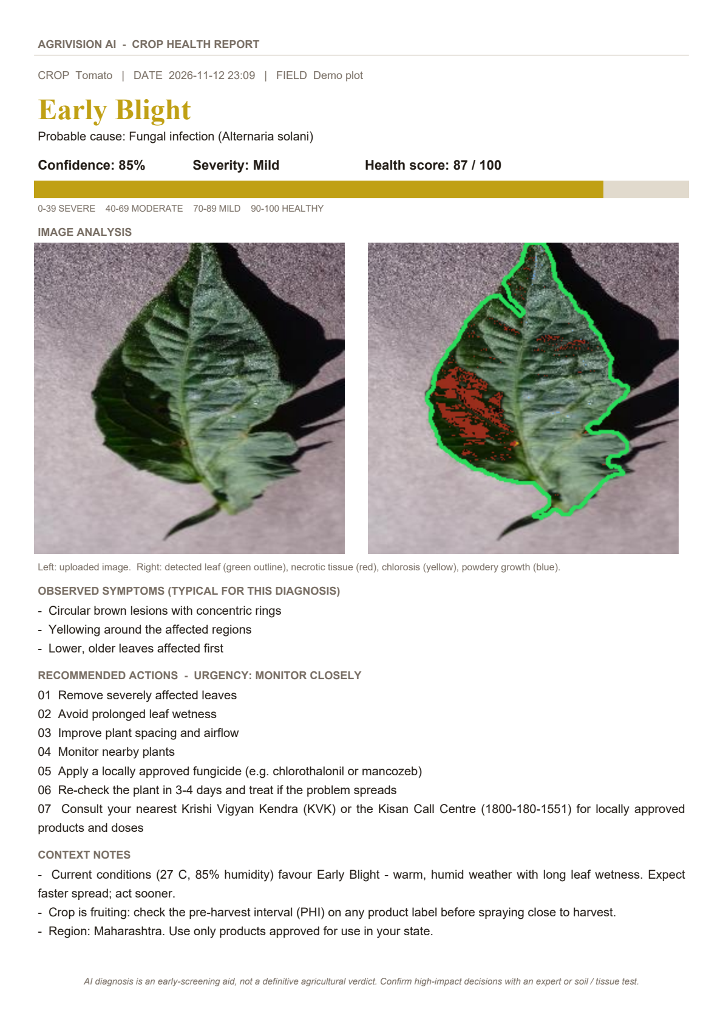
Crop health report
11 · SAMPLE AI REPORT
WHAT EVERY REPORT CONTAINS
Diagnosis
condition and probable cause
Confidence
how sure the model is
Severity
band plus health-score bar (0–100 scale)
Images
leaf photo next to its damage map
Symptoms
what this condition typically looks like
Actions
numbered, with an urgency level
Context notes
weather risk, growth stage, recurrence
Prevention
how to avoid it next season
Disclaimer
screening aid, not a final verdict
Downloadable from the web app, and opened or shared (e.g. on WhatsApp) from the Android app.
Report on the phone
PRESENTED BY AKSHATA BAKRE
Notes:
Every diagnosis can become a crop health report - this is a real PDF generated by our system, on the left.
It contains everything from our mid-sem report design: the diagnosis and probable cause, confidence, severity with a health-score bar, the leaf photo next to its damage map, symptoms, numbered actions with an urgency level, context notes like weather risk, prevention tips, and a disclaimer that this is a screening aid.
The report can be downloaded from the website, or opened and shared from the phone app - for example sent on WhatsApp to an expert. The phone screenshot on the right shows it in the app.

Slide 13
Lab images are not field images
12 · DATASET & EVALUATION
TRAINING DATA
PlantVillage
97.9%
57.2%
41,141 lab photos · plain background · 39 classes
lab accuracy
field accuracy
PlantDoc
6,170 unseen lab photos
236 unseen field photos
2,578 field photos · real backgrounds · 28 classes
99.4%
79.2%
// DATASET PIPELINE
Raw images → cleaning → label mapping
→ split 70 / 15 / 15 → training
→ evaluation on unseen photos
right category
field top-3
disease / pest / healthy (lab)
correct answer in top 3
PlantDoc’s own test set (236 photos) is kept aside to measure real-world performance.
Abstention cuts lab misdiagnoses from 2.1% to 1.3%.
PRESENTED BY HIMANSHU KASHYAP
Notes:
How well does it work? We trained on two datasets: PlantVillage, 41 thousand clean lab photos, and PlantDoc, 2,578 real field photos with messy backgrounds. Every result here is measured on photos the model never saw during training.
On lab photos the model is 97.9% accurate, and it gets the problem category right 99.4% of the time. On real field photos it is 57.2% accurate, and the right answer is in its top three 79.2% of the time.
The chart is our most important finding - the mid-sem title "lab images are not field images". A model trained only on lab photos got just 19.9% on field photos. Adding field photos raised it to 53.8%, and 2.7 times more training data to 57.2%.
Because field photos are hard, the system abstains when unsure; on lab photos this cuts misdiagnoses to 1.3%.

Slide 14
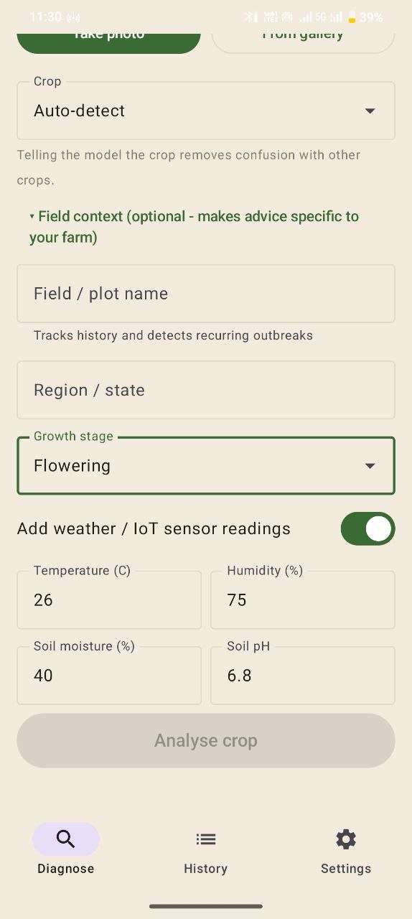
Vision plus context
13 · IOT INTEGRATION & ROADMAP
SCALABILITY ROADMAP
// SENSOR INPUTS — BUILT INTO THE APP
Temperature & humidity
PHASE 1 · PROTOTYPE
DONE
warns when weather favours the disease
Upload · classification · disease detection · advice · report
Soil moisture
flags water stress behind mite attacks
PHASE 2 · INTELLIGENT DIAGNOSIS
DONE
Pest · nutrients · severity · 14 crops · history · Android app
Soil pH
points to iron vs magnesium deficiency
PHASE 3 · IoT
PARTIAL
Growth stage
seedling, flowering and harvest precautions
Sensor inputs ready · live sensors and alerts next
Entered in the app today — an IoT sensor can fill the same fields automatically.
PHASE 4 · LARGE-SCALE PLATFORM
FUTURE
Disease maps · yield prediction · voice · drones
Field context in app
PRESENTED BY HIMANSHU KASHYAP
Notes:
Vision plus context. A photo alone cannot tell everything, so the app also accepts sensor-style inputs: temperature, humidity, soil moisture, soil pH and growth stage. Today the farmer types them in; an IoT sensor can fill the very same fields later. They change the advice - for example, warm humid weather triggers a "disease will spread faster" warning.
The roadmap from our mid-sem: Phase 1, the prototype, is done. Phase 2, intelligent diagnosis - pests, nutrients, severity, history and the Android app - is done. Phase 3, IoT, is partial: the inputs are ready, live sensors are next. Phase 4 is the future platform.
The screenshot shows the field-context screen of our app.

Slide 15
Who benefits — and what it can’t do
14 · IMPACT & LIMITATIONS
IMPACT
CURRENT LIMITATIONS
// BUSINESS MODEL
Freemium + B2B
Field photos: 57% accuracy — the app abstains when unsure
Only one pest class (spider mites) in public data
Nutrient results need soil-test confirmation
Dark lesions at the leaf edge can be undercounted
One leaf per photo; the phone needs the laptop server
For farmers
A diagnosis in seconds, before the damage spreads
FREE
Limited photo diagnoses
For agricultural experts
PREMIUM
Faster triage and a digital history of every field
Unlimited · history · PDF reports
ENTERPRISE
For organisations
IoT · farm analytics · dashboards
POSITIONING
Decision support and early screening — with an expert or soil test for every high-impact decision.
Aggregated diagnoses for regional disease surveillance
Free diagnoses drive adoption; institutions pay for analytics.
PRESENTED BY HIMANSHU KASHYAP
Notes:
Who benefits? Farmers get a diagnosis in seconds, before damage spreads. Experts get faster triage and a digital history of each field. Organisations could combine many diagnoses to watch disease spread across a region.
The business model stays as planned: free basic diagnoses to drive adoption, premium for history and reports, and enterprise for IoT and analytics.
We are also honest about limitations. On real field photos accuracy is 57%, so the app refuses to answer when unsure. Only spider mites are covered as a pest. Nutrient results need a soil test. Dark lesions at the leaf edge can be under-counted. And today the phone needs the laptop server nearby.
So we position AgriVision as decision support and early screening, not a replacement for an expert.

Slide 16
FROM DETECTION TO PREVENTION
“What is happening, why, how severe is it, what should I do — and how do I prevent it happening again?”
// FUTURE SCOPE
DATA
More field photos from local farms
AI
Fine-tune the full model on a GPU
PESTS
AgriVision AI
YOLO to locate individual insects
OFFLINE
SEE → DIAGNOSE → RECOMMEND → MONITOR → PREVENT
Run the model on the phone itself
IoT
39
97.9%
57.2%
< 2 s
Live sensors and automatic alerts
classes · 14 crops
lab accuracy
field accuracy
per diagnosis
SCALE
Regional disease maps and forecasting
Thank you — questions?
VOICE
Multilingual voice for farmers
AKSHATA BAKRE · HIMANSHU KASHYAP — GUIDED BY DR. SANJAY KUMAR
Notes:
To conclude: our goal was never just "what is wrong with my crop", but what is happening, why, how severe, what to do, and how to prevent it.
What we delivered: a working system covering 39 classes across 14 crops, 97.9% accurate on lab photos, 57.2% on real field photos - nearly three times better than a lab-only model - with a full diagnosis in under two seconds, available on the web, through an API, and on an Android phone.
Future scope on the right: more local field photos, fine-tuning on a GPU, YOLO for pests, running the model offline on the phone, live IoT sensors, regional disease maps, and a multilingual voice interface.
Thank you. We are happy to take questions, and we can show a live demo on the phone.

