Slide 1


Vijayanagar Educational Trust
EAST WEST COLLEGE OF ENGINEERING
Affiliated to VTU Belagavi,Approved by AICTE,New Delhi, Recognized by Govt of Karnataka
(CA Site, 13, Sector A, Yelahanka New Town, Bengaluru, Karnataka 560064)
Department of Computer Science and Engineering
PROJECT PHASE-2
REVIEW-2
Presentation on
“RANSOMWARE DETECTION USING MACHINE LEARNING TECHNIQUES”
Presented by:
AKSHATA G B
ANANYA K
ANJU K
ANUSHA
Under the guidance of
GNANAMANI H
Assistant Professor
Dept Of CSE,EWCE 1
DEPT
1

Slide 2
contents
Abstract
Introduction
Literature survey
Problem statement
Objective & scope
Requirements
Methodology
References

Slide 3
ABSTRACT
Ransomware is a type of malicious software that encrypts user data and demands ransom for recovery, creating serious security problems. Traditional antivirus systems use signature-based detection, which cannot detect new ransomware variants. This project proposes a machine learning-based ransomware detection system. The system analyzes system behavior such as file activity, CPU usage, memory usage, and network activity to detect ransomware. Machine learning algorithms are used to classify programs as ransomware or normal software. This approach helps in early detection and prevents data loss and financial damage.

Slide 4
INTRODUCTION
Ransomware attacks are increasing rapidly across the world.
Ransomware encrypts files and asks for ransom money to decrypt them.
Many individuals, companies, and organizations are affected by ransomware attacks.
Traditional detection methods fail to detect new ransomware variants.
Machine Learning helps in detecting unknown ransomware using behavior analysis.
ML models learn patterns from previous ransomware attacks.
The system monitors system activities like file access, registry changes, and network behavior.

Slide 5
LITRATURE SURVEY
SL.NO | YEAR | AUTHOR NAME | TITLE | SUMMARY | DRAWBACK
1 | 2024 (Mar) | Jonathan Zapata et al | Ransomware Detection with Machine Learning: Techniques, Challenges and Future Directions | The paper reviews ML techniques using Random forest, SVM, and Neural Networks. | It lacks real time implementation
2 | 2024 (Jul) | Shayma jawed et al. | Machine learning approaches to ransomware detection | This paper performs a comparative analysis of ML alg like Decision tree, Random Forest and SVM. | Lacks real-world deployment and faces challenges
3 | 2024 (oct) | T.M.H.Mohamed et al | Ransomware Early Detection Model Based on Enhanced Machine Intelligence. | This paper presents an early detection model that analyzes system behavior before file encryption occurs. | Performance depends on training data and risk of overfitting and poor generalization

Slide 6
Slno | Year | Author Name | Title | Summary | Drawback
4 | 2025 (Jan) | M.T.R. Rafi et al. | Enhancing Cybersecurity: Comparative Insights in Machine Learning for Ransomware Detection | The study shows ML methods outperform traditional approaches | Requires high computational resources and large datasets
5 | 2025 (Feb) | J. Lee et al. | Machine Learning-Based Ransomware Detection Using File Entropy Analysis | The paper proposes an entropy-based ransomware detection approach. | Advanced attackers can evade entropy-based detection

Slide 7
PROBLEM STATEMENT
Signature-based antivirus systems may fail to detect new or unknown ransomware variants.
This project uses machine learning to analyse Windows executable PE-header features.
The system classifies files as “Ransomware” or “Benign” and provides immediate alerts and detection history.

Slide 8
OBJECTIVES AND SCOPE
OBJECTIVE:
The project detects ransomware in Windows executable files.
It analyses PE-header features using machine learning.
It classifies files as Ransomware or Benign.
It provides instant threat alerts to users.
SCOPE:
The project includes a React-based web dashboard.
It uses Node.js and Python for backend processing.
It uses a Random Forest model for classification.
It stores scan history and displays statistics.

Slide 9
REQUIREMENTS
Hardware Requirements:
System Type :64-bit Computer
Hard Disk :Minimum 500GB
RAM :Minimum 4 GB
Intel i3 Processor,4GB RAM,500GB
Scikit-learn,Numpy,Pandas,ML Alg.
Software Requirements:
Operating system :Windows 10/Linux
Coding Language :Python
Tools :VS Code ,PyCharm

Slide 10
METHODOLOGY
Data Collection: Collect system data for both normal and ransomware activities.
Data Preprocessing: Clean and prepare the data by removing errors and normalizing values.
Feature Extraction: Select important features like file activity, CPU usage, and network behavior.
Model Selection: Choose machine learning algorithms such as Decision Tree, Random Forest, and SVM.
Model Training: Train the selected algorithms using the dataset to learn patterns.
Model Testing: Test the trained models using new data to check their performance.
Model Evaluation: Compare models using accuracy, precision, and recall to find the best one.
Deployment: Use the best model to detect ransomware in real-time systems.

Slide 11
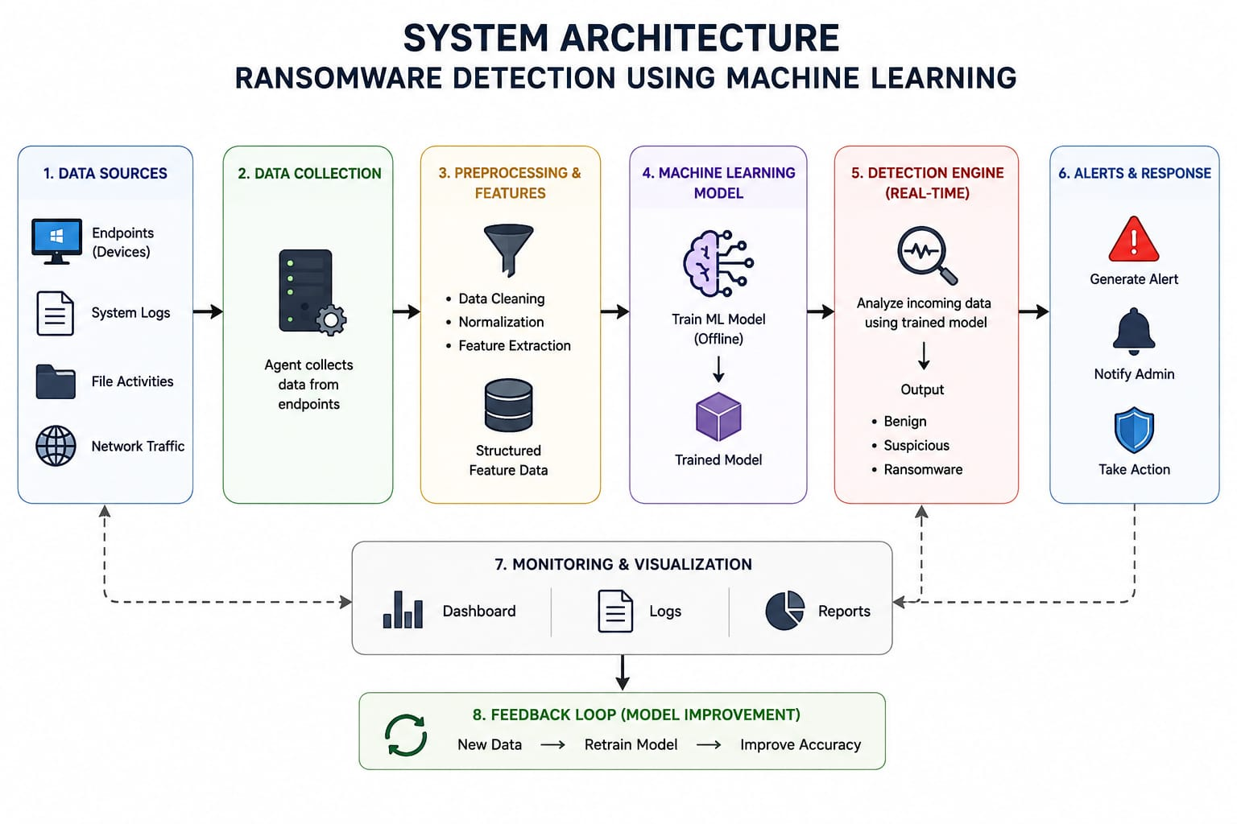

Slide 12
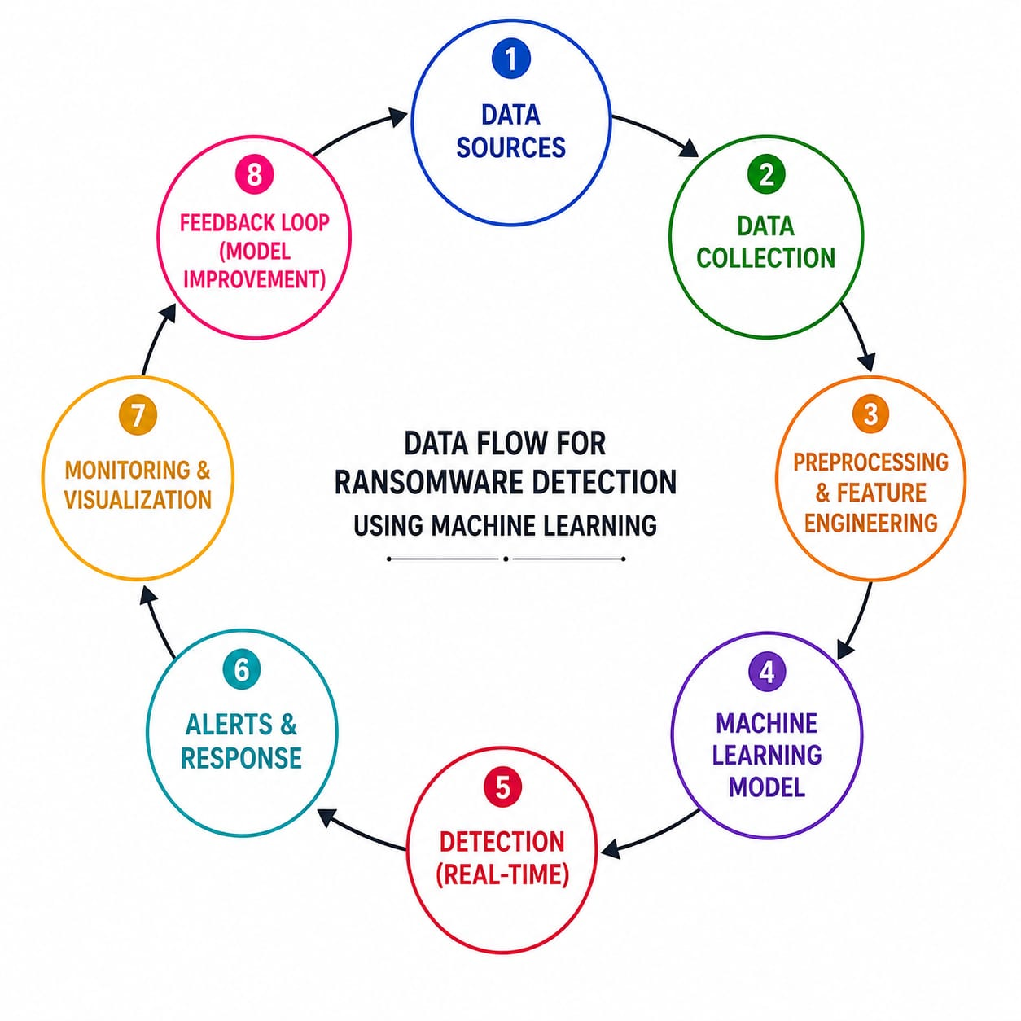

Slide 13
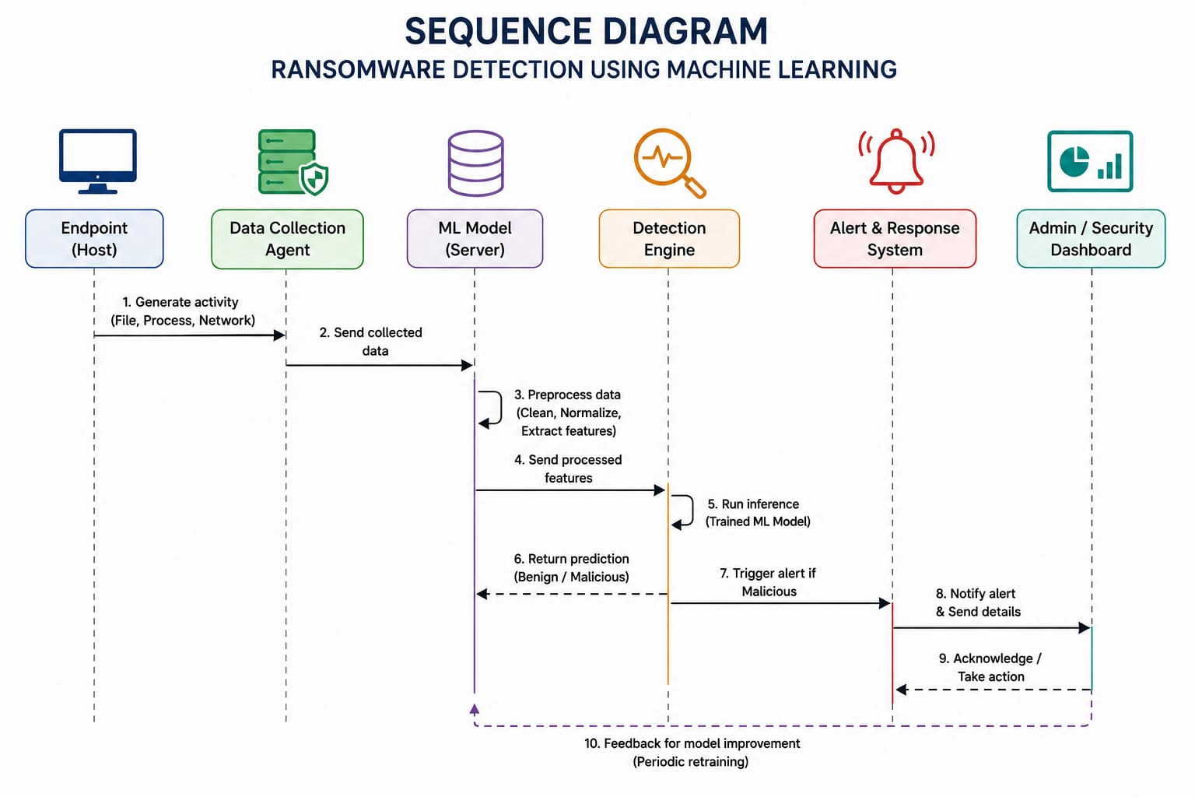

Slide 14
REFERENCES
T. Meurs, E. Cartwright, A. Cartwright, M. Junger, and A. Abhishta, “Deception in double extortion ransomware attacks: An analysis of profitability and credibility,” Computers & Security, vol. 138, p. 103670, 2024.
J. Lee, J. Yun, and K. Lee, “A study on countermeasures against neu realizing technology: Encoding algorithm-based ransomware detection methods using machine learning,” Electronics, vol. 13, no. 6, p. 1030, 2024.
A. Mehrban and S. K. Geransayeh, “Ransomware threat mitigation through network traffic analysis and machine learning techniques,” arrive preprint arXiv:2401.15285, 2024.
O. Dib, Z. Nan, and J. Liu, “Machine learning-based ransomware classification of bitcoin transactions,” Journal of King Saud University Computer and Information Sciences, vol. 36, no. 1, p. 101925, 2024

Slide 15


