Slide 1
AiD-LExys
AN ANDROID APP TO AID DYSLEXIC KIDS

Slide 2
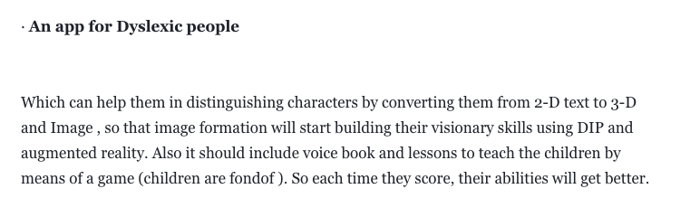
PROBLEM STATEMENT

Slide 3
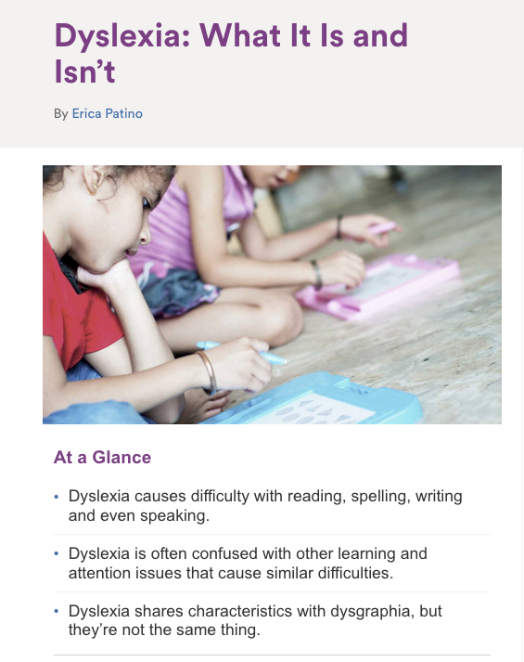

Slide 4
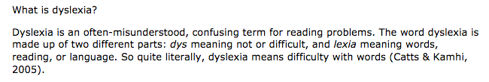

Slide 5
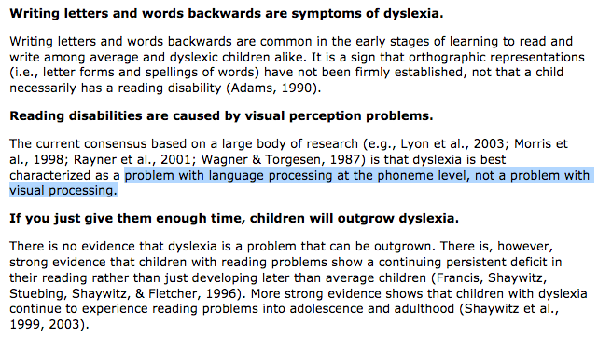

Slide 6
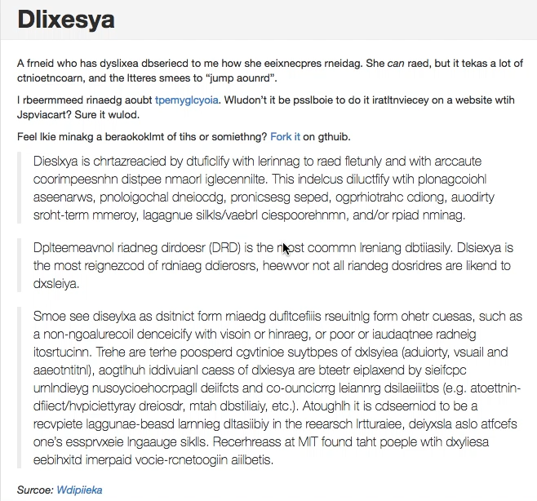

Slide 7
Features
Character Visualization as a LEARNING TOOL (using AR)
Help the child learn using augmented 3D models. They can better understand the intricacies of whatever

Slide 8
Features
Visualizing words in a context.
Children might not relate to the words they read. This aspect has been tackled by allowing the child to see images of the nouns that he reads. We used OCR to detect words in the image and then display the image of the same.

Slide 9
Features
Toolbox for aiding them in day-to-day life.
We have also provided them with the frequently used tools for them in one place.
We implemented T2S, S2T, OCR, in one place. This is hopefully going to help them in their day to day activities.

Slide 10
Thank You !

