Slide 1

DAYANANDA SAGAR UNIVERSITY
SCHOOL OF ENGINEERING
Department of Computer Science and Engineering
2026-2027
Major Project Phase-I
Review 0
PORTFOLIO DRAWDOWN RISK LABELING OF NIFTY 50 SECTOR PORTFOLIOS DURING MACRO STRESS EVENTS
Under the Supervision
Yashpal Gupta S
1
Presented By:
AKSHATA I KALLIMATH ENG23CS0016
BASANAGOUDA ENG23CS0028
GURU KUMAR ENG23CS0070
INDUSHREE D N ENG23CS0080
Notes:
Title of the project
CSE Dept., SET-Jain University
1

Slide 2
Outline
Problem Definition and Project Relevance
Literature Review and Research Gap
Proposed Methodology
Innovations and Objectives and expected Outcomes
Feasibility evaluation and Project Planning
References
*
Dept of CSE., SOE-Dayananda Sagar University
2 of 12

Slide 3
Problem Definition and Project Relevance
Problem
Existing Indian stock-market datasets mainly focus on normal trading periods and do not specifically capture portfolio behaviour during major macroeconomic stress events.
There is no standardized dataset that provides sector-wise risk labels for different crisis periods in the Indian market.
Portfolio risk measures such as Maximum Drawdown (MDD), Value at Risk (VaR), Sharpe ratio decline, and recovery time are rarely combined into a single labeled dataset.
As a result, researchers lack a reliable benchmark for training and evaluating machine-learning models for crisis-period portfolio risk classification.
Need
A dedicated dataset is needed to analyze how different NSE sectors respond to major macroeconomic stress events.
The dataset should cover multiple crisis windows such as COVID-19, Russia-Ukraine conflict, RBI rate hikes, and US Fed tightening.
It should combine key portfolio risk metrics—MDD, VaR (95%), recovery days, and Sharpe ratio drop—into a structured dataset.
A High / Medium / Low risk classification can then provide standardized labels for comparing sector resilience and building future risk-prediction models.
*
Dept of CSE., SOE-Dayananda Sagar University
3 of 12

Slide 4
Relevance
The project provides a structured and reproducible benchmark for analysing sector-level portfolio risk during macroeconomic stress events, enabling meaningful comparison of sector resilience and supporting future machine-learning-based risk classification.

Slide 5
Literature Review
Study | Focus | Key Contribution | Limitation
Dynamic Market Risk and Portfolio Choice – Indian Stock Market (2023) | Sectoral market risk | Analysed 10 Indian sectoral indices under different volatility regimes and market-stress conditions. (Indian Institute of Management Bangalore) | Focuses on dynamic market risk and portfolio construction, not a crisis-specific labeled dataset.
Sector-Wise Portfolio Risk Assessment – NIFTY 50 Stocks (2025) | Sector-level portfolio risk | Evaluates sectors using VaR, CVaR and Maximum Drawdown, showing differences in risk across sectors. (ResearchGate) | Does not create a standardized sector × stress-event risk-label dataset.
Prediction-based Mean-VaR Portfolio Optimization (2023) | ML + portfolio risk | Combines ML models including Random Forest, XGBoost and AdaBoost with Mean-VaR portfolio optimization using international market data including India. (ScienceDirect) | Focuses on portfolio selection and return prediction rather than crisis-period risk labeling.
Financial Risk Identification using Random Forest (2025/26) | ML-based risk classification | Demonstrates Random Forest for low/medium/high financial-risk classification and highlights its ability to handle nonlinear financial data. (Springer) | Focuses on corporate financial risk rather than sector-level market drawdowns.
Guru & Das (2021) | COVID-19 & sectoral volatility | Studied volatility spillovers across 10 major BSE sector indices and found that COVID-19 significantly increased market volatility. | Focuses on volatility spillovers, not portfolio drawdown or risk labels.
*
Dept of CSE., SOE-Dayananda Sagar University
5 of 12

Slide 6
Research Gap
• Existing Indian market datasets (BSE/NSE OHLCV on Kaggle, Mendeley) cover normal trading — none isolate crisis windows.
• Portfolio risk models trained on normal-period data fail during stress events because crisis behaviour is structurally different.
• No dataset provides a sector x stress-event risk label matrix for NSE — forcing researchers to build it from scratch each time.
• MDD, VaR, and recovery time are rarely combined in a single labeled dataset for Indian emerging market sectors.

Slide 7
Proposed Methodology
1. Collect Market Data
Collect daily OHLCV data for 11 NSE sectors using yfinance.
Define the 4 major stress periods: COVID-19, Russia-Ukraine, RBI Rate Hikes, and US Fed Tightening.
2. Calculate Risk Metrics
Calculate Maximum Drawdown (MDD), VaR (95%), Recovery Days, and Sharpe Ratio Drop for each sector during each stress period.
3. Assign Risk Labels
Based mainly on MDD, classify each sector-event combination as:
  High Risk
  Medium Risk
  Low Risk
4. Build & Validate Dataset
Create the final 44-record dataset (11 sectors × 4 stress events).
Train a Random Forest classifier as a baseline and evaluate its performance.
*
Dept of CSE., SOE-Dayananda Sagar University
7 of 12

Slide 8
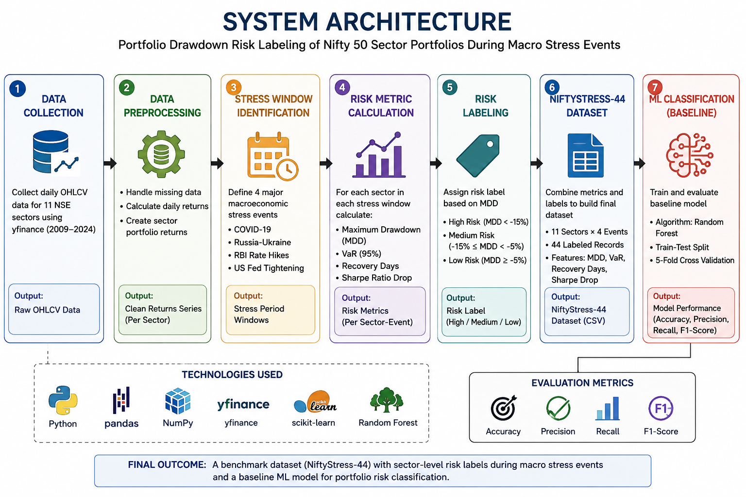
System Architecture

Slide 9
Methods
Data Collection & Preprocessing – Collect daily OHLCV data for 11 NSE sectors and calculate sector-level returns.
Stress-Period Analysis – Identify and validate 4 major macroeconomic stress windows.
Risk Metric Calculation – Calculate MDD, VaR (95%), Recovery Days, and Sharpe Ratio Drop for each sector-event combination.
Risk Classification – Assign High, Medium, or Low risk based on MDD thresholds.
ML Baseline – Use a Random Forest classifier to establish a baseline for risk prediction.

Slide 10
Technologies
Python – Main programming language
Pandas & NumPy – Data processing and numerical calculations
yfinance – Market OHLCV data collection
SciPy – Statistical calculations
Scikit-learn – Random Forest classification and evaluation
Excel / GitHub / Zenodo – Validation, code sharing and dataset release

Slide 11
Implementation Plan
Phase | Focus | Key Activities
Phase 1 | Data Collection | Define and validate the 4 macroeconomic stress windows. Collect daily OHLCV data for the 11 NSE sectors. Calculate sector-level portfolio returns.
Phase 2 | Risk Analysis | Calculate Maximum Drawdown (MDD). Calculate VaR (95%), Recovery Days, and Sharpe Ratio Drop. Validate the calculated metrics against available market data.
Phase 3 | Dataset & ML Model | Assign High / Medium / Low risk labels using MDD thresholds. Generate the NiftyStress-44 dataset with 44 sector-event records. Train and evaluate the Random Forest baseline classifier.
Phase 4 | Validation & Release | Perform domain validation and manual spot checks. Prepare the data dictionary and final dataset files. Document and publish the code and dataset for reproducibility.

Slide 12
Innovations and Objectives and expected Outcomes
Innovations/Novality
Crisis-focused dataset: Captures sector-level portfolio risk specifically during major macroeconomic stress events.
Combined risk analysis: Integrates MDD, VaR, Recovery Days, and Sharpe Ratio Drop in one dataset.
Standardized risk labels: Classifies sector-event combinations into High, Medium, and Low Risk.
ML-ready benchmark: Provides a structured dataset for training and benchmarking portfolio risk classifiers.
Objectives
Analyze the risk behaviour of 11 NSE sectors across 4 macro stress events.
Calculate MDD, VaR (95%), Recovery Days, and Sharpe Ratio Drop.
Generate the NiftyStress-44 labeled dataset containing 44 sector-event records.
Develop a Random Forest baseline classifier for risk classification.
*
Dept of CSE., SOE-Dayananda Sagar University
12 of 12

Slide 13
Expected Outcomes
A complete NiftyStress-44 dataset with sector-wise risk metrics and labels.
An 11 × 4 risk-label matrix for comparing sectors across stress events.
A validated baseline ML classification model with accuracy, precision and recall results.
Reproducible dataset, documentation and source code for future research.

Slide 14
Feasibility evaluation
Technical Feasibility: The project can be implemented using publicly available market data and standard Python libraries such as Pandas, NumPy, yfinance, SciPy, and Scikit-learn.
Data Feasibility: Daily OHLCV data can be collected for the required 11 NSE sectors for the 2019–2024 period.
Computational Feasibility: The proposed risk calculations and Random Forest model can be executed using conventional computing resources; no GPU is required.
Research Feasibility: The methodology uses reproducible calculations and publicly available data, making the dataset suitable for validation and future research.
*
Dept of CSE., SOE-Dayananda Sagar University
14 of 12

Slide 15
Project Planning
Phase | Major Activities | Timeline
Phase 1 | Stress-window definition & sector data collection | Week 1–2
Phase 2 | MDD, VaR, Sharpe Drop & Recovery Days calculation | Week 2–3
Phase 3 | Risk labeling, dataset creation & validation | Week 3
Phase 4 | Random Forest classifier & evaluation | Week 4
Phase 5 | Documentation, GitHub & dataset release | Week 5–6

Slide 16
Risk & Mitigation
Missing data → Handle limited missing values and flag incomplete windows.
Incorrect stress windows → Validate against Nifty 50 drawdowns.
Calculation errors → Cross-check selected results with public NSE data.
Model limitations → Use Random Forest as a baseline for future models.

Slide 17
References
Sharpe, W. F., “The Sharpe Ratio,” The Journal of Portfolio Management, Vol. 21, No. 1, pp. 49–58, 1994. — Supports the Sharpe-ratio component of your methodology.
Jorion, P., “Market Risk,” Encyclopedia of Quantitative Finance, 2010. — Useful reference for Value at Risk (VaR) and historical-simulation-based risk measurement.
Baptista, A. M. and Alexander, G. J., “Portfolio Selection with a Drawdown Constraint,” Journal of Banking & Finance, Vol. 30, No. 11, pp. 3171–3189, 2006. — Supports the use of maximum drawdown as a portfolio risk measure.
Goldberg, L. R. and Mahmoud, O., “Drawdown: From Practice to Theory and Back Again,” 2014. — Provides theoretical background on maximum drawdown and drawdown-based risk measurement.
NSE Indices, “NIFTY 50 Index – Index Methodology and Historical Data.” — Primary reference for Nifty 50/index information and Indian market data.
Reserve Bank of India, Annual Report 2022–23, “Chronology of Major Policy Announcements: April 2022 to March 2023.” — Supports the RBI Rate Hike stress event, including the increase from 4.0% to 6.5% between May 2022 and February 2023.
*
17 of 12
Dept of CSE., SOE-Dayananda Sagar University

