Slide 1
WELCOME
PRESENTED BY
1. Sharvari Suresh Hodage
2. Padmaja Sanjay Patil
3. Kanchan Mahadev Kokitkar
4. Varsha Punappa Mane

Slide 2
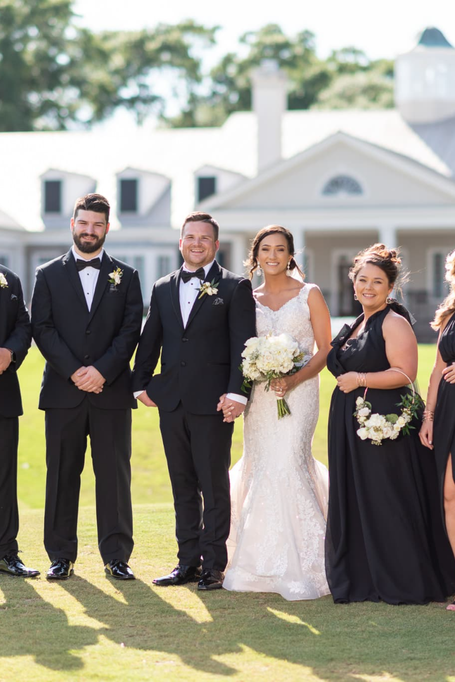
Web application for wedding Planners
Project title

Slide 3


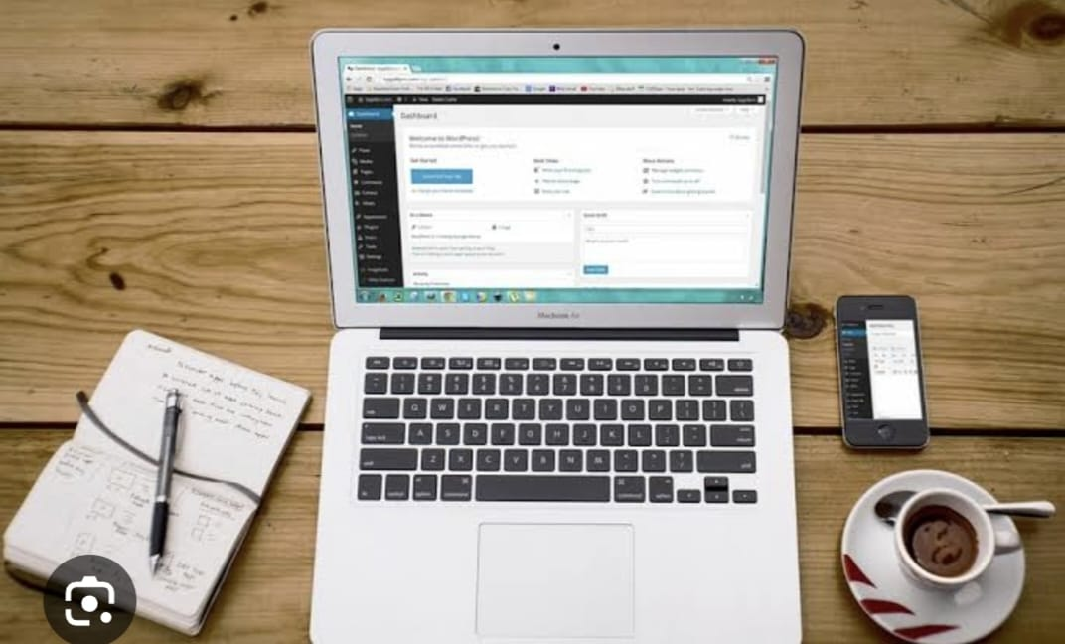
In there different types of organizers are listed
Customer can choose the organizer according her needs.

Slide 4
In The Brief
We give the two options for the users.
a. sign in as customer ( where customer has been normally login the platform).
b. sign in as organizer(where the organizer can create her portfolio and listed in the platform)
In there platform different organisers are listed with our work and its portfolio and its services.
Customer can choose the organizers according its need.
After that customer and organizer can directly contact to each other and done her deal with it.

Slide 5
Customer can choose the organizer according her budget we provide the basic methods that are..
Basic | Standard | Premium
The basic it rangers form the minimal budget form 40,000 to 100000 | The standard it rangers form the minimal budget form 100000 to 500000 | The Premium it rangers form the minimal budget form 500000 to 700000

Slide 6
Objectives for developing this project.
All the needs are cover in only one platform of the customers.
Organisers get her work through the multiple clients.
Easy to mange the every event(function).
selecting or booking the menus are more comfort than offline meetings.
customer can choose the organization team according her budget.

Slide 7
Block Diagram
User
Became customer
Became Organizer
Successfully login
Successfully Register
Forgot pass/sign up phone number
Forgot pass/sign up phone number
Main Interface Visible
Create portfolio
Verification/
Active status in main interface
User can chose the Organizer according its needs
Multiple Organizer can listed below
It will redirect particular organizer portfolio
If user can chose any organizer
They contact it/
Fix her dial

Slide 8
Technology stack of web development
1
Front End
(CSS, html, bootstrap, JavaScript )
Back End
(python, Django)
2
3
Database
(MySQL)

Slide 9
Thank you

