Slide 1
TOP 200 COMMON PASSWORDS BY DIFFERENT COUNTRY 2022....
By
AKSHATA SHIRWALE
&
PAURAVI KHATPE
UNDER THE GUIDEENCE OF :-
PROF . SUSHMITA BHAMBHURE

Slide 2
Data Visualization
Data visualization is the secret art of turning data into visual graphics that people can understand (graphs, charts, info graphics, etc.).
Here are a few additional statistics highlighting the importance of data visualization over text when presenting information:
90% of the information transmitted to the brain is visual
Humans process images 60,000 times faster than text
70% of our sensory receptors are in our eyes
65% of people are visual learners
By using visual elements like charts, graphs, and maps, data visualization techniques provide an accessible way to see and understand trends, outliers, and patterns in data.

Slide 3
Benefits of Good Data Visualization
Whenever we visualize a chart, we quickly identify the trends and outliers present in the dataset.
The basic uses of the Data Visualization technique are as follows :-
It is a powerful technique to explore the data with presentable and interpretable results.
In the data mining process, it acts as a primary step in the pre-
processing portion.
It supports the data cleaning process by finding incorrect data and corrupted or missing values.
It also helps to construct and select variables, which means we have to determine which variable to include and discard in the analysis.
In the process of Data Reduction, it also plays a crucial role while combining the categories.
.

Slide 4
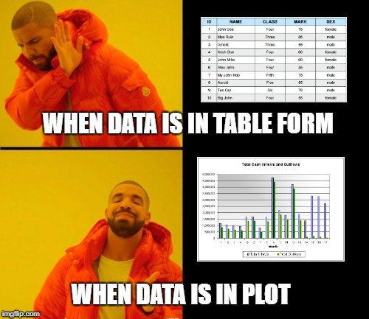

Slide 5
DATA VISUALIZATION TECHNIQUES
Bar Chart
Histogram
Heat Map
Box and Whisker Plot
Waterfall Chart
Area Chart
Scatter Plot
Pictogram Chart
Timeline
Highlight Table
Bullet Graph
Choropleth Map
Word Cloud
Network Diagram
Correlation Matrices

Slide 6
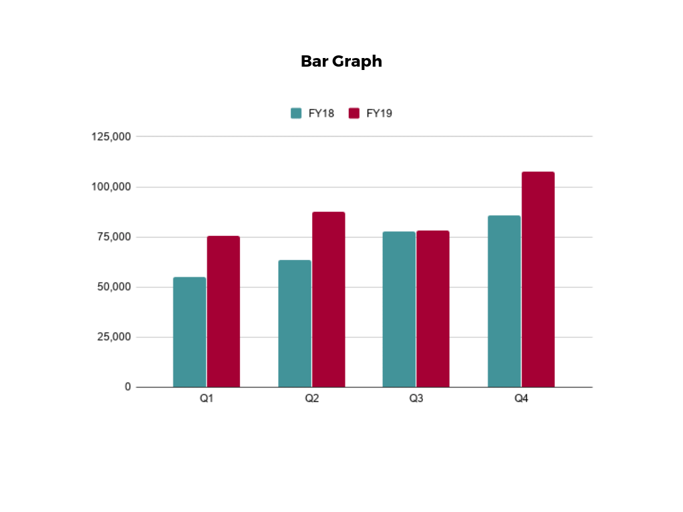
1. Bar Chart
In this type of visualization, one axis of the chart shows the categories being compared, and the other, a measured value. The length of the bar indicates how each group measures according to the value.

Slide 7
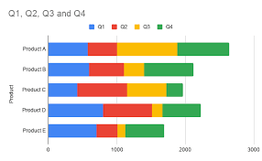
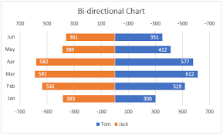
2. Horizontal and Bi-directional

Slide 8
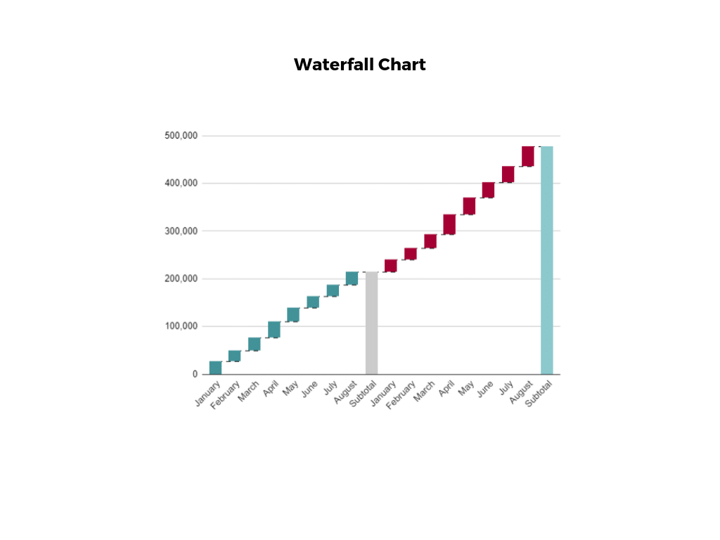
3. Waterfall Chart
The main goal of this chart is to show the viewer how a value has grown or declined over a defined period. For example, waterfall charts are popular for showing spending or earnings over time.

Slide 9
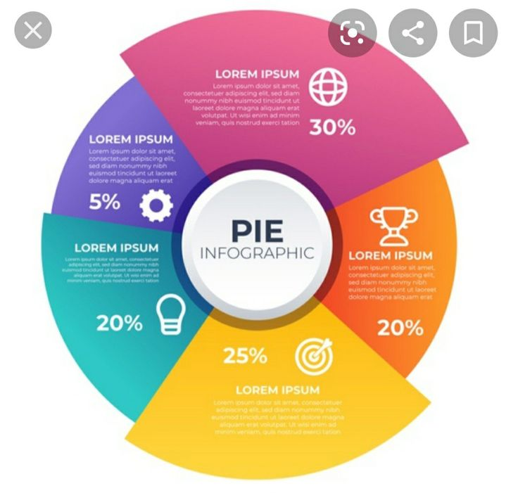
4.Infographic Example
An infographic is a collection of imagery, data visualizations like pie charts and bar graphs, and minimal text that gives an easy-to-understand overview of a topic.

Slide 10
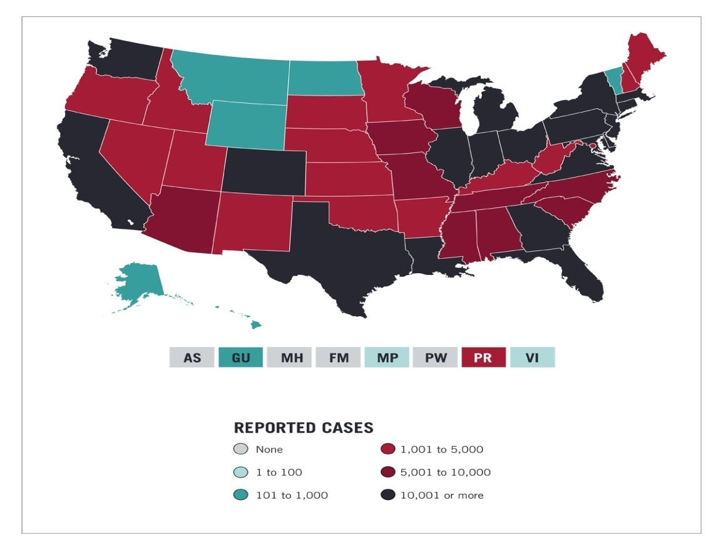
5.Choro pleth Maps
A choropleth map uses color, shading, and other patterns to visualize numerical values across geographic regions. These visualizations use a progression of color (or shading) on a spectrum to distinguish high values from low.

Slide 11
Top 200 Common Passwords By Different Country 2022
We take data from kagal.com website (Top 200 common passwords by country 2022)
We have all country data from A-Z
In data we have column name such as-
country_code, country/territory name, rank, password, user count, time to crack password, global rank, time to crack password (in seconds)

Slide 12
We have used data processing techniques on the data
There are techniques we can use for data processing.
The one we used for our data is data cleaning.
To begin with, check the null values in the data, isnull() is used to check null values.
If there are any null values replace it with mean or median values , or remove null values, or use forward or backword fill.
We replaced it with mean values in place of null values

Slide 13
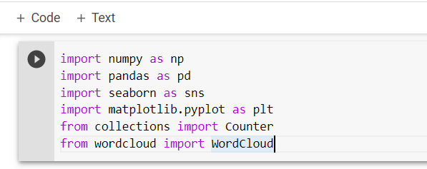
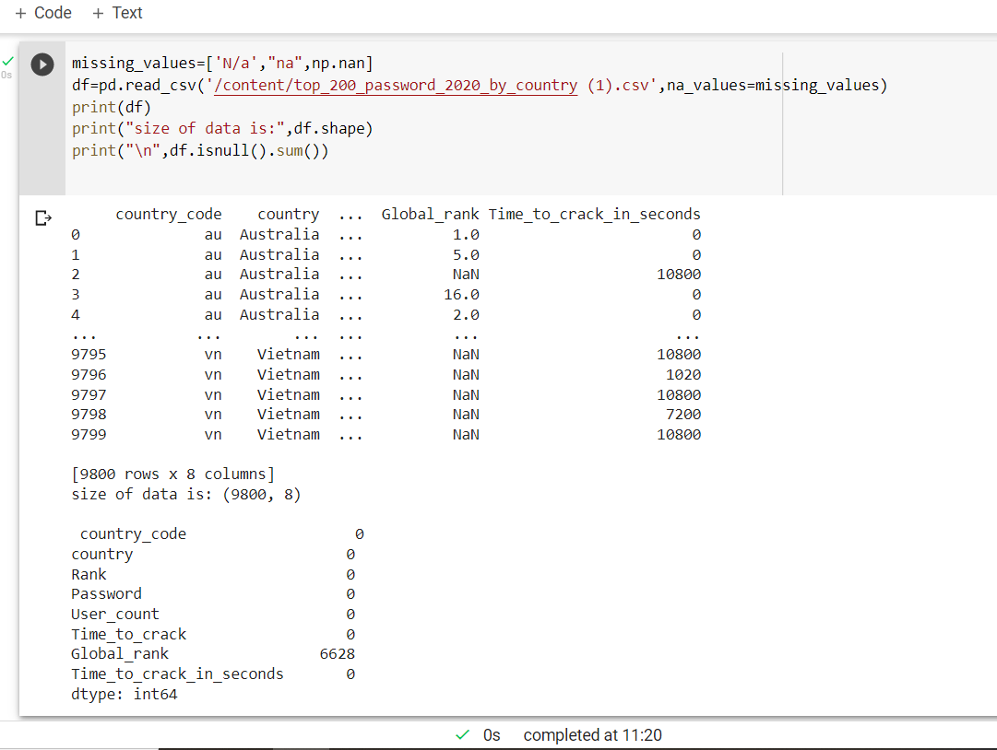
First we have imported the libraries and then displayed the data
Libraries like seaborn and matplotlib, wordcloud are used for data visualization.
For displaying data we use pd.read_csv.
df.shape displays the size of the data.
is.null().sum() checks the null values in data and sum gives the total of null values in each column.

Slide 14
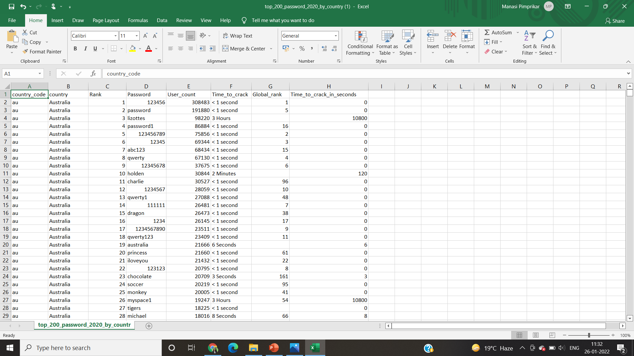
This is our data
This is the link of data from kaggle
kaggle datasets download -d prasertk/top-200-passwords-by-country-2022

Slide 15
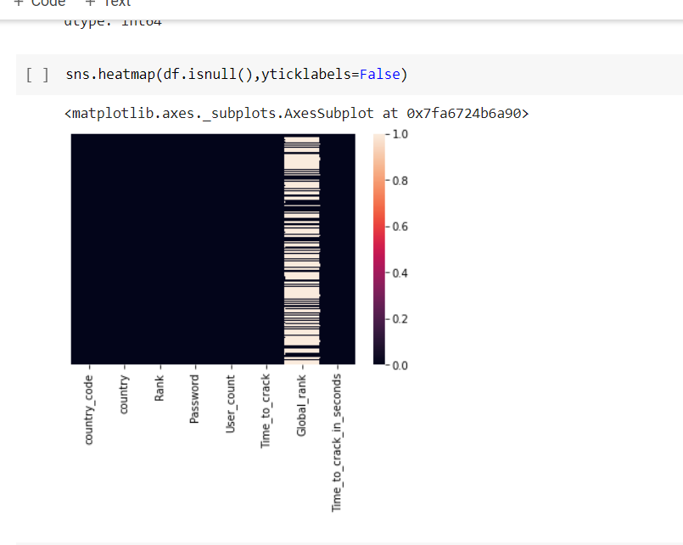
This is heat map showing the null values in Global_rank column.
White area represents the null values and black is not null values.
It checks the null values in data and represents it in heap map

Slide 16
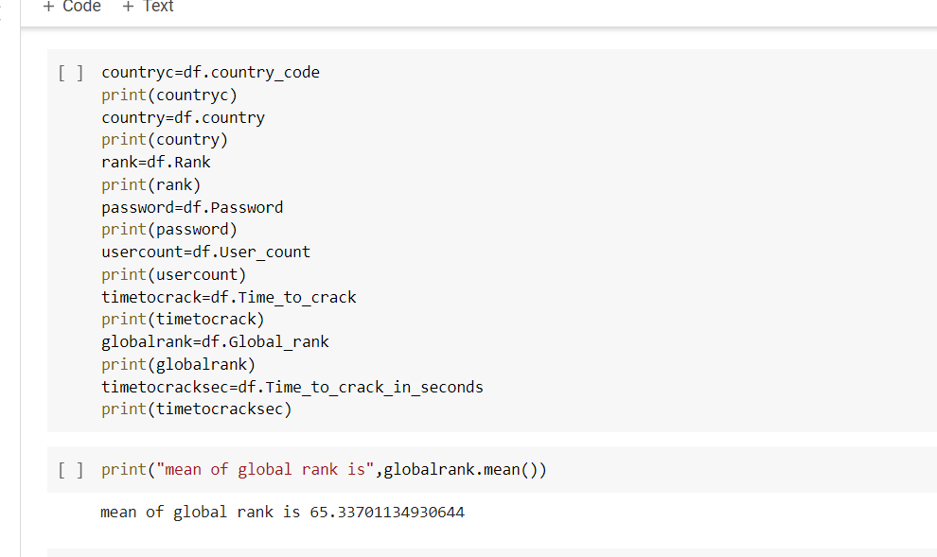
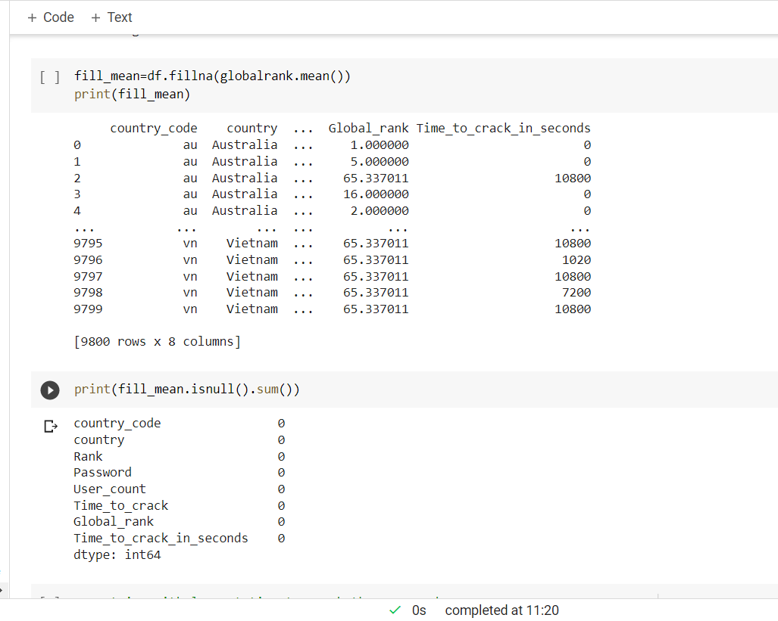
Now we know that we have null values in only one column, so first we have to create a variable of each column.
Then we have to replace the null values with mean values, globalrank.mean() gives the mean of global rank column.
In second picture we have displayed the data with mean values.
Now if we check there are no null values.

Slide 17
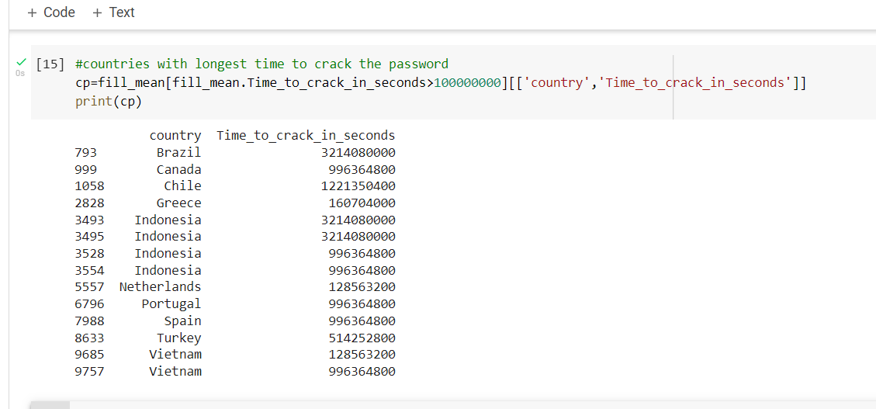
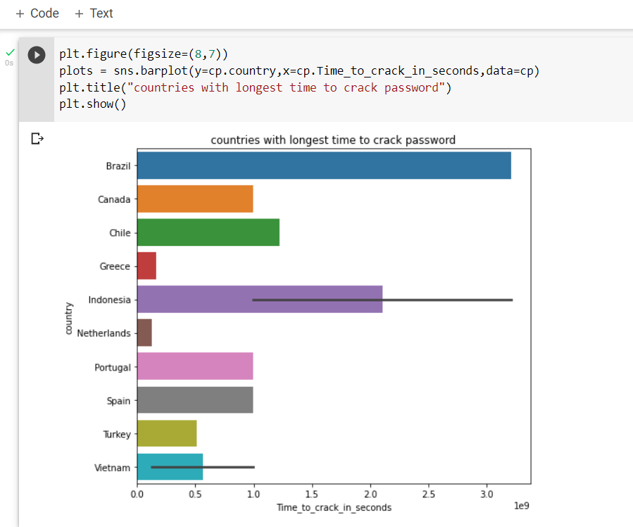
Now we have to see the countries which take longest time to crack the password.
For that we have used horizontal bar chart.
The time should be >100000000.Output we get is two columns country and time to crack in seconds.
The code in the picture represents the horizontal bar chart.
The graph is plot with country against time to crack.

Slide 18
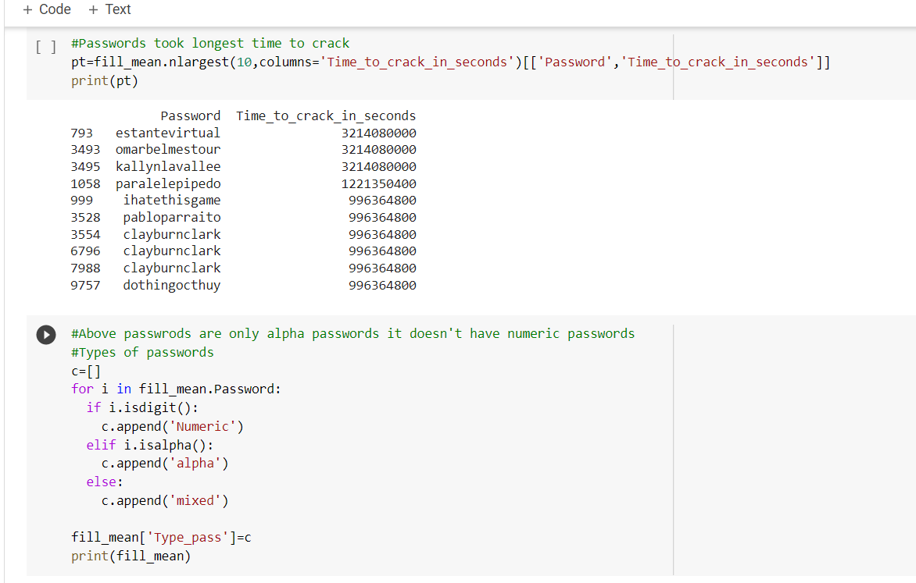
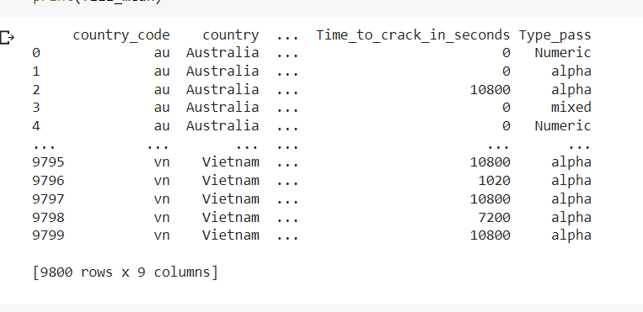
Now we will check for passwords who took longest time to crack.
The 10 passwords which took longest time are printed.
If we look the passwords are only alpha values, so for printing numeric, alpha and mixed passwords .
So for that we have to make another column named type_pass which print password types.

Slide 19
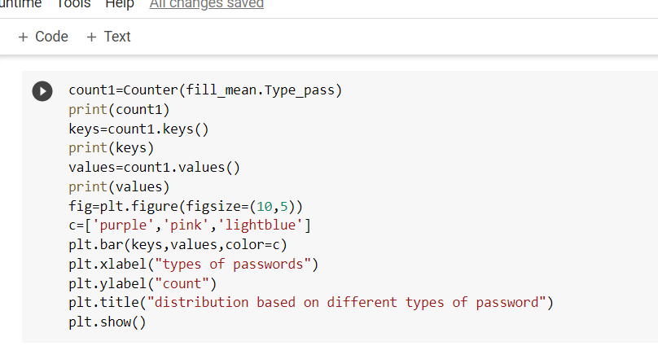
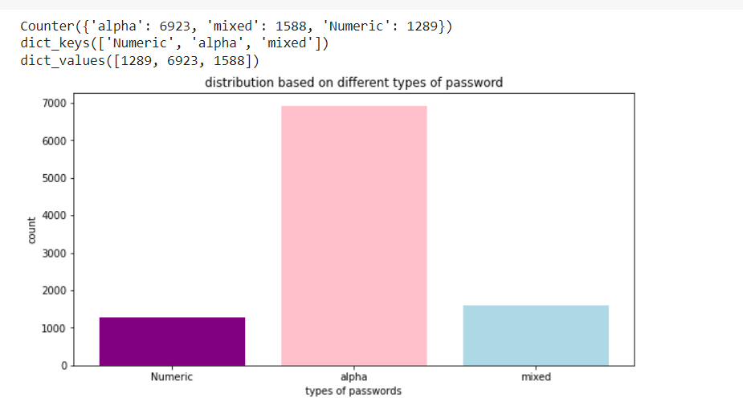
We have displayed here the bar chart with types of password against count.
Counter is used to store elements as dictionary. Type_pass is used and it print elements as keys and count as values
We can see that alpha passwords are used more.

Slide 20
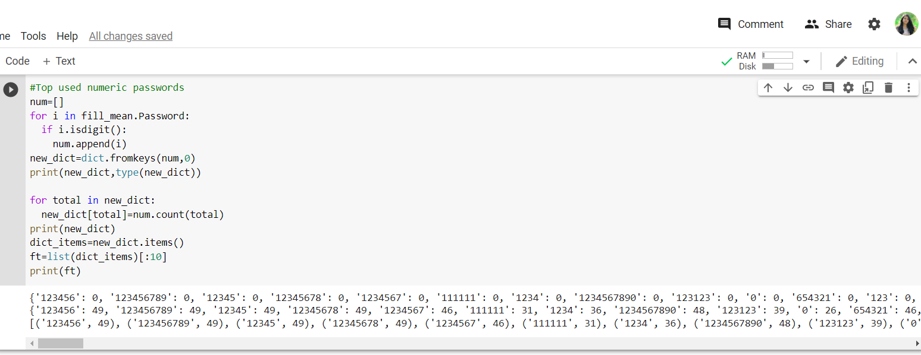
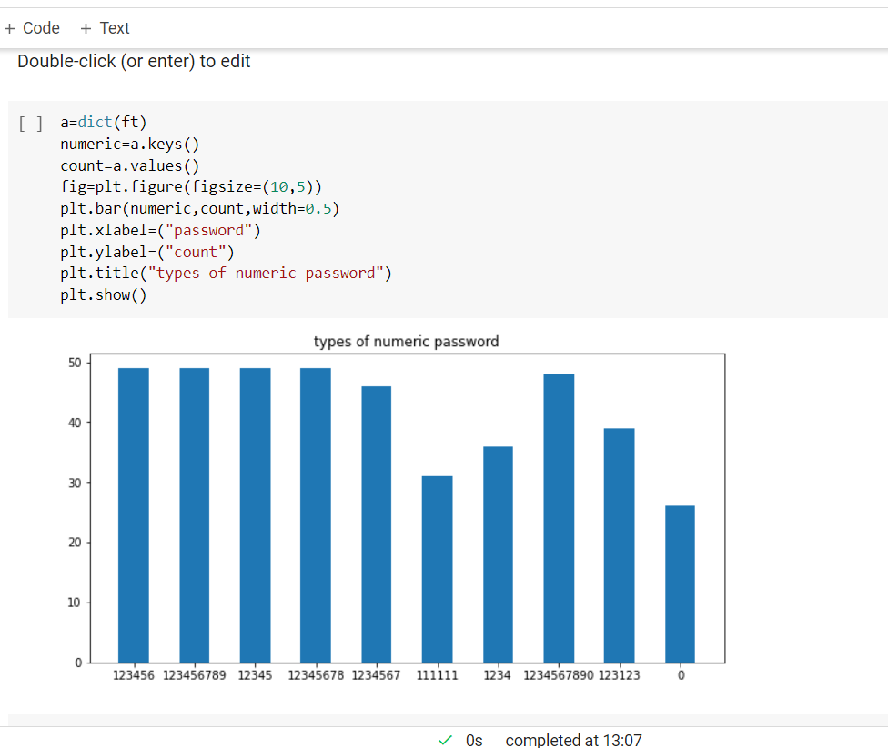
Top 10 numeric passwords are displayed.
The graph is plot numeric passwords against count
And from this graph we can tell that 1-4 passwords have same count.

Slide 21
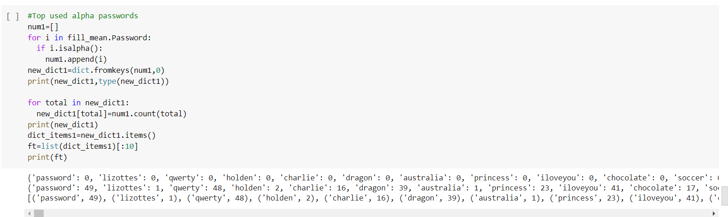
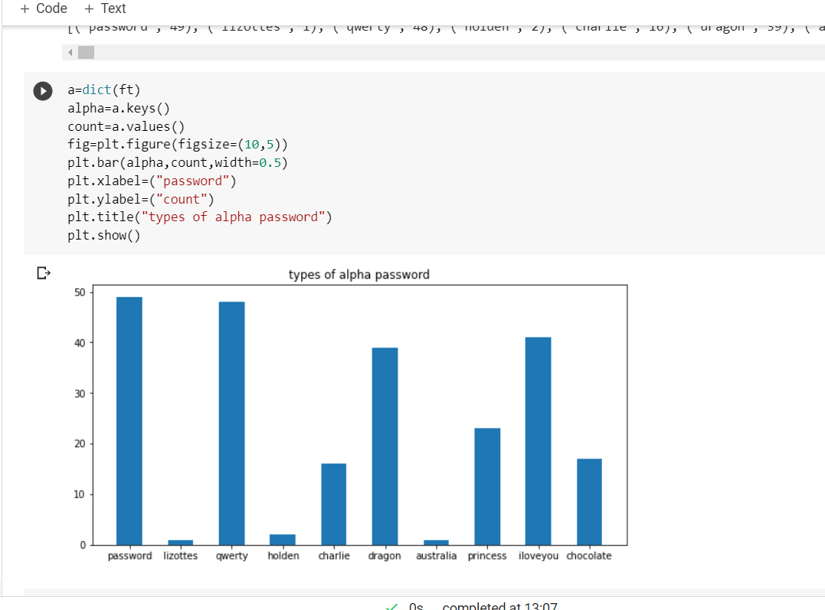
Top 10 alpha passwords are displayed.
The graph is plot alpha passwords against count
And from this graph we can tell password and qwerty are most used passwords.

Slide 22
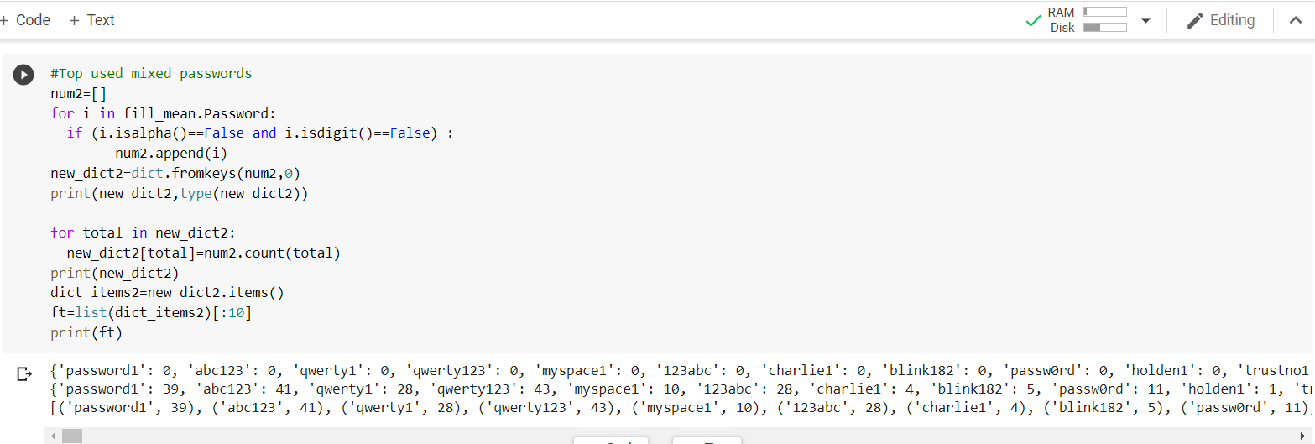
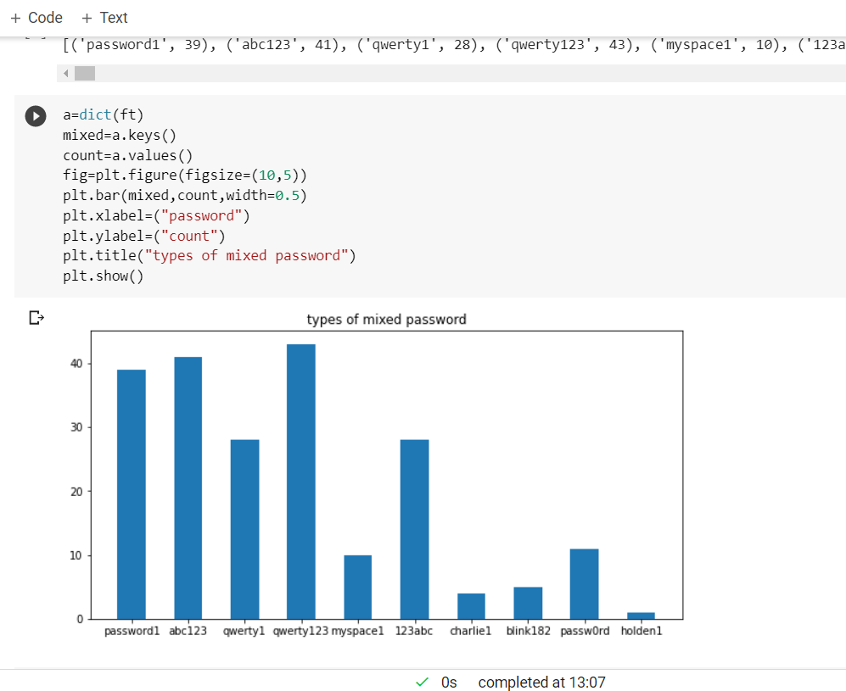
Top 10 mixed passwords are displayed.
The graph is plot mixed passwords against count
And from this graph we can tell that password qwerty123 is most used.

Slide 23
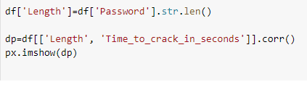
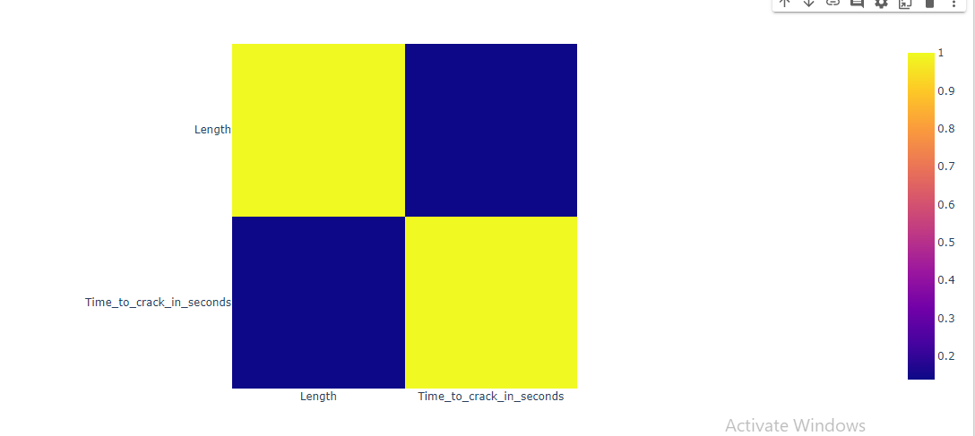
In this code the length of the passwords are displayed in data.
Then we have find the correlation between length and time to crack and we have drawn a heat map.
Based on map we can tell that between length and time to crack we have very small correlation

Slide 24
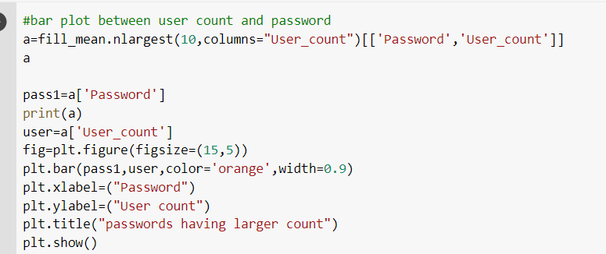
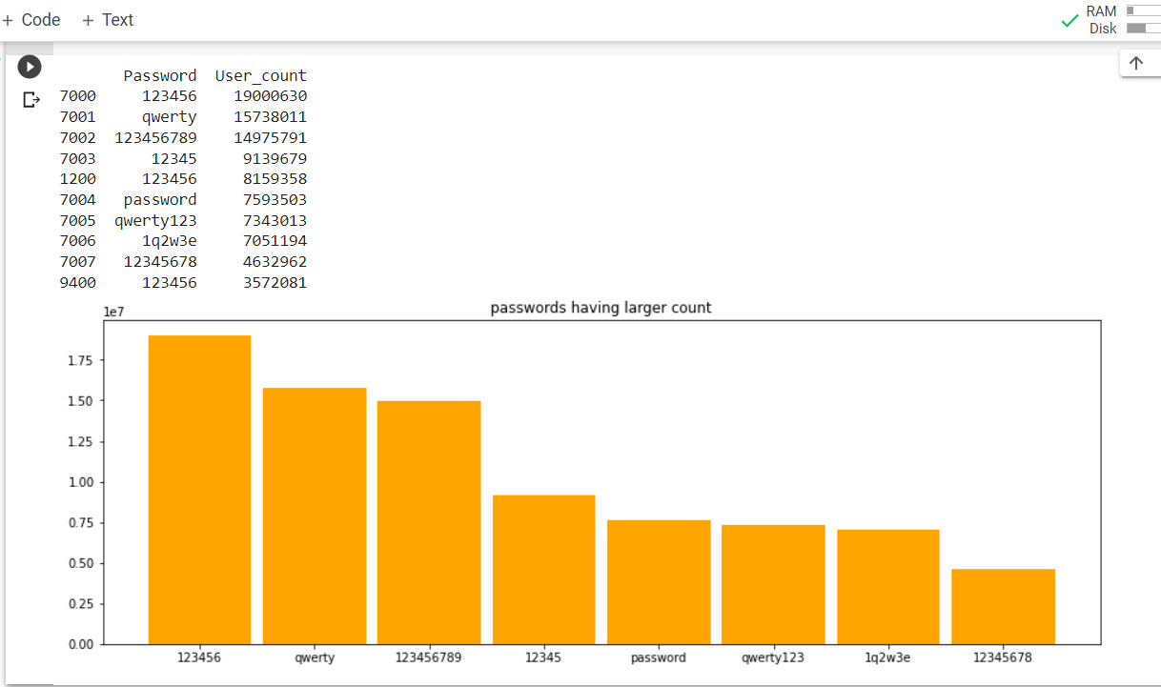
In this code we take user_count column.
And we found out top 10 largest user count and their password.

Slide 25
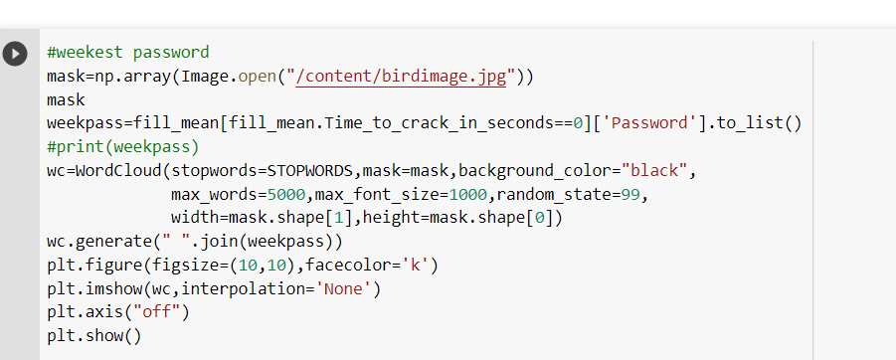
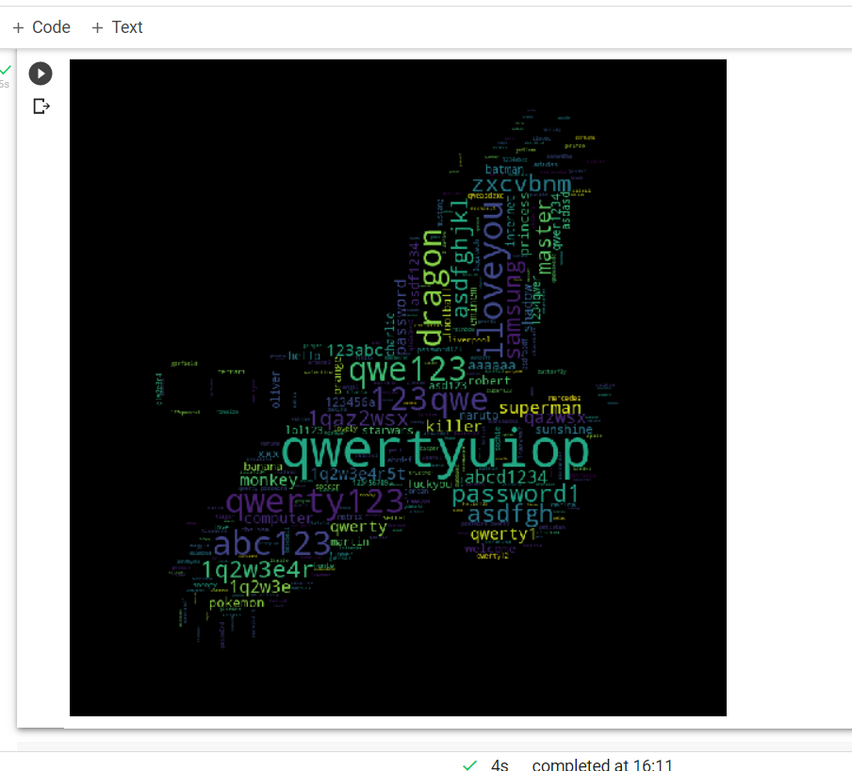
In this we have analyze the weakest passwords with the help of word cloud.
Word cloud means it is a collection of words in different sizes. The bolder the word appears it is most important.
In our case qwertyuiop is bolder so this is the weakest password.

Slide 26
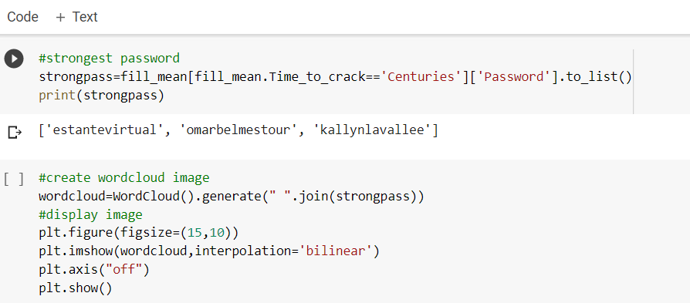
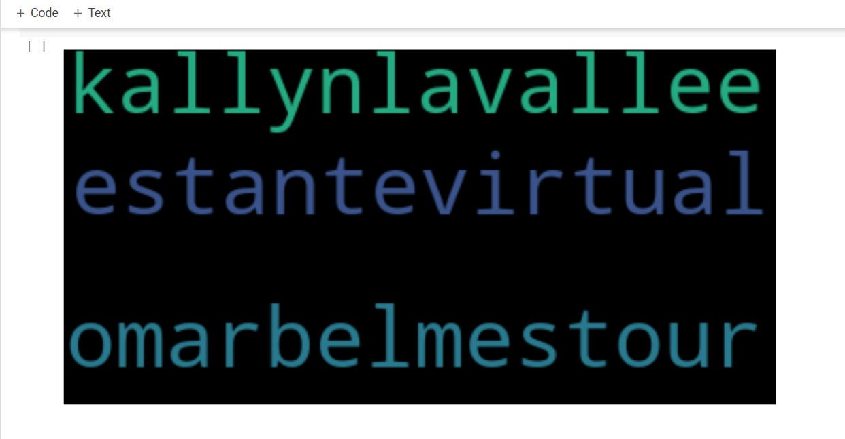
In this we have analyse the strongest passwords with the help of word cloud.
In this case kallynlavallee is bolder so this is the strongest password.

Slide 27
Data Visualization & Interpretation
In countries we see Brazil country take longest time to crack the password.
We can see the alpha passwords are mostly used in all the countries.
In numeric password pattern (1234567890) , In alpha pattern (password/qwerty) , In mixed (qwerty123) these paaword are mostly used rather than remaining password patterns.
Password (123456) has large user_count in all countries.
In we have analyze the weakest passwords with the help of word cloud.
By word cloud image qwertyuiop is bolder so this is the weakest password.
In this we have analyse the strongest passwords with the help of word cloud.
In this kallynlavallee is the strongest password.

Slide 28
Conclusion
In this project we have analyzed the which countries take longer time to crack the passwords, password which took longer time to crack, types of passwords, strongest and weakest passwords.
And finally we concluded that we have to use alpha password or mixed password because it is difficult to crack that type of password and its safe.
For data processing we used data cleaning method.
For analysis we used bar chart, horizontal bar chart, heat map and word cloud.

