Slide 1

Document Store Databases
Akshata Dhuraji

Slide 2



Introduction
NoSQL Database is a type of non-relational database management system that stores and retrieves data, without needing to adhere to a fixed schema or table structure. Its major purpose is to store large amounts of data over multiple and distributed data stores and servers. There are 4 major types of NoSQL Databases. I will be discussing Document Store Databases in this presentation.

Slide 3
What is a Document Store Database?
A document store database is a type of non-relational database that is designed to store and query data as JSON-like documents.
Documents are often written in XML, JSON,BSON etc.
The flexible, semi structured, and hierarchical nature of documents and document databases allows them to evolve with applications' needs.

Slide 4
Why use a Document Store Database?
A document store database is used when there is a need to store large volumes of data, without the need for any consistent structure(tabular structure) or schema, and queries need to be processed efficiently.

Slide 5
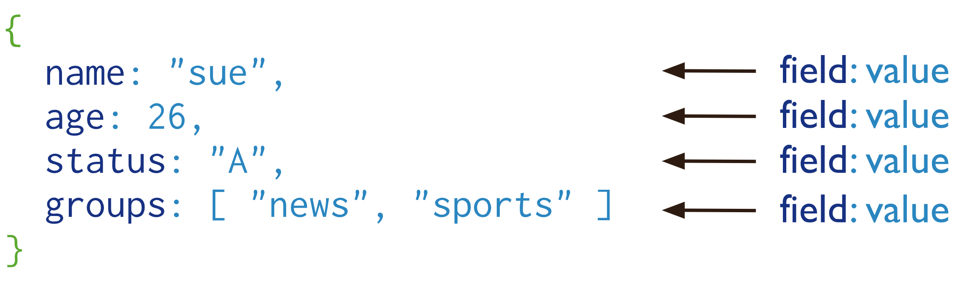
Example

Slide 6
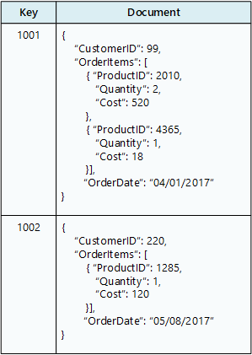
Example

Slide 7
Document Store Databases vs RDBMS
Document Store Database | RDBMS
Non-relational or distributed database management system | Relational databases
No Normalization required | Normalization is a must
Flexible and Dynamic Schema | Fixed Schema
Document based databases | Table based databases
Uses unstructured query language | Uses structured query language
Follows BASE properties | Maintains on ACID properties

Slide 8
Areas of Application
User Content: Document Store Databases can be used for storing and handling large volumes of user-generated data such as chat logs, blogs, user comments, user profiles.
Catalogs and General Storage: These database systems are efficient and effective at storing catalog information for e-commerce businesses and for general storage of information such as real-time insights, user accounts. A widely popular example is Sanoma that uses MongoDB to provide learning exercises to its users.
Gaming: Document Store Databases can be used to store and track gaming scores, in-game statistics, etc.
Web Applications: Primarily used for providing detailed data and web analytics, managing online businesses, user preferences, and application programming interface (API) data. A widely successful example is Amazon and its usage of its own document-oriented database system, DocumentDB.

Slide 9
Advantages
Large amount of storage: Designed to store large documents in a key/value store that are easy to search and access.
Enhanced Readability: The entire document is read into a memory object that is easy to read and present.
Developer Friendly: Document databases make it easier for developers to store and query data in a database by using the same document-model format they use in their application code. Developers also have more control over structure of data.

Slide 10
Advantages
High Flexibility: Documents do not need to be consistent and can be structured differently. Thus, large amounts of data can be stored, integrated and added easily.
Powerful Querying and Analytics: Designed to perform high-speed querying operations, increasing efficiency.
Supports Cloud Storage: Most of these database systems are cloud-based. Thus, reduced dependency of storage on local machines.
Easily Available Tools: Majority of these database systems are readily available online and free to use.

Slide 11
Disadvantages
High Memory Usage: Database systems designed to store large volumes of data, hence use higher memory for data storage.
Lack of Standardizations: Design and query languages can vary widely between different products and technologies.

Slide 12
Technologies
MongoDB: MongoDB is by far the most widespread NoSQL database. The software is written in C++ and uses JSON-like documents.
CouchDB: The Apache Software Foundation released the open-source software CouchDB. The database management system is written in Erlang, uses JavaScript, and is utilized in Ubuntu and Facebook applications, among others.
SimpleDB: With SimpleDB (written in Erlang), Amazon developed its own DBMS for the company’s Cloud services. The provider charges a fee for use.
Web Applications: Primarily used for providing detailed data and web analytics, managing online businesses, user preferences, and application programming interface (API) data. A widely successful example is Amazon and its usage of its own document-oriented database system, DocumentDB.

Slide 13
MongoDB
MongoDB is one of the most popular Document Store Databases.
It is an open-source document database built on a horizontal scale-out architecture. Founded in 2007, MongoDB has a worldwide following in the developer community.
Instead of storing data in tables of rows or columns like SQL databases, each row in a MongoDB database is a document described in JSON, a formatting language.

Slide 14

Example
JSON Document describing contact information

Slide 15
Why is it popular?
Documents in MongoDB are in JSON or BSON. Thus, data is stored in a ‘natural’ form.
Structured and unstructured data can be stored in the same document.
Flexible and dynamic schema so addition and deletion of data is not a problem.
Structure is easily controlled by the developer, without the help of a database administrator.
Supports wide variety of indexing methods like text, decimal, binary, integer.
Supports geospatial tagging so that documents can be queried by location.

Slide 16
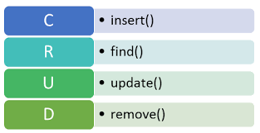
CRUD commands in MongoDB

Slide 17
Create Operations
Create or insert operations add new documents to a collection. If the collection does not currently exist, insert operations will create the collection.
MongoDB provides the following methods to insert documents into a collection:
db.collection.insertOne()
db.collection.insertMany()

Slide 18
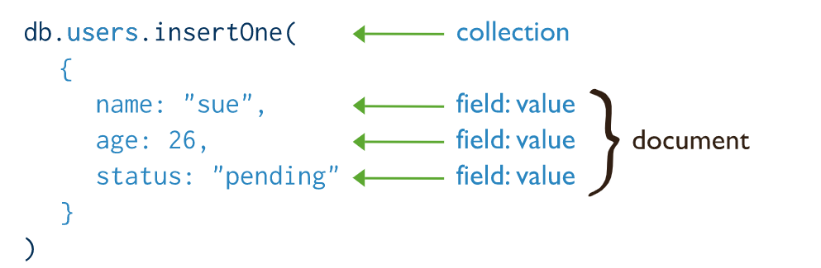
Create Operations

Slide 19
Read Operations
Read operations retrieve documents from a collection; i.e., query a collection for documents.
Query filters or criteria, an be specified, that identify the documents to return.
MongoDB provides the following methods to read documents from a collection:
db.collection.find()

Slide 20
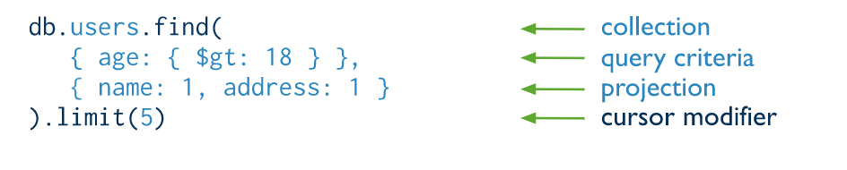
Read Operations

Slide 21
Update Operations
Update operations modify existing documents in a collection.
Update operations target a single collection. All write operations in MongoDB are atomic on the level of a single document.
Query filters or criteria, an be specified, that identify the documents to update. These filters use the same syntax as read operations.
MongoDB provides the following methods to update documents of a collection:
db.collection.updateOne()
db.collection.updateMany()
db.collection.replaceOne()

Slide 22
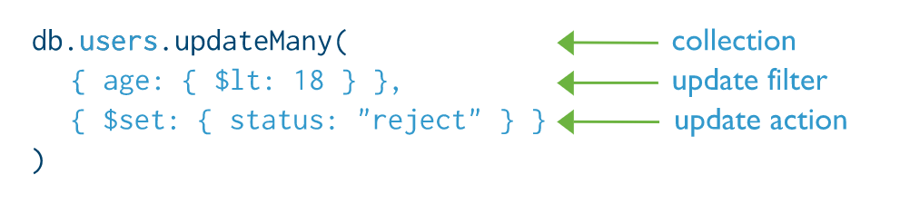
Update Operations

Slide 23
Delete Operations
Delete operations remove documents from a collection.
Delete operations target a single collection.
Query filters or criteria, an be specified, that identify the documents to remove. These filters use the same syntax as read operations
MongoDB provides the following methods to delete documents of a collection:
db.collection.deleteOne()
db.collection.deleteMany()
.

Slide 24
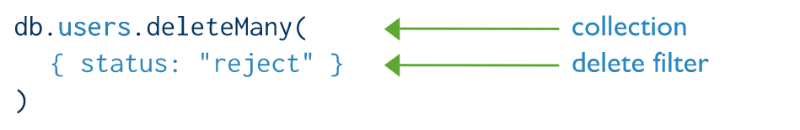
Delete Operations

Slide 25
Important Aspects of MongoDB
MongoDB provides a variety of storage engines for managing data. Example: GridFS
MongoDB provides for a ‘journal’ that is a log that helps the database recover in the event of a hard shutdown.
In MongoDB, an operation on a single document is atomic. Embedded Documents and arrays are used to capture relationships as opposed to normalization of data in RDBMS.
MongoDB supports indexes that support the efficient execution of queries.

Slide 26
Summary
A record in a Document Store Database, is a data structure composed of field and value pairs. The values of the field may include other documents, arrays and arrays of documents.
They have a flexible dynamic schema that supports fluent polymorphism.
Documents are stored in collections.

Slide 27
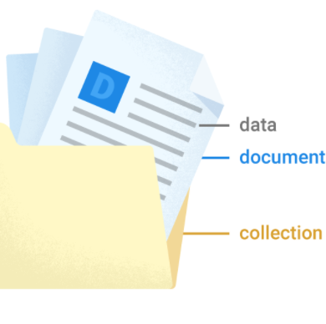
Thank you
Presenter Name: Akshata Dhuraji
Email: akshata.Dhuraji@gmail.com

