Slide 1

Building Chatbots using Dialog Flow and Alexa/Slack Integration
Akshat Bordia
Neha Joshi
Citrix R&D India
in/akshatbordia/
in/neha-d-joshi/

Slide 2
Agenda
Overview, Creating DialogFlow(API.AI) Account, Downloading Files
DF Terminologies – Agent, Intent, Entity, Context, Parameters
Create agent and enable smallTalk and test from console
Building the bot using JavaScript
Training and Example for Zomato APIs
Slack/Alexa Integration
Notes:
Overview, Creating DialogFlow(API.AI) Account, Downloading Files– 5 Minutes
DF Terminologies – Agent, Intent, Entity, Context, Parameters – 5 Minutes
Create agent and enable smallTalk and test from console – 5 minutes
Building the bot using JavaScript– 10 minutes
Training and Example for Zomato APIs – 20 Minutes
Slack/Alexa Integration – 10 Minutes
Queries during session – 5 Minutes

Slide 3
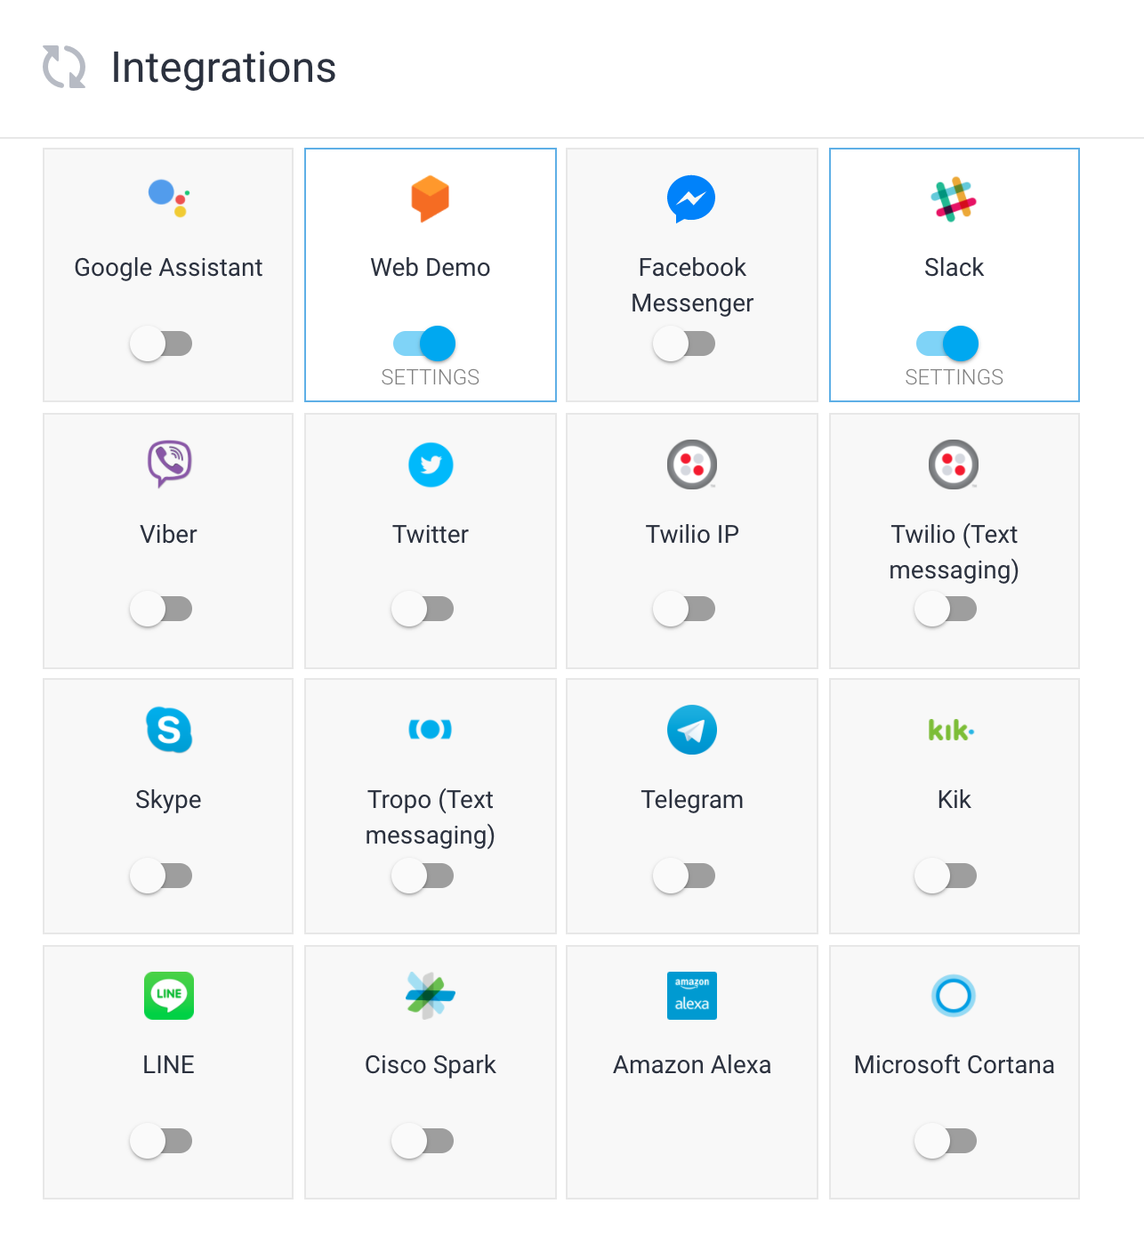

Slide 4
Let’s get started!
Create API.AI Account:
https://console.dialogflow.com
Create Zomato Developer Account:
https://developers.zomato.com/
Download Artifacts:
https://github.com/akshatb1/BotMeetUp

Slide 5
Dialog Flow Terminologies
Agent: Chatbot application for a particular use case, collection of intents, prebuilt agent available
Intent: A Query and Response pair with other powerful details like annotated entities, Actions, values etc.
Entity: User Defined Enums, eg. City, Country, Can be used to extract parameter values
Parameters: Value of an entity in a particular query
Context: Required to understand other queries
Notes:
NJ
https://dialogflow.com/docs/reference/agent/query
https://dialogflow.com/docs/getting-started/basics

Slide 6
Create Agent
Create Agent
Sample Conversation in in-built console
Enable SmallTalk
Sample Conversation in in-built console
Sample Conversation in iframe (local html/ URL)
Iframe – Security Issues, Support Issues, Indexing issues
Notes:
AB – Show
NJ -- Talk

Slide 7
The Real Deal: Bot using JavaScript and Zomato APIs
Download Files
Get API.AI, Zomato authorization tokens
Exercise 1: Create Entities for City and Area
Exercise 2: Create Intents for Restaurants Search
Exercise 3: Complete API Call
Exercise 4: Extract message from results
Let’s chat!
Notes:
https://dialogflow.com/docs/reference/agent/query
Hi
What’s up?
I need help
Please find some restaurants in Bangalore
In Indira Nagar / Area is Ulsoor / In MG Road
Please find some restaurants in Mumbai
In Marine Drive
Find some restaurants in Delhi
In Connaught Place
Thanks
Bye
//TODO : Show API.AI API Query Formation and Response
//TODO : Show Zomato Query Response

Slide 8
Slack and Alexa Integration
One Click Integration for Slack
Export Support for Alexa
Overview of Deploying in AWS (Lambda)
Demo

Slide 9
Github.com/akshatb1
Akshat.bordia31@gmail.com
nehadjoshi93@gmail.com
Thank You!

