Slide 1
Edits - Irate My Manager
Kindly See All the pages

Slide 2
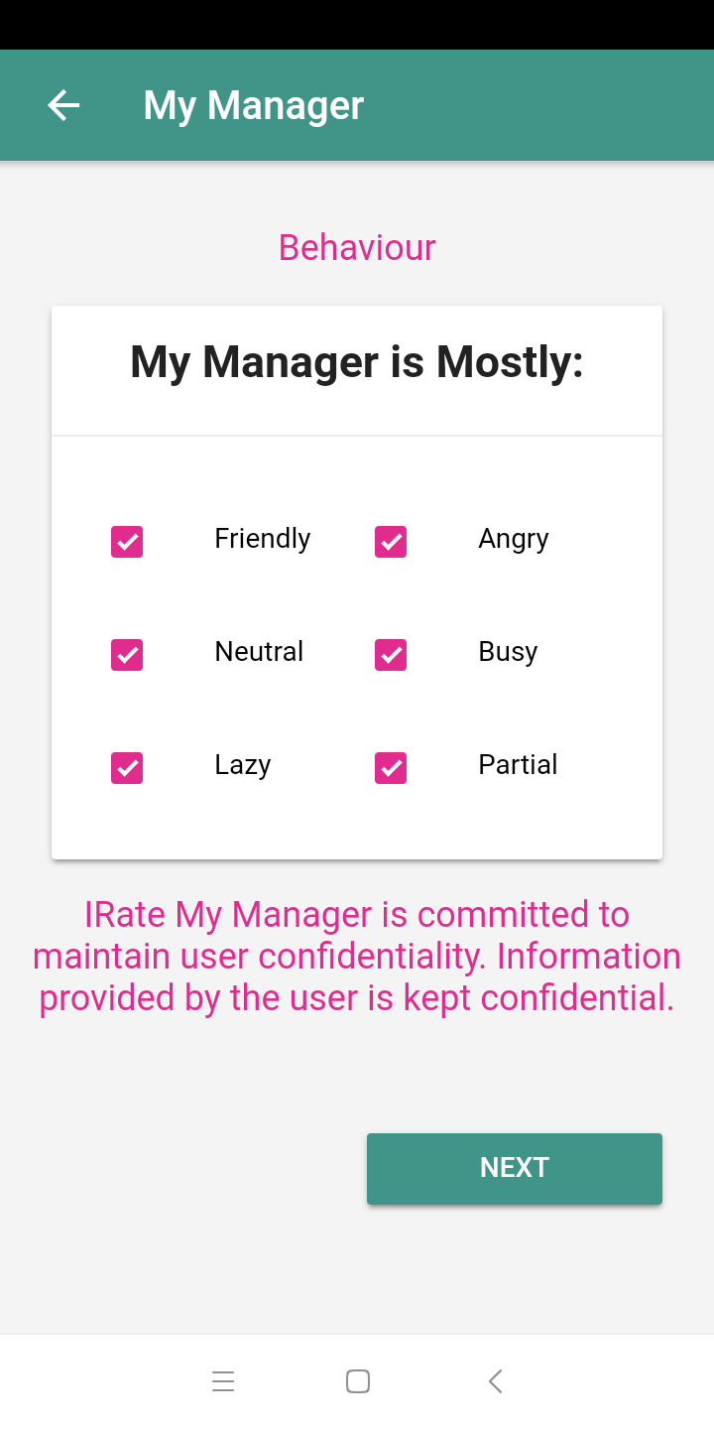
This question is mutually exclusive. Hence a user should be able to click only one option at a time. A user can login multiple times and provide his/her feedback about same company and same manager again. So it means say in week1 my manager was mostly angry, but during week2 my manager could be mostly busy. But we have recorded both sentiments of same employee about same manager into the database.
Thanks for adding this.

Slide 3
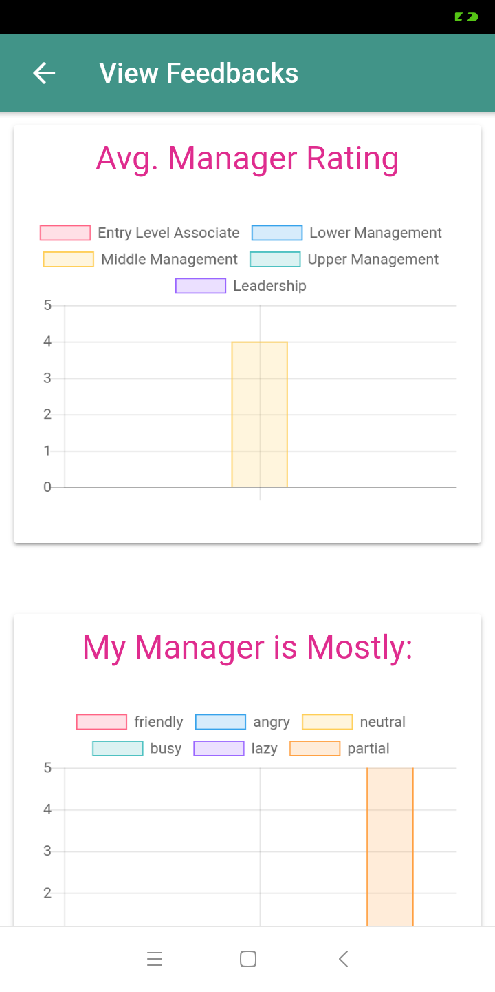
Replace it with “ Manager Rating as rated by their Reportee
A word of Caution
Remember this app is about an employee rating his/her manager (which is usually the next level employee). Hence in this case we cant have ratings FOR “Entry Level Associate” right ? Because no one is reporiting to an “Entry Level Associate”
Ya we can have ratings where “Entry Level Associate” has rated his/her manager which would fall in category of “Lower Management”
First letter in Capital please

Slide 4
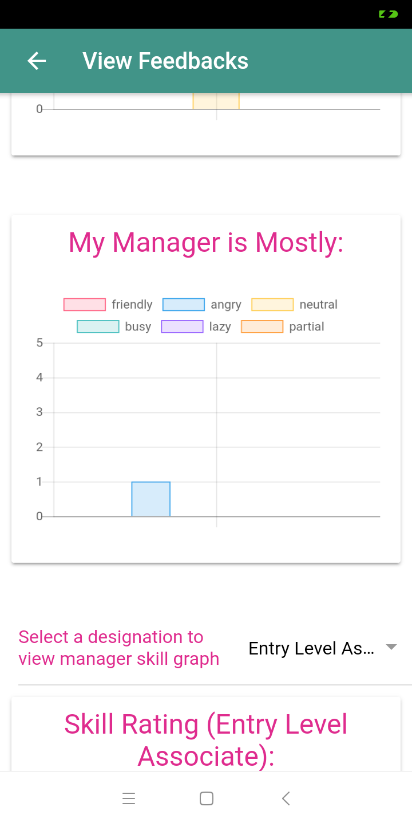
Can we not change it to “Insights”
Bring this “Level” Filter here.
The graphs below should reflect the changes after selecting this “Level” Filter.
A Word of Caution
Remember this app is about an employee rating his/her manager (which is usually the next level employee). Hence in this case we cant have ratings FOR “Entry Level Associate” right?
Ya we can have ratings where “Entry Level Associate” has rated his/her manager which would fall in category of “Lower Management”
First letter should be in Capital.
Replace it with “Manager Skills as rated by Employee Level”
Can we adjust the font size so that we could utilize the space??

Slide 5
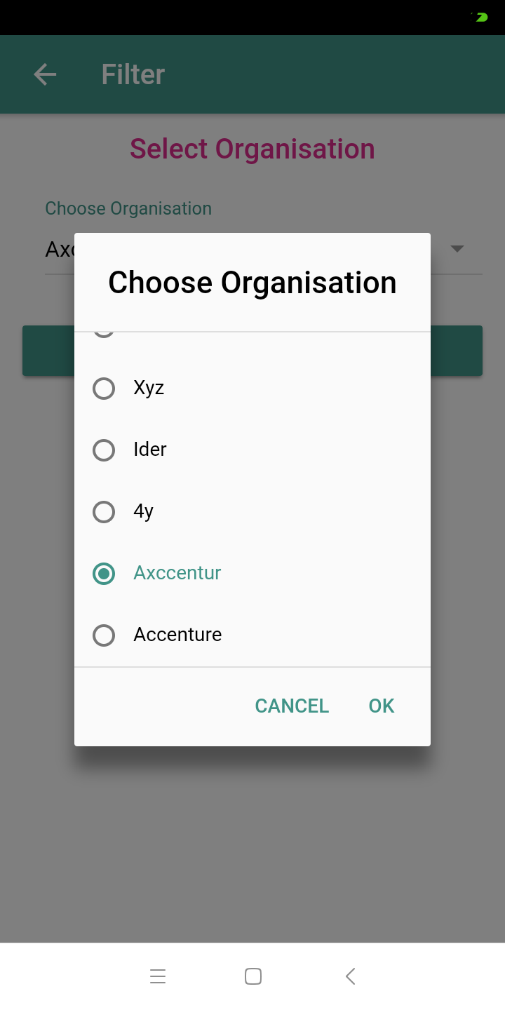
This is a classic example of erroneous data . As you can see someone misspelt Accenture. How to deal with such cases? So the results for Accenture would not be counted against the actual company name. I am really worried about this. Since this will keep showing junk on our app and that does not make good impression on the user.

