Slide 1
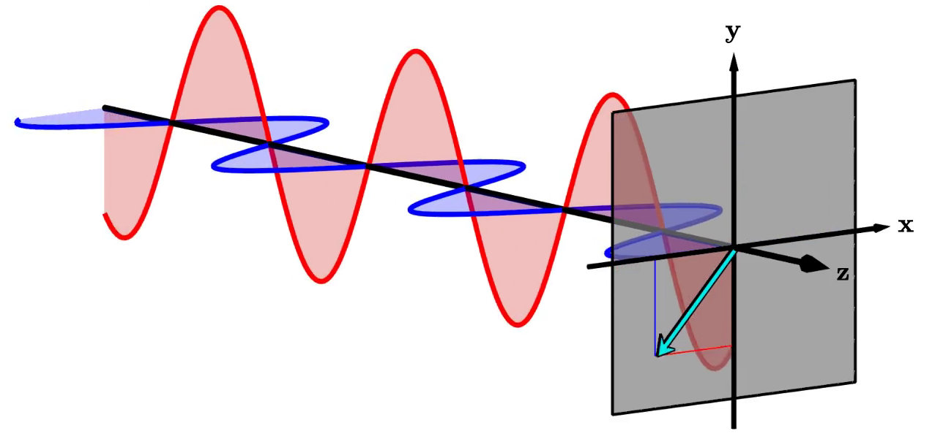
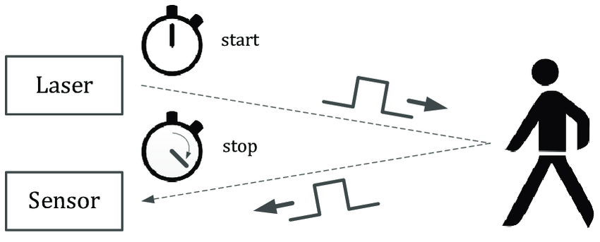
Seeing beyond line-of-sight

Slide 2



Slide 3
