Slide 1


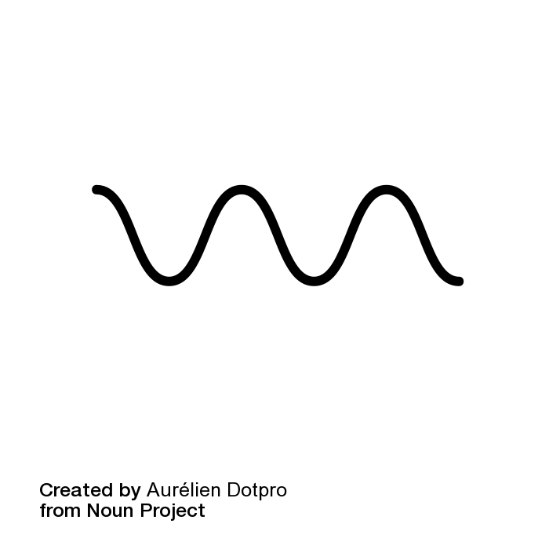
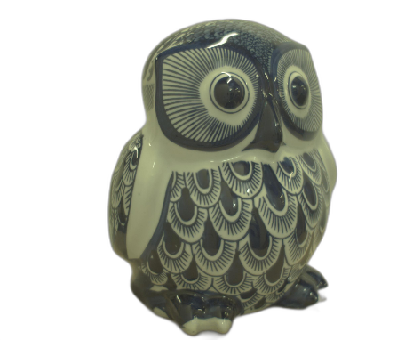
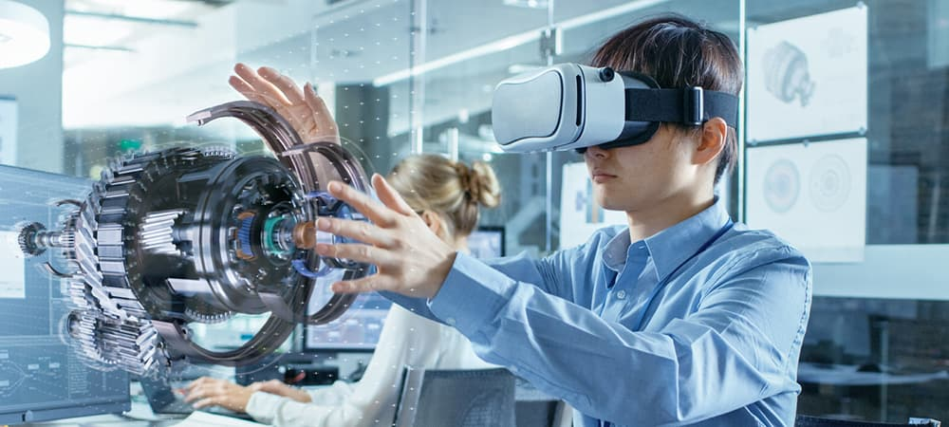
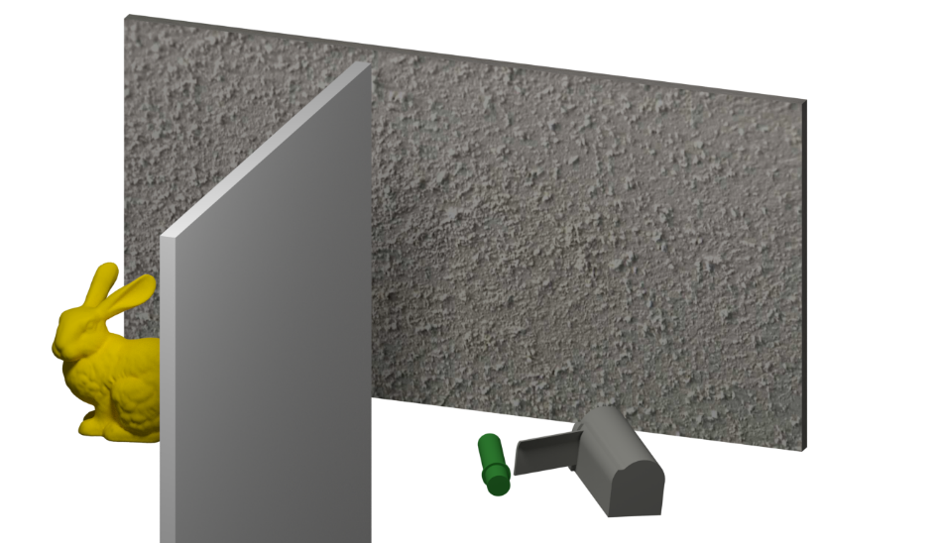

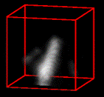
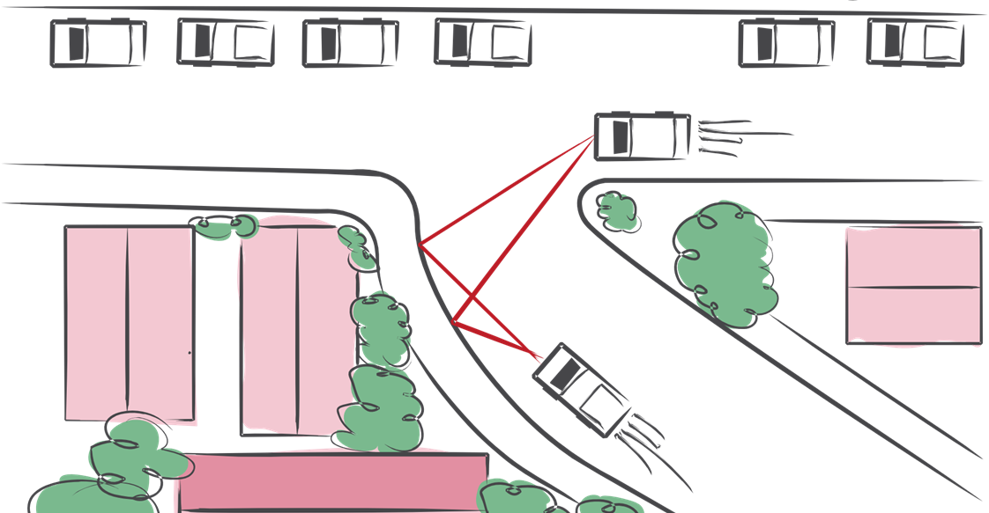
(a) Research Approach: Co-design of cameras and algorithms leveraging unique light properties
Computational Imaging
Physics-based Machine Learning
Vision Systems that Reveal the Invisible
Cameras that capture unique light properties
AI that analyzes
the physics of light
Augmented / Virtual Reality
3D Shape & Appearance
(b) Research Outcomes demonstrated in the doctoral research
(c) Potential Impact Areas
of doctoral research
Automotive and Robotics Vision
Seeing Around Corners
Extracting intrinsic scene properties
Polarization
Neural Fields
Time of Flight
Neural Rendering
Industrial Vision
Single-photon Statistics
Deep Priors
Internal Stress Analysis
Extended Reality (XR)
Reflectance Separation
Surface Normals
Incident Lighting
Input Scene
Practical appearance capture for photorealistic digital twins
Uncovering hidden scene information
Autonomous Navigation
Safer cars and robots devoid of blind spots
NLOS Scene Setup
Experimental Reconstructions
Notes:
https://en.wikipedia.org/wiki/Subsurface_scattering https://pixabay.com/photos/blue-sky-white-cloud-look-up-nature-1505848/
https://www.freepik.com/free-vector/smoke-bubbles-set_13381581.htm#query=smoke%20illustration&position=8&from_view=search&track=ais https://www.freepik.com/free-vector/vector-wireless-sharing-devices_3129708.htm#query=camera%20side%20view%20flat%203D&position=19&from_view=search&track=ais

