Slide 1
NETRA
Network-wide Trajectory & Recognition Analytics
City-wide multi-camera ANPR, cross-camera vehicle trajectory reconstruction and urban traffic analytics.
Smart India Hackathon · Problem Statement 127
Notes:
One line to open: "This city has 400 cameras and 400 blind spots. Each one sees a moment. None of them sees a journey."

Slide 2
The problem
Every camera is an island.
400
A camera can count what passes it. At best it can read a plate.
Nobody can answer the questions that actually matter for traffic management:
where did this vehicle come from, where is it going, how long did that journey take, and which corridor is choking right now.
No layer stitches the islands into a single view of a vehicle moving through the city.
cameras in a mid-size Indian city
0
of them can tell you where one vehicle went

Slide 3
Where the real difficulty is
It is not detection, and it is not OCR. Both are mature.
What is solved
What is not
Detecting a vehicle in a frame
Following it while it stays in view
Reading a plate from a good crop
Identity continuity under uncertainty.
Naive plate matching fails in BOTH directions — it misses real matches, and it invents false ones.
MH12DE1433 read as MH12OE1433
Same vehicle. One character apart. A string comparison says these are different cars.

Slide 4
The solution
A unified intelligence layer over cameras that already exist.
1
Detect
2
Track
3
Read
vehicles, per frame
stable IDs in one camera
plate, many times over
4
Agree
5
Associate
6
Reconstruct
one plate from many reads
the same vehicle, across cameras
the journey, with confidence

Slide 5
The innovation
Three signals. One of them can veto.
EVIDENCE
EVIDENCE
CONSTRAINT
Plate
Appearance
Physics
Confusion-aware similarity.
0↔O and D↔O cost less than an
arbitrary substitution.
Vehicle class, dominant colour,
shape. Corroboration —
never identification on its own.
Does the road network permit
this journey in this time?
If not, the link is refused.
Plate similarity 1.00 — but that link implies 3,168 km/h over 4.4 km. REFUSED.
We never claim an identity match. We assert a confidence and show the reasoning — including what we refused to assert.
Notes:
This is the slide. Show a rejection during the demo — Analytics tab, "Links the system refused". Almost no competing team demos a negative result on purpose.

Slide 6
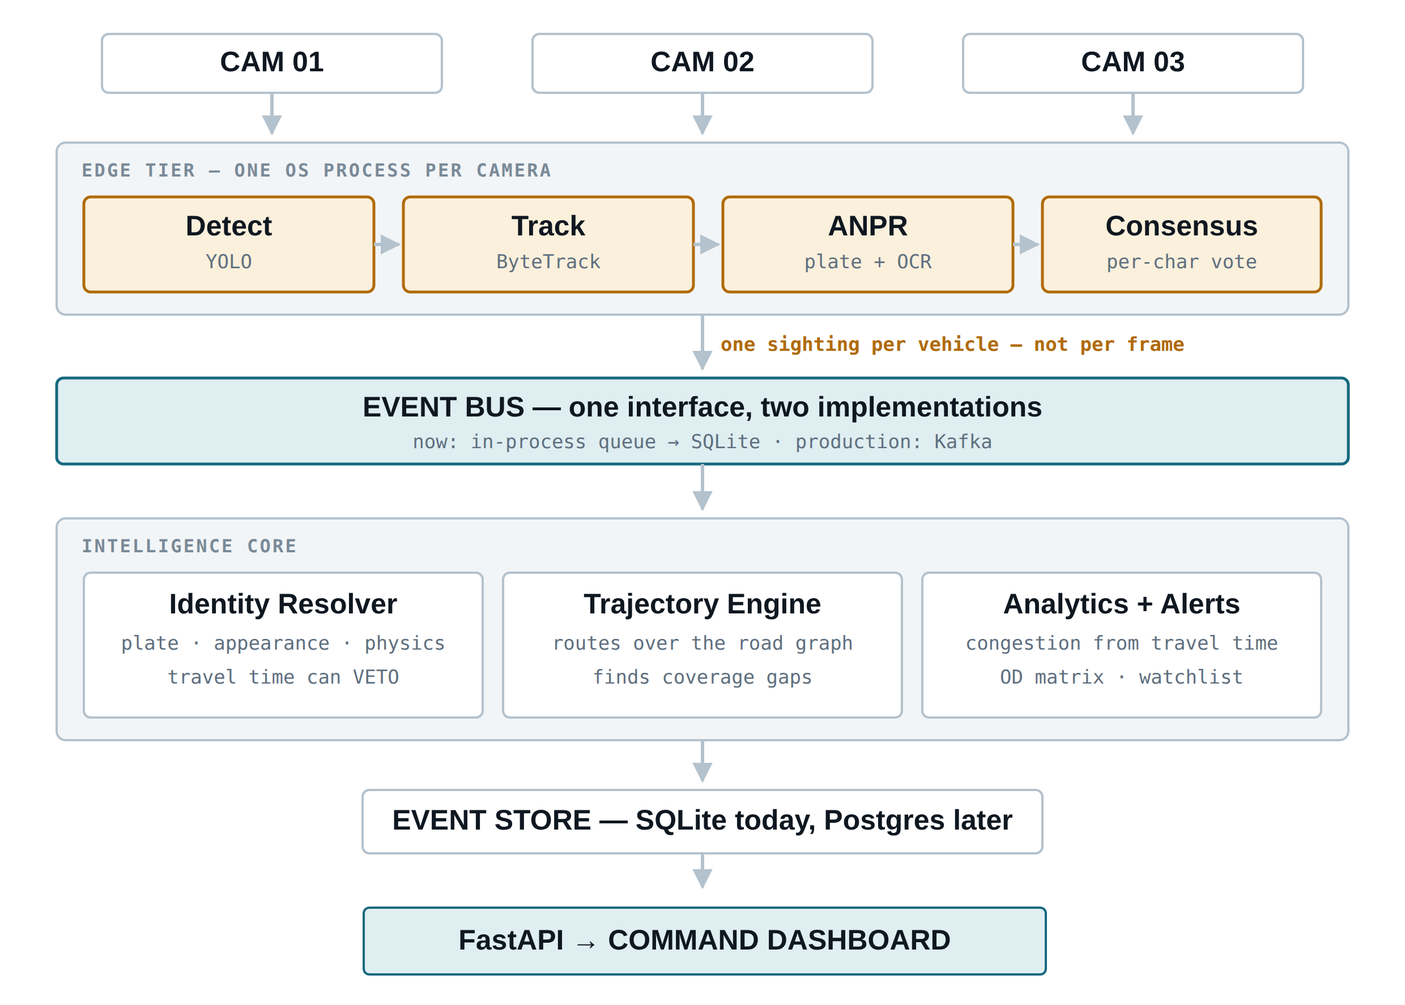
Architecture
One direction of flow. Every boundary is where the network goes in production.
One process per camera
Python’s GIL means threads would serialise. Processes run truly in parallel — and this is exactly where an edge box goes later.
A bus, not a function call
Eighty lines. Swapping LocalBus for KafkaBus is a second implementation of the same interface, not a rewrite.
One row per vehicle
Consensus happens in the worker, so a camera writes one sighting per vehicle rather than one per frame.

Slide 7
We never trust a single frame
A vehicle is in view for 40–90 frames. Use all of them.
Naive
Ours
Take the highest-confidence single read and discard what every other frame knew.
Vote per character position, weighted by the OCR’s own per-character confidence, then repair against the plate grammar.
KA01AB1Z34
KA01AB1234
one frame · 0.77 confidence · wrong
15 reads · 0.95 confidence · correct
Measured on our own data: a plate is agreed from 15 reads on average — no single frame decides it.

Slide 8
The cheapest big win
200 lines. No model, no training. More accuracy than swapping OCR engines.
OCR returned
Repaired to
What the grammar knew
KA0LAB12E4
KA01AB1234
district must be digits; number must be digits
MH12OE1A33
MH12OE1433
position 7 must be a digit — A is a 4
TN09BX22S5
TN09BX2255
S in a digit block is a 5
ZZZZZZZZZZ
(refused)
ZZ is not a real state code — we do not invent plates
We only repair towards plates that could actually exist. Without that rule, the repair turns noise into a structurally valid plate with an invented state code — confident nonsense, which is the exact failure this project exists to avoid.

Slide 9
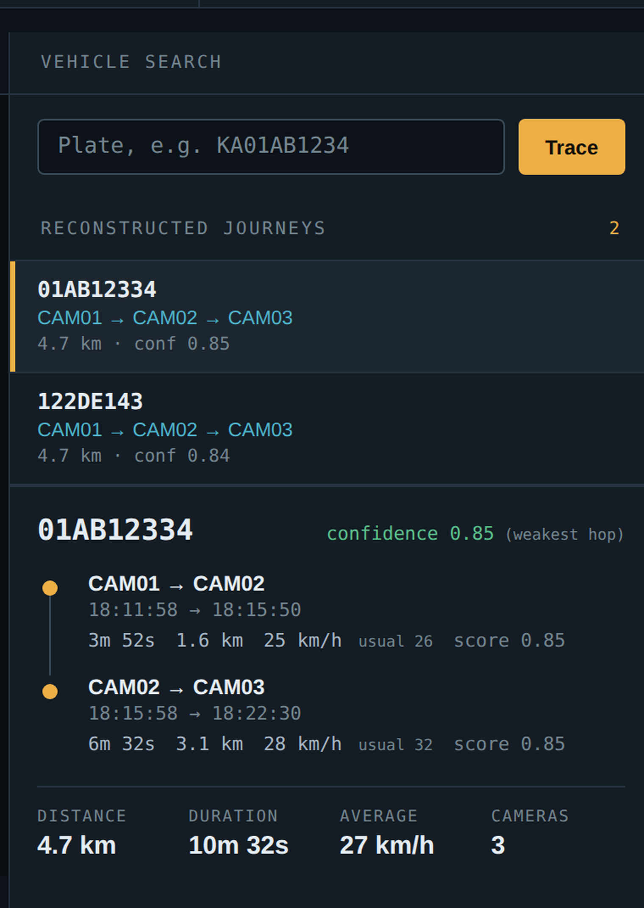
What the demo shows
Live, end to end, on one laptop.
1
Live
three cameras processing at once
2
Trace
pick a plate, watch the journey animate
3
Refused
a link we would not assert, and why
4
Analytics
congestion from travel time, not counts
Recorded footage standing in for live CCTV. The architecture does not change when the source becomes RTSP.

Slide 10
Measured results
Regenerated by a script from the system’s own output. No figure is typed by hand.
15
262
0.82
4
OCR reads behind each
agreed plate
logic tests, all passing
mean journey confidence
(the weakest hop)
independent alert rules
Association precision and recall: pending our ground-truth dataset.
These need one row per vehicle pass, recorded while filming. The report script prints “not yet measured” rather than estimating — and we would rather say that than quote a number we cannot defend.
Notes:
Run `make report` after the camera shoot; this slide fills itself in from docs/RESULTS.md.

Slide 11
Impact
What a city does with a journey it could not previously see.
1
Congestion, measured
2
Incident response
Delay from real travel times, not vehicle counts. Four vehicles crawling is congestion; forty moving freely is not.
A vehicle of interest traced across the network in seconds, with the confidence of every hop shown.
3
Urban planning
4
Camera accountability
Origin–destination patterns over the whole network — the input to signal timing and road investment.
Coverage gaps: a camera the vehicle certainly passed that recorded nothing. A fault report the city can act on.

Slide 12
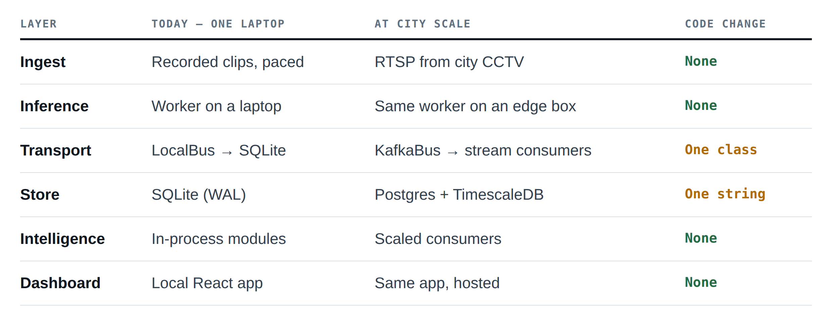
Scalability
If a scaling claim requires a rewrite, it is not a scaling claim.
The workers already publish to a bus and never touch the database. That boundary is where the network goes — so the migration is a second implementation, not a redesign.

Slide 13
Feasibility
Built and demonstrable today, on hardware we already own.
₹0
Runs on
One laptop, three cameras in parallel
YOLO + ByteTrack + ONNX ANPR, all CPU-capable
SQLite, FastAPI, React — nothing exotic
One command to start; a preflight check that catches the twenty things that break demos
total cost
Every model, library, map tile and dataset is free and open. No API keys, no accounts, no cards. The whole system runs offline on one laptop.

Slide 14
Limitations
Stated before anyone has to ask.
—
Plate readability depends entirely on camera placement and resolution. A plate needs roughly 80 px of width to be read reliably.
—
Evaluated on a small dataset we collected ourselves, not at city scale.
—
COCO has no auto-rickshaw class. India’s most common three-wheeler is currently absorbed into car or truck. Fixing it means fine-tuning.
—
Appearance re-identification degrades badly at night; we therefore never assert an identity without a plate.
—
Association confidence is calibrated on our data and would need re-calibration per deployment.
—
A real deployment carries privacy, consent and data-retention obligations this prototype does not address.
Notes:
Say these yourself. Being caught by a limitation reads as naive; naming it first reads as rigour.

Slide 15
Future scope
In the order we would actually build them.
Next
Fine-tune detection on Indian vehicles, including auto-rickshaws. Learned re-ID embeddings so plate-less vehicles can be linked.
Then
Live RTSP ingest, edge inference beside the camera, Kafka in place of the local bus — all second implementations of interfaces that already exist.
Later
Signal-timing recommendations from measured origin–destination flow. Predictive congestion. Integration with city incident-response systems.
Nothing on this list requires the architecture to change.

Slide 16
Cameras see moments.
NETRA sees journeys.
Smart India Hackathon · Problem Statement 127

