Slide 1
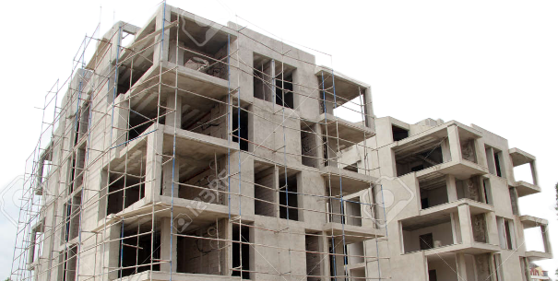
PPT Agenda
TEAM: ERROR404
USE SLIDE SHOW

Slide 2
Problem Statement
TEAM: ERROR404
Error 404’s Solution
A brief about the sensors used
PPT Agenda
Neural network models
Model Flowchart
Business model

Slide 3
E-404’s Solution
Problem Statement:
Workplace Safety Optimization
According to estimates, there are around 30 deaths per 1000 construction workers per year. And the three major reason for the injuries are
(a) fall for heights
(b) electrocution
(c) heart stress.
To overcome such bad haps we at ERROR 404 have developed a transforming workspace with the integration of wearable IoT technology that monitors workers' vital signs, and utilize IoT infrastructure to enhance the workplace safety and over all well being well-being.

Slide 4
Problem Statement:
E-404’s Solution
1. At E-404 we will implement predictive maintenance strategies to prevent unforeseen breakdowns by
reducing repair costs and increasing efficiency.
2. The gyro sensors are instrumental in accurately identifying the movement of the workers whether they
are walking, standing, or falling with DNN this real-time analysis is key in ensuring the
workers safety
3. Moreover, the system continuously monitors water pressure data, promptly generating
alerts when it surpasses predefined thresholds. This proactive monitoring helps prevent
potential equipment failures or leaks.
4. Furthermore, temperature sensors are deployed to maintain optimal working
conditions for personnel.
5. Additionally, Team Error 404 will develop a specialized CNN capable of
accurately detecting cracks on building walls, for improved structural integrity
assessments
All under one roof!!

Slide 5
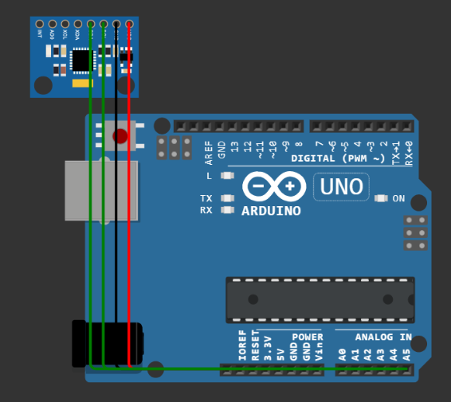
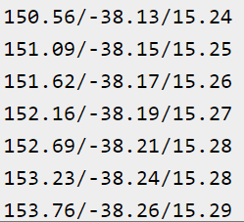
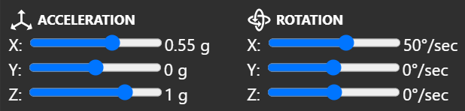
E-404’s Solution
A brief about the sensors used
(a) Accelerometer and Gyroscope Sensor
The MPU6050 sensor using i2c protocol provides us with the
position of the worker in a 3D orientation, when integrated with a DNN provides us with the accurate status of the worker.
Working of the sensor:-
-Here the raw data of the accelerometer is converted to G-force units and calculates
Rotation around the x, y and z axes and adjusts itself over time
At E-404 we have implemented predictive maintenance strategies to prevent unforeseen breakdown by
reducing repair costs and increase efficiency.
The gyro sensors are instrumental in accurately identifying the movement of the workers whether they
are walking or standing or falling with DNN this real time analysis is key in ensuring the
workers safety
Moreover, the system continuously monitors water pressure data, promptly generating
alerts when it surpasses predefined thresholds. This proactive monitoring helps prevent
potential equipment failures or leaks .
Furthermore, temperature sensors are deployed to maintain optimal working
conditions for personnel.
Additionally, Team Error 404 has developed a specialized CNN capable of
accurately detecting cracks on building walls, for improved structural integrity
assessments

Slide 6
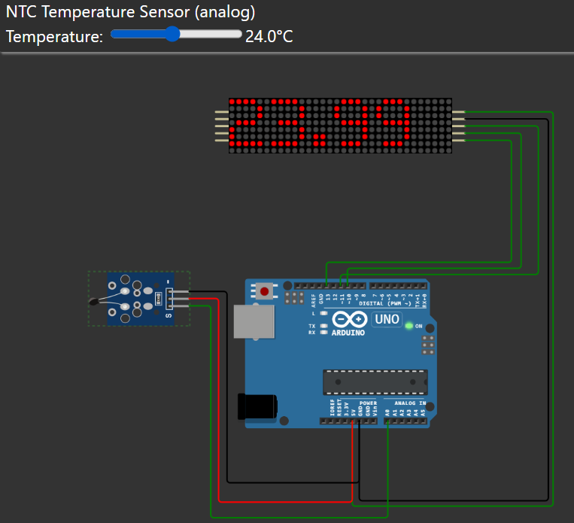
A brief about the sensors used
(b) Temperature sensor
Working of the sensor:-
This IoT sensor reads the temperature from a thermostat and displays it on a
LED.
We will use libraries like MD_Parola and MD_MAX72xx for controlling
the LED matrix then the analog value is read and clears existing contents
before displaying

Slide 7
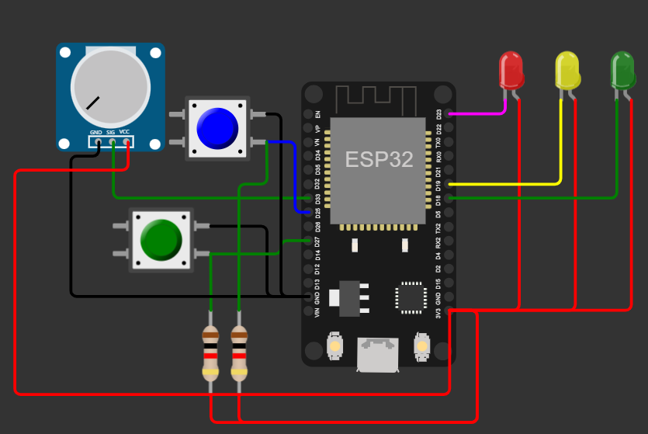
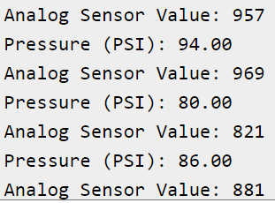
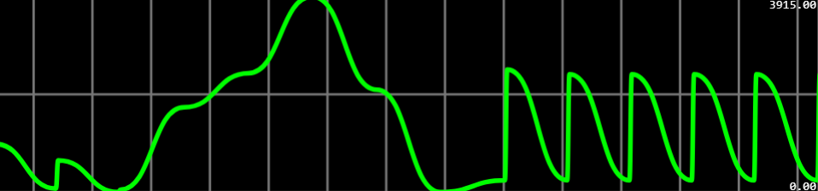
Neural Network Models
Deep Neural Network (DNN)
Convulsion Neural Network (CNN)
A brief about the sensors used
(c) Water pressure sensor
Working of the sensor :-
The ESP-32 reads the raw data on the voltage on the pressure sensor
every 100 ms if the PSI is less than 0 or less then the green light turns on
other the red does.

Slide 8
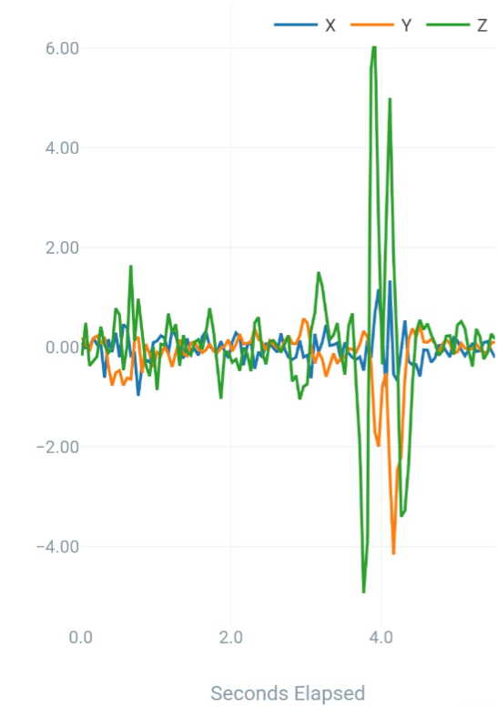
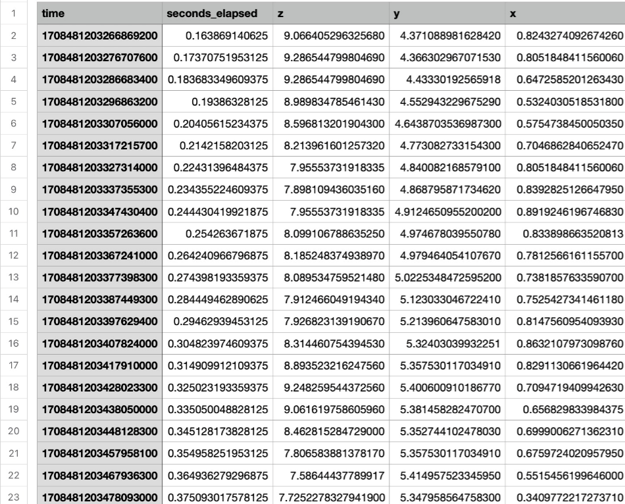
Neural Network Models
Convulsion Neural Network (CNN)
Deep Neural Network (DNN)
We will enhance our machine learning model to replicate real-world scenarios, such as falling, walking, and stationary movements, by integrating it with accelerometer and gyroscope sensors.
This model reads live data to predict the motion status of workers, providing potential hazard detection.
In the event of a hazard, it promptly sends an alert for immediate attention.

Slide 9
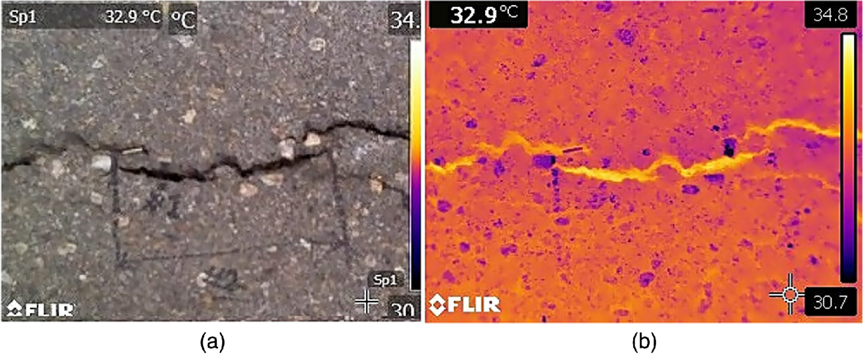
Convulsion Neural Network (CNN)
By leveraging a comprehensive database of cracked walls, we will develop a highly accurate CNN model for detection.
Our Convolutional Neural Network (CNN) model will be capable of predicting minute cracks in walls that may go unnoticed by humans. This capability significantly increases our chances of preventing potential disasters in the future.
This innovative assessing structural predictive maintenance tool empowers structural engineers with unparalleled precision in integrity

Slide 10
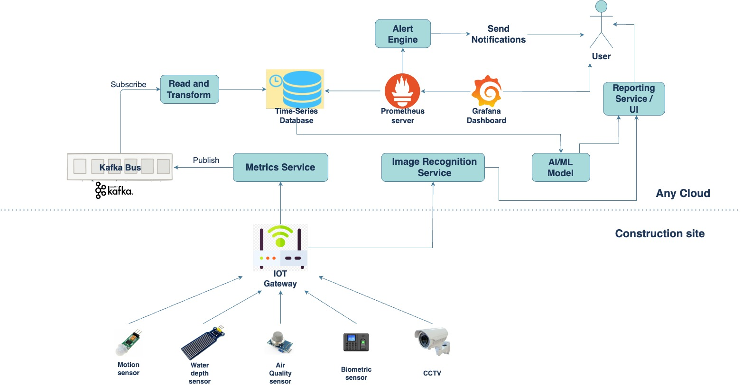
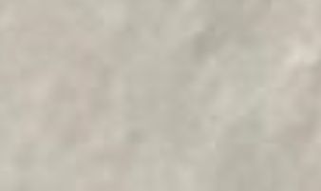
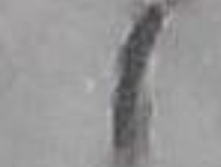
Business model and future prospects
Convulsion Neural Network (CNN)
Model Flowchart

Slide 11
Business model and future prospects
Why should a discerning entrepreneur consider investing in our model for their business??
Investing in our model aligns with Digital Twin and Building Information Modeling (BIM), ensuring a precise digital replica of buildings. This approach enhances worker safety, boosts construction efficiency, prevents infrastructure-related costs, and accelerates project timelines. This strategic investment prioritizes worker well-being while delivering long-term cost-effectiveness and expedited project completion.
How much is it going to cost?
According to research by the prestigious Georgia Tech University, it costs about $0.1 per meter square.
How is E404’s model different from Azure twin building models??
Our model is different from traditional building models in a few ways. Our model is designed to be more comprehensive, including information about the building's occupants, energy use, and environmental impact. Additionally, our model is designed to be more dynamic, and able to adapt to changes in the building's use and occupancy.

