Slide 1
What the Model Learns
from Coded Audio
Null-Calibrated Feature Attribution in Explainable Speech Emotion Recognition
Akshath R
Independent researcher · akshath.r333@gmail.com
7,442
4
436
15
CREMA-D clips
91 actors
coding conditions
29,768 files
named acoustic
descriptors
classifiers
+ 10 XAI methods

Slide 2
INTRODUCTION · PROBLEM STATEMENT
Models are validated on WAV and deployed on coded audio
• Benchmarks ship as uncompressed WAV and are read straight from disk. Almost nothing reaches an inference endpoint that way.
Contact-centre archives hold MP3. Streaming clients negotiate AAC or Opus. Broadcast pipelines resample and requantise.
• The usual defence: every ingestion path decodes to linear PCM before features are extracted, so the delivery format looks like an implementation detail.
• Where that defence has been tested, it has been tested on accuracy — and accuracy is now only half of what a deployed affective system is required to report.
A clinician, an auditor or a QA analyst is shown an attribution over acoustic evidence. That second output has its own robustness properties, and they do not follow from the first.
THE QUESTION
Does perceptual coding change the evidence a speech-emotion model uses — not just how often it is right?
Answered with models whose evidence is a named acoustic descriptor rather than a latent dimension, so every attribution has a phonetic reading by construction.
Attribution fragility has been demonstrated under adversarial perturbation. A transcode is not adversarial. It is routine, it is everywhere, and it is almost never logged.
Null-Calibrated Feature Attribution in Explainable SER · CREMA-D
2 / 20

Slide 3
LITERATURE
What the literature establishes, and where it stops
Coding × speech tasks
Attribution fragility
Interpretability for audio
Reddy & Vijayarajan (2020) — codec effects on SER are real, modest, and depend on both codec family and front end. Coding interacts with the representation rather than degrading uniformly.
Wu et al. (2024), Codec-SUPERB — signal-domain fidelity metrics fail to predict whether task-relevant information survives. A codec can score well on reconstruction and still discard paralinguistics.
Ghorbani et al. (2019) — perturbations below human perception, with identical predictions, still produce very different attributions.
Adebayo et al. (2018) — some saliency methods are statistically independent of the model they claim to explain.
Krishna et al. (2022) — methods disagree on the same fitted model, and practitioners resolve it on no principled basis.
Haunschmid et al. (2020) — audio explanations must be listenable; image-segmentation logic on spectrograms yields components with no perceptual correlate. Nasr et al. (2025) extend the critique to speech emotion specifically.
Rudin (2019) — in high-stakes settings, replace the post-hoc layer with an intrinsically interpretable model. Our leaderboard speaks to this directly, and does not support it.
Coding is known to interact with the front end, and attribution is known to be fragile — but the two literatures have never been put in the same experiment.
Null-Calibrated Feature Attribution in Explainable SER · CREMA-D
3 / 20

Slide 4
RESEARCH GAP
The gap, and what this paper contributes
WHERE THE GAP LIES
CONTRIBUTIONS
• Coding effects are characterised for accuracy, and never for evidence.
• Attribution fragility is characterised for vision under adversarial perturbation, and not for audio under the routine degradation that actually occurs.
• No prior work isolates the container under a verified constraint of signal invariance, and none calibrates an importance shift against a matched empty perturbation.
1
A matched-format decomposition of the codec effect. 38.6 points of loss recovered by training in the served condition — the codec does not remove the affective information.
2
Tree structure as a readable attribution. Which named test the codec changes, at which threshold, and how far the agreement reaches; entropy at every node separates structural from informational agreement.
3
Null calibration for feature-importance shift. Three floors — tie-breaking, actor resampling, and an informationally empty container re-wrap — under a paired within-draw design.
4
A repair that is diagnosable and cheap. One named descriptor recovers 98 % of a kernel machine's loss, at no cost on clean audio.
5
A class-level reading of the mismatch failure. The mismatched network abandons half the label space — arithmetically invisible to balanced accuracy.
6
Two negative results reported rather than smoothed over. XAI methods disagree on one fitted model; a global ranking can look stable while the classifier has stopped working.
Null-Calibrated Feature Attribution in Explainable SER · CREMA-D
4 / 20

Slide 5
DATASET AND EXPERIMENTAL DESIGN
CREMA-D, rendered in four coding conditions
THE CORPUS
THE FOUR CONDITIONS
Clips | 7,442 (7,441 usable)
Actors | 91 — 48 male, 43 female, ages 20–74
Sentences | 12 fixed, identical across emotions
Emotions | 6 — ANG DIS FEA HAP NEU SAD
Clip length | 2.54 s ± 0.51
Split | speaker-independent, 60 / 11 / 20 actors
 | 4,905 / 896 / 1,640 clips
Canonical reference: 16 kHz mono 16-bit PCM, loudness-normalised to EBU R128 (I = −23 LUFS, LRA 7, TP −2 dB). One encoder invocation per condition; one identical FFmpeg call decodes them all, so the decoder never confounds the codec.
Condition | What it is | What it varies
ref | uncompressed WAV | the reference
mp3_64 | MP3 @ 64 kbit/s | codec
mp4_aac64 | MP4/AAC @ 64 kbit/s | codec
roundtrip_wav | AAC bitstream re-wrapped as WAV | container only
• Holding the words constant removes the lexical channel. Any signal a model recovers is carried by acoustic realisation — which is exactly what perceptual coding operates on.
• Human voice-only ceiling is 45.5 % (NEU recall 0.966, SAD 0.164) — context for the absolute accuracies, not a target.
• Speaker η² = 0.178 against emotion η² = 0.098, and 340 of 436 descriptors are speaker-dominant. Speaker-independent splitting is load-bearing here, not a refinement.
• Extraction failed on exactly one clip, 1076_MTI_SAD_XX — the one the corpus documents as containing no audio.
roundtrip_wav is the device that makes the study identifiable.
It carries the same codec output through a different container, so it changes the decode path and no coding information at all. Median standardised feature difference |SMD| = 7.6 × 10⁻⁵; only 12 of 436 descriptors exceed 0.05. That is the noise floor of this study, and it is used as an informationally empty perturbation rather than merely reported as small.
Null-Calibrated Feature Attribution in Explainable SER · CREMA-D
5 / 20

Slide 6
METHODOLOGY · REPRESENTATION
436 named acoustic descriptors, not learned features
Family | n | Contents
Cepstral | 240 | 20 MFCCs with their Δ and ΔΔ temporal derivatives
Spectral | 114 | centroid, bandwidth, roll-off 85/95 %, flatness, flux, entropy, slope, ZCR, RMS, 7-band contrast, 8 band-energy ratios, HF survival above 4 and 6 kHz
Prosodic | 56 | F₀ statistics and slope, jitter (local/RAP/PPQ5/DDP), shimmer (local/dB/APQ3/APQ5/APQ11/DDA), HNR, formants F₁–F₅ with bandwidths, intensity, voiced timing, CPPS
Chroma + global | 26 | 12 chroma bins; clip duration and peak amplitude
WHY NAMED DESCRIPTORS
An attribution on a latent dimension is not a claim about anything an acoustician would recognise.
An attribution on prosody_cpps is a claim about breathiness. A split on spectral_contrast_6_mean is a claim about the 6–8 kHz band. Everything here is exact rather than estimated, and can be checked against an acoustic reading.
SEPARABILITY
• Every frame-level contour is collapsed to eight order statistics — mean, std, min, max, median, IQR, skewness, excess kurtosis.
• librosa with a 512-point FFT, 400-sample window, 160-sample hop; prosody in Praat through Parselmouth. Chroma tuning is pinned to zero — an estimated tuning would itself shift under compression and become part of the effect being measured.
• 397 of 436 descriptors separate emotion at Bonferroni-corrected significance.
• Strongest: mfcc_d1_00_std (F = 1194), mfcc_00_std (1159), prosody_intensity_std (1078) — all variability measures. Emotion in acted speech lives in the dynamics.
• 51 principal components for 95 % of variance: genuinely high-dimensional, not a few latent factors under 436 names.
Null-Calibrated Feature Attribution in Explainable SER · CREMA-D
6 / 20

Slide 7
METHODOLOGY · MODELS
Fifteen models, an explicit splitting criterion, ten XAI methods
THE ZOO
• 14 scikit-learn classifiers spanning tree ensembles, kernel machines, linear and discriminant models, and instance-based and probabilistic baselines.
• 1 PyTorch MLP — 512-256-128, batch norm, dropout 0.3, AdamW under a cosine schedule, class-weighted cross-entropy with label smoothing, early stopping on validation balanced accuracy.
ENTROPY AND INFORMATION GAIN
Trees are grown with the Shannon-entropy criterion rather than Gini, so the split rules reported later are exactly the rules these equations describe. Class weights are balanced.
H(S) = − Σc pc log2 pc
IG(S, f, τ) = H(S) − (wL/w) H(SL) − (wR/w) H(SR)
THE XAI STACK
• Tabular — TreeSHAP (exact for ensembles), LinearSHAP, KernelSHAP, LIME, permutation importance, partial dependence, and a depth-4 global surrogate tree.
• Network — six Captum methods: Saliency, Input×Gradient, Integrated Gradients, DeepLIFT, GradientSHAP, Feature Ablation.
• All attribution is measured on the held-out speakers.
WORKED EXAMPLE · THE ROOT OF EVERY TREE
• Balanced weights make the root entropy identical in all four conditions: H = log₂ 6 = 2.5850 bits.
• On uncompressed audio the maximising test is prosody_intensity_std ≤ 8.2184, sending 3098.67 of the 4905.00 weighted samples left.
• IG = 2.5850 − 1.5066 − 0.7693 = 0.3090 bits.
• The single most informative question about a CREMA-D clip is how much does its loudness vary, and the answer resolves 12 % of the total label uncertainty.
Null-Calibrated Feature Attribution in Explainable SER · CREMA-D
7 / 20

Slide 8
METHODOLOGY · NULL CALIBRATION
An attribution-shift claim needs a null: the ranking itself is fragile
• A claim of the form “compression changed which features the model relies on” is easy to produce and hard to justify.
• Feature-importance rankings are unstable by construction. Two descriptors that split the data almost equally well trade places, and a single swap near the root reroutes every node below it.
• The general warning is in the literature. The specific discipline it implies — measure the shift induced by a manipulation that carries no information — is not yet standard practice.
THE PAIRED WITHIN-DRAW DESIGN
Draw
On each of 20 draws, sample 51 of the 60 training actors without replacement. No actor is duplicated.
Floor
Fit the tree twice on the uncompressed audio of those actors under different tie-breaking. That is the floor for this draw.
Effect
Fit once on the coded audio of the same actors. That is the effect for this draw.
THREE FLOORS, ALL ON THE SAME ESTIMATOR
Floor | What it varies
Tie-breaking | the estimator only, data held fixed
Actor bootstrap | which actors are fitted, codec fixed
Container re-wrap | the decode path, codec output fixed
Test
Wilcoxon signed-rank on the paired per-draw difference. Sampling variance is held fixed by construction.
Made marginally, the actor-resampling floor is wide enough to swallow every codec effect, and we would have reported nothing at all. Floor and effect must be measured inside the same draw.
Null-Calibrated Feature Attribution in Explainable SER · CREMA-D
8 / 20

Slide 9
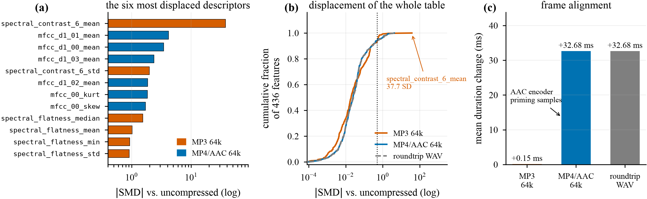
RESULTS · WHAT CODING DOES TO THE DESCRIPTORS
Two codecs, two entirely different mechanisms
Measured on the feature table over 7,441 clips, before any model is involved. (a) the six most displaced descriptors under each codec · (b) ECDF of |SMD| over all 436 · (c) the encoder-priming shift.
MP3 @ 64 kbit/s abandons the top octave
MP4/AAC shifts frame alignment
Perceptual bit allocation quantises the highest band coarsely and sets masked bins to zero.
spectral_contrast_6_mean (the 6–8 kHz band) moves 16.38 → 46.54, which is 38.6 training standard deviations. Spectral flatness collapses with it, mean 0.0189 → 0.0066.
The descriptor arrives at inference in a range no model fitted on clean audio has ever seen. Concentrated damage.
Encoder priming lengthens every clip uniformly by +32.68 ms. MP3 adds only 0.15 ms.
That perturbs every frame-aligned temporal derivative a little: the largest AAC shifts are all delta-MFCC means, led by mfcc_d1_01_mean at SMD = −4.16.
Diffuse damage. Caveat: delta means sit near zero with small standard deviations, so their SMDs are inflated; the duration measurement is the harder evidence.
Null-Calibrated Feature Attribution in Explainable SER · CREMA-D
9 / 20

Slide 10
RESULTS · IN-FORMAT PERFORMANCE
On clean audio, intrinsic interpretability costs a third of the performance
Model | Acc. | Bal. acc. | Macro F₁ | κ
ANN (PyTorch) | 0.599 | 0.599 | 0.596 | 0.518
LightGBM | 0.590 | 0.591 | 0.584 | 0.508
SVM (RBF) | 0.585 | 0.586 | 0.581 | 0.502
LDA (shrinkage) | 0.585 | 0.585 | 0.580 | 0.502
Linear SVM | 0.583 | 0.584 | 0.577 | 0.500
XGBoost | 0.581 | 0.582 | 0.575 | 0.497
MLP (scikit-learn) | 0.573 | 0.574 | 0.569 | 0.488
Logistic regression | 0.565 | 0.567 | 0.561 | 0.478
Random forest | 0.532 | 0.535 | 0.517 | 0.439
kNN (k = 15) | 0.477 | 0.479 | 0.466 | 0.373
Decision tree | 0.390 | 0.391 | 0.382 | 0.268
Dummy (majority) | 0.171 | 0.167 | 0.049 | 0.000
0.391
0.599
−34 %
decision tree
balanced accuracy
PyTorch ANN
balanced accuracy
the price of a model
a human can read
• The decision tree is the one model in the zoo a human can read from beginning to end, and it reaches 0.391 against 0.599 for the network. Intrinsic interpretability costs a third of what is achievable here.
• That argues against Rudin's prescription in this specific setting, and in favour of applying post-hoc attribution to a strong model.
• The spread between the top eight models is less than three points, so the leaderboard ordering carries little information. The differences that matter here are 10 to 38 points, and they appear only when the coding condition changes.
Six-way task, 20 held-out speakers. Chance = 0.167; human voice-only ceiling = 0.455. Eleven of fifteen models shown.
Every model beats the 45.5 % human voice-only ceiling: they are trained on the intended label and exploit acting cues listeners do not consciously decode.
Null-Calibrated Feature Attribution in Explainable SER · CREMA-D
10 / 20

Slide 11
RESULTS · TRAIN / SERVE MISMATCH
Robustness is decided by how a model consumes a value
AXIS-ALIGNED PARTITIONING · MAGNITUDE-SENSITIVE
• The split is categorical, not graded. Every tree-based model stays within ±0.014 of its clean score on MP3. Every model that consumes a descriptor as a continuous magnitude loses 12 to 38 points.
• The mechanism is readable because the descriptors are named. A tree asks whether spectral_contrast_6_mean exceeds a threshold near 17, and the answer is the same at 16.4 or at 46.5. A kernel model multiplies that 38σ excursion straight into its decision function.
• The groups are named for the property that separates them, not for a model family: kNN computes distances and Gaussian NB per-descriptor likelihoods. What all eight share is that magnitude enters continuously.
• Container routing has no material effect. Across the fifteen models the median difference between roundtrip and mp4_aac64 is 0.003 and the maximum 0.010 — one to two orders of magnitude below the codec effects.
Model | ref | mp3_64 | Δ MP3 | aac64 | Δ AAC | r-trip
LightGBM | 0.591 | 0.586 | −0.005 | 0.559 | −0.032 | 0.562
XGBoost | 0.582 | 0.586 | +0.004 | 0.560 | −0.022 | 0.560
HistGradientBoosting | 0.573 | 0.559 | −0.014 | 0.530 | −0.043 | 0.533
Random forest | 0.535 | 0.532 | −0.003 | 0.522 | −0.013 | 0.522
Extra trees | 0.519 | 0.521 | +0.002 | 0.512 | −0.007 | 0.507
Decision tree | 0.391 | 0.382 | −0.009 | 0.367 | −0.023 | 0.371
kNN | 0.479 | 0.362 | −0.118 | 0.467 | −0.012 | 0.457
Gaussian NB | 0.430 | 0.277 | −0.152 | 0.437 | +0.008 | 0.433
Linear SVM | 0.584 | 0.405 | −0.179 | 0.471 | −0.113 | 0.462
MLP (scikit-learn) | 0.574 | 0.383 | −0.191 | 0.491 | −0.083 | 0.494
ANN (PyTorch) | 0.599 | 0.354 | −0.246 | 0.513 | −0.087 | 0.512
LDA (shrinkage) | 0.585 | 0.338 | −0.247 | 0.507 | −0.079 | 0.502
Logistic regression | 0.567 | 0.233 | −0.334 | 0.472 | −0.095 | 0.470
SVM (RBF) | 0.586 | 0.203 | −0.383 | 0.499 | −0.087 | 0.497
All fifteen models, trained on uncompressed audio only. Balanced accuracy on 20 held-out speakers.
MP4/AAC costs everyone something and nobody very much — 0.7 to 11 points regardless of family.
Null-Calibrated Feature Attribution in Explainable SER · CREMA-D
11 / 20

Slide 12
RESULTS · THE COLLAPSE, OPENED BY CLASS
Balanced accuracy is arithmetically unable to show what actually failed
CLIPS THE NETWORK PREDICTS INTO EACH CLASS, OF 1,640
• Under MP3 the network never predicts disgust, neutrality or sadness. Not rarely — never: zero predictions across all 1,640 test clips. What survives is a three-way classifier that routes 934 clips, 57 % of the test set, into fear.
• The arithmetic that hides this is worth stating. Three of six per-class recalls are zero by construction, so the highest score this degenerate model could reach is 0.500 even with perfect recall on the classes it still emits. It reaches 0.354 of that — which reads as moderate degradation rather than structural failure.
• Macro F₁ is the more honest instrument and falls 0.596 → 0.249; top-2 accuracy falls 0.805 → 0.477.
• AAC shows the same mechanism mildly, which is what makes it a mechanism and not an artefact of one extreme setting: neutrality nearly vanishes (248 → 84 predictions, F₁ 0.611 → 0.340) and disgust absorbs the displaced mass (221 → 432). The container control reproduces it to within a few clips per class.
Condition | ANG | DIS | FEA | HAP | NEU | SAD
ref | 299 | 221 | 322 | 253 | 248 | 297
mp3_64 | 375 | 0 | 934 | 331 | 0 | 0
mp4_aac64 | 319 | 432 | 315 | 292 | 84 | 198
roundtrip_wav | 293 | 441 | 311 | 308 | 82 | 205
PER-CLASS F₁
Condition | ANG | DIS | FEA | HAP | NEU | SAD
ref | 0.770 | 0.467 | 0.555 | 0.567 | 0.611 | 0.607
mp3_64 | 0.660 | 0.000 | 0.407 | 0.429 | 0.000 | 0.000
mp4_aac64 | 0.718 | 0.416 | 0.555 | 0.538 | 0.340 | 0.481
roundtrip_wav | 0.705 | 0.422 | 0.562 | 0.531 | 0.342 | 0.495
A monitor watching balanced accuracy alone records a serious but ordinary degradation. A monitor watching the predicted-class histogram — which costs nothing to compute — sees half the label space disappear.
Null-Calibrated Feature Attribution in Explainable SER · CREMA-D
12 / 20

Slide 13
RESULTS · MATCHED-FORMAT TRAINING
The codec does not remove the affective information
BALANCED ACCURACY WHEN FITTED AND EVALUATED IN THE SAME CONDITION
• The codec does not remove the information. The RBF-SVM scores 0.589 on MP3 when it is trained on MP3, against 0.586 on clean audio — a recovery of 38.6 points over its mismatched 0.203. If 64 kbit/s MP3 destroyed the acoustic correlates of emotion, no model fitted on MP3 could recover them.
• No model has a spread greater than 0.039 across the four conditions. The catastrophic cross-format column measures an artefact of deployment practice, not a property of the codec.
• The tree family's advantage exists only under mismatch. Under matched training LightGBM leads the RBF-SVM by 0.008 on clean audio and trails it by 0.006 on MP3.
• The fix is format-specific, not a general immunisation. An RBF-SVM trained on mp4_aac64 and served MP3 falls to 0.167 — exactly chance. Matched training protects against the codec it saw and no other, which is why the descriptor-level repair is the more practical remedy when the delivery format is unknown in advance.
Model | WAV | MP3 | AAC | r-trip | range
LightGBM | 0.591 | 0.583 | 0.582 | 0.585 | 0.008
SVM (RBF) | 0.586 | 0.589 | 0.572 | 0.572 | 0.017
LDA (shrinkage) | 0.585 | 0.586 | 0.579 | 0.584 | 0.007
MLP (scikit-learn) | 0.574 | 0.566 | 0.569 | 0.558 | 0.017
Logistic regression | 0.567 | 0.563 | 0.570 | 0.567 | 0.008
Random forest | 0.526 | 0.519 | 0.524 | 0.523 | 0.007
Decision tree (d = 12) | 0.408 | 0.379 | 0.398 | 0.369 | 0.039
Decision tree (d = 3) | 0.407 | 0.408 | 0.389 | 0.389 | 0.019
+38.6
+33.0
+24.8
points recovered
by the RBF-SVM
logistic
regression
LDA
Null-Calibrated Feature Attribution in Explainable SER · CREMA-D
13 / 20

Slide 14
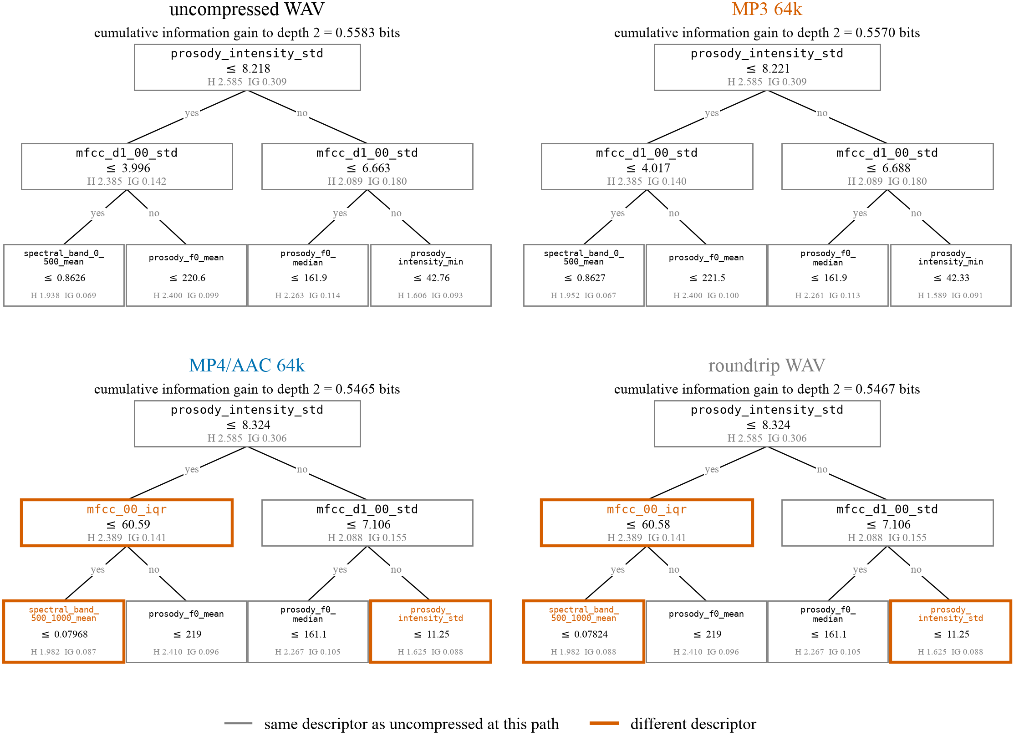
RESULTS · TREE STRUCTURE AS A READABLE ATTRIBUTION
The same root question in every condition, then a substitution
ROOT (H = 2.5850 BITS) · THEN DEPTH 1, BRANCH L
Condition | Descriptor | Threshold | IG
ref | prosody_intensity_std | 8.2184 | 0.3090
mp3_64 | prosody_intensity_std | 8.2210 | 0.3090
mp4_aac64 | prosody_intensity_std | 8.3241 | 0.3064
roundtrip_wav | prosody_intensity_std | 8.3241 | 0.3064
ref | mfcc_d1_00_std | 3.9965 | 0.1415
mp3_64 | mfcc_d1_00_std | 4.0175 | 0.1398
mp4_aac64 | mfcc_00_iqr | 60.5853 | 0.1408
roundtrip_wav | mfcc_00_iqr | 60.5802 | 0.1408
• The primary evidence does not change, and the threshold moves in step with the mechanism. MP3 shifts it by 0.03 %, AAC by 1.29 %: AAC priming adds 32.68 ms of near-silent lead-in to every clip, raising the dispersion of the intensity contour, and the tree compensates.
• The trees diverge at depth 1, under AAC and not under MP3. WAV and MP3 ask about mfcc_d1_00_std, a temporal derivative; AAC abandons it for mfcc_00_iqr, a static dispersion measure of the same coefficient, at 0.1408 bits against 0.1415 — exactly what a frame-alignment perturbation should do.
• The container control reproduces structurally. mp4_aac64 and roundtrip_wav select identical descriptors at all seven nodes.
Null-Calibrated Feature Attribution in Explainable SER · CREMA-D
14 / 20

Slide 15
RESULTS · THE ENTROPY CALCULATION THROUGH THE WHOLE TREE
Structure is lost with depth. The information budget is not.
DESCRIPTOR AGREEMENT AT PATH-ALIGNED NODES
INFORMATION GAIN BY DEPTH
• Sample-weighted, so the depths are commensurable and sum to the total. Entropy falls along almost the same trajectory in every condition: no per-depth mean differs from the uncompressed value by more than 0.064 bits.
• Over six levels WAV extracts 0.8754 of the 2.5850 bits available, MP3 0.8714 (−0.46 %) and AAC 0.8590 (−1.87 %).
• The empty re-wrap extracts the lowest total of the four while carrying no coding information at all — a difference of this size sits inside the floor.
• One caution. Gain per depth bottoms out at depth 3 and then rises again, 0.0832 → 0.1292 — the signature of fitting noise, not of resolved structure. Much of the deep tree should not be read as evidence about emotion at all.
Comparison | d0 | d1 | d2 | d3 | d4 | d5
Tie-breaking | 1/1 | 2/2 | 4/4 | 8/8 | 16/16 | 29/30
Empty container re-wrap | 1/1 | 2/2 | 4/4 | 8/8 | 11/16 | 12/23
MP3 @ 64k | 1/1 | 2/2 | 4/4 | 4/8 | 5/16 | 4/27
MP4/AAC @ 64k | 1/1 | 1/2 | 2/4 | 0/8 | 1/16 | 0/24
Roundtrip WAV | 1/1 | 1/2 | 2/4 | 0/8 | 0/16 | 0/23
Depth | ref | mp3 | aac | r-trip
0 | 0.3090 | 0.3090 | 0.3064 | 0.3064
1 | 0.1556 | 0.1546 | 0.1462 | 0.1462
2 | 0.0938 | 0.0935 | 0.0939 | 0.0941
3 | 0.0832 | 0.0842 | 0.0863 | 0.0860
4 | 0.1047 | 0.1027 | 0.1036 | 0.1031
5 | 0.1292 | 0.1275 | 0.1226 | 0.1220
total | 0.8754 | 0.8714 | 0.8590 | 0.8578
Rows above the rule carry no coding information. Cells give the number of path-aligned nodes selecting the same descriptor, of those internal in both trees.
• Trees grown to depth 6 per condition and aligned on the path from the root — the only identifier that means the same thing in two trees fitted on different data.
• Refitting on identical audio leaves every node to depth 4 untouched, and an informationally empty re-wrap costs three levels: exact to depth 3, then 69 % at depth 4.
• Both codecs fall below that floor, in the order the mechanisms predict: MP3 to depth 2, AAC to depth 0. Over 20 paired draws every gap is significant (p ≤ 3.5 × 10⁻⁴).
MEAN NODE ENTROPY H̄
Depth | ref | mp3 | aac | r-trip
0 | 2.5850 | 2.5850 | 2.5850 | 2.5850
2 | 2.0516 | 2.0506 | 2.0708 | 2.0708
5 | 1.7245 | 1.7882 | 1.7458 | 1.7369
Below depth 2 the AAC tree shares essentially no structure with the reference, and still resolves the same label uncertainty to within two parts in a hundred. Coding changes which question the model asks, and leaves the answer worth the same.
Null-Calibrated Feature Attribution in Explainable SER · CREMA-D
15 / 20

Slide 16
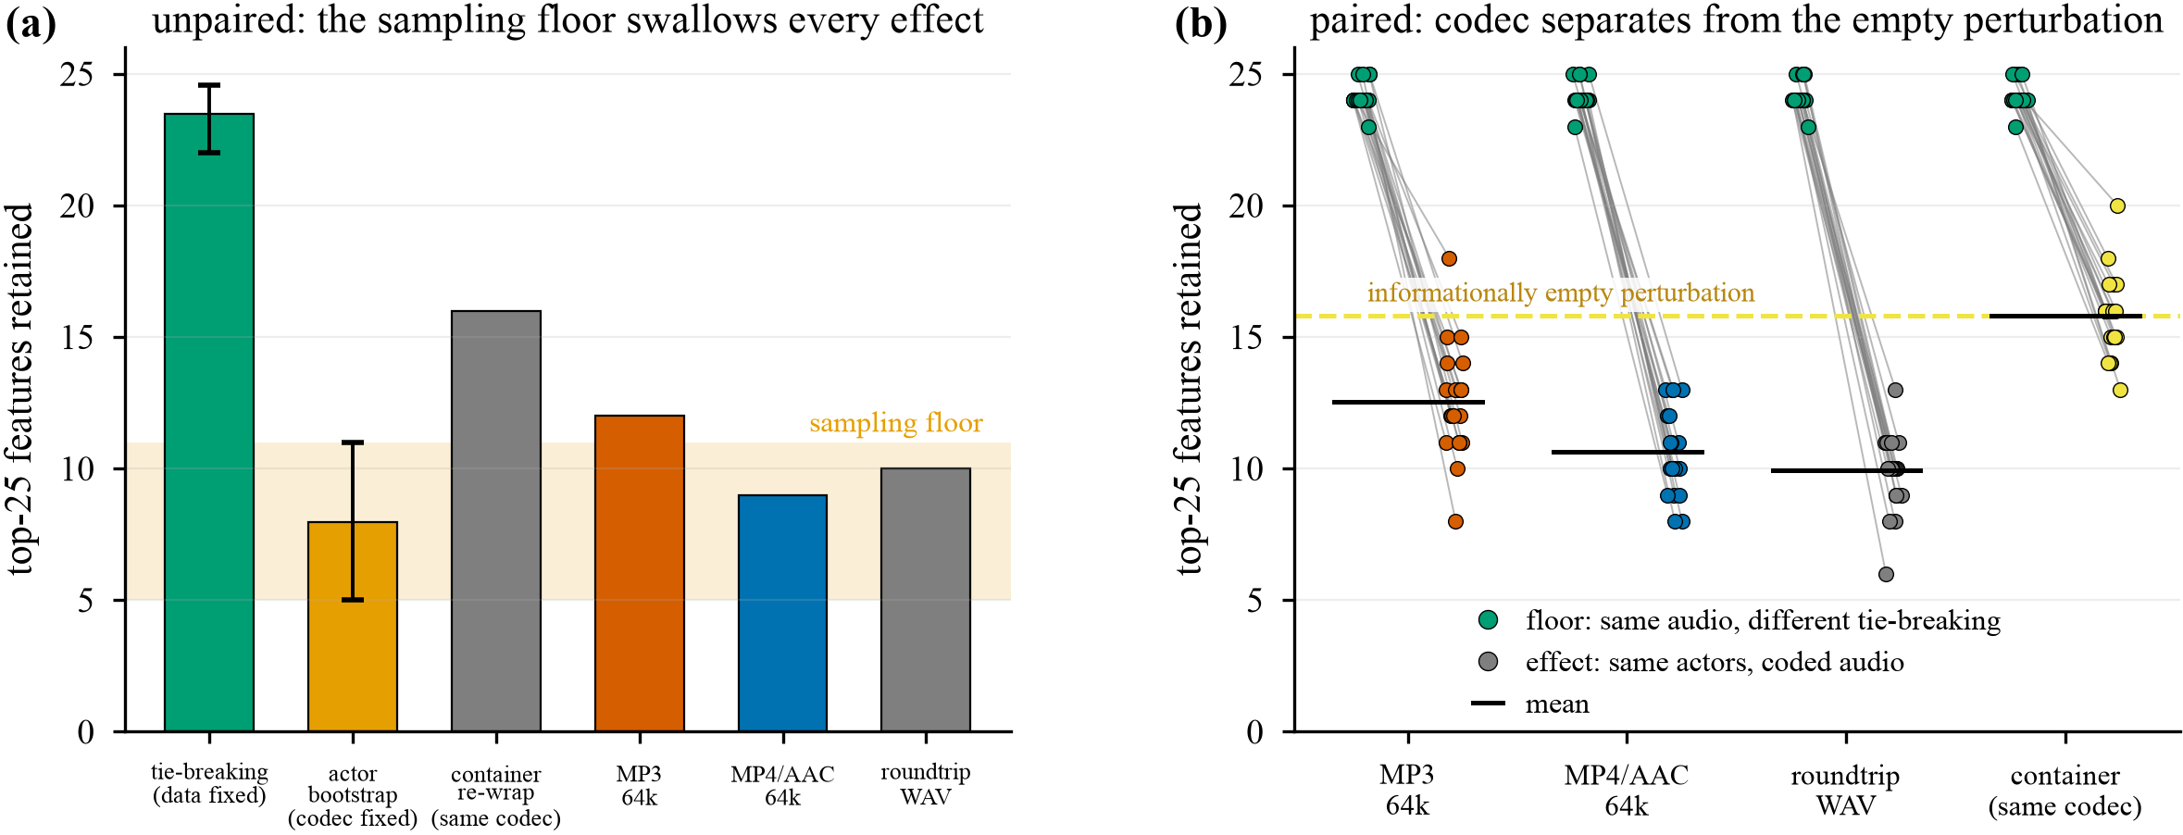
RESULTS · NULL CALIBRATION
Most of the apparent codec effect is generic sensitivity to perturbation
PAIRED WITHIN-DRAW: 20 DRAWS OF 51 OF 60 TRAINING ACTORS
• The estimator is reproducible. With the data fixed and only tie-breaking varied, the tree keeps 24.15 of its 25 top descriptors at ρ = 0.958. Whatever else here is fragile, the fitting procedure is not.
• An informationally empty perturbation is expensive. The container re-wrap is the same AAC bitstream, decoded the same way, differing by a single int16 requantisation whose median effect is 7.6 × 10⁻⁵ standardised units. It still costs 8.35 of the 25 top descriptors. A ranking that turns over by a third under a manipulation carrying no information cannot be read as a description of what the model needs.
• The codec effect is real, and about two fifths of its apparent size. Measured against the empty floor, MP3 keeps 12.55 and AAC 10.65. Of the 13.5 descriptors AAC appears to displace, 8.35 are generic sensitivity and only 5.15 are the codec. Reporting the raw figure over-attributes by a factor of 2.6.
• AAC displaces more of the ranking than MP3 — the reverse of the accuracy ordering, where MP3 is catastrophic and AAC mild. Coding that perturbs every temporal derivative slightly reorganises a tree more than coding that destroys one band the tree can threshold around.
 | top-25 kept | ρ | p vs. floor
floor (same audio, refit) | 24.15 | +0.958 | n/a
Container re-wrap (empty) | 15.80 | +0.196 | 8.1 × 10⁻⁵
MP3 @ 64k | 12.55 | −0.068 | 8.4 × 10⁻⁵
MP4/AAC @ 64k | 10.65 | −0.137 | 8.3 × 10⁻⁵
Roundtrip WAV | 9.95 | −0.126 | 7.9 × 10⁻⁵
(a) made marginally, the actor-resampling floor swallows every codec effect · (b) floor and effect inside the same draw.
Null-Calibrated Feature Attribution in Explainable SER · CREMA-D
16 / 20

Slide 17
RESULTS · EXPLAINABILITY, WHAT HOLDS
Five model families and four attribution algorithms return one answer
• The convergence. The top SHAP descriptors for XGBoost and LightGBM are identical in their first five: mfcc_d1_00_std, mfcc_d2_00_std, duration_s, prosody_intensity_std, mfcc_00_std. The decision tree leads with prosody_intensity_std, matching its own root split. All six gradient methods on the network return the same leaders.
• The two leading descriptors are the standard deviations of the first and second derivative of MFCC-0 — how variable the rate of change of overall loudness is, which is a direct formalisation of vocal agitation.
• Attribution mass is spread across families, not concentrated. Integrated gradients gives MFCC 54.2 %, spectral 23.8 %, prosody 15.3 %, chroma 5.7 %. MFCCs hold 55 % of the columns and take 54 % of the attribution: no per-descriptor advantage. The decision tree is the outlier, leaning on prosody at 0.306.
MOST-ATTRIBUTED DESCRIPTORS PER EMOTION (INTEGRATED GRADIENTS)
 | Descriptors | Reading
ANG | mfcc_d1_00_std (0.294), mfcc_d2_00_std (0.232) | loudness dynamics
DIS | duration_s (0.285), prosody_f2_std (0.241) | timing, F₂ movement
FEA | prosody_f0_median (0.235), prosody_hnr_std (0.181) | raised, unstable pitch
HAP | duration_s (0.307), spectral_flux_std (0.247) | spectral churn
NEU | mfcc_00_skew (0.327), prosody_cpps (0.327) | steady phonation
SAD | prosody_cpps (0.154), mfcc_d2_00_std (0.149) | breathiness
• A construct-validity check, not a finding about emotion. CPPS, the standard correlate of breathy phonation, leads for sadness; median F₀ leads for fear; F₂ movement leads for disgust — with no phonetic supervision.
• Two of these connect to the coding results. prosody_cpps leads for sadness and is one of the descriptors that leaves the top 25 under MP3; duration_s leads for disgust and happiness and is what AAC priming moves by 32.68 ms. The emotions whose evidence the codecs disturb are identifiable in advance from this table.
THE ROBUST SET
Only the descriptors that survive all four independent views should be reported as robust. Here that set is mfcc_d1_00_std, prosody_intensity_std, duration_s, prosody_cpps and prosody_f0_median.
Null-Calibrated Feature Attribution in Explainable SER · CREMA-D
17 / 20

Slide 18
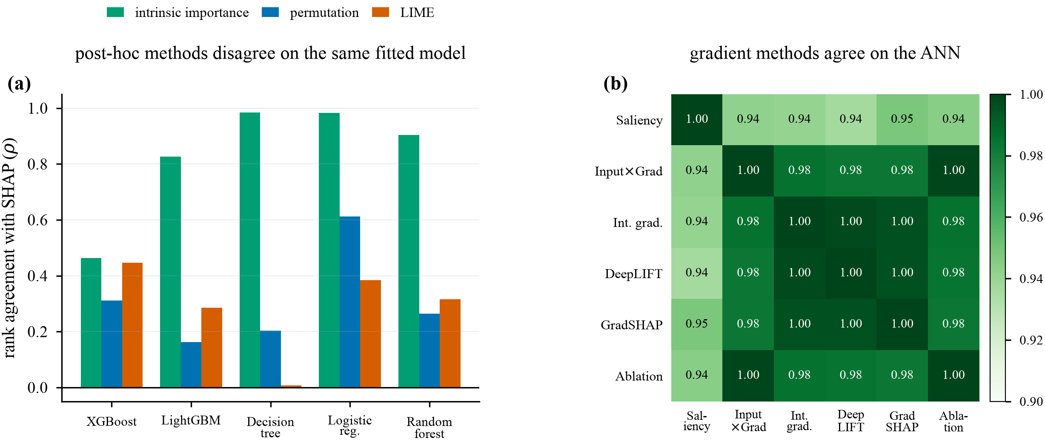
RESULTS · EXPLAINABILITY, WHAT FAILS
Three negative results we report rather than smooth over
2 · A BLIND SPOT IN GLOBAL ATTRIBUTION METRICS
Under MP3, logistic regression keeps a near-identical SHAP ranking — ρ = 0.987, 22 of 25 top descriptors retained — while its balanced accuracy collapses from 0.567 to 0.233.
Its coefficients did not change. Only the inputs moved out of range, and a global ranking over mean |SHAP| is largely blind to that. A global attribution-stability metric can report that nothing has changed while the classifier has effectively stopped working.
(a) post-hoc methods on the same fitted tabular model · (b) the six gradient-family methods on the network.
• 1 · The methods disagree with each other. SHAP tracks a model's intrinsic importance closely for the simpler models — ρ = 0.98 for both the decision tree and logistic regression — while LIME and permutation importance are close to unrelated to it. On the decision tree, LIME and SHAP rank descriptors at ρ = 0.008, while still sharing 10 of their top 20.
• Panel (b) sharpens this rather than softening it: the six gradient-family methods agree at ρ ≥ 0.94 for every pair. High agreement inside one family reflects a shared mathematical lineage, not correctness.
• A depth-4 global surrogate reproduces its target only 57–74 % of the time.
3 · AN ESTIMATOR THAT FAILED LOUDLY
• KernelSHAP was applied to the RBF-SVM with 100 sampled coalitions over 436 descriptors. It fits a weighted least-squares regression with one unknown per descriptor, so that system is rank-deficient — and it diverged. Maximum mean |SHAP| reached 2.1 × 10¹² against a median of 5.3 × 10⁻⁴.
• The cheap tell: a well-behaved additive attribution over 7,441 clips does not assign whole descriptor families exactly 0.000.
• The ranking is excluded from every conclusion as an estimation artefact, and the implementation now raises when the coalition budget does not exceed the descriptor count. The SVM's trustworthy views are permutation importance and LIME, whose top descriptors reproduce the consensus.
Null-Calibrated Feature Attribution in Explainable SER · CREMA-D
18 / 20

Slide 19
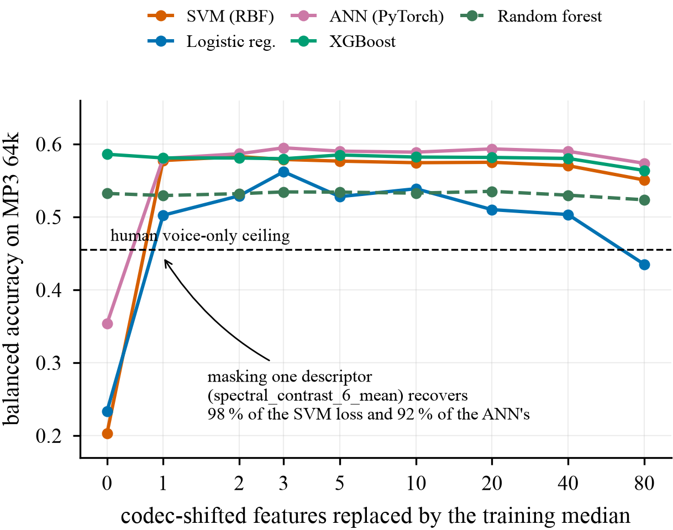
RESULTS · DIAGNOSIS AND REPAIR
One named descriptor recovers almost the entire collapse
BALANCED ACCURACY ON MP3 AS CODEC-SHIFTED DESCRIPTORS ARE MASKED
• Descriptors were ranked by how far each codec moves them in units of training standard deviation, then replaced progressively with training medians — in the compressed test set and the clean one.
• The single masked descriptor is spectral_contrast_6_mean. Masking it alone recovers 98 % of the RBF-SVM's 38.3-point loss and 92 % of the network's 24.6-point loss. Three descriptors bring logistic regression to 0.562 against its 0.567 clean score.
• Control 1. On uncompressed audio the identical masking costs nothing out to 20 descriptors — the network's clean control sits at 0.607–0.609, marginally above its 0.599 baseline. These columns never carried load-bearing evidence. They were the channel through which the encoder's fingerprint entered the model.
• Control 2. AAC behaves as its different mechanism predicts: no single descriptor dominates. The network's best recovery arrives at 10 masked (0.513 → 0.560), the SVM's at 40 (0.499 → 0.542).
• The diagnosis is covariate shift on a few identifiable descriptors, not a loss of emotional information.
Masked | SVM | Log. reg. | ANN | MLP | XGBoost | Tree
clean | 0.586 | 0.567 | 0.599 | 0.574 | 0.582 | 0.391
0 | 0.203 | 0.233 | 0.354 | 0.383 | 0.586 | 0.382
1 | 0.578 | 0.502 | 0.580 | 0.552 | 0.581 | 0.382
2 | 0.583 | 0.529 | 0.587 | 0.554 | 0.581 | 0.391
3 | 0.579 | 0.562 | 0.595 | 0.565 | 0.580 | 0.391
10 | 0.575 | 0.539 | 0.589 | 0.562 | 0.582 | 0.394
80 | 0.551 | 0.435 | 0.574 | 0.523 | 0.564 | 0.396
This repair has no counterpart in a system whose front end is learned: identifying the contaminated channel needed attribution over units that carry acoustic meaning.
Null-Calibrated Feature Attribution in Explainable SER · CREMA-D
19 / 20

Slide 20
CONCLUSION
Three questions that a single accuracy number runs together
1
Does the codec destroy the information?
No.
Matched-format training recovers 38.6 points and lands within 0.003 of the clean score.
THE TRANSPORTABLE RESULT
An informationally empty container re-wrap already displaces 8.35 of a tree's 25 most important descriptors. Only the gap beyond that floor belongs to the codec: 3.25 for MP3 and 5.15 for AAC.
We would ask reviewers to require, alongside any claim that an intervention changed a model's explanation, a measurement of the divergence induced by an intervention that carries no information. With it, our own claim shrinks by a factor of two and a half — and becomes defensible.
2
Does the codec break deployed models?
Severely.
Provided they consume descriptor magnitudes and were fitted on clean audio. And the aggregate conceals how: the network silently becomes a three-way classifier.
3
Does it change what the model learns?
Yes, but less.
The root test survives both codecs. MP3 leaves two further levels untouched, AAC none, and everything below is reorganised.
LIMITATIONS
4
Does that reorganisation cost anything?
No.
• Acted rather than spontaneous emotion, on 12 fixed sentences. Absolute accuracies do not transfer.
• One deterministic split, not repeated CV. The codec effects at issue are 10–38 points and are not at risk from split variance.
• Two codecs at one bitrate; 64 kbit/s is aggressive for MP3.
• Summary statistics discard time, so nothing here localises when in a clip the evidence sits.
Structural and informational agreement come apart. The AAC tree shares almost no structure below depth 2 and still resolves 0.859 bits against 0.875 — one question substituted for another of equal value.
Future work. A bit-exact container null · null calibration extended to SHAP and IG rankings under refitting · a bitrate ladder including Opus, turning the two-point comparison into a dose–response curve.
Null-Calibrated Feature Attribution in Explainable SER · CREMA-D
20 / 20

