Slide 1
EVM TamperDetect System
(ETDS)
Akshatha Kamath
Tanvi Anand
Twisha Jain

Slide 2
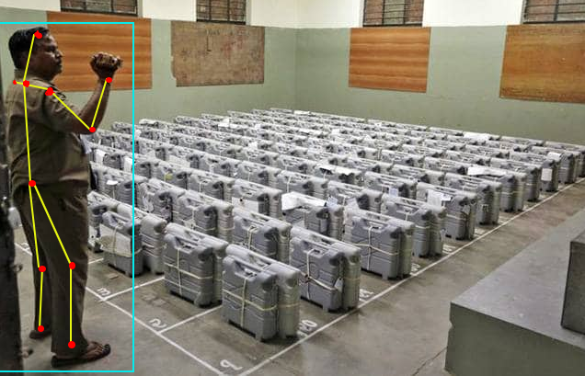
Problem Statement
Design and development of a surveillance system using Deep Learning based Human Pose Estimation techniques to detect possible physical tampering of an Electronic Voting Machine (EVM)
Fig: Pose Detection in an EVM storage room

Slide 3
Thinking out of the (EVM) box...
According to a recent technical research on EVMs used in India, “The design of India’s EVMs relies entirely on the physical security of the machines and the integrity of election insiders.” While underlying software in the EVM requires periodic updates to tackle the ever growing possibilities of being attacked, physical tampering of EVMs is also another major threat. It is more likely to happen, and at the same time more difficult to avoid. We propose a novel solution, where cameras installed within the voting area monitors everyone within the vicinity of the machine, and raises a flag if a person is found behaving suspiciously with it. We aim to do this using human pose estimation using Deep Learning from the videos and/or images that the installed cameras capture. The same technology may be extended to be used as another layer for ensuring vote count tally.
Source : https://indiaevm.org/evm_tr2010-jul29.pdf

Slide 4
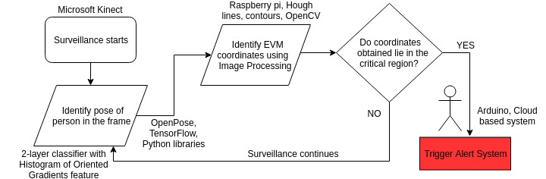
Methodology and Technology Stack

Slide 5
Possible sources of faults
False alarm if camera isn’t mounted in the proper location
Lighting issues might create problems for joint visibility
Strong articulations, occlusions and clothing also hinder accuracy

Slide 6
Other options
Other solutions for fraud detection require major software changes to be made to the EVM itself. While we are not entirely dismissing that idea, our proposal ensures that no physical tampering is done to the EVM.
We resort to 2D pose estimation because due to the larger 3D pose space, the ambiguities increase. There is also a requirement of a larger setup with multiple sensors and bodysuits, which is impractical in our case. However, it allows further updation into 3D pose estimation if required.
We considered several options including PoseNet, HRNet, DeepPose, OpenPose and AlphaPose. The major advantage of choosing OpenPose is that it works on both CPU and GPU- including versions compatible with AMD graphic cards.

Slide 7
System extension/improvement
We can use Internet of Things (IOT) to make the surveillance smarter, provided security is ensured.
The alert module can be cloud based, a person can monitor and take required actions such as blocking the EVM based on alerts given by our system.
Support on Android/IOS apps to allow authorised personnel to monitor, and the system can be augmented to channelise alerts through the app in case of unusual activity detection.

