Slide 1
Student Portfolio
STUDENT NAME :AKSHATHA.R
REGISTER NO AND NMID : 24132120500122004 AND A85F8DD24DB10B382FF4E4E7AEF7
DEPARTMENT : BCA
COLLEGE: COLLEGE/ UNIVERSITY :SIDDHAR SIVAGNAANI ARTS AND SCIENCE COLLEGE, BOMMAYAPALYAM AFFILIATED TO ANNAMALAI UNIVERSITY.

Slide 2
STUDENTS POTFOLIO

Slide 3


AGENDA
Problem Statement
Project Overview
End Users
Tools and Technologies
Portfolio design and Layout
Features and Functionality
Results and Screenshots
Conclusion
Github Link
3/21/2024 Annual Review

Slide 4

PROBLEM STATEMENT
A problem statement is a clear and concise description of an issue that needs to be addressed. It defines the gap between the current state and the desired future state, outlining the problem, its impact, and why it's important to solve. It's a crucial step in problem-solving, project management, and research, helping to focus efforts and align stakeholders.

Slide 5

PROJECT OVERVIEW
•A project overview is a concise, one-page summary of a project's purpose, goals, scope, and expected outcomes, used to get stakeholders and team members on the same page and to gain approval.
•It acts as a quick-reference guide throughout the project's lifecycle, providing a high-level framework and outlining key deliverables, risks, assumptions, resources, and potential success criteria.

Slide 6

WHO ARE THE END USERS?
•End users are the individuals or entities who ultimately use a product, service, or system to fulfill their needs, distinguishing them from customers who may purchase it but not necessarily use it.
•For example, employees using company-purchased software are end users, while the company buying the software is the customer.
• Understanding end users is crucial for businesses to design effective products that meet their needs and offer a positive user experience.

Slide 7

TOOLS AND TECHNIQUES
HTML :
This forms the structural foundation of the project. It defines the content and organization of the web page, including elements like headings, paragraphs, images, links, forms, and tables. HTML provides the raw data and defines the semantic meaning of the content.
CSS :
CSS is responsible for the visual presentation and styling of the HTML elements. It controls aspects such as colors, fonts, layout, spacing, responsiveness, and visual effects. CSS separates the content from its visual appearance, allowing for consistent styling across multiple pages and easier maintenance.
JavaScript :
JavaScript adds interactivity and dynamic functionality to the web project. It allows for manipulation of the HTML and CSS, responding to user actions, fetching data from external sources, creating animations, and implementing complex application logic. JavaScript transforms a static web page into a dynamic and engaging user experience.

Slide 8
PORTFOLIO DESIGN AND LAYOUT
My portfolio design includes section like home/about me, project, skills,and contact.I kept the layout simple, user-friendly, and responsive so it works well on both mobile and desktop devices.
8

Slide 9
FEATURES AND FUNCTIONALITY
•Features are the tangible attributes or components of a product or service, such as a smartphone's camera or a software's user interface.
•Functionality describes the actions and overall capabilities of the product or service, including how well it performs its tasks to fulfill user needs and provide value.
•In essence, features are the "what" a product has, while functionality is the "how well" it does things.

Slide 10
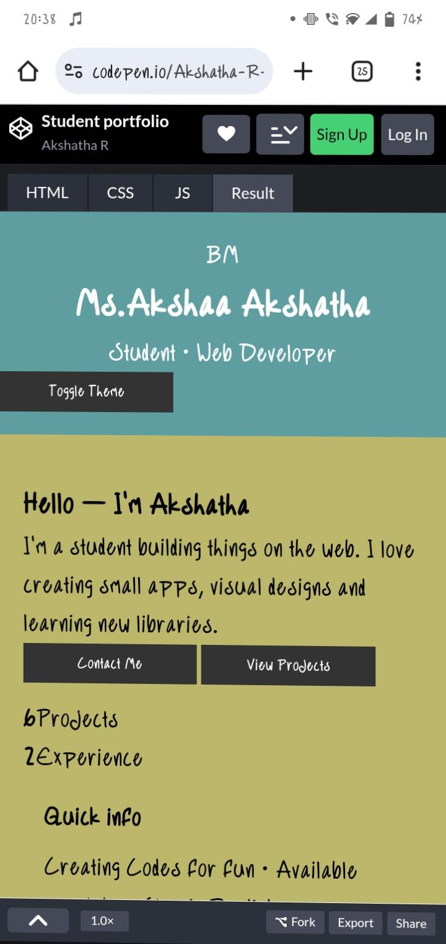

RESULTS AND SCREENSHOTS
3/21/2024 Annual Review
10

Slide 11
CONCLUSION
Through this project, I learner how a portfolio website is made using HTML,CSS, and JavaScript. It gave me base knowledge of web design and hosting.
11

