Slide 1
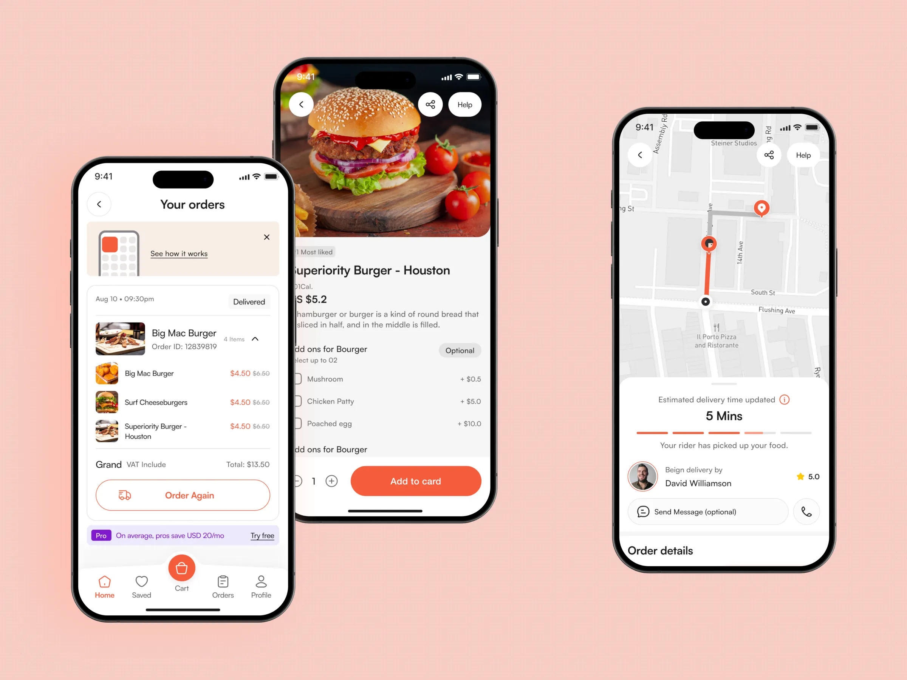
Empathy Map – Food Delivery App User
UI/UX Practicum | Understanding the user before designing the interface
• Target user: college student / busy young user
• Orders food when busy, tired, or unable to cook
• Wants quick search, simple ordering, and affordable meals
• Checks ratings, reviews, price, and delivery time
• Needs confidence that the order will arrive correctly
• Main UX goal: make ordering fast, clear, and stress-free
Example food-delivery mobile UI screens

Slide 2
Empathy Map
What the user says, thinks, does, and feels
SAYS
THINKS
• “I want my food quickly.”
• “Show the total price clearly.”
• “I want good offers.”
• Is this restaurant reliable?
• Will my order arrive on time?
• Are there hidden charges?
FOOD DELIVERY USER
DOES
FEELS
• Searches and compares restaurants
• Reads ratings and reviews
• Tracks the order after payment
• Happy with discounts
• Worried when tracking is unclear
• Frustrated by delays or errors

Slide 3
User Needs, Frustrations & Expectations
UX insights converted into design requirements
USER NEEDS
FRUSTRATIONS
EXPECTATIONS
• Simple home screen and search
• Clear food photos and descriptions
• Ratings, reviews, price and ETA
• Transparent checkout
• Easy live order tracking
• Too many steps to order
• Slow or confusing screens
• Hidden charges at checkout
• Incorrect delivery time
• Payment or support problems
• Fast and smooth performance
• Useful offers and recommendations
• Secure payment
• Accurate delivery updates
• Quick help when something goes wrong
UI reference image: Dribbble food-delivery UI concept (used as visual reference).

