Slide 1
RAG- Based Customer Support Assistant
Internship Capstone Project
High-Level Design (HLD)

Slide 2
Problem Statement
Software companies face a massive volume of repetitive technical and billing queries. Manual handling results in:
High Latency: Customers wait hours for Tier-1 answers.
Operational Costs: Scaling human support teams is expensive.
Inconsistency: Human error leads to varied answers for the same policy.
Workload: Support agents are overwhelmed by low-level troubleshooting.

Slide 3
Scope of the System
Automated Handling
Pricing & Subscription Plans
Refund Policy Queries
API Access & Error Guides
Password Resets & Security
Basic Technical Troubleshooting
Human Escalation (HITL)
Payment/Refund Disputes > $500
Enterprise SLA Breaches
Security Vulnerability Reports
Out-of-Scope (Salesforce integration, etc.)
Low-confidence LLM outputs

Slide 4
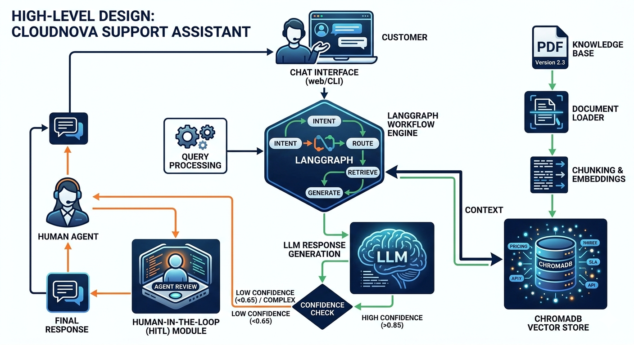
Architecture Diagram

Slide 5
Architecture Explanation
The system utilizes a Stateful RAG architecture managed by LangGraph.
Ingestion: The PDF Knowledge Base is transformed into vector embeddings for semantic search.
Workflow: LangGraph controls the state of the conversation, allowing for complex multi-step reasoning.
Retrieval: Relevant context is pulled from ChromaDB to ground the LLM's response.
Safety Guard: If no relevant context is retrieved from ChromaDB, the system avoids hallucination and routes the query to HITL instead of generating uncertain responses.
Escalation: A conditional edge checks the LLM's confidence score. If thresholds aren't met, the query is passed to a human interface.

Slide 6
Workflow
Loader: PyPDF Loader parses PDF text.
Retriever: Logic to fetch context based on query similarity.
Chunking: Recursive splitting into 1000-char pieces.
LLM: GPT-4 handles reasoning and synthesis.
Embeddings: Sentence-Transformers for semantic vectors.
ChromaDB: Vector database for embedding storage.
LangGraph: Workflow engine orchestrating nodes.
HITL: Human-in-the-Loop review for edge cases.

Slide 7
Data Flow
Lifecycle of a Support Query:
Ingestion: PDF → Text → Chunks → Vectors → ChromaDB (Offline).
Query: User submits a question.
Retrieval: LangGraph fetches top-k chunks from ChromaDB.
Augmentation: Chunks + Prompt are fed to the LLM.
Generation: LLM produces a draft response.
Validation: Confidence score check; if low, route to Human Agent.
Resolution: Final validated answer sent to User.

Slide 8
Technology Choices
ChromaDB: Lightweight, open-source, and supports efficient metadata filtering.
GPT-4: Best-in-class reasoning and ability to follow strict safety/policy guideline.
LangGraph: Enables stateful workflows and cyclic loops (superior to simple linear chains).
Sentence-Transformers: High-performance local embedding generation without API dependency.

Slide 9
Scalability Considerations
Parallel Ingestion: Processing multiple support handbooks concurrently.
Horizontal Scaling: Deploying multiple LangGraph instances behind a load balancer.
Latency: Implementing Semantic Caching for frequent queries to bypass LLM processing.
Distributed Storage: Scaling ChromaDB as a central service for multiple regional support bots.

Slide 10
Conclusion
The CloudNova Systems Support Assistant represents a production-grade RAG implementation:
Accuracy: Grounded in the company's master handbook.
Safety: "Hallucination Guards" and HITL ensure sensitive queries are handled by humans.
Efficiency: Frees support teams to focus on complex technical challenges.
Scalability: Built on a modern, modular stack ready for enterprise growth.

