Slide 1
NAMED ENTITY RECOGNITION AND CLASSIFICATION
Presenter - Akshat kumar

Slide 2
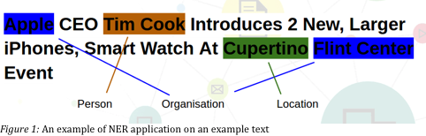
BACKGROUND
Locate and classify named entity mentioned in unstructured text into different categories
Applications:
Classifying content for news providers
Powering Content Recommendations
Efficient Search Algorithms
Customer Support

Slide 3
PROBLEM STATEMENT
Information extraction technique to identify and segment the named entities and categorize them under predefined classes.
The project aims to classify the text in the articles in the following categories
Location
Person
Organization

Slide 4
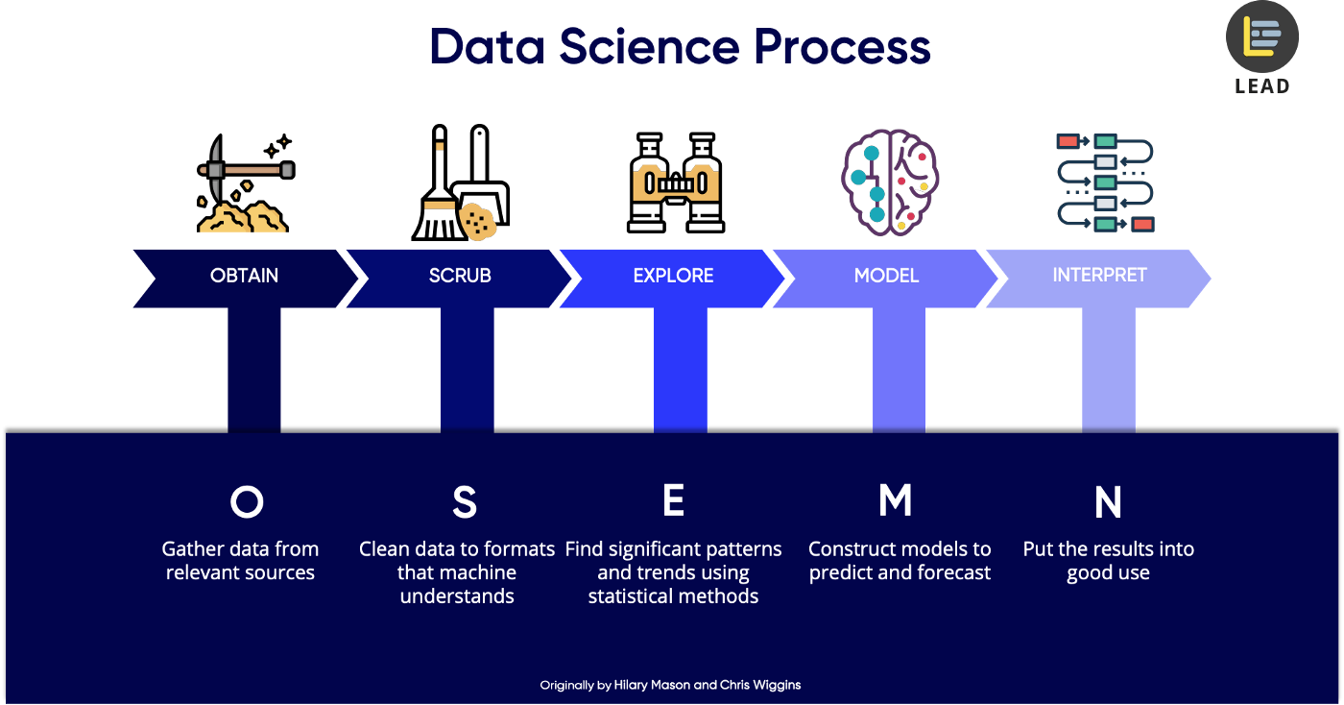

Slide 5
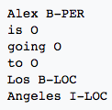
DATA DESCRIPTION
Named Entity Recognition data from Europe historical newspapers
The IOB Tagging system contains tags of the form
~84k words in 2 articles B - Beginning of named entity I - Inside of named entity O – Outside of named entity

Slide 6
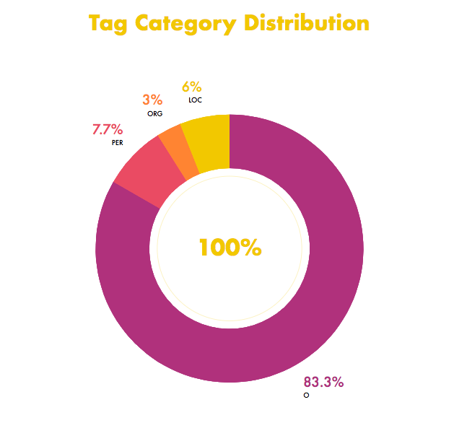
DATA DESCRIPTION
Distribution dominated by ‘O’ followed by PER, LOC and ORG
Imbalanced Dataset

Slide 7
TEXT PRE-PROCESSING
Text Cleaning
Removal of punctuation, special characters, white spaces
Removal of stop words
Do not have either a positive/negative impact on our statement
E.g words like a, it, the
Truncate Sentence Length
Reduce sentence length for vectorization
Lemmatization
Converting derived words to their root form
E.g. words like “trouble”, “troubling”, “troubled” based on “trouble”

Slide 8
EXPLORATORY DATA ANALYSIS

Slide 9
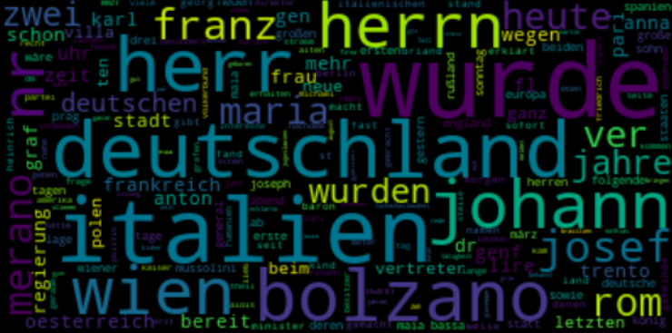
TRENDING CITIES
Article mostly talks about European countries and locations
Deutschland (Germany), historical Italian cities like Bolzano, Trento, Rom and Wien (Austria)

Slide 10
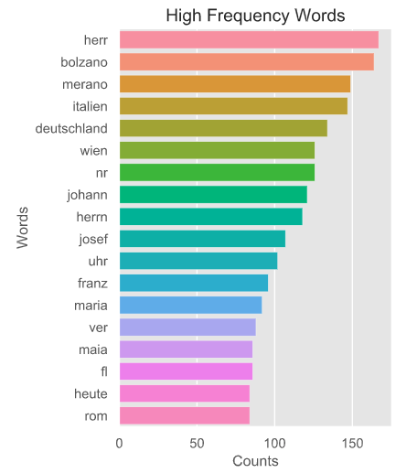
HIGH FREQUENCY WORDS
High frequency words are dominated by European countries and cities

Slide 11
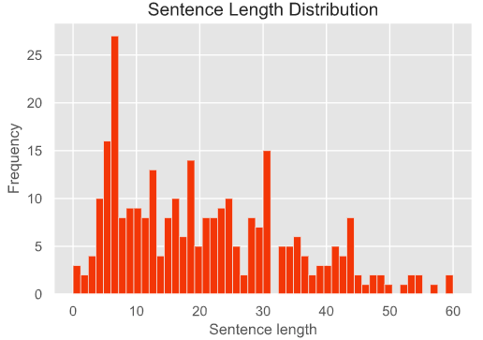
SENTENCE LENGTH
Most sentences are in the range of 4-20 and distribution is close to normal

Slide 12
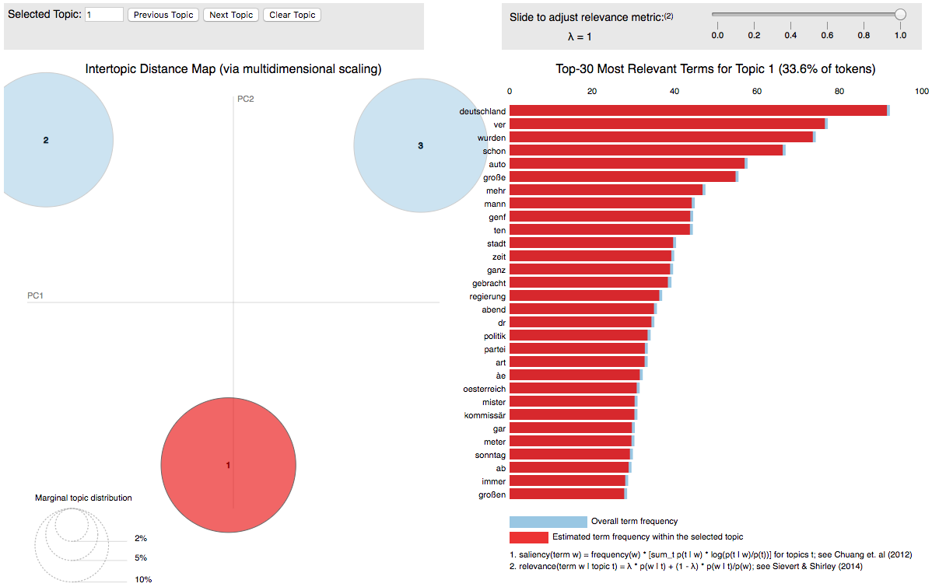
DISCOVERED TOPICS
Extracted topics using topic modeling
Topics extracted concentrated upon Germany, Italy and history

Slide 13
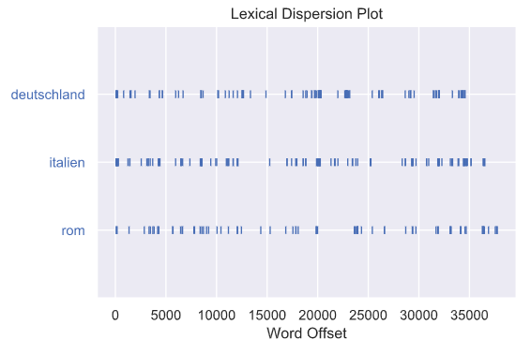
CONTEXTUAL CHANGE
Lexical Dispersion identifies contextual change during the course of a text
Mostly about Germany at start and middle and ends with Italy
Notes:
f

Slide 14
MODELING ALGORITHMS
Baseline Model
Decision Trees
Random Forest
Conditional Random Field
CRF
Hypertuned CRF
Deep Learning
LSTM
Bi-Directional LSTM

Slide 15
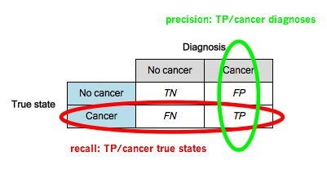
EVALUATION METRICS
Skewed or Imbalanced Dataset (83.3 % ‘O’ category)
Precision, recall and F1 score chosen as evaluation metric
Sensitive to imbalanced dataset
Insight into performance of classes individually

Slide 16
BASELINE MODEL
Rule based classifiers
Decision Trees and Random Forest
Features – Title, Upper, Lower, Length, Digit, Alphabet
Precision and recall values 0 for most classes
Model memorizing words and tags
Predicts label for single sample without considering "neighboring" samples
Need far more contextual features for classification

Slide 17
CONDITIONAL RANDOM FIELD

Slide 18

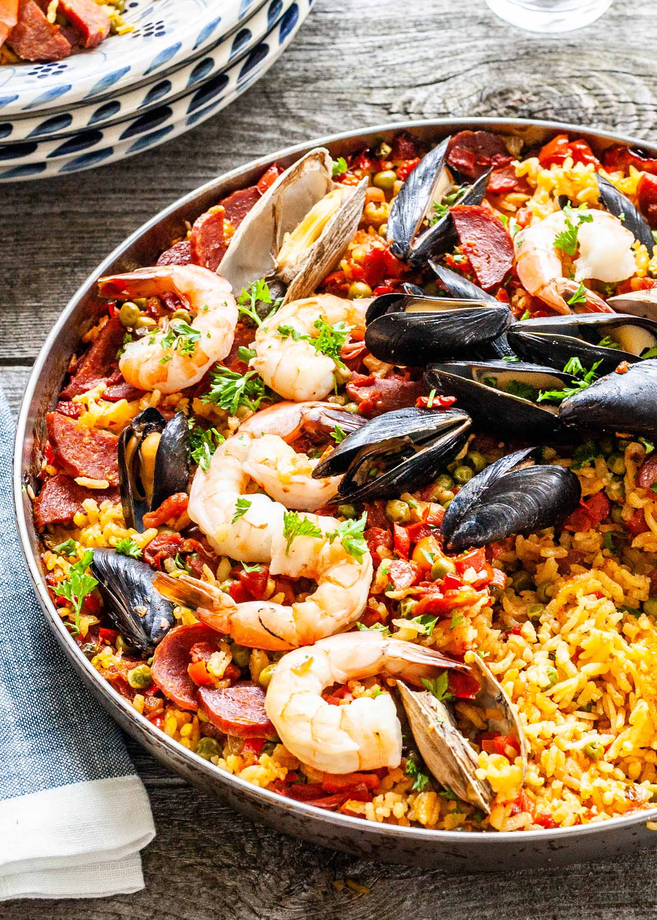
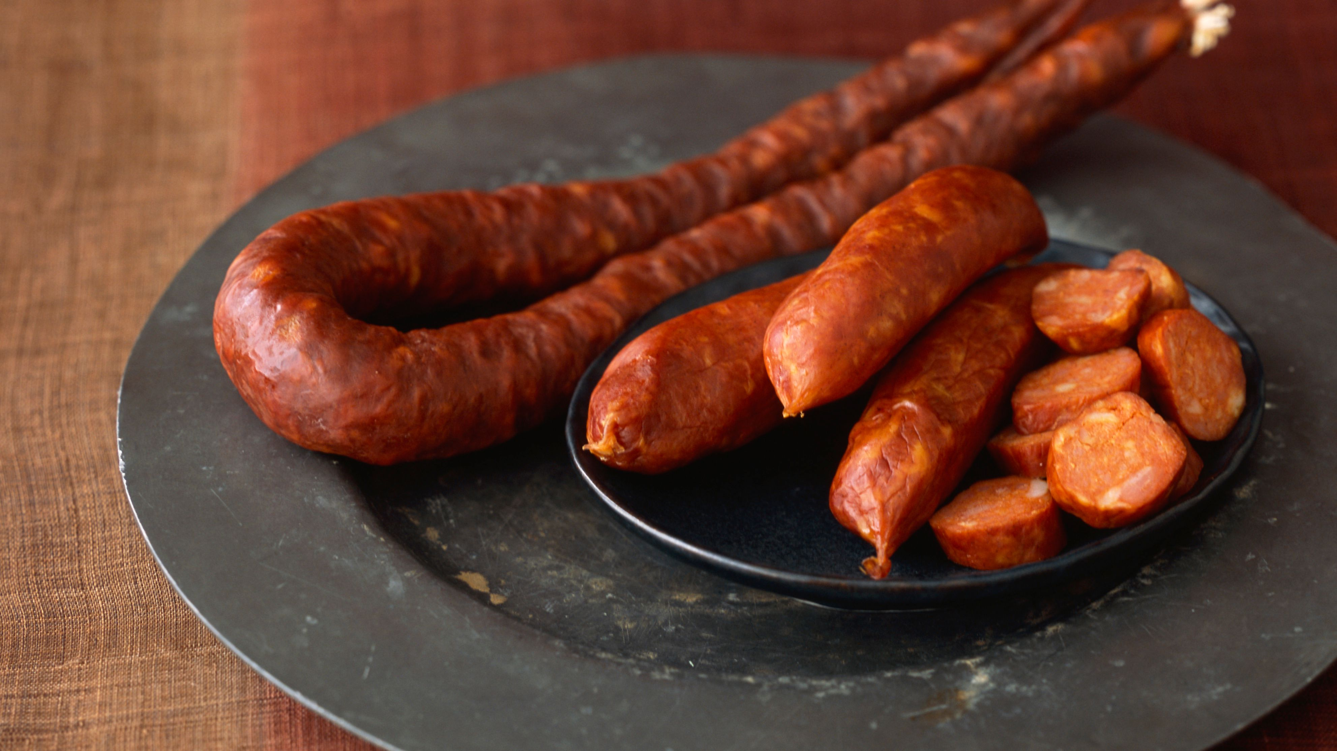
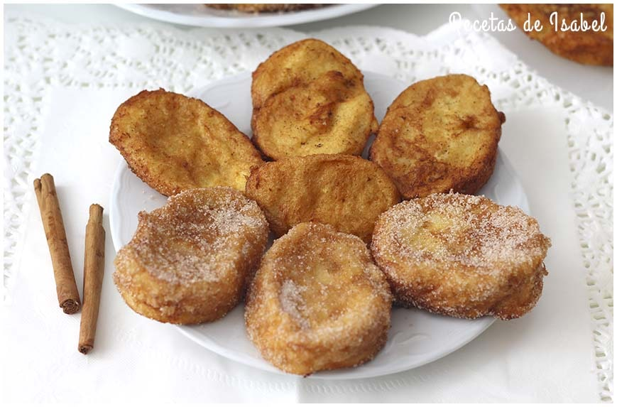
WHY CRF ?
Rice based dish
Paella
Chorizo
Torrijas
CUISINE ?
SPANISH CUISINE

Slide 19
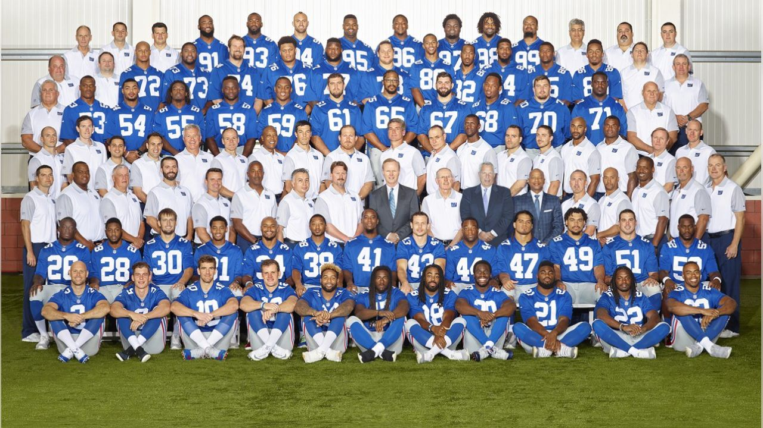

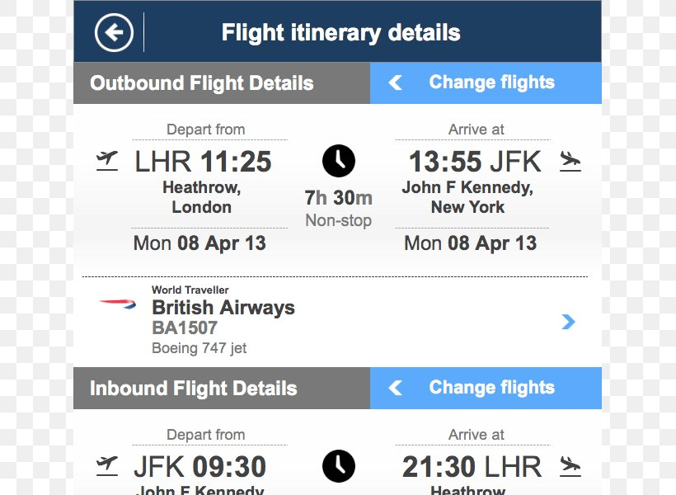

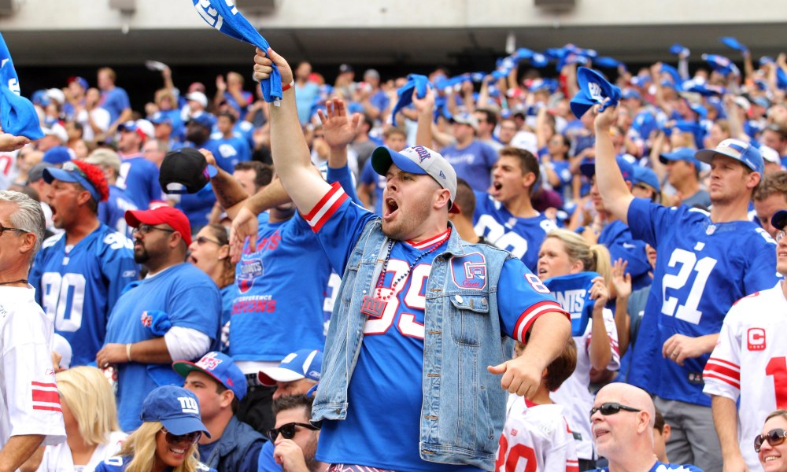
WHY CRF ?
NY Giants Performance

Slide 20
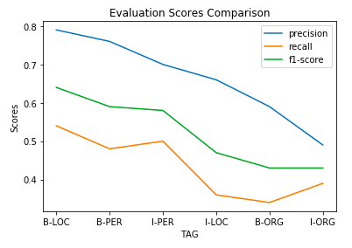
CRF
Word identity, word suffix, word shape, POS tag, before and after neighboring word information
Model understood context well and not just remembered words
Scores improved for all classes after fine tuning CRF

Slide 21
DEEP LEARNING MODEL

Slide 22
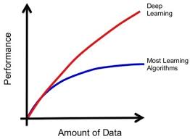
BIDIRECTIONAL LSTM
Learns high-level features from data in an incremental manner.
Two networks that access past as well as future information
Understand context better than a single network
CRF layer adds some constraints to the predicted labels to ensure validity
Deep Learning out perform other techniques if the data size is large

Slide 23
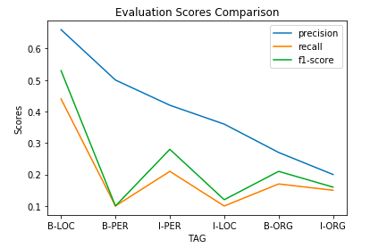
BIDIRECTIONAL LSTM
Person and Organization worst performing classes
Unrepresentative data sample do not effectively cover cases observed in broader domain
Traditional algorithms generally perform better on small datasets

Slide 24
CONCLUSIONS
Skewed or Imbalanced Dataset, basis for evaluation metric
Articles covered historical European countries and cities
Precision and recall 0 for baseline model
CRF understood the context from neighboring words
CRF’s transition features extracted important rules
False negatives high for each classifier
Deep learning methods underperformed due to data scarcity

Slide 25
FUTURE WORK
Very few sentences for training, need larger dataset
Need better way to extract the sentences
Reduce false negatives to improve recall
CRF model offers more parameters, tuning for performance enhancement
Closely analyze CRF’s state and transition features
Tuning deep learning model parameters on a wider search space using GPU
Using pre-trained models and fine tune them for specific task
Deploy application using Docker and cloud based services

Slide 26
REFERENCES
https://towardsdatascience.com/named-entity-recognition-applications-and-use-cases-acdbf57d595e
https://createmomo.github.io/2017/09/12/CRF_Layer_on_the_Top_of_BiLSTM_1/
https://github.com/EuropeanaNewspapers/ner-corpora
https://prateekvjoshi.com/2013/02/23/why-do-we-need-conditional-random-fields/
https://sklearn-crfsuite.readthedocs.io/en/latest/tutorial.html

Slide 27
THANK YOU

