Slide 1

Team Details
  Team name: The Last Percent
  Team leader name: Akshat Jain
  Problem Statement: Retail & Commerce — Intelligent Customer and Business Experiences

Slide 2
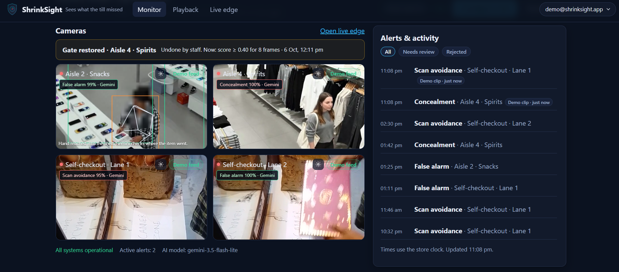
Google Cloud
AI Builder Cup
H2S
Brief about the idea
Two-tier, privacy-first loss prevention on a store's existing cameras.
Tier 1 — on the device: MediaPipe in the browser tracks pose and marked zones (scanner, bagging, shelf) and blurs faces before anything leaves the device. A self-calibrating gate opens only on suspicious moments.
Tier 2 — Gemini agent: watches the clip, calls tools for the till receipt, zone policy and prices, and returns a structured, timestamped incident: which item, when, where it went, and the ₹ loss.
Safety rules + a human: deterministic receipt and shop-floor rules check Gemini's answer; staff confirm or dismiss with a reason, and each camera learns from it.
Why now: self-checkout losses rise 22% in the first year, and 52% of shrink is accidental — alerts must carry evidence, not accusations.
ShrinkSight · 2

Slide 3
Google Cloud
AI Builder Cup
H2S
Opportunities
How is it different?
Existing tools (Everseen, Veesion, Sensormatic) use one model and fire one alert.
ShrinkSight cross-checks the video against the till receipt with a Gemini agent + a fixed rule: an item is unscanned only if no receipt line matches it.
Shop-floor custody: came from (shelf / own bag) → ended in (in hand / concealed / put back).
Privacy by design: on-device face blur, no facial recognition, clips not stored.
How does it solve the problem?
Only gated moments reach Gemini — staff review minutes, not hours.
Every verdict has evidence: boxes that follow the video, timestamps, the missing receipt line and ₹ loss.
Unclear cases become “Needs review” — never a silent accusation.
Staff decisions teach each camera; the gate auto-tunes from false alarms.
USP
Receipt-checked video reasoning — tool calls + deterministic safety rules.
Self-learning cameras — reviews become memory; Tier-1 gate self-calibrates.
Zero new hardware — existing CCTV + a browser; scales to zero.
Free-tier footprint — Gemini only on suspicious moments; cached results.
ShrinkSight · 3

Slide 4
Google Cloud
AI Builder Cup
H2S
List of features offered by the solution
Detection & investigation
On-device Tier 1: pose, zones, gate score, CCTV-distance face blur
Gemini investigation agent: video + stills + close-ups in one call
Till-receipt cross-check → exact unscanned item and ₹ loss
Shop-floor custody: came from → ended in
Item-pile inventory: Gemini lists items, staff confirm the chips
Zones on any camera angle — mark them or let Gemini suggest
Optional Tier-1 screening on Investigate (0 tokens until you send)
Live edge: webcam / file → blurred, always-playable clips sent automatically
Operations & trust
Live store Monitor with real-time alerts (Firestore)
Demo mode: camera wall loops demo clips with stored Gemini results
Playback: clickable Gemini timeline + boxes that follow the video
Confirm / Dismiss with reason → camera memory for future clips
Self-calibrating edge gate (auto-tunes from false alarms)
Ask the agent about any incident; plain-English store rules
One-click demo login · 24 h on-device replay · short retention
Mobile-friendly UI
ShrinkSight · 4

Slide 5
Google Cloud
AI Builder Cup
H2S
Process flow diagram
Camera / upload
Existing CCTV, webcam or clip
Tier 1 · browser
Pose + zones + face blur → gate score
Gemini agent
Watch clip · tools: receipt, zone policy, prices
Safety rules
Receipt rule · floor rule · one re-check
Incident
Verdict · items · timestamps · boxes · ₹ loss
Gate shut → keep watching (0 cost)
Staff: Confirm / Dismiss with a reason
→ camera memory (few-shot context) + Tier-1 gate auto-tune ↺
Use cases
Self-checkout lane: missed scan, item passed around the scanner, hidden under another item.
Shop-floor aisle: concealment in pocket / bag, leaving through an exit zone with an unpaid item.
Safety: person lying on the floor flagged as a health hazard.
ShrinkSight · 5

Slide 6
Google Cloud
AI Builder Cup
H2S
Architecture diagram of the proposed solution
Browser · Firebase Hosting
Next.js 16 static app
MediaPipe Tasks Vision: pose, face, objects
On-device face blur · Tier-1 gate · clip buffer
Monitor · Incident · Playback · Investigate · Live edge · Rules
Cloud Run · FastAPI
Investigation agent + safety rules
Camera memory · edge auto-tuning
Demo clips · rate limits · cache · fallback
Data & secrets
Firestore: incidents, receipts, feedback, edge config (live listeners)
Cloud Storage: demo clips via signed URLs
Secret Manager: Gemini key, auth secret
Firebase Auth: app sessions
Gemini API
Video understanding
Function calling (receipt, zones, prices)
Structured JSON output · model fallback
CI/CD: GitHub Actions → Workload Identity Federation (no stored keys) → Cloud Run + Firebase Hosting · stateless API · scale to zero
ShrinkSight · 7

Slide 7
Google Cloud
AI Builder Cup
H2S
Technologies used in the solution
Gen AI
Gemini (google-genai SDK): video understanding, function calling, structured output, media-resolution control; Flash / Flash-Lite with automatic fallback
On-device AI
MediaPipe Tasks Vision — pose landmarker, face detector, object detector (WebAssembly / GPU)
Frontend
Next.js 16 (static export), TypeScript, Firebase Hosting, responsive / mobile UI
Backend
Python 3.12, FastAPI, Pydantic, uv — containerised on Cloud Run
Data
Firestore (real-time listeners), Cloud Storage, Secret Manager, Firebase Auth
DevOps & quality
GitHub Actions, Workload Identity Federation, Docker; 285 automated tests (pytest + node test)
ShrinkSight · 8

Slide 8
Google Cloud
AI Builder Cup
H2S
Estimated implementation cost
Prototype: $0
Runs entirely on free tiers: Gemini API free tier, Cloud Run (scale to zero), Firestore, Firebase Hosting.
No new hardware — existing CCTV and a browser.
Why it stays cheap at scale
Tier 1 runs on the store's own device: Gemini cost grows with suspicious moments, not camera hours.
Cached results: a re-run costs 0 tokens; a Tier-1-cleared clip costs 0 tokens.
Per-store monthly estimate
Gemini: suspicious moments / day × tokens per investigation (≈ 15 K, shown on every incident) × price per token × 30 days
Cloud Run: pay per request, $0 when idle · Firestore + Storage: cents per day per store
Example (estimate): ≈ 20 moments/day × ≈ 15 K tokens ≈ 9 M tokens/month ≈ $1–3 per store per month at Gemini Flash-Lite / Flash list prices — less than one hour of staff time.
ShrinkSight · 9

Slide 9
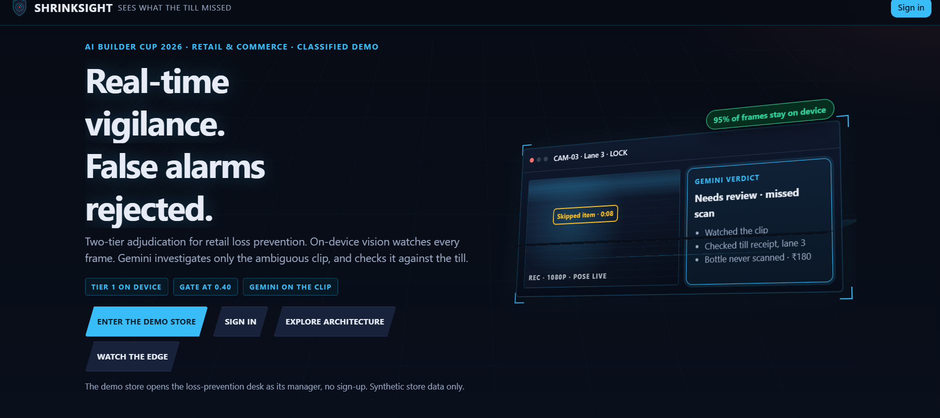
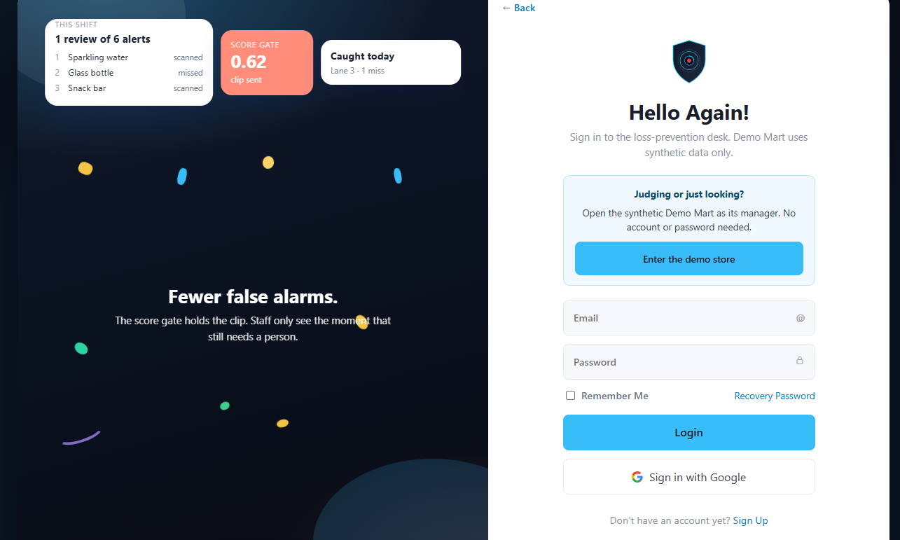
Google Cloud
AI Builder Cup
H2S
Snapshots of the prototype
ShrinkSight · 10

Slide 10
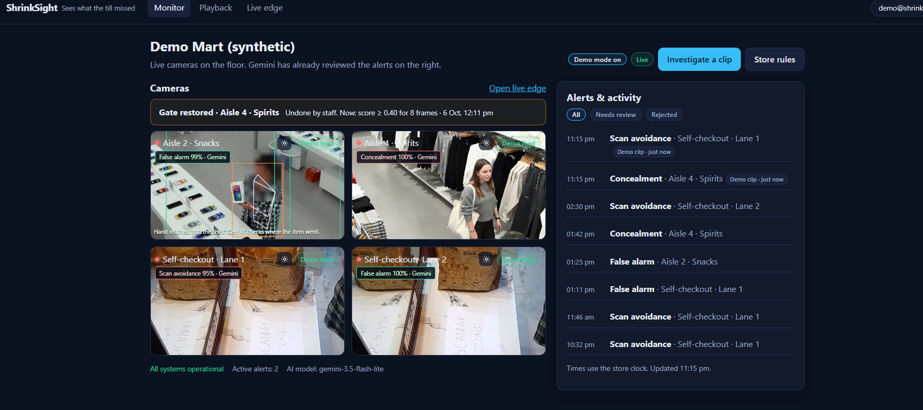
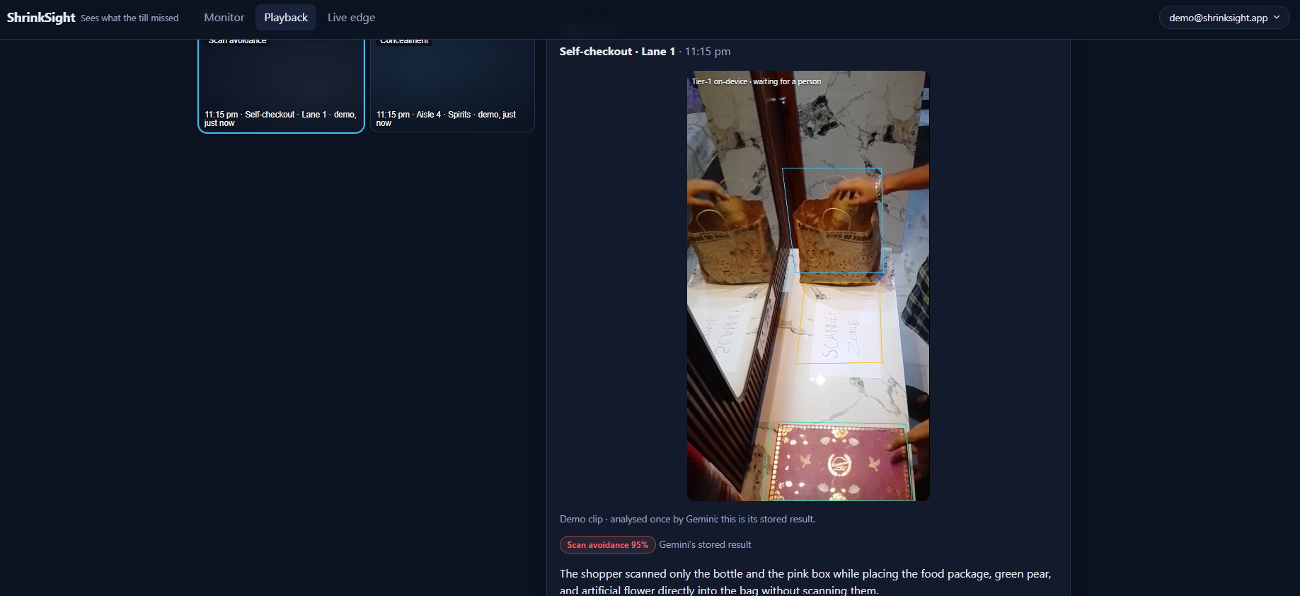
Google Cloud
AI Builder Cup
H2S
Snapshots of the prototype
ShrinkSight · 10

Slide 11
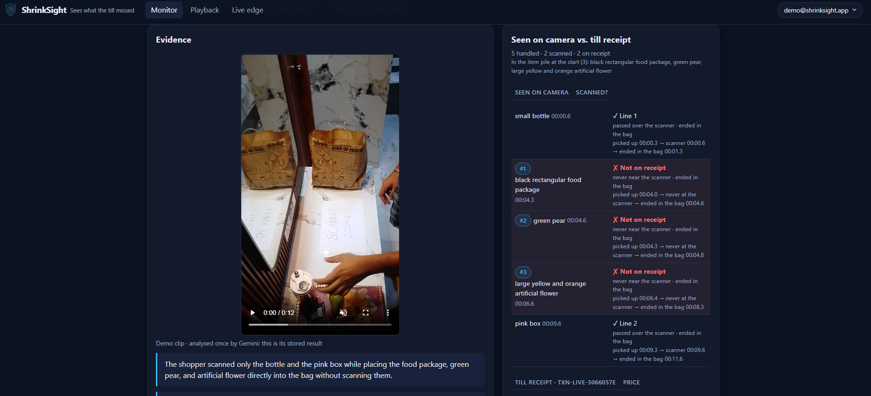
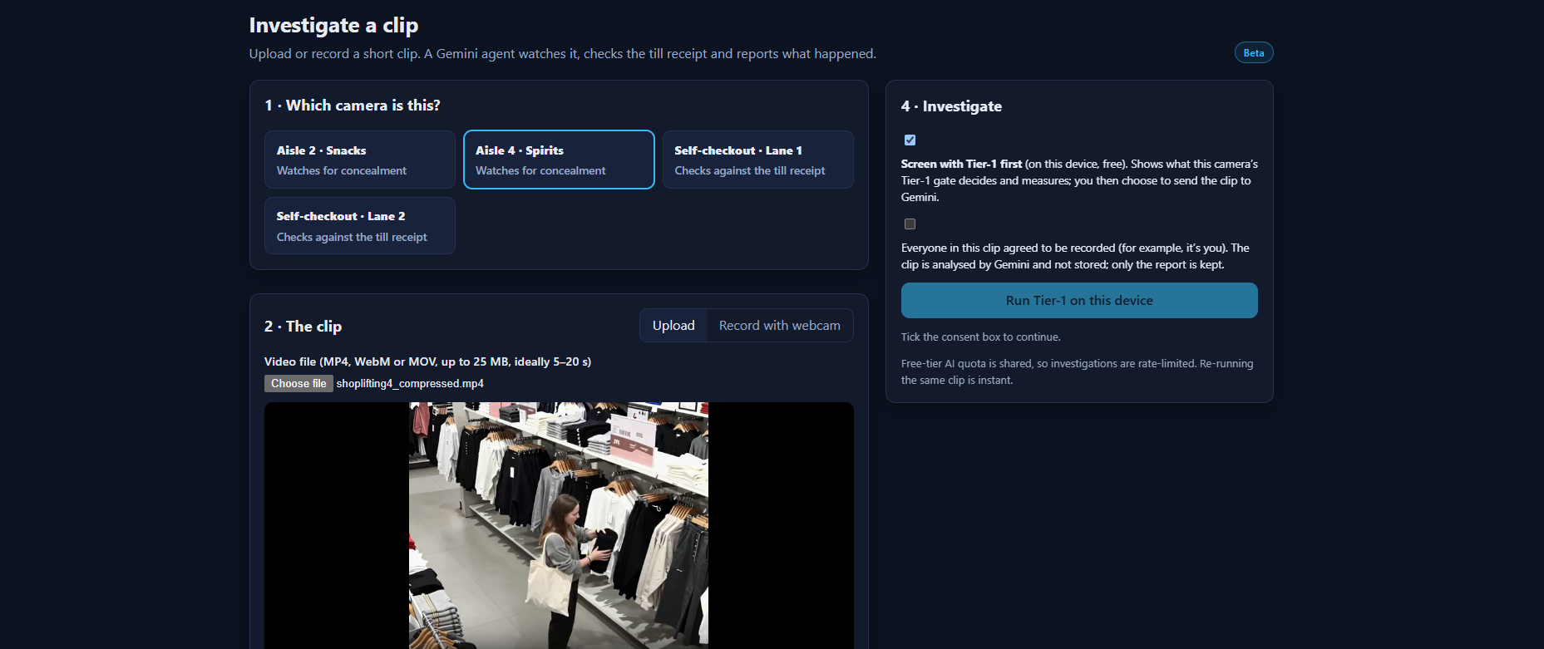
Google Cloud
AI Builder Cup
H2S
Snapshots of the prototype
ShrinkSight · 10

Slide 12
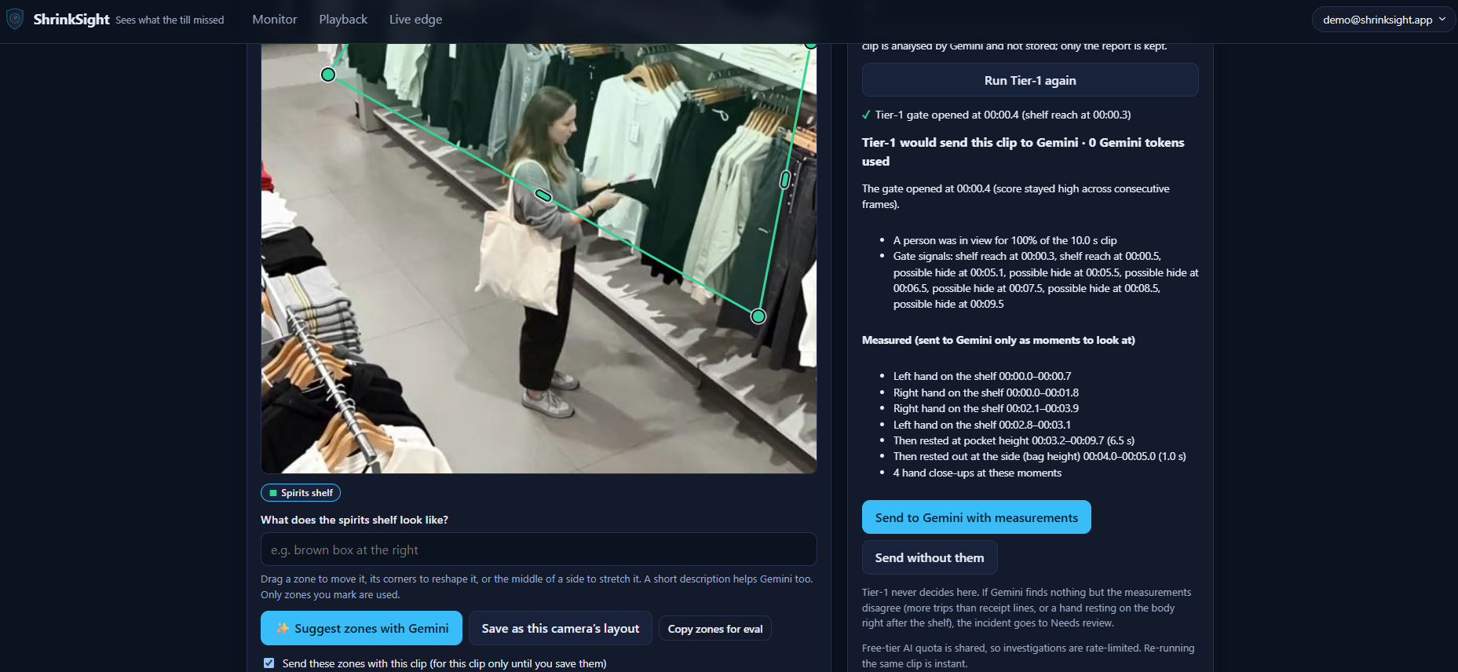
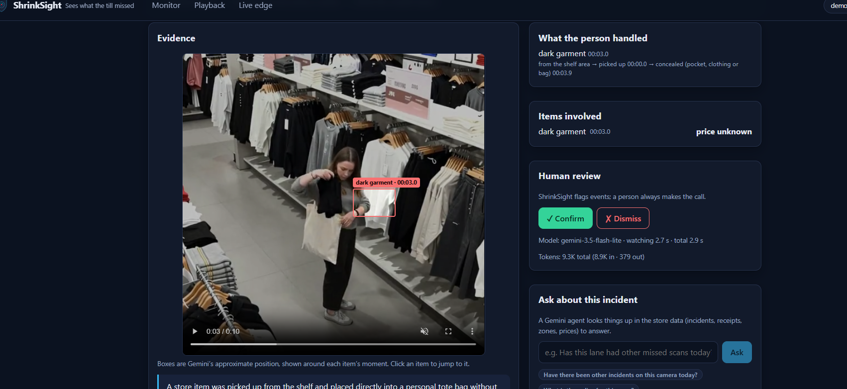
Google Cloud
AI Builder Cup
H2S
Snapshots of the prototype
ShrinkSight · 10

Slide 13
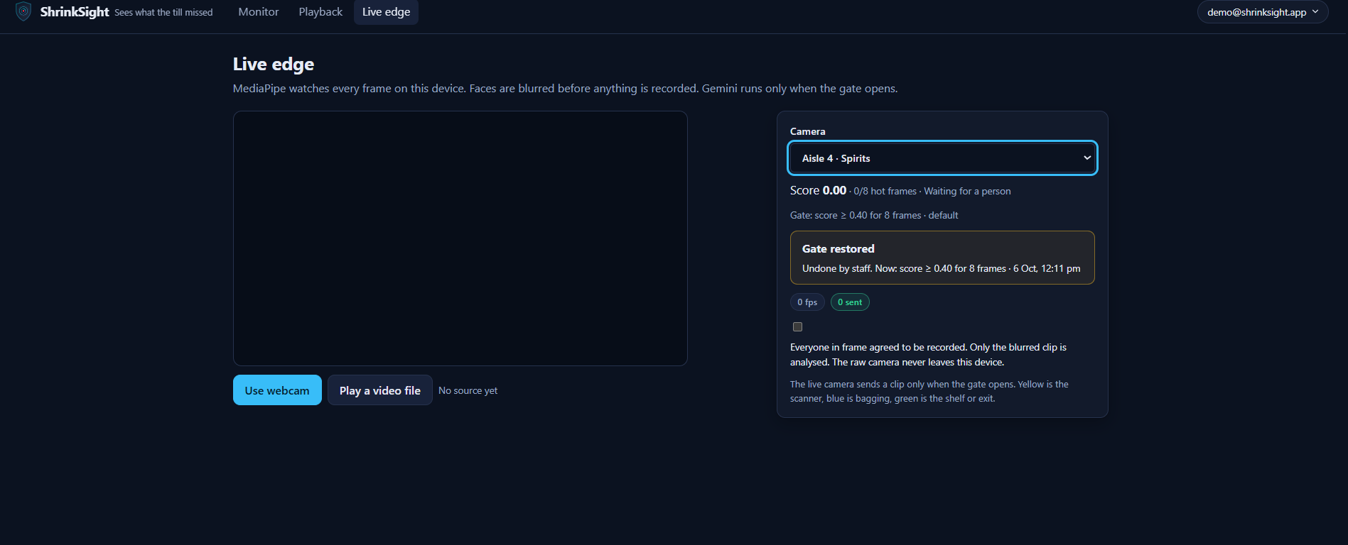
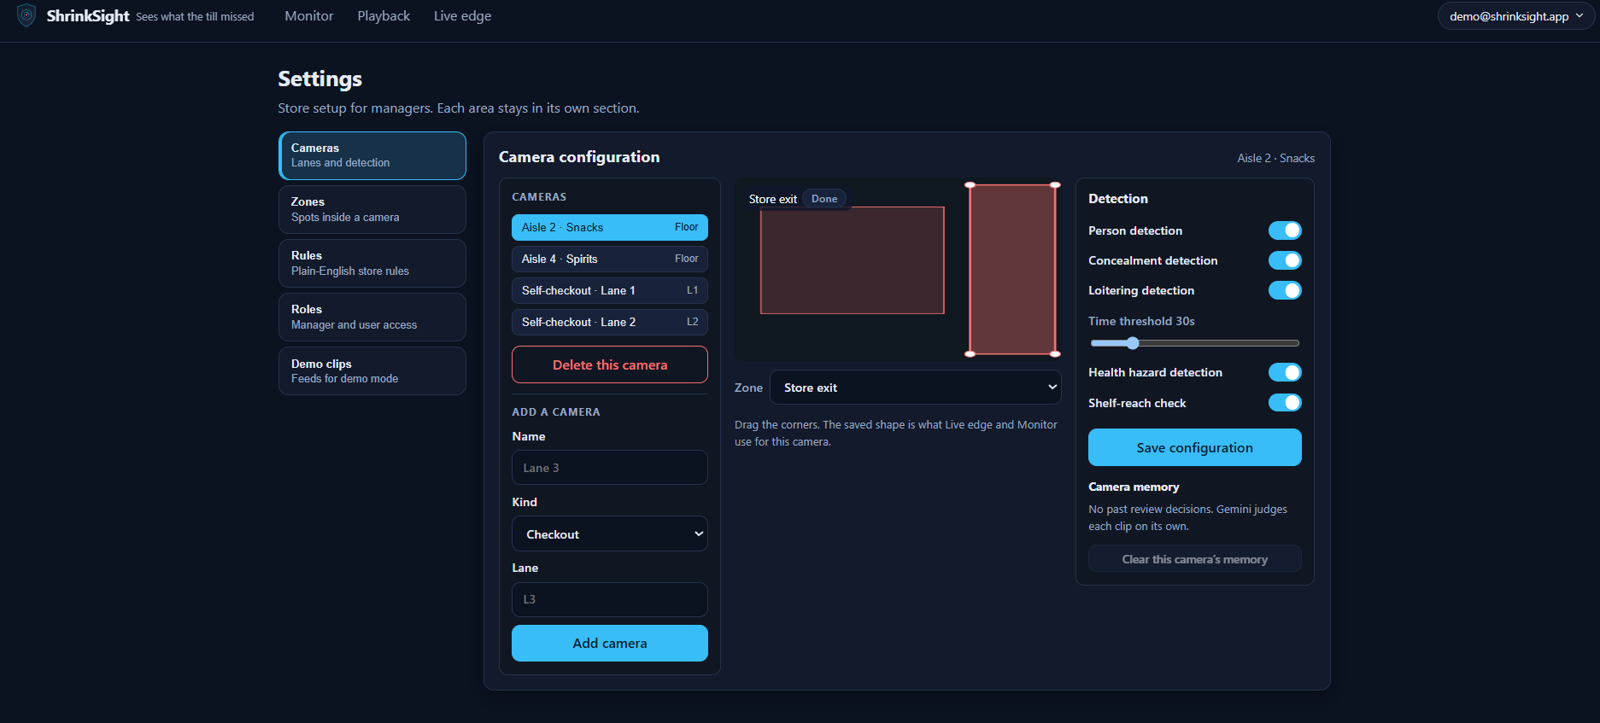
Google Cloud
AI Builder Cup
H2S
Snapshots of the prototype
ShrinkSight · 10

Slide 14
Google Cloud
AI Builder Cup
H2S
Prototype performance report / benchmarking
Speed: typical end-to-end ≈ 15–30 s for a 10–20 s clip, inside a hard 50-second budget; every incident shows where the time went (upload · watching · re-check).
Cost: ≈ 10–20 K tokens per investigation (shown on every incident). Cached re-run = 0 tokens; Tier-1-cleared clip = 0 tokens.
Accuracy method: evaluation harness (eval/) runs labelled clips with --repeat to check verdict stability; demo clips show ✓ / ✗ against their expected verdict.
Reliability: deterministic receipt rule overrides contradictory answers; one re-check on inconsistency; automatic model fallback on quota limits.
Tier 1: ~15 pose scans per second in the browser; face blur at CCTV distance; self-calibrating gate.
Engineering: 205 backend + 80 frontend automated tests; CI on every push.
ShrinkSight · 11

Slide 15
Google Cloud
AI Builder Cup
H2S
Additional details / Future development
Shopper's Advocate
A second Gemini agent argues the innocent explanation with fresh close-ups; a fixed rule decides.
We found no retail product that does this today.
“Fix my bill” nudge
Show the exact missed item and price on the kiosk.
One tap to add it — recovery without confrontation.
Scale & integrations
Live POS feeds instead of typed receipts.
Multi-store dashboards, shrink trends, Vertex AI quotas, Pub/Sub for bursts.
Responsible AI
Prompts describe actions only — never appearance, age, gender or ethnicity. Human-in-the-loop for every alert.
Faces blurred on the device; clips not stored; false alarms deleted after 1 day, real events after 7 days.
ShrinkSight · 12

Slide 16
Google Cloud
AI Builder Cup
H2S
Provide links to your
GitHub Public Repository
https://github.com/akshatjain-akj/shrinksight
Demo Video Link (3 minutes)
[paste your YouTube link]
Final Product Link
https://shrinksight-app.web.app → click “Enter the demo store” (no sign-up)
Theme: Retail & Commerce — Intelligent Customer and Business Experiences
ShrinkSight · 13

Slide 17


