Slide 1


BEYOND
Analysis
COR-239
Rajat Maheshwari
Akshat Jain
Madhukar
Notes:
1. Welcome all to our presentation BEYOND ANALYSIS . Our Team is COR-239.

Slide 2
Problem statement
Estimating customer value and extrapolating the existing value into future for the online skill-based gaming
Data set includes multiple customer behavioral features and their Temporal variation as inputs, and customer values and temporal extrapolation as targets
We used average mean square error for the targets as our evaluation metric
Notes:
1. Let's see the problem statement.
2. We are trying to estimate the customer value and extrapolate the existing value into future for online skilled gaming domain
3. Dataset includes multiple features like winnings, Deposit, Revenue to the company , practice games played which conveys customer behaviour.
4. Regarding the evaluation metric we used average MSE of the targets.

Slide 3
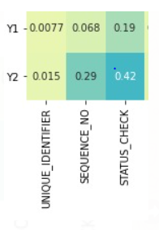
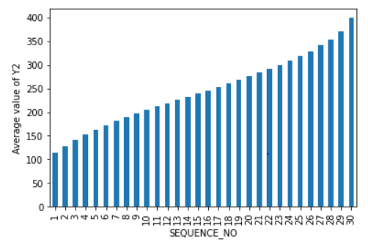
Feature ENGINEERING
Figure 1
From figure 1 We can see the correlation between the pair Y2 ,SEQUENCE_NO is high .
In figure 2, we can observe that the average value of Y2 for a customer is increasing as the sequence_no increases.
Based on the observations we have engineered a new feature which stores the maximum sequence number for a particular customer
Multiple time stamps of the same customer was given in the dataset, so we took the mean over the sample which belong to same customer
Figure 2
Notes:
1. Let's see the interesting things we found upon doing EDA.
2. We observed high correlation for Y2 and SEQUENCE_NO . Here SEQUENCE_NO denotes the snapshots of the customer at different time frames
3.after investigating further we found average value of Y2 increases with increase in SEQUENCE_NO which can be seen from the bar plot.
4. We created a new feature which stores the maximum SEQUENCE_NO for a customer. This improved our model performance.
5. For Handling the multiple time stamps we averaged the data based on customer id.

Slide 4
Methods explored
Deep Learning
We have trained two models out of which model1 had y1 as target and model2 had both y1 and y2 as their targets.
When generating the prediction for test we considered prediction for y1 from model1 and prediction for y2 from model2.
The reason for doing this , we observed higher mse when model for predicting Y2 was trained alone , but observed lower mse when both y1 and y2 were trained together.
Notes:
1. We explored a wide variety of methods which includes RandomForestRegressor, XGBOOST, ADABOOST and FeedForward Neural Network.
2. We trained two models out of which model1 predicts y1 and model2 predicts y1 and y2 simultaneously.

Slide 5
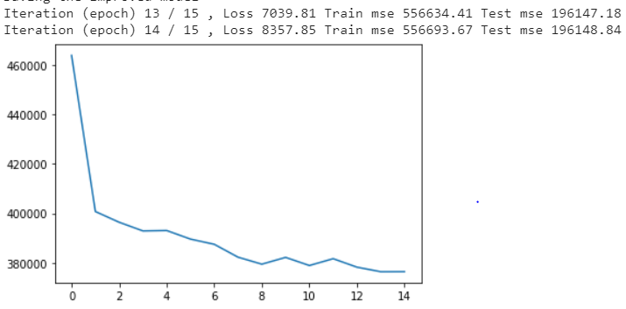
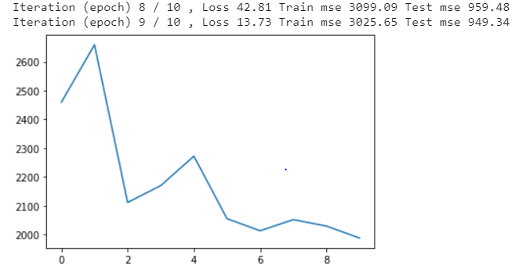
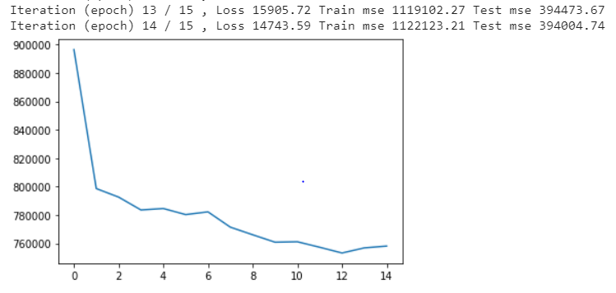

MSE vs Epochs GRAPHS
When Y1 and Y2 was used as Targets
When Y1 was used as Target
When Y2 was used as Target
Notes:
1. During prediction we used model1 to predict y1 and model2 to predict y2. We observed lower MSE when y1 and y2 are trained simultaneously compared to training Y2 seperately.
2. One of the possible reasons could be the correlation between Y1 and Y2 due to which the MSE has improved when Y1 and Y2 are used as targets simultaneously.

Slide 6
Methods explored
XGBoost Regressor
We tried tuning hyperparameters
Random Forest Regressor
We tried tuning hyperparameters
Among these three methods we observed that Deep Learning gave us the lower overall MSE
Notes:
1. We tried tuning hyperparameters for XGBOOST , RandomForest Regressor.
2.Out of these traditional methods , we observed better performance from XGBOOST, But DL based model stood as winner for us.

Slide 7





TOOLS USED
For model building we used:
PyTorch
Scikit-Learn
XGBoost library
For visualization:
Seaborn
Matplotlib
For data preparation:
Pandas
NumPy
For performance measurement:
MSE for Deep Learning model
RMSE for Machine Learning model
Notes:
1. These are the tools we used for our analysis and model building.
2. For performance measurment, We used RMSE for traditional methods and MSE for DL.

Slide 8
Results
We estimated customer values and temporal extrapolation which are continous in nature
When Y1 was trained alone approximate MSE value was 3025
When Y2 was trained alone approximate MSE value was 1122123
When both Y1 and Y2 was trained simultaneously approximate MSE value was 556693
Due to this we considered Y2 from the combined model and Y1 from the stand-alone model for prediction of the test data
Using the above techniques, we achieved an RMSE of 67.85363
Notes:
1. As we have seen in the graphs earlier, the combined model gave us better performance. These are the results we got for our model.
2. Our final RMSE is 67.85

Slide 9
CHALLENGES
Multiple time stamps of the same customer was given in the dataset
After averaging the data over the customer ID there was a dramatic reduction in the dataset
Due to this our testing RMSE increased
Lessons learned
We learned how to handle Multiple time stamp data​
We used combined results from two different models to do the prediction on the test data, these kind of approaches can be used to increase performance of the model​
Notes:
1. few challenges we faced were Multiple time stamps of the same customer was given in the dataset
2. After averaging the data over the customer ID there was a dramatic reduction in the dataset
3. We learned how to handle Multiple time stamp data .
4. We used combined results from two different models to do the prediction on the test data, these kind of approaches can be used to increase performance of the model

Slide 10
FUTURE PROSPECTS​
By performing extensive EDA, we can remove columns which have less impact​
We observed there more outliers in the features Winnings_1 , upon removing may improve the performance of the model.​
Since the target variables involve temporal extrapolation, we can build DL models which can handle time series data effectively like RNN and LSTM based models.​
Notes:
1. We can remove uncorrelated columns and filter outliers which can improve the quality of predictions made by the model.
2. Since temporal component is involved, we can try using RNN, LSTM and Transformer based models for better performance.

