Slide 1
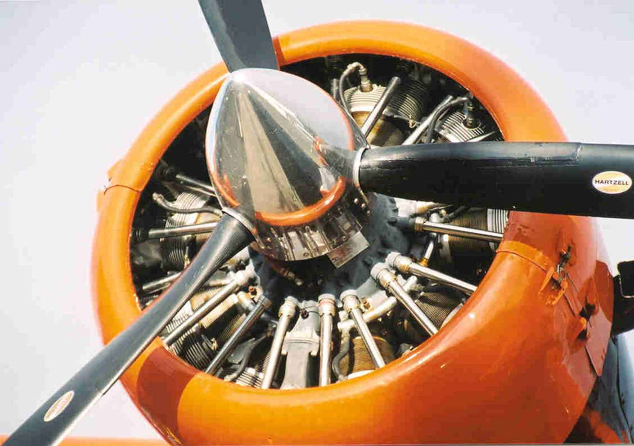
Airbus Flight Challenge 2024
Techkriti 2024
Indian Institute of Technology
Kanpur
Team Name
Chakravyuh Squadron (AIR005)
Team Members
Akshat Hemang Jani
Vedant Salphale
Vanshaj Anand

Slide 2
Abstract
This study investigates strategies to improve the efficiency of propeller systems through a combination of design optimization and performance analysis by researching and analyzing a variety of blade shapes and their performance for corresponding flight phases. The research aims to address the increasing demand for more energy-efficient propulsion solutions in aerospace by emphasizing more on increasing the propeller efficiency and lowering the power consumption. Key factors influencing propeller efficiency, such as airfoil selection, blade geometry, blade orientation, etc. are examined using various optimization techniques and previous studies for the given set of operational constraints. The proposed methodology describes the optimal propeller designs based on performance metrics suitable for given operating requirements, optimization of thrust and power consumption. The study also brings up the idea of energy harvesting capability where the propeller would act as a wind turbine during the phases of flight where the engine power is idled ex. descent, thus, generating and storing power which can boost up the endurance of the flight. The findings offer valuable insights for the development of next-generation propeller systems such as morphing propellers tailored to specific applications, leading to significant improvements in energy efficiency and environmental sustainability.

Slide 3
Contents
Mission Profile & Introduction to Energy Recuperation
Blade Airfoil Selection & Morphing Blades
Optimization of Power Consumption for various modes of propeller operations.

Slide 4
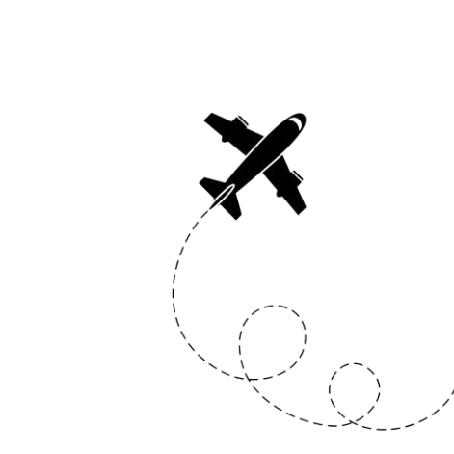
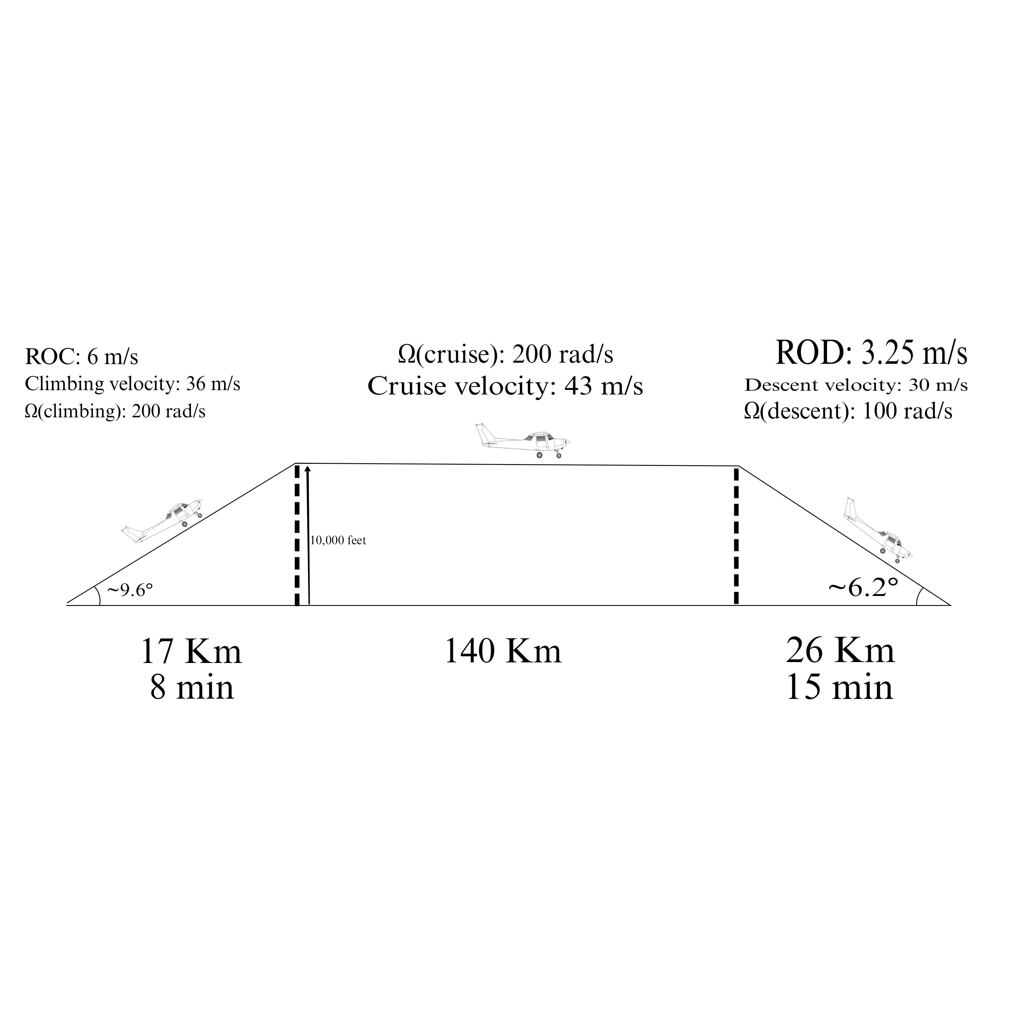
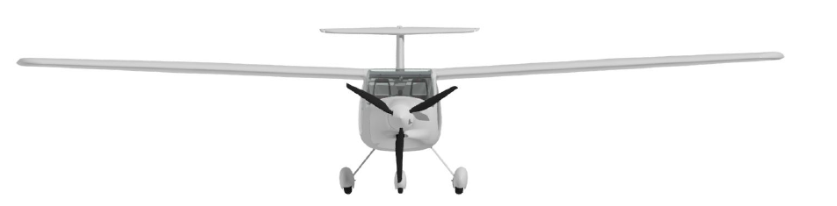
Flight Profile
Fig 1.1 Estimated Mission Profile
Ref Aircraft: Pipistrel Alpha Electro
Max Power : 60 kW Powerplant: Electric Max RPM: 2240 (cruise)
Weight : 5395.5N No. of Blades : 3
Cruise Range Distance: 108nm (200km)
10.5m
R=0.82m
2.05m
Fig 1.2 Aircraft Geometry – Front View

Slide 5
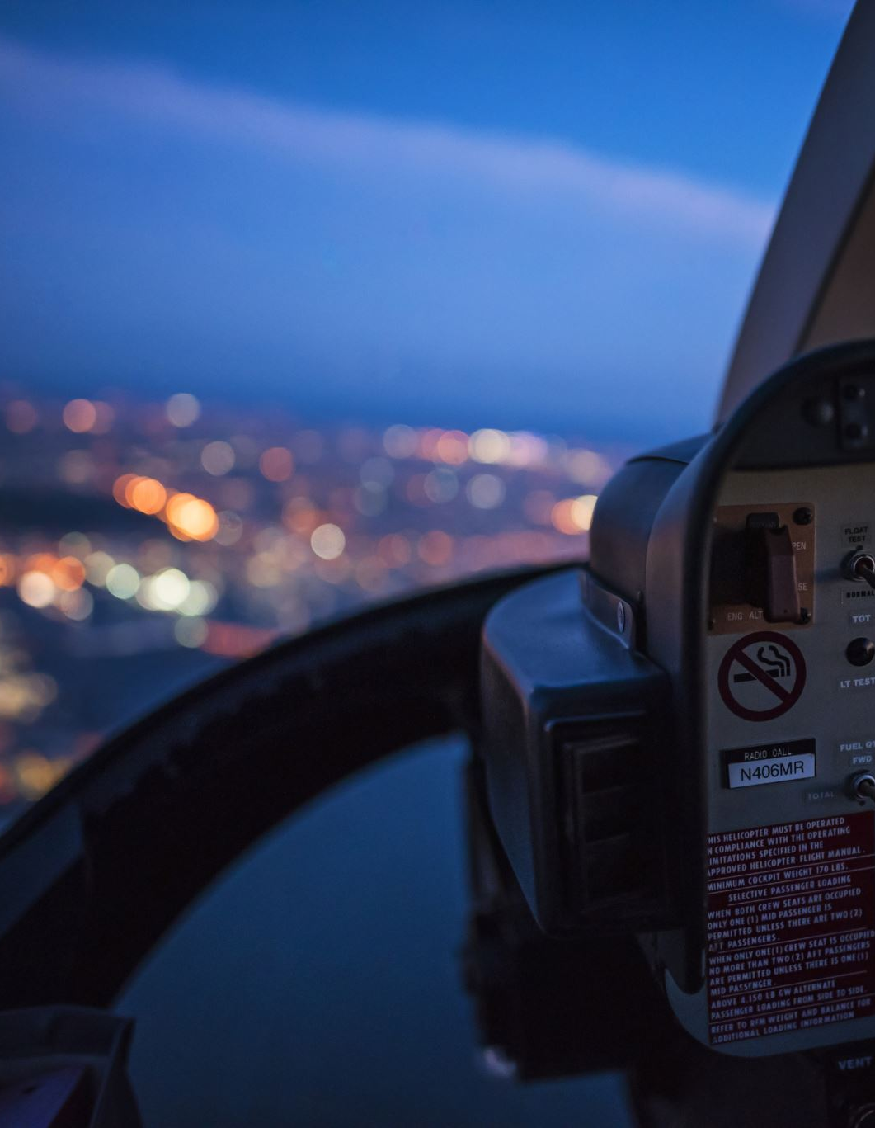
What is regenerative Flight ?
The flight time can be increased if necessary, or storage of energy for the subsequent flight becomes possible.
It is claimed that the technology enables a reduction in energy consumption as well as an extension of the options and flexibility the pilot obtains with the ’extra energy’ that would not be there without in-flight energy recuperation

Slide 6
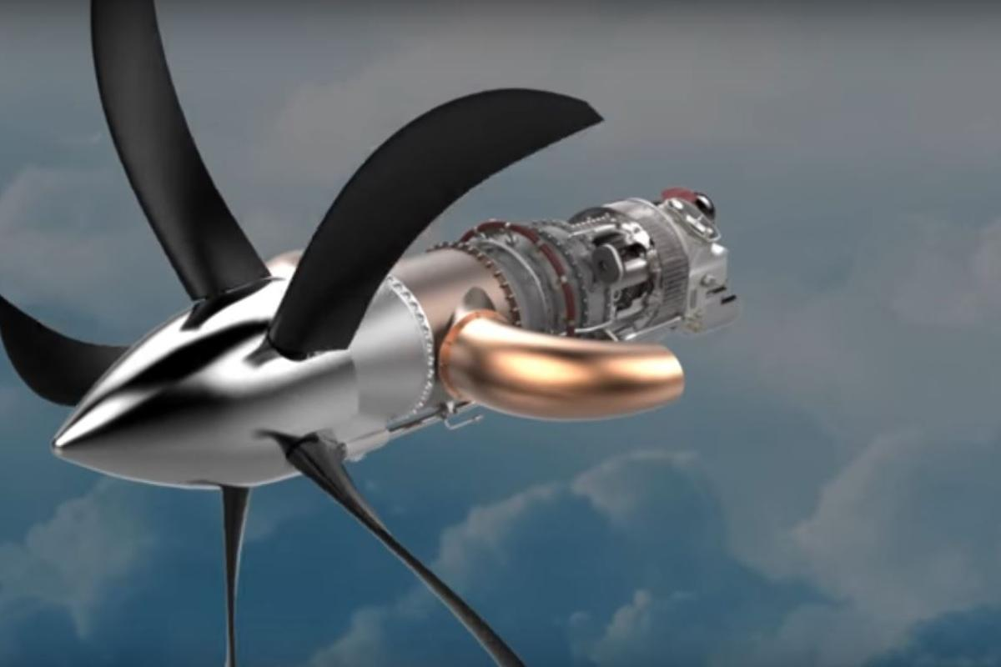
Is regenerative Flight Practical? (Spoiler Alert YES!)
The main mechanism driving regenerative flight technology is an innovative propeller design that can accomplish a dual function of delivering sufficient power in the most energy-demanding climbing flight phase, while simultaneously regenerating as much energy as possible by windmilling during the descent flight phase.

Slide 7
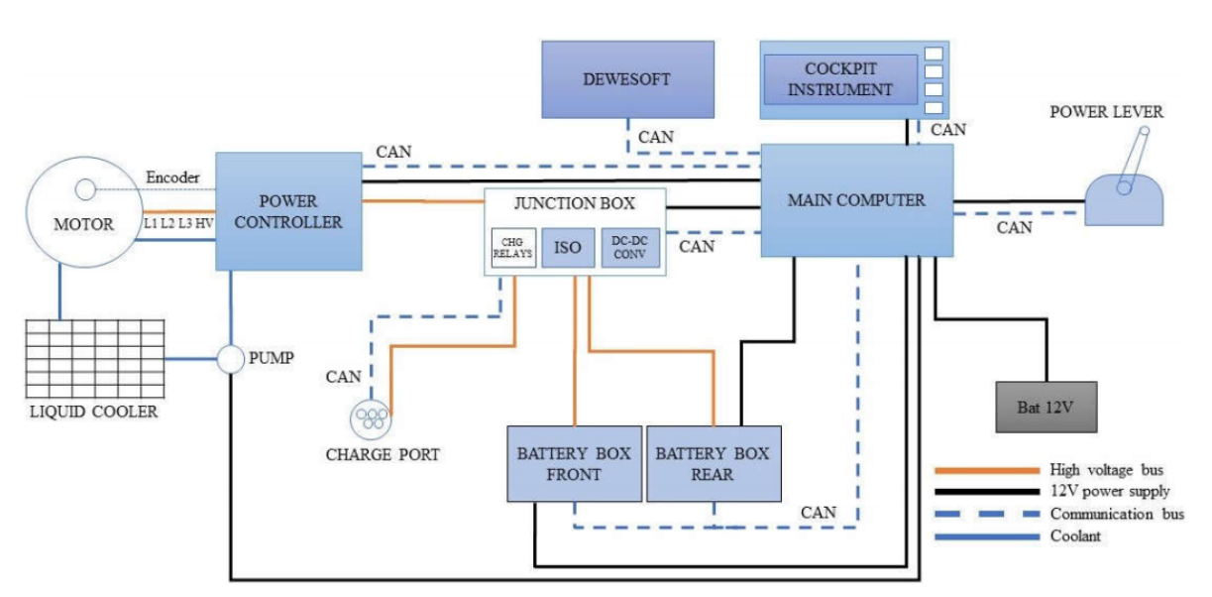
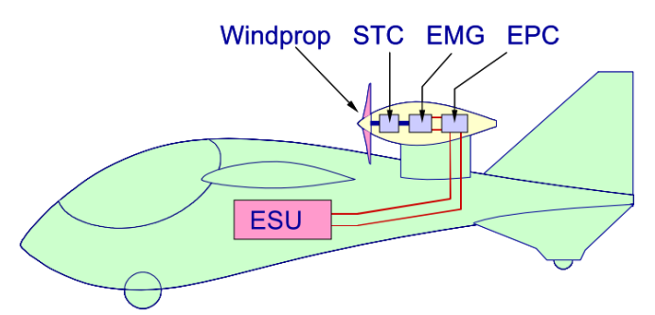
Figure 1.3: Powertrain Architecture
Figure 1.4 : Main components of a regenerative powertrain
ENERGY HARVESTING POWERTRAIN ARCHITECTURE
Energy is exchanged between the ESU(Electrical Storage Unit) and the electrical-power conditioner (EPC)
EPC is used to control the Speed of the Electric Motor Generator(EMG)
Shaft power generated is transmitter to propeller via Speed Torque Controller(STM)
It has two modes : energy consuming (propelling) or energy extraction (windmilling) mode

Slide 8
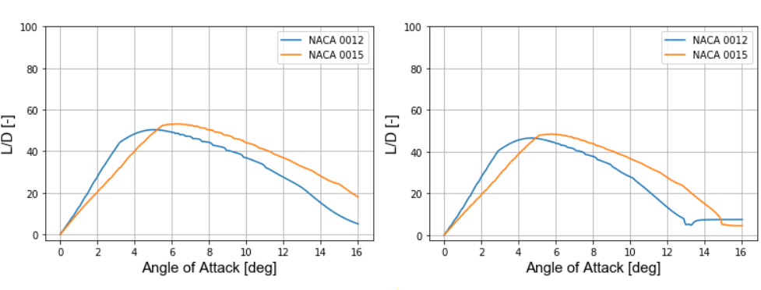
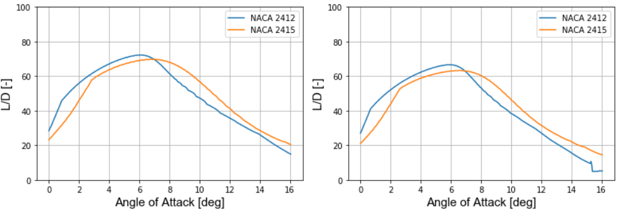
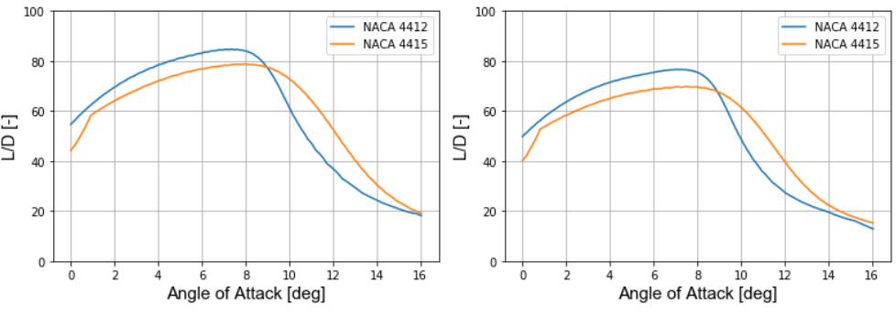
Blade Airfoil Selection
Blade cross section is made up of airfoil and plays a crucial role in performance
Single airfoil over the entire blade span
Higher efficiency requires high Lift-to-drag ratio
Each regime has different characteristics and hence the requirements of the camber
3 airfoils were chosen after careful literature review
L/D plots for Propulsive and Regenerative regimes are plotted in Fig.2.1
Fig. 2.1 : Lift to Drag ratio for different A.O.A. for propulsive mode^{[1]}

Slide 9
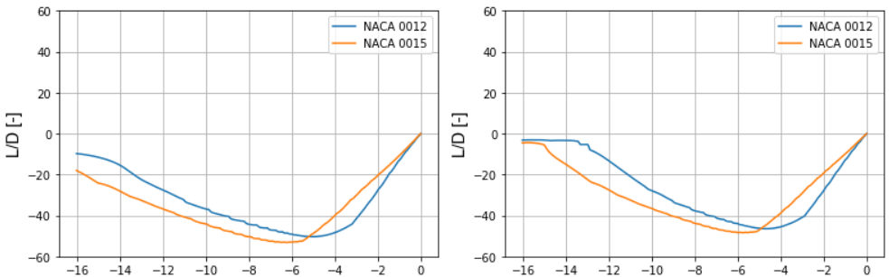
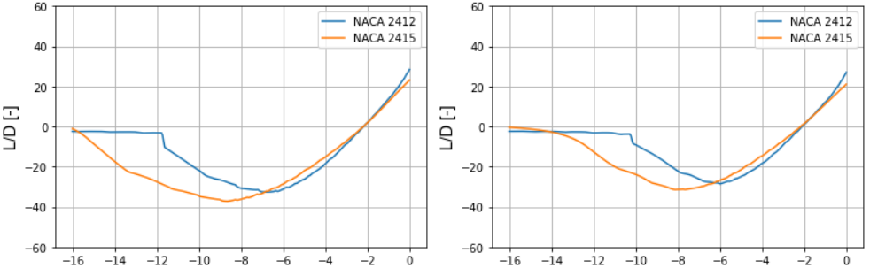
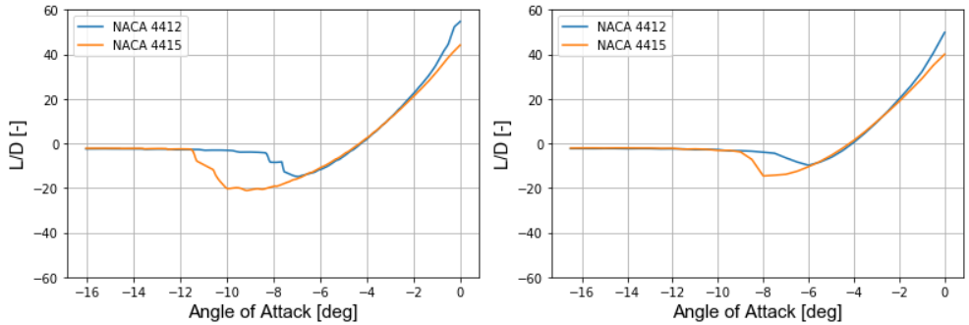
Some important airfoil criteria
High positive L/D ratio over a wide range of A.O.A. in propulsive mode
Low negative L/D ratio over a wide range of A.O.A. in regenerative mode
Thickness-to-chord ratio between 10% and 20%
Good low and high speed performance
Benign stall characteristics
Why NACA 4-Series ?
It is hard to determine the exact range of Mach and Reynolds numbers on the propeller span
Thin airfoil at tip : Higher critical mach number
Reduced compressibility drag because of higher velocities seen at the blade tip
A compromise as it complies very well with the above listed criteria
Fig. 2.2 : Lift to Drag ratio at different A.O.A. in regenerative mode^{[1]}

Slide 10
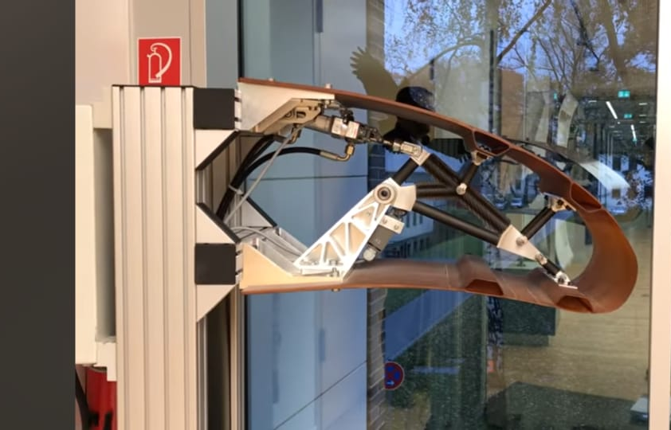
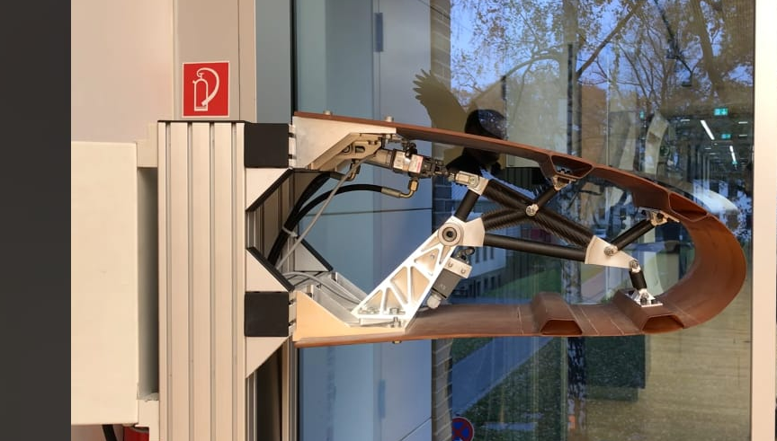
Morphing Blades : A Novelty
Proposal is to design a single propeller that can be modified for propulsive and regenerative phases
Morphing means to undergo transition from one form to another
Challenge is to put such small actuators in blades
Shape Memory Alloys (SMA) such as Nitinol is a suitable choice for actuators without increasing weight ^{[2]}
Using micro mechanical actuators inside the blade section for changing camber and thickness
A flexible yet strong material for blades that can be morphed is Ti-6Al-4V alloy which has a yield strength of upto 1000 MPa and excellent bending capabilities
Fig. 3.1 : Pneumatic morphic wing

Slide 11
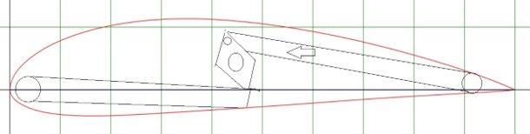
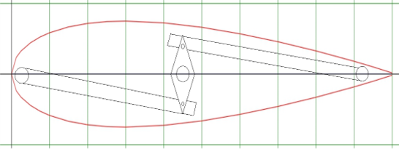
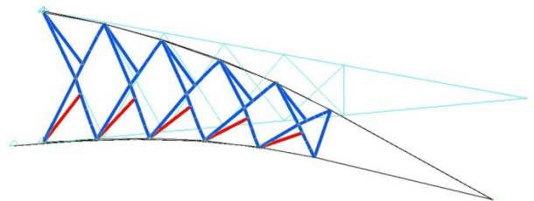
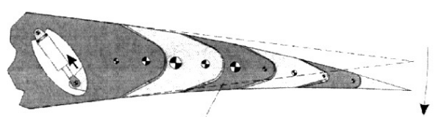
First approach is to mount on SMA strip to surface
Upon activation the wire would contract and cause an increase in the blade camber
Nitinol recovers it's original shape on being heated through it's transformation temperature
Overall transformation temperature span are about 40 to 70 Deg. C
Pneumatic linear actuators are also a viable option for increasing the camber of the structure
Actuating the first movable rib segment all the other rib segments would also rotate relative to the segment
Fig. 3.2 : NACA 4415 and NACA 0015 with actuating mechanism schematic
Fig. 3.3 : Pin-connected truss elements
Fig. 3.4 : Movable rib with pneumatic actuator

Slide 12

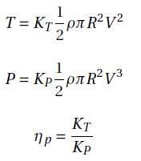

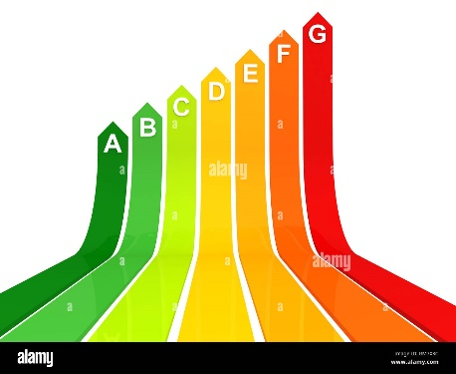







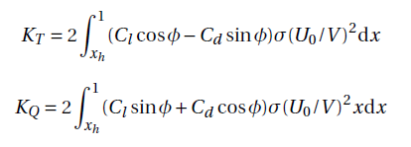








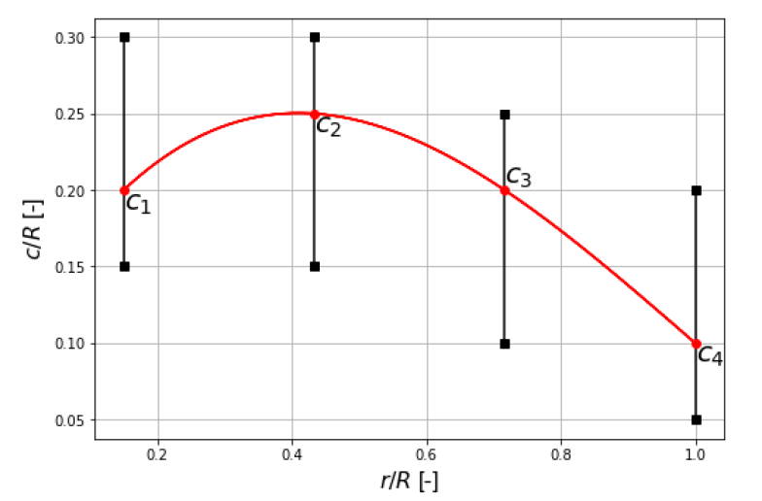
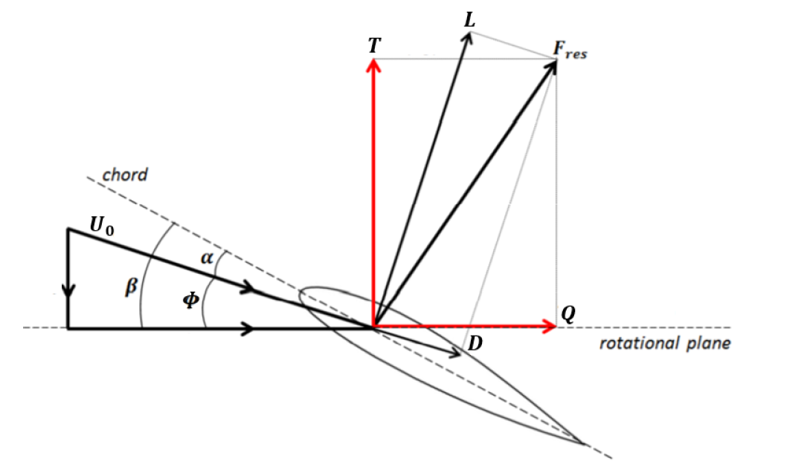
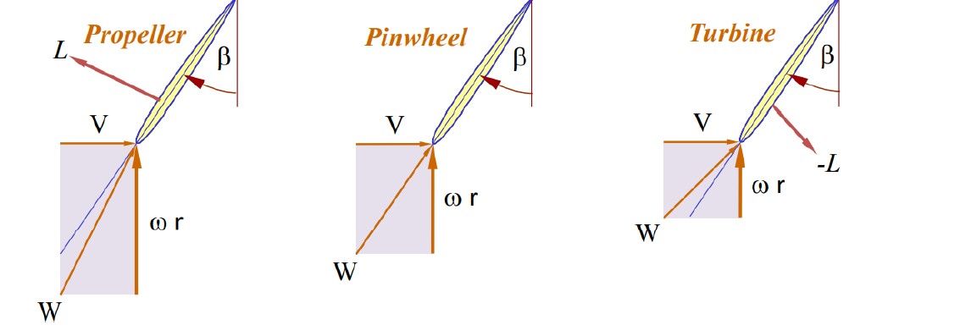
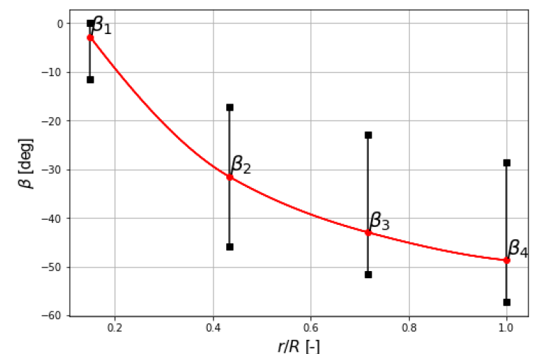

$$∅ \left(Inflow Angle\right)$$
$$β \left(Blade angle\right)$$
$$V \left(Freestream Velocity\right)$$
$$x_{h} \left(Normalised Hub Radius\right)$$
$$ρ\left(Airflow Density\right)$$
$$R \left(Radius of Blade\right)$$
$$d \left(Flight Distance\right)$$
$$ω \left(Rotational Speed\right)$$
$$r (Radial Distance)$$
Assumptions:
Same airfoil along the blade
V = const. in each flight phase
xh = 0 (xh << R)
Steady, Level Flight
Optimization Results from [1]
Airfoil Database (xflr5)
Optimization Function
Fig 4.1 Blade Section Schematic
Fig 4.2 F.B.D. of Blade at different modes
Fig 4.3 Control Points for chord/blade distributions

Slide 13
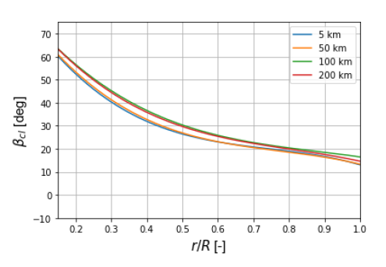
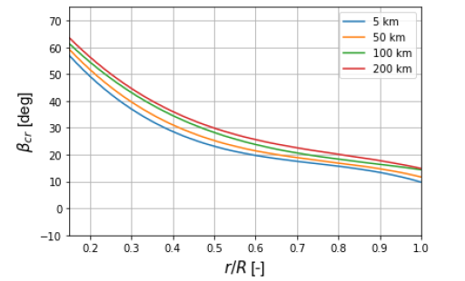
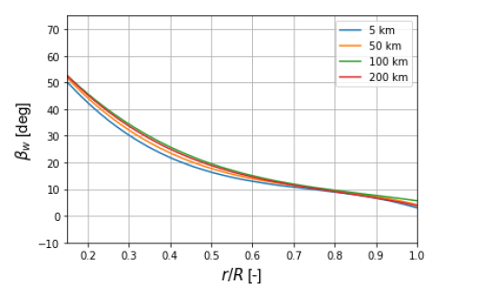
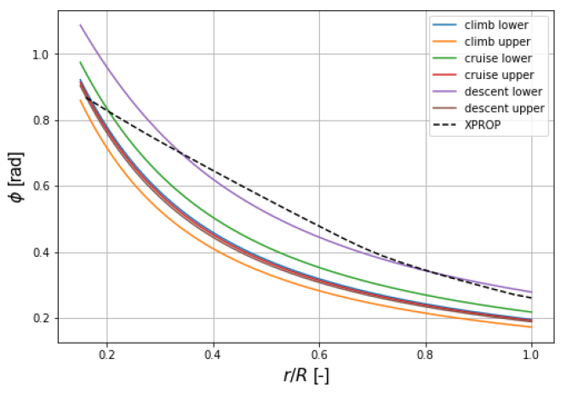
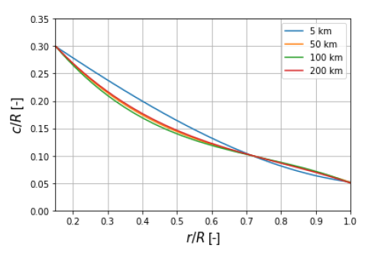



Optimization Results (from [1]) for VPVR Propellor
Fig 4.4 Blade Angle distributions for Climb, Cruise & Descent Phases
Constraints such as:
3m/s <= RDr <= 5m/s
2. Mdd >= U0/A
3.
4.
5.
Etc…
Fig 4.5 Inflow & Chord Distributions

Slide 14
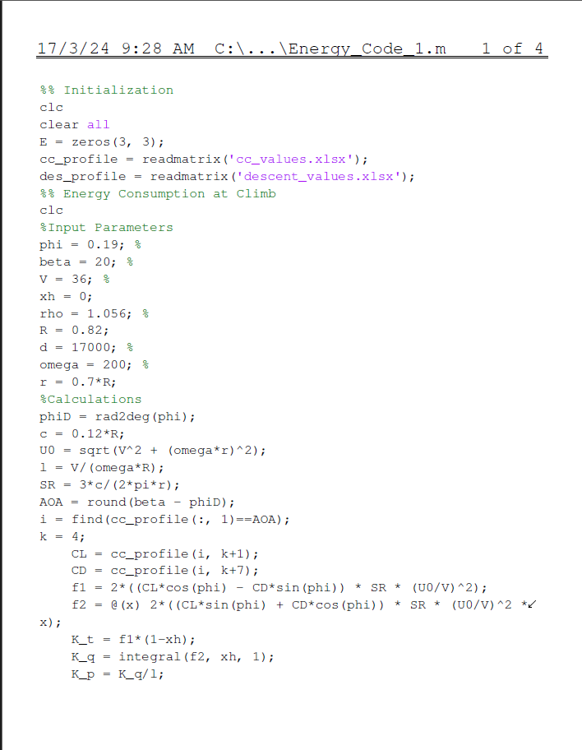
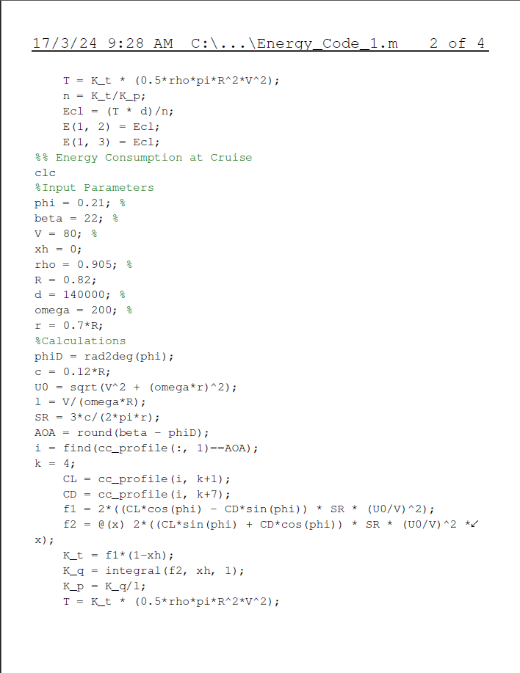

Slide 15
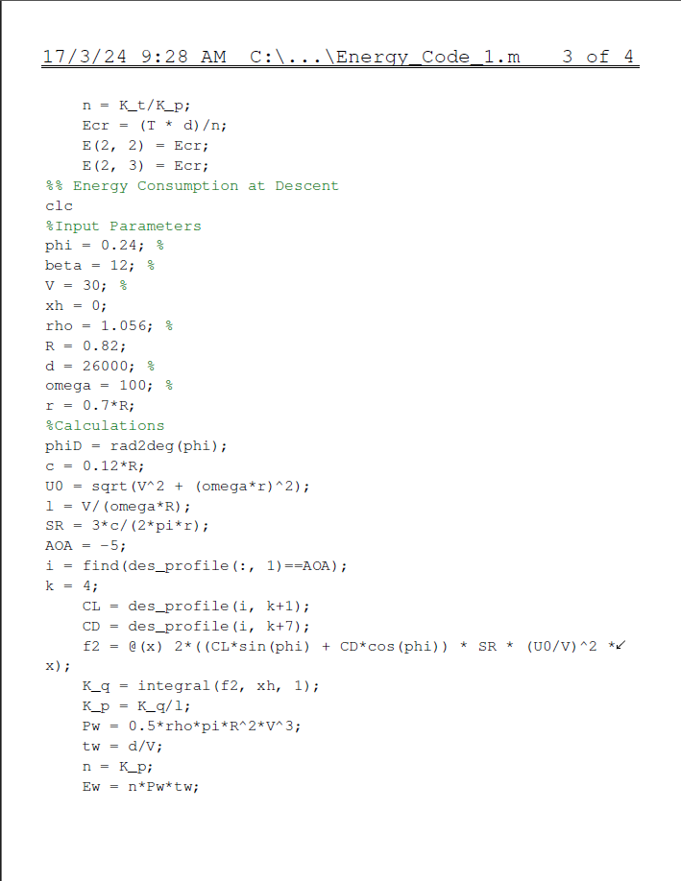
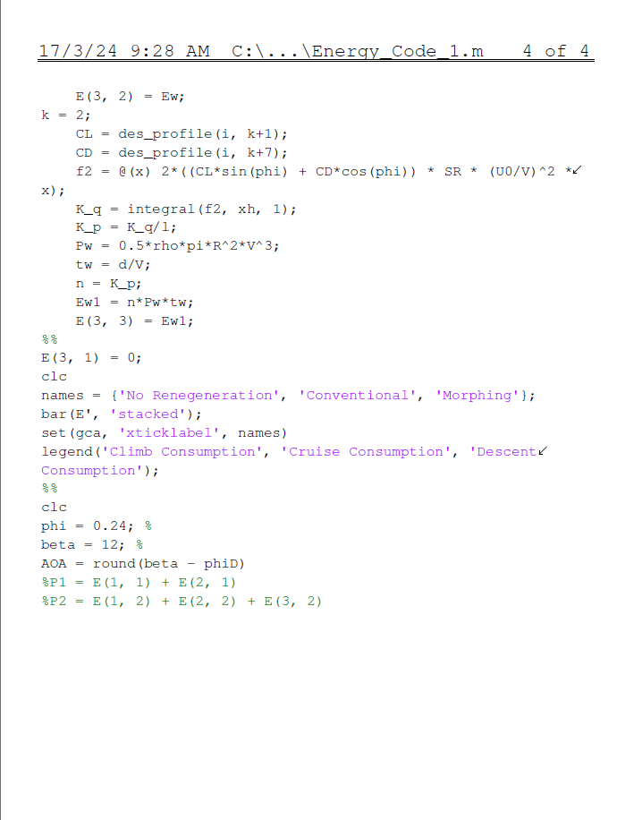

Slide 16
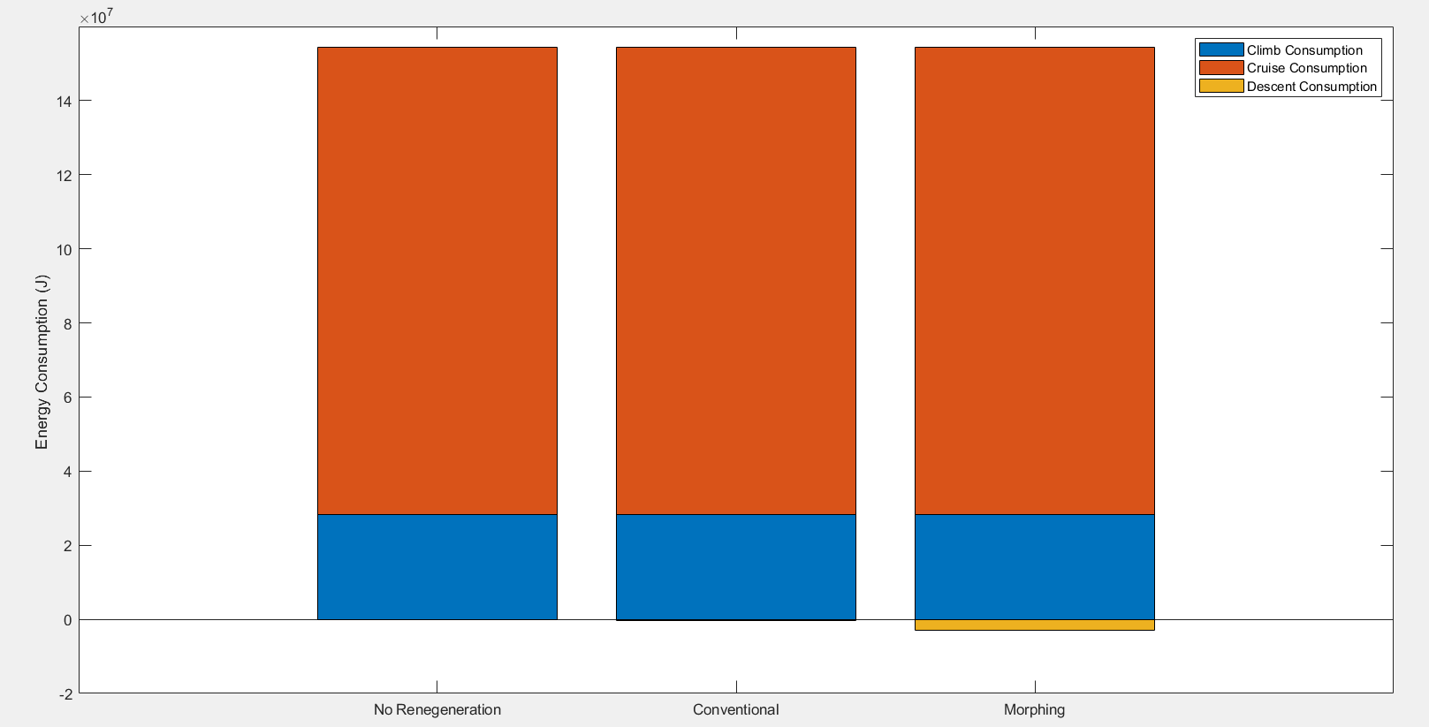
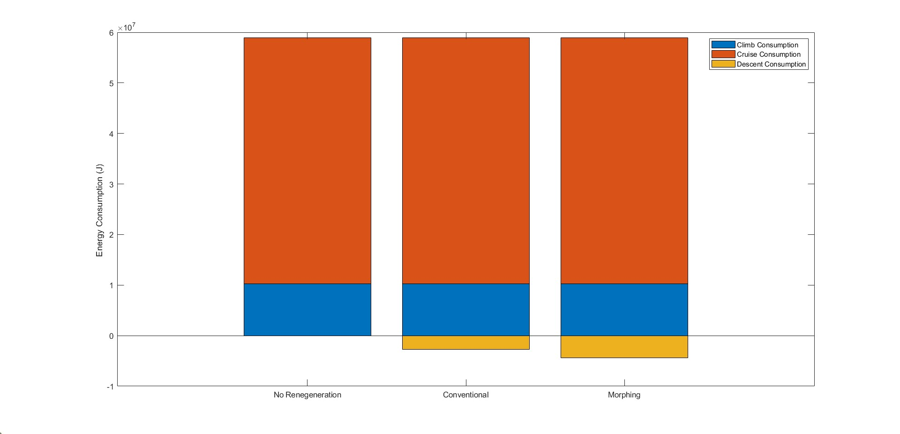
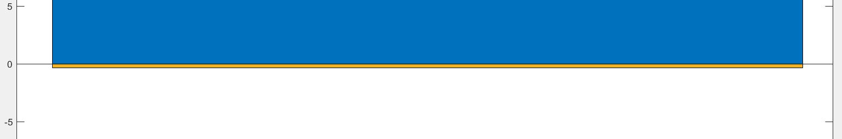
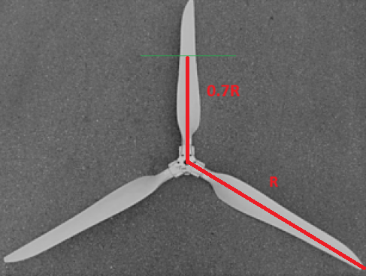
Overall Power Consumption for CPVR & VPVR Propellors
-0.25%
-2%
-4.68%
-7.43%
Fig 4.6 Power Consumption for CPVR propellor at r = 0.7R location
Fig 4.6 Power Consumption for VPVR propellor at r = R (tip) location
Blade Section | Conventional (with Regen.) | Morphing | Daily Savings (2 Legs)
Tip (VPVR) | -4.7 % | -7.4% | -9%, -14%
Tip (CPVR) | -0.2 % | -1.7% | -0.4%, -3.4%
0.7R (VPVR) | -0.22% | -1.56% | -0.44%, -3.12%
0.7R (CPVR) | -0.24% | -1.7% | -0.48%, -3.4%
Fig 4.7 %Savings in various cases
Fig 4.8 Schematic for radial distance r

Slide 17
Conclusions
Proposal has been made to use the propeller in the descent phase in a windmilling mode to extract energy from the wind and store it in the battery
An airfoil section is chosen after careful literature review and optimization algorithm
A novel idea of morphing the propeller geometry to change the cross-section i.e. the camber of the airfoil is proposed along with a suitable blade material
A Power Consumption study has been performed which predicts considerable power savings in the long term for regenerative propellers (conventional and morphing) compared to ones without energy recuperation capability.

Slide 18
References
J.M.F. van Neerven, Design of a Variable Pitch, Energy-Harvesting Propeller for In-Flight Power Recuperation on Electric Aircraft, Technische Universiteit Delft , 2020
Johann Dorfling, Feasibility of morphing aircraft propeller blades, Wichita State University, 2014
Pipistrel, Aircraft information pipistrel alpha electro, https://www.pipistrel-usa.com/alpha- electro/#manuals (2018).
4. Pipistrel, Pilot’s operating handbook, https://www.pipistrel-usa.com/alpha-electro/#manuals (2018).
5. O. Gur and A. Rosen, Optimization of propeller based propulsion system, Journal of Aircraft 46, 95 (2009).
6. J. P. Barnes, Regenerative electric flight synergy and integration of dual role machines, in 53rd AIAAAerospace SciencesMeeting (2015) p. 1302.
7. Q. R.Wald, The aerodynamics of propellers, Progress in Aerospace Sciences 42, 85 (2006).
8. C. Epstein, Pipistrel Shows Electric Aircraft Options at Oshkosh, https://www.ainonline.com/aviation-news/general-aviation/2018-07-23/pipistrel-shows-electric-aircraft-options-oshkosh (2018).

Slide 19
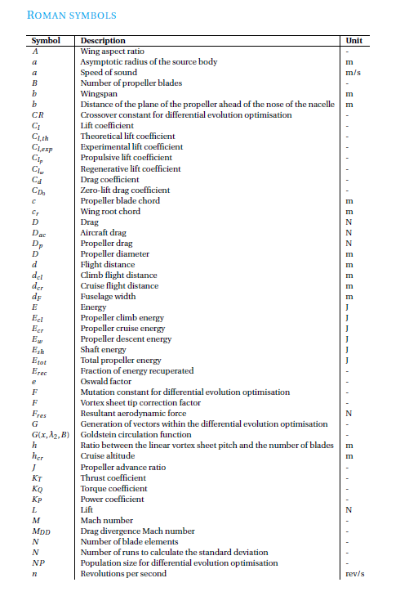
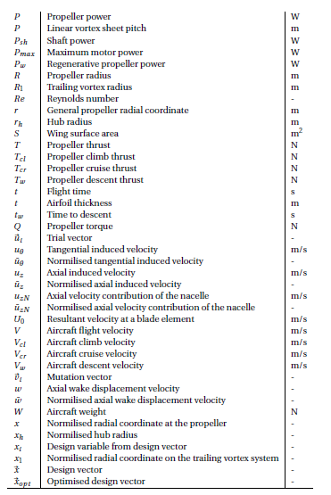
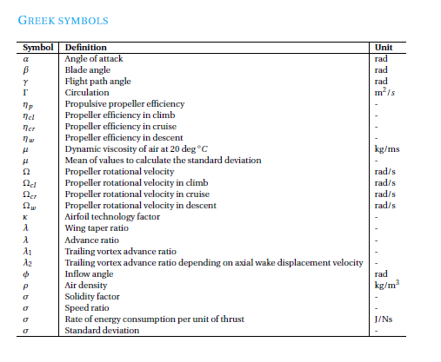
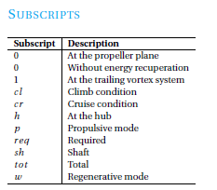
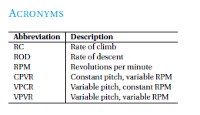
Abbreviations

Slide 20
Thank you!

