Slide 2
Conclusions
A proposal has been made to use the propeller in the descent phase in a windmilling mode to extract energy from the wind and store it in the battery
An airfoil section is chosen after a careful literature review and optimization algorithm
A novel idea of morphing the propeller geometry to change the cross-section i.e. the camber of the airfoil is proposed along with a suitable blade material
A Power Consumption study has been performed which predicts considerable power savings in the long term for regenerative propellers (conventional and morphing) compared to ones without energy recuperation capability.

Slide 4

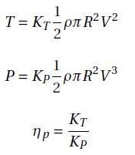



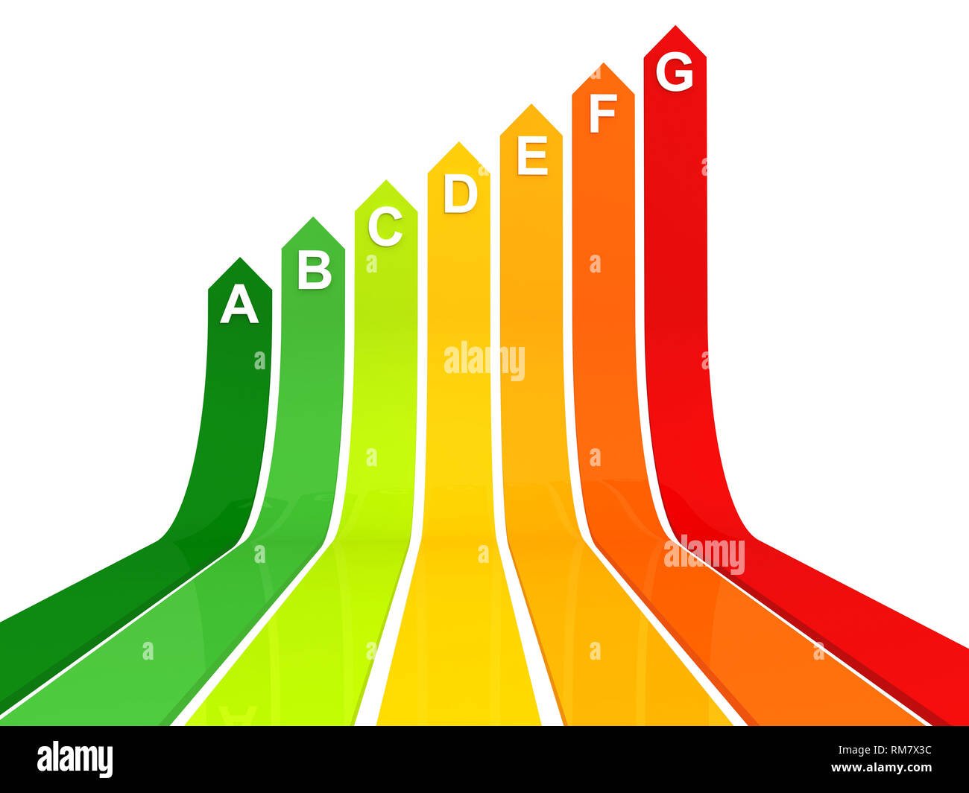





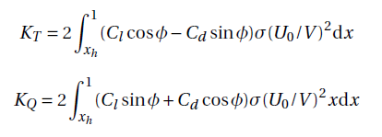







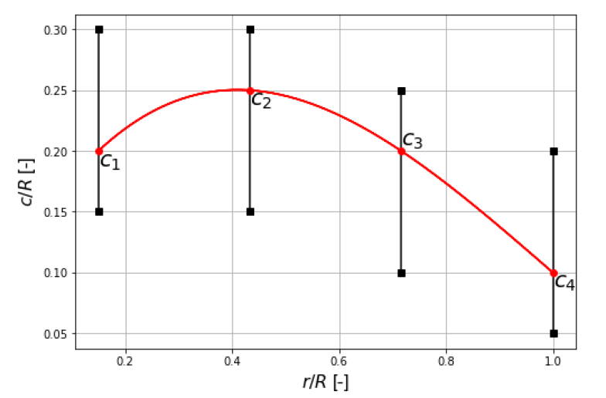
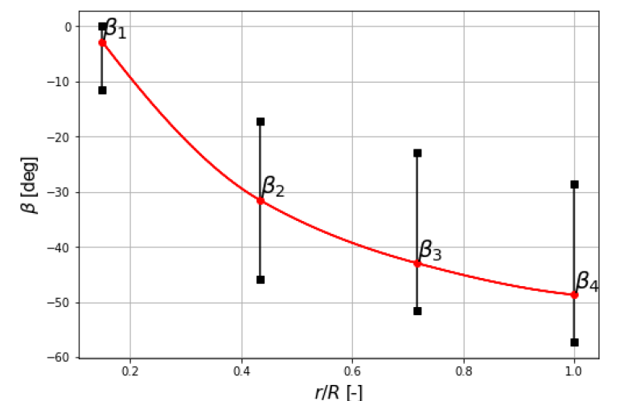
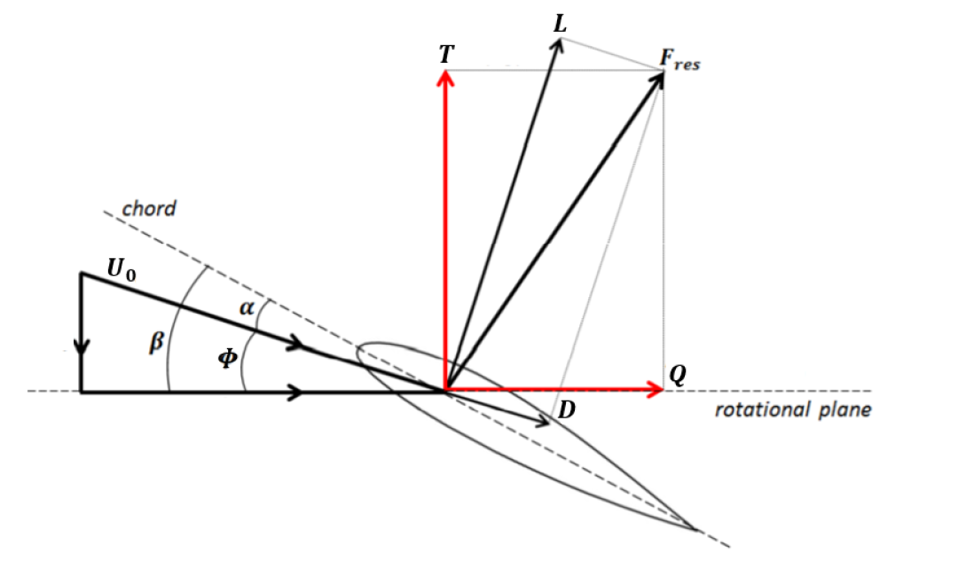

$$∅ \left(Inflow Angle\right)$$
$$β \left(Blade angle\right)$$
$$V \left(Freestream Velocity\right)$$
$$x_{h} \left(Normalised Hub Radius\right)$$
$$ρ\left(Airflow Density\right)$$
$$R \left(Radius of Blade\right)$$
$$d \left(Flight Distance\right)$$
$$ω \left(Rotational Speed\right)$$
$$r (Radial Distance)$$
Assumptions:
Same airfoil along the blade
V = const. in each flight phase
xh = 0 (xh << R)
Optimization Function
Optimization Results from [1]

