Slide 1
Approaches to measure multivocality in ESG
November 2024

Slide 2
Working-definition of Multivocality in ESG
General definition from the literature: Discursive and material activity that sustains different interpretations among various audiences with different evaluative criteria, in a manner that promotes coordination without requiring explicit consensus (Ferraro et al., 2015; Furnari, 2014; Mody & Nelson, 2013; Pinch & Bijker, 1987)
In the broader ESG movement: Discursive and material activity that sustains different interpretations among various stakeholders of what it means to promote sustainable and responsible business and investment practices by incorporating environmental, social, and governance factors into strategy and investment decision-making process.
In the context of ESG funds: Discursive and material activity that sustains different interpretations among various stakeholders regarding environmental, social, and governance factors and approaches in the investment strategy and decision-making process.
Notes:
This practically results in a variety of strategies across ESG funds, with funds prioritizing distinct aspects of ESG in different ways, demonstrating a plurality of perspectives within the investment framework.
There may be varied interpretations and applications of ESG criteria across different funds. Each fund may weigh environmental, social, or governance factors differently, reflecting diverse priorities and strategies within the broader ESG movement. This diversity in how funds implement ESG principles highlights the multivocal nature of the field, where different frameworks coexist, and investors may align with those that best reflect their values or investment goals.

Slide 3
How to study ESG investing multivocality in funds?
Main text used: Strategy description within 497K documents
497K documents: A fund’s summary prospectus that provides key details about the specific fund (not the entire fund family) in a concise format, covering performance data, fees, investment strategies, and risks. It's more standardized than full prospectuses, which refer to all funds in a family and are less uniform. 497K documents must be published whenever there is an update in the fund’s strategy, performance, or fees, typically on an annual basis or more frequently if needed.
Note: While "Objective" and "Risk" sections were extracted, they may not provide valuable insights for this study, as "Objective" is brief and "Risk" focuses solely on risks.

Slide 4
Operationalization: Four main categories of ESG multivocality in funds
Components (What): An ESG fund demonstrates greater multivocality when it includes a focus on more than one of the ESG components (Environmental, Social, Governance) in the description of its strategy.
Implementation (How): Multivocality extends to the strategies used to implement ESG criteria. A fund using multiple strategies is more multivocal than one relying on a single strategy.
Framing (How): Multivocality may also be reflected in the ambiguity in how ESG strategies are described (language used).
Motivation (Why): The use of belief-based language to describe ESG in the fund’s strategy can also reflect multivocality, showing this is not only a financial choice, but also a value-driven one.

Slide 5
Operationalization: Four main categories of ESG multivocality in funds
Components (What): An ESG fund demonstrates greater multivocality when it includes a focus on more than one of the ESG components (Environmental, Social, Governance) in the description of its strategy.
Implementation (How): Multivocality extends to the strategies used to implement ESG criteria. A fund using multiple strategies is more multivocal than one relying on a single strategy.
Framing (How): Multivocality may also be reflected in the ambiguity in how ESG strategies are described (language used).
Motivation (Why): The use of belief-based language to describe ESG in the fund’s strategy can also reflect multivocality, showing this is not only a financial choice, but also a value-driven one.

Slide 6
Components (What): 1st approach Keyword search SHELLY
Starting from the dictionaries provided by the ESG initiative, I added new words from other papers and removed ambiguous terms in the context of funds (e.g., "class" from the social dictionary was dropped due to its reference to "share class").
We performed a simple word count to assess the relative emphasis on E, S, and G. The dictionary for each category was iteratively reviewed with manual checks of funds' strategies.
Limitations: Keyword searches don't account for context. This is problematic, especially in G, where words may refer to internal governance or governance of investee companies, without the possibility to distinguish between the two.

Slide 7
Components (What): 2nd approach TF-IDF SHELLY
The TF-IDF (Term Frequency-Inverse Document Frequency) method turns a collection of texts into numbers that represent how often a word appears in each text, while also giving less importance to words that appear frequently across all texts.
We combined the list of investment strategies with additional texts representing "E" (environmental), "S" (social), and "G" (governance) criteria.
We used a TF-IDF vectorizer, which turns the text into numerical values based on word frequency and how unique the words are across all texts.
We calculated cosine similarity between the investment strategies and the "E", "S", and "G" texts. This shows how closely each investment strategy aligns with environmental, social, or governance criteria.

Slide 8
Method | Pros | Cons | Usage
TF-IDF embedding | Simple and Interpretable: Each dimension of the TF-IDF vector represents a specific word. This makes the representation highly interpretable—you can easily see which words contribute the most to the similarity score. Low Computational Complexity: TF-IDF is computationally inexpensive to compute, especially for small-to-moderate-sized corpora. Good for Sparse Data: TF-IDF handles sparse data well, meaning it works effectively for documents that share few common words. No Need for Pre-training: You don’t need any pre-trained models or large-scale data for TF-IDF, as it’s derived directly from the text corpus itself. | Vocabulary Size Dependency: The vector size depends on the total number of unique words in the corpus, which can become very large and lead to high-dimensional sparse vectors. No Semantic Understanding: TF-IDF treats words independently, without considering the semantics of words or their context. For example, "dog" and "canine" will have zero similarity unless they both appear in the same document. Bag-of-Words Limitation: It doesn’t capture word order or context, so it may miss nuanced relationships between words (e.g., idiomatic phrases, negations, etc.). | You have a small-to-moderate dataset and need a simple, interpretable model. You’re dealing with very sparse data or need to compute similarity quickly without high computational costs. You don’t need a deep semantic understanding of the text, or you only care about the frequency of terms.

Slide 9
Components (What): 3rd approach LLM embedding SHELLY
We created embeddings (numerical representations of text) for each of the E, S, and G keyword lists using a model called 'text-embedding-3-small', resulting in 1536-dimensional embeddings.
We applied the same process to embed the investment strategies for selected documents (only 500 to do a trial – this method has a cost by using the GPT API).
Then, we calculated cosine similarity between each investment strategy embedding and the E, S, and G keyword embeddings to measure how closely they align.
See an example of how the scores look like in the file attached in the email.

Slide 10
Method | Pros | Cons | Usage
LLM embedding | Captures Semantics: LLM-based embeddings capture deep semantic relationships between words. They understand synonyms, polysemy (same word with different meanings), and context. For example, "dog" and "canine" will be close in vector space even if they don't appear in the same document. Contextualized Representations: Unlike TF-IDF, which is static, LLMs generate embeddings based on the surrounding context of words. The same word can have different representations depending on its use (e.g., "bank" in "river bank" vs. "financial bank"). Handles Complex Language Constructs: LLMs understand more complex language structures like idioms, negations, and multi-word expressions that are lost in simpler models like TF-IDF. | Computationally Expensive: LLM-based embeddings require significant computational resources, both in terms of memory and processing power, especially if you are using a large, pre-trained model like GPT or BERT. Black-Box Nature: The embeddings are dense vectors, and it’s difficult to interpret which specific aspects of the text are contributing to the similarity. Unlike TF-IDF, where you know which words contribute, LLMs provide limited interpretability. Pre-training Dependency: LLM embeddings rely on large-scale pre-trained models, which may require fine-tuning on domain-specific data if the text in your corpus differs significantly from the data used to train the LLM. Resource and Time Intensive: Fine-tuning or even just using these models may require powerful hardware (e.g., GPUs) and more time for inference, making them less practical for real-time or resource-constrained environments. (But we don’t need to do this though) | You need a model that captures the semantic meaning of the text and understands context. The texts are long or complex, and you need to handle nuanced language, such as synonyms, idioms, or polysemous words. You have access to sufficient computational resources (e.g., GPUs) and can afford the higher computational cost. You’re working with a domain that requires contextual understanding (e.g., natural language processing tasks like question answering or summarization).

Slide 11
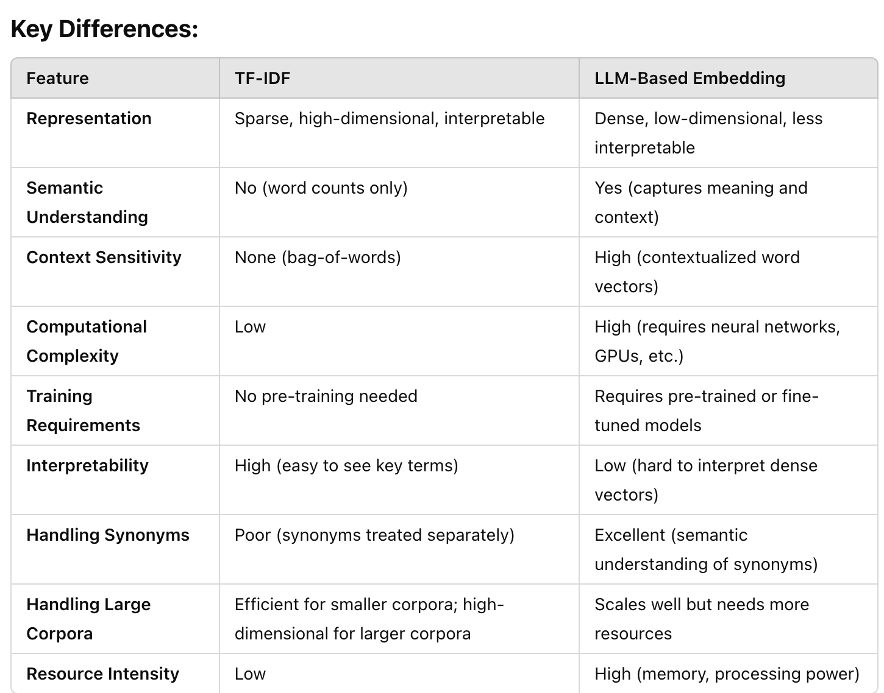

Slide 12
Components (What): Work in progress
We are adjusting the G list of words. The keywords used in other papers (e.g., Baier, Berninger, and Kiesel, 2020; Nielsen and Villadsen, 2023) are too general. Using these words result in capturing sentences related to the focal fund’s governance, rather than that of the portoflio companies.
We will estimate how costly is the 3rd approach once we solve the point above.

Slide 13
Operationalization: Four main categories of ESG multivocality in funds
Components (What): An ESG fund demonstrates greater multivocality when it includes a focus on more than one of the ESG components (Environmental, Social, Governance) in the description of its strategy.
Implementation (How): Multivocality extends to the strategies used to implement ESG criteria. A fund using multiple strategies is more multivocal than one relying on a single strategy.
Framing (How): Multivocality may also be reflected in the ambiguity in how ESG strategies are described (language used).
Motivation (Why): The use of belief-based language to describe ESG in the fund’s strategy can also reflect multivocality, showing this is not only a financial choice, but also a value-driven one.

Slide 14
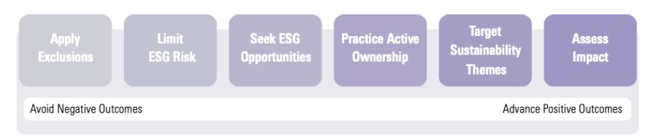
Implementation (How)
After trying to use different bottom-up methods (inductive approach such as topic modelling) to find a list of ESG strategy categories without success, I decided to use a top-down method. Specifically, I propose to use a pre-defined list of categories of ESG strategies.
After some searching, I propose the following categorization, described in depth in the PDF document in the email (Jon Hale, 2021, Mornigstar)
Notes:
Sustainable-Investing Approaches (Jon Hale)
Strategies
Styles

Slide 15
Apply exclusions (1/6)
This approach refers to excluding sectors, companies, or practices that investors consider harmful or not in alignment with sustainability criteria. Exclusions may range from traditional "sin" stocks (alcohol, tobacco, gambling) to guns and controversial weapons to business ethics (violators of the United Nations Global Compact or companies engaged in major controversies). Many investors today exclude the fossil fuel industry from their portfolios, either entirely or by excluding practices with the worst climate and environmental impacts (such as thermal coal extraction and use, Arctic exploration, or tar sands drilling). Using company ESG metrics, investors can avoid companies that are poor sustainability performers, either overall or in certain areas of emphasis. Portfolio optimization techniques can be used to reduce the impact of exclusions on a portfolio’s tracking error to a market benchmark.
Example: This fund excludes companies involved in tobacco production, fossil fuel extraction, and controversial weapons. It focuses on maintaining a portfolio free from industries that have a negative environmental or social impact.

Slide 16
Limit ESG Risk (2/6)
Investors can address sustainability concerns by taking steps to limit ESG risks. Sometimes referred to more generically as ESG integration, this approach uses ESG ratings and data in the risk-management process to assess material ESG risks. Investors may price ESG risk into valuation models or seek to avoid investments with a certain level of ESG risk regardless of valuation. This approach has become widespread among traditional investments as more investors have come to understand that material ESG issues may reflect hidden risks that traditional analysis may overlook. This is especially true of risks associated with climate change.
Example: This fund integrates ESG risks into its investment analysis, giving special consideration to companies with significant climate-related risks. The portfolio is adjusted to reduce exposure to companies that might be affected by climate change.

Slide 17
Seek ESG Opportunities (3/6)
Investors may also use ESG information to identify companies that are sustainability leaders or those seeking to improve their ESG practices to build competitive advantages. This approach includes what is sometimes called ESG best in class or positive screening based on ESG ratings. An ESG best in class approach typically favors companies with better ESG ratings on a sector or industry basis. It is a subset of positive screening, which more generally builds portfolios around companies with better ESG ratings. Some investors look for companies with so-called ESG momentum that are improving their overall performance on ESG metrics in ways that will enhance their financial performance. Finally, investment approaches focused on quality growth may use ESG performance as a nonfinancial indicator of quality that contributes to a company’s competitive advantage, or economic moat.
Example: The fund identifies companies that are leading in sustainability practices or are improving their ESG performance. It particularly targets firms that are increasing their investments in renewable energy and green technologies.

Slide 18
Practice Active Ownership (4/6)
Investors may seek positive ESG outcomes via their active ownership, or stewardship, activities, made possible primarily because asset managers are shareholders in public companies. These activities may include direct engagement with companies on ESG issues, proposing ESG-related shareholder resolutions, supporting ESG issues through proxy voting, participating in ESG-related investor coalitions, and advocating for public policy measures that address sustainability issues.
Through these activities, investors communicate not only their specific sustainability concerns but also encourage corporate leaders to focus more broadly on stakeholders and the long term. As corporate managements come to understand that their investor base consists of a growing proportion of sustainability-minded investors, they become more likely to adjust corporate strategy in ways that support stakeholder capitalism.
Example: This fund actively engages with companies to encourage them to improve their ESG performance, particularly in governance. It frequently exercises its proxy voting rights and submits shareholder resolutions related to ESG issues.

Slide 19
Target Sustainability Themes (5/6)
Thematic investing focuses on identifying long-term societal trends and the investments that stand to benefit from those trends. In targeting sustainability themes, investors seek to take advantage of opportunities created as the world moves toward greater sustainability and transitions to an economy driven by renewable energy. Sustainability-themed investments often use the 17 United Nations Sustainable Development Goals to identify specific themes to pursue. Such themes may be related to climate action or other environmental concerns, like healthy ecosystems and natural resource security, or they may be related to social issues, like human development, including diversity, equity, and inclusion, or basic needs.
Example: This fund specifically focuses on companies aligned with sustainability themes such as renewable energy, clean water, and sustainable agriculture. Its investments are aimed at driving long-term societal benefits through these themes.

Slide 20
Assess Impact (6/6)
Investors may wish to integrate impact assessments into security selection and portfolio construction. Fixed-income investors, for example, may consider a bond’s use of proceeds, focusing on bonds that finance projects that benefit people and planet. Equity investors may consider whether a company’s products and services, as well as its policies and behaviors, support or detract from the U.N. goals, which many investors and companies use as an impact framework. At the portfolio level, investors may assess the overall impact of their portfolio holdings in relation to a goal or benchmark. Impact reporting provides transparency for investors into the societal outcomes an investment has created or encouraged and which social causes an investment is aligned with.
Example: This fund measures the impact of its investments on society, particularly in terms of carbon footprint reduction and contributions to the U.N. Sustainable Development Goals. It provides detailed reports on the outcomes of its investments.

Slide 21
Implementation (How): GPT-4o Few-shot Learning RENU
The main approach uses GPT-4o Few-shot Learning to categorize fund strategies directly from their descriptions. Steps:
Dataset Input: Extract the investment strategy field from the dataset. Provide a few labeled examples of fund strategies already categorized into the six ESG categories.
Prompting GPT-4o: Feed the extracted strategy text into GPT-4 using a few-shot prompting technique. This involves presenting several labeled examples so that GPT-o can learn how to categorize new, unseen strategies.
Categorization: GPT-4o will generate scores for each ESG category based on the context and language of the strategy.
Output: For each strategy, GPT-o outputs a score for each of the six ESG categories, allowing us to determine which categories the strategy aligns with and by how much.
Limitation: it may be expensive (we estimate around 500 dollars, we will give a more precise estimate soon)
Notes:
acs-support@wharton.upenn.edu
Fellow working with Vit on a project – co-authors
Vit in CC.
Discount

Slide 22
Operationalization: Four main categories of ESG multivocality in funds
Components (What): An ESG fund demonstrates greater multivocality when it includes a focus on more than one of the ESG components (Environmental, Social, Governance) in the description of its strategy.
Implementation (How): Multivocality extends to the strategies used to implement ESG criteria. A fund using multiple strategies is more multivocal than one relying on a single strategy.
Framing (How): Multivocality may also be reflected in the ambiguity in how ESG strategies are described (language used).
Motivation (Why): The use of belief-based language to describe ESG in the fund’s strategy can also reflect multivocality, showing this is not only a financial choice, but also a value-driven one.

Slide 23
Plan for Framing and Motivation
Framing (How): Multivocality may also be reflected in the ambiguity in how ESG strategies are described (language used).
I followed DesJardine, M. R., Marti, E., & Durand, R. (2021) AMJ and looked for the dictionary they use “Hiller's Communication Vagueness Scale.”
I will try the free version of Provalis Research Corp. who sells the dictionary through WordStat. I will ask for the budget if this is not possible.
Motivation (Why): The use of belief-based language to describe ESG in the fund’s strategy can also reflect multivocality, showing this is not only a financial choice, but also a value-driven one.
I collected from previous studies a vocabulary of “moral-values”. We will finish the Multivocality components and implementation before going ahead with this.

Slide 24
Additional text: Fund name SHELLY
I wanted to collect the name of the fund for each document to ensure our approach using the 497K document was correct (i.e., is it really referring to just one fund? If not, it would compromise the dataset).
We crafted and tested a prompt using GPT-3.5 (good combination of quality and affordability for this task) to extract the fund names from each document.
First result: Our approach using 497K is validated!
Second result: We can now also study ESG fund name changes over time, tracking specific words added or removed, particularly those related to ESG criteria. Currently, we’re reviewing about 40 cases where ESG words were inconsistently added and removed.
You can see in the email the file tracking the names and their changes

Slide 25
Steps for the next weeks
Close tests for the Governance dictionary
Complete troubleshooting and comparison of the two advanced approaches for Components (What).
If Approach 3 is optimal, apply it to all documents and use others for robustness
Complete prompting engineering of GPT for Implementation (How).
Seek budget approval for Implementation (How) using GPT.
Assess the cost of Hiller's Communication Vagueness Scale.
Finalize detection of fund name changes.

