Slide 1
HEALTH DIAGNOSIS
USING THREE ML ALGORITHM

Slide 2
INTRODUCTION
Accurate and on-time analysis of any health-related problem is essential for preventing and treating the illness. The traditional way of diagnosis may not be sufficient in the case of a severe ailment.
Developing a medical diagnosis system based on machine learning (ML) algorithms to predict any disease can help in a more accurate diagnosis than the conventional method.
Tested the performance of three machine learning algorithms - Naive Bayes, Decision Tree, and Random Forest and achieved the best-case accuracy of 95.12%.

Slide 3
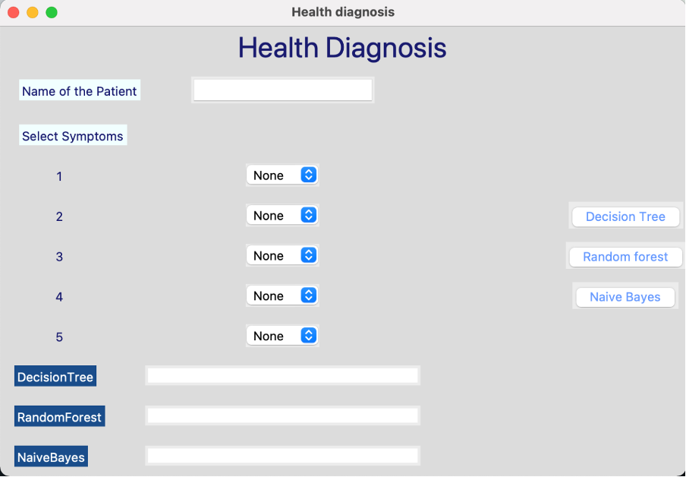
GRAPHIC USER INTERFACE(GUI)
Tested the performance of three machine learning algorithms - Naive Bayes, Decision Tree, and Random Forest and achieved the best-case accuracy of 95.12%.
We have used Tkinter for our GUI (Graphical User Interface). Python with tkinter is the fastest and easiest way to create the GUI applications.

Slide 4
THANK YOU
BY:
ISHA GOEL(102183055)
AKSHAT KHOSLA(102053026)
ARUSHI SHARMA(102003202)

