Slide 1

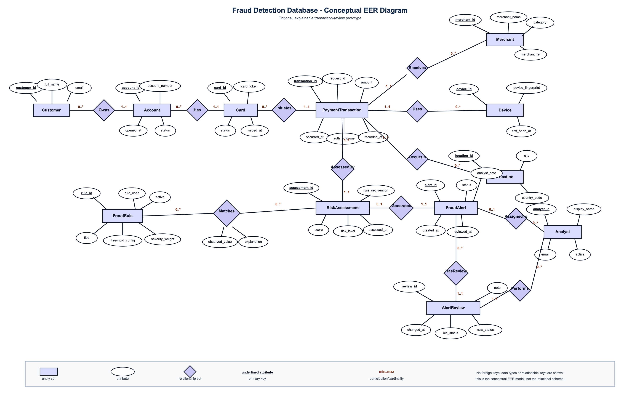
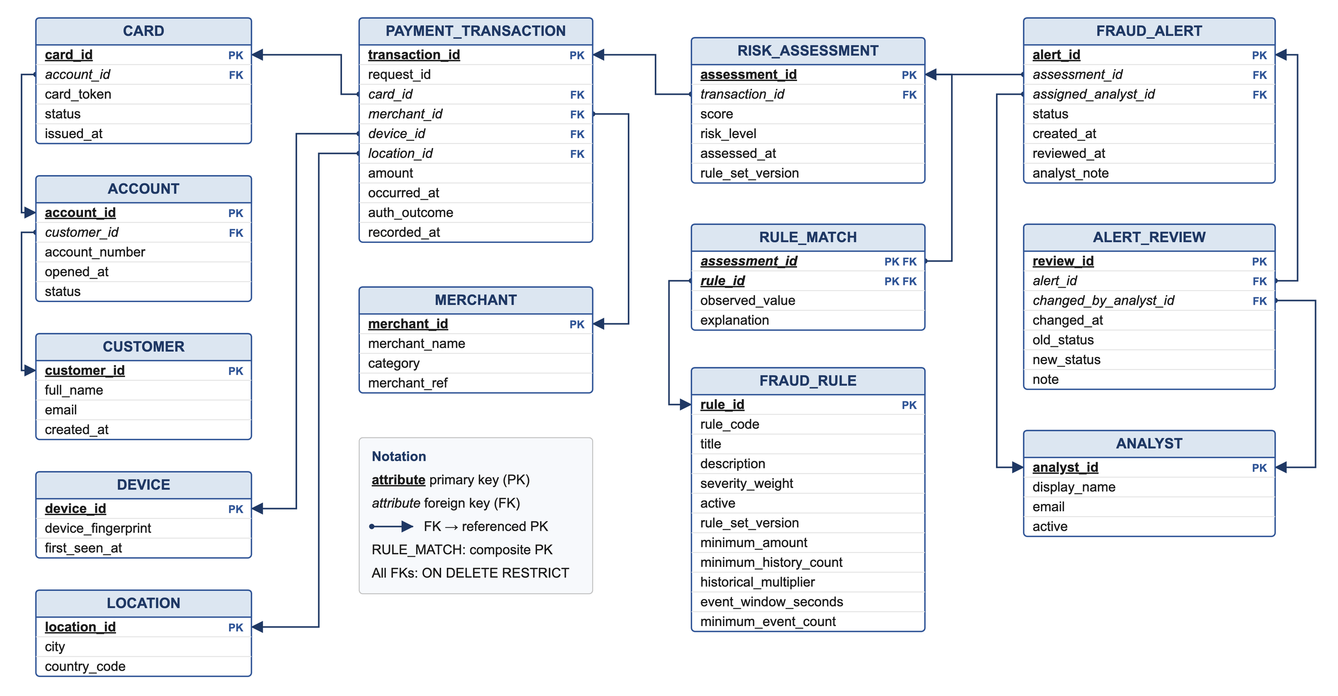
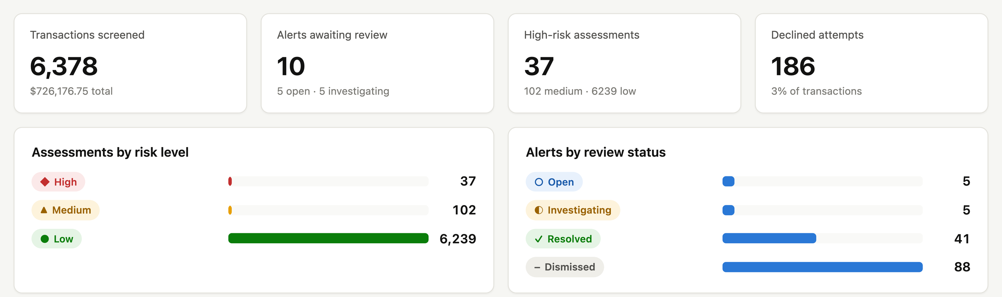
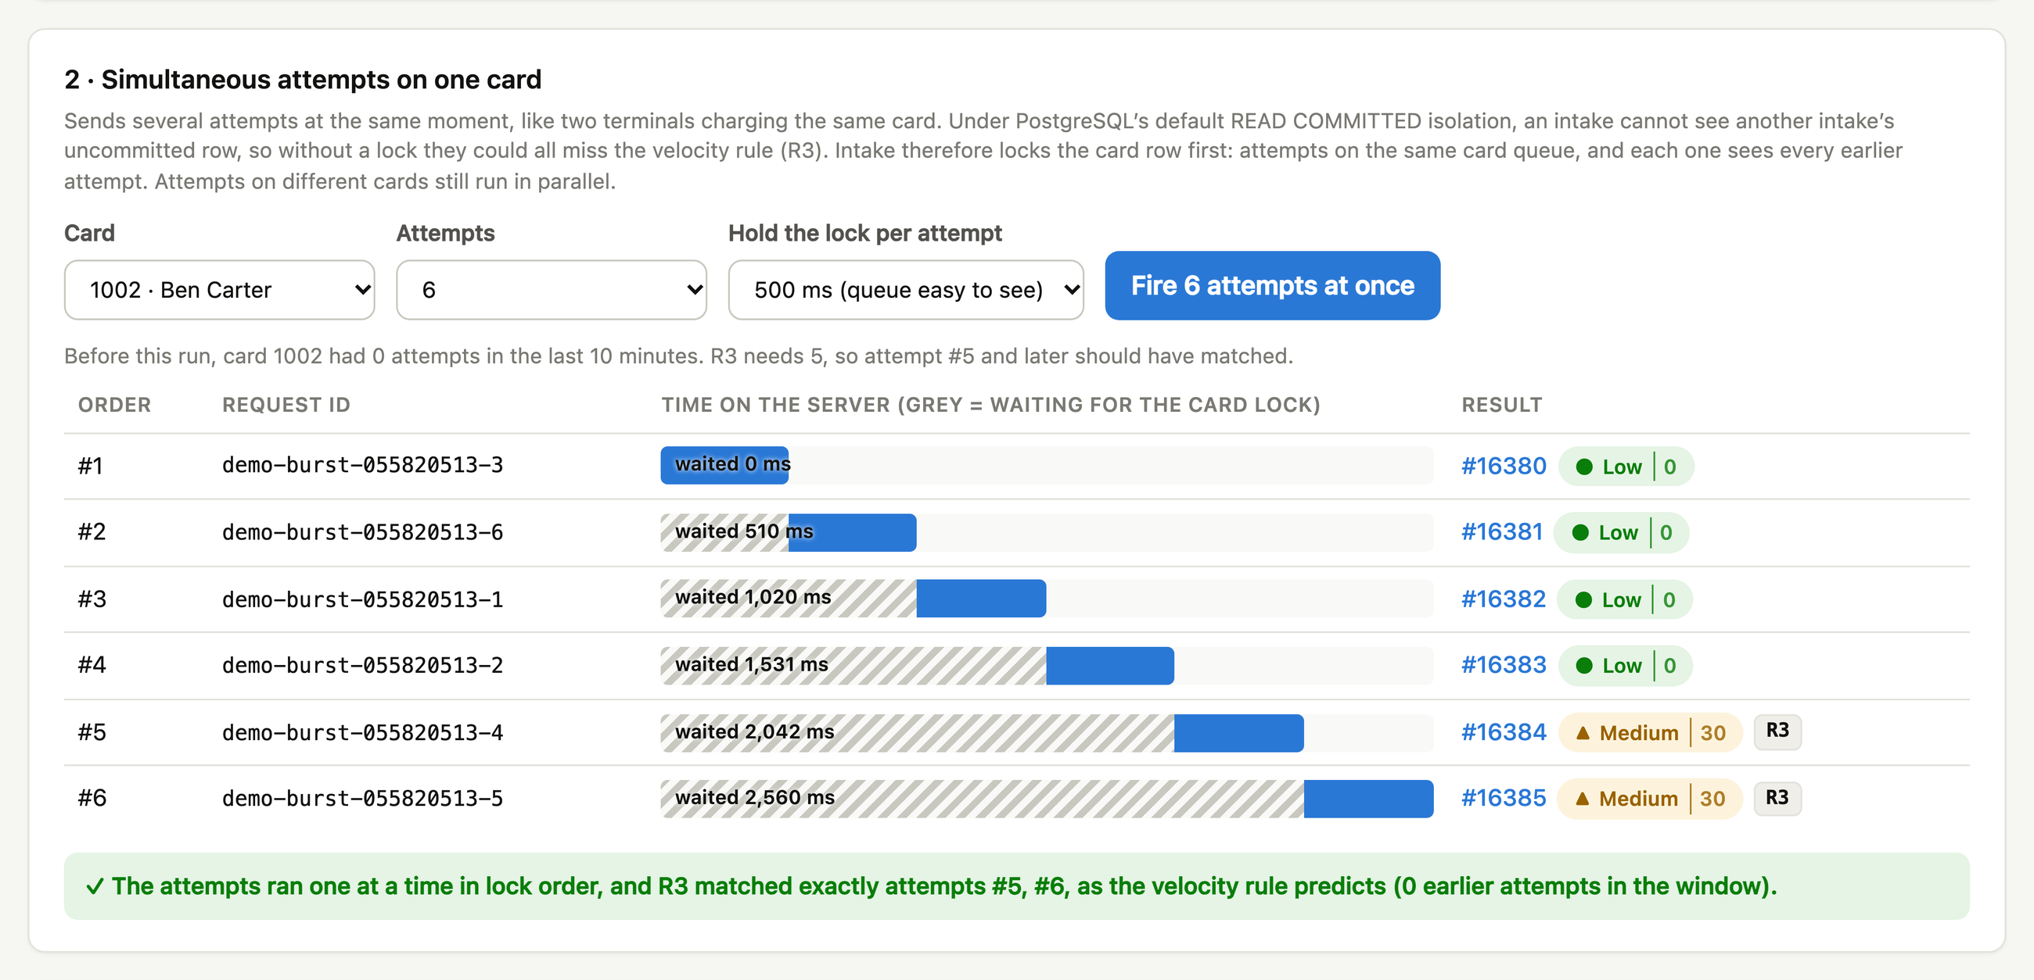
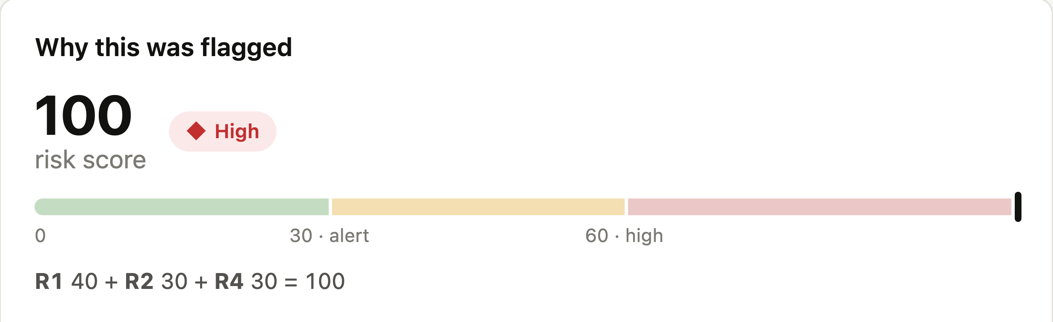
COMP9120: Semester 2 2026
Fraud Detection Database
Akshat Mathur
amat0369@uni.sydney.edu.au
Sanchit Singhal
ssin0398@uni.sydney.edu.au
Prajwal Bankar
pban0764@uni.sydney.edu.au
An explainable, auditable PostgreSQL database for reviewing card-transaction fraud
1
The problem
2
Our solution
At a glance
Fraud analysts must decide quickly which card payments to investigate. A risk score alone does not say why a payment looks suspicious, and a lost or duplicated record breaks the audit trail.
Users: fraud analysts who review alerts, and an operator who submits test payments.
Goal: score every payment with explainable rules and keep every decision and review as evidence.
1
Payment arrives card, merchant, device, location, amount
13
relations, 12 in BCNF
5
explainable fraud rules
2
5 explainable rules large amount, high vs history, velocity, new device, declines
3
Risk score stored for every payment, with the evidence for each rule
6,378
synthetic transactions
0
rows left by a failed transaction
4
Alert if score ≥ 30 into the analyst queue
5
Analyst reviews open → investigating → resolved / dismissed
3
Database design
Conceptual EER model (Chen notation, min..max participation)
Relational model: primary keys underlined, each foreign key points to the key it references
Mapping
M:N Matches becomes RULE_MATCH with a composite key; 1:1 AssessedBy is a UNIQUE foreign key; two analyst roles become two named foreign keys.
Normalisation
12 of 13 relations are in BCNF. RISK_ASSESSMENT keeps score → risk level on purpose, guarded by a CHECK constraint.
Integrity
Primary and UNIQUE keys (incl. request ID), foreign keys with ON DELETE RESTRICT, CHECKs: amount > 0, valid statuses, closed alerts need a note.
SQL
8 report queries using correlated subqueries, LATERAL joins, GROUP BY … HAVING and FILTER, e.g. accounts with repeated alerts.
4
A multi-step transaction
5
Working prototype
Boundary: one payment = one database transaction. BEGIN → lock the card row → check the request ID → insert the transaction → evaluate rules on earlier history → insert the assessment and rule matches → alert if score ≥ 30 → COMMIT.
Failure: a fault injected at the alert step rolls back all earlier steps; 0 rows are kept. Concurrency: simultaneous attempts on one card queue on the lock, so velocity rule R3 fires on exactly #5 and #6.
Stack: PostgreSQL 17 · Java 21, Spring Boot, JDBC · React, TypeScript. Tested: 16 integration tests; SQL and Java rule evaluation agree on all 31,890 checks.
Acknowledgements: COMP9120 teaching team · All data is synthetic · Generative AI use is acknowledged in the report

