Slide 1
Influencer-Brand Matching via GAIL & Graph Spillover
Review 2: the pipeline is complete, and every claim is tested
Shimona Sinha (data, temporal analysis, web app)
Eesha (GAIL model) | Akshat (infrastructure)
UE23CS441A, Project 011 | 28 October 2026
Notes:
Opening. One sentence: we built the full pipeline from data to a web app, and this review is about what is real, what is validated and what is still open. We say the limits ourselves.

Slide 2
What changed since the last review
59,300
1,874
95 of 150
159
YouTube videos of the 150 creators
Sponsorship events
Creators with a graph link
Independent training examples
was 21,100 on 25 Oct (history extended to 24 months)
was 897 on 25 Oct, after the labelling pass
was 17 (collaboration and Reddit only)
was about 39 (one example per engagement change)
Why this matters: GAIL can only learn from what the data shows, so we spent this phase on the data first: more history, correct labels and brands, and more links between creators.
How we checked: numbers are from the live database on 27 Oct 2026, and every change to shared data was backed up before it was made.
Influencer-Brand Matching via GAIL & Graph Spillover | Review 2 | 28 Oct 2026
2
Notes:
Four numbers tell the story. YouTube history grew about 2.8 times. Sponsorship events doubled after re-labelling. Linked creators went from 17 to 95 of the 150. The number of independent training examples is about four times larger. All measured on live data on 27 October and every data change has a backup.

Slide 3
The system end to end
1
2
3
4
5
6
Collect
Clean + label
Graph
GAIL
Fusion
Web app
YouTube API, Instagram, Reddit; runs daily on its own
owner checks, brand fixes, sponsorship detector
collaboration, shared brand, @mention links
spillover: does a post lift linked creators
0.4 spillover + 0.3 sentiment + 0.3 features
ranked list, scores, explanations
Status: everything runs and is tested. Only the final GAIL retraining is left.
Temporal sentiment
CLIP and BERT features
comment sentiment per creator; English plus a Hindi-script model
how well a creator's posts match the brand brief
Influencer-Brand Matching via GAIL & Graph Spillover | Review 2 | 28 Oct 2026
3
Notes:
Walk left to right. Collection runs by itself every day. Labels and brands are cleaned and corrected. The graph links creators. GAIL estimates spillover; two other branches add sentiment and creator features; fusion combines the three into a 0 to 100 score with a confidence range; the web app shows it with its basis. Only GAIL still needs the final retraining.

Slide 4
What we collected
59,300
270,357
165,862
YouTube videos
growth readings
YouTube comments
Dec 2023 to Oct 2026
every 2 hours since 11 Oct
for sentiment
1,021
61,570
1,874
Instagram posts
Reddit comments
sponsorship events
78 of 150 creators
3,308 posts, brand talk
1,874 labelled, 109 creators
Collection never stops: YouTube is read every 2 hours inside Supabase, Instagram once a day (read-only, capped at 130 page loads a day to avoid blocks), Reddit on request.
Influencer-Brand Matching via GAIL & Graph Spillover | Review 2 | 28 Oct 2026
4
Notes:
These are the 150 verified Indian fitness creators. YouTube is the strong side: 59 thousand videos and a growth reading every two hours since 11 October. Instagram is thinner because of the rate limit: 78 of 150 creators. Collection keeps running without anyone's laptop for YouTube, and daily for Instagram.

Slide 5
Making the data trustworthy
1
Whose post is it?
2
Wrong brands removed
3
Missing brands filled
Instagram posts are checked against the true owner; foreign posts were detached, with a backup.
28 words that are not brands (gmail, Delhi) no longer count as sponsors.
17 sponsored posts of 9 creators now carry the brand named in their own text.
4
Brands classified
5
Labels corrected
6
Sentiment fixed
25 unclassified brands sorted, so they can link creators.
Two look-alike posts unflagged ('Not a paid promotion'); an accuracy figure of ours was retracted.
Hindi-script comments now use a multilingual model.
Influencer-Brand Matching via GAIL & Graph Spillover | Review 2 | 28 Oct 2026
5
Notes:
This is the cleaning work. The important point for the committee: each fix is small, checked, and reversible. We removed Instagram posts that belonged to other accounts, removed wrong brand attachments, gave brands to sponsored posts that had none, and classified brands so they can link creators.

Slide 6
How reliable are the sponsorship labels?
Checked one by one by a person
73 of 75 flagged events were real (95% range 91 to 99%), but that is only about 4% of the 1,874 events.
Text-only reading (amber)
Only 61% of 113 weak-tier events look sponsored from the description alone. Text cannot hear a spoken sponsor, so this is a lower bound.
So
Weak tiers are 81% of events and their true precision is between about 60% and 95%. A person checking more rows is the only fix.
Influencer-Brand Matching via GAIL & Graph Spillover | Review 2 | 28 Oct 2026
6
Notes:
Be careful and honest here. The strong evidence tiers, checked one by one by a person, are almost always right: 73 of 75. But that is only 4 percent of events. When Claude read only the description of weak-tier events, only 61 percent looked sponsored, though text cannot hear a spoken sponsor. So the true weak-tier precision is somewhere between about 60 and 95 percent. We corrected an earlier 91 percent figure that mixed assumed rows with checked ones.

Slide 7
Graph formation: from 17 to 95 linked creators
Two new relations
Shared brand: both creators promoted the same classified brand (1,226 links).
@mention: one creator tags another tracked creator (34 pairs inside the 150).
What the graph means
Only 7 real collaboration pairs are inside the 150, so most links say "same niche, same brand", not "one influenced the other". We call it exploratory.
Still open
55 creators have no link in any data we hold and stay neutral.
Influencer-Brand Matching via GAIL & Graph Spillover | Review 2 | 28 Oct 2026
7
Notes:
Before, only 17 of the 150 creators had any link, mostly Reddit co-mentions, because only 7 of 880 listed collaborators were inside our 150. We added two real relations from data we already hold: two creators who promoted the same brand, and one creator @-mentioning another. The honest reading: most links mean same brand, not influence. 55 creators still have no link.

Slide 8
Spillover on real data: what the tests say
Test (real data) | Result | Reading
Within-neighbour placebo (65 neighbours) | +0.00 (-0.04 to +0.03) | No broad spillover
Strong-evidence events only | -0.11 (-0.17 to 0.00) | Same answer without weak labels
Stronger tie = more spillover? | trend -0.05 (-0.28 to +0.19) | No dose-response
Sponsored vs usual YouTube video | views x0.98 (0.83 to 1.21) | Same views; slightly lower likes
Read with care: the exposed-versus-unexposed comparison shows +0.49, but it is confounded: exposed creators were already growing faster before the posts. We never quote it alone.
Influencer-Brand Matching via GAIL & Graph Spillover | Review 2 | 28 Oct 2026
8
Notes:
Test A compares each neighbour with itself: its lift after a sponsored post versus its lift at placebo dates. The answer is about zero. The exposed-versus-unexposed comparison gave plus 0.49 but that is confounded because exposed creators were already growing faster; never quote it alone. Stronger ties show no stronger spillover. A sponsored video draws about the same views as the creator's usual video.

Slide 9
Would our test have found a spillover? A simulated check
SIMULATED
Planted effect on the real network
Naive analysis: off by +0.38 and finds an effect even when there is none.
Placebo test: off by -0.05, no false alarms, finds 0.25 or more in every study.
Limit
If only about 20% of neighbours are affected, we would miss it (6% found). Finding who matters is GAIL's job.
Influencer-Brand Matching via GAIL & Graph Spillover | Review 2 | 28 Oct 2026
9
Notes:
This slide is simulated and labelled as such. We keep every real event and neighbour and their real noise, then plant an effect of known size plus a fake pre-existing trend. A naive analysis says there is an effect every time, even at zero, and is off by 0.38. Our placebo test has no false alarms, is off by 0.05, and finds 0.25 or more every time. Limit: an effect that reaches only 20 percent of neighbours is missed, which is what GAIL's attention is meant to find.

Slide 10
Lag and sentiment
Lag: Instagram post to YouTube views
Real data: the method finds the control effect (a YouTube upload lifts that channel's views), but the Instagram to YouTube effect is not confirmed: best window p = 0.043, not significant after correction.
SIMULATED check: extra attention planted after real Instagram posts. All-posts test (294 posts) finds +10% of a normal day; the strict test (65 posts) finds +15 to 25%. No false alarms.
So: a large delayed effect is ruled out; a small one could still hide in 17 days of readings.
Labels are Claude's reading of 120 comments, not human ground truth. We use the multilingual model for Hindi-script comments only.
Influencer-Brand Matching via GAIL & Graph Spillover | Review 2 | 28 Oct 2026
10
Notes:
Lag: after an Instagram post, do the creator's older YouTube videos gain more views over the next two days? The method passes its positive control. The best window gives p equals 0.043 which does not survive correcting for four windows, so no lag is confirmed. The simulation shows the all-posts test would find an extra 10 percent of a normal day and the strict test 15 to 25 percent, so a large delayed effect is ruled out but a small one could hide in 17 days of readings. Sentiment: the English model is good on English, weaker on Hinglish, and weak on Hindi script until we added a multilingual model for that part. These labels are Claude's, not human ground truth.

Slide 11
GAIL: ready to retrain, with honest limits
Ready
Honest limits
159 independent training examples from 75 neighbours (was about 39)
95 of 150 creators linked in the graph (was 17)
Training patch fixed and tested on the live data; training files exported
Held-out scoring and baselines prepared
Simulated acceptance check ready to run on the new checkpoint
Only 159 labelled examples: a large model can memorise them, so we test on held-out creators only
The old model failed our simulated acceptance check (0 of 4); it is re-run after retraining
Real data shows no clear spillover, so expect wider coverage rather than a proven effect
55 creators have no link and stay neutral
Next: Eesha retrains, then acceptance check, held-out scores against baselines, and fusion refresh.
Influencer-Brand Matching via GAIL & Graph Spillover | Review 2 | 28 Oct 2026
11
Notes:
Data side is ready: 159 independent examples from 75 neighbours, 95 of 150 creators linked, and a corrected training patch (the old one would have crashed). Eesha retrains next. The key honesty point: 159 labelled examples is small for a model with about a million parameters, so it can memorise them. We therefore judge it only on creators held out of training, against simple baselines, and we never quote the in-sample number. The old model failed our simulated acceptance check 0 of 4; we rerun it on the new checkpoint.

Slide 12
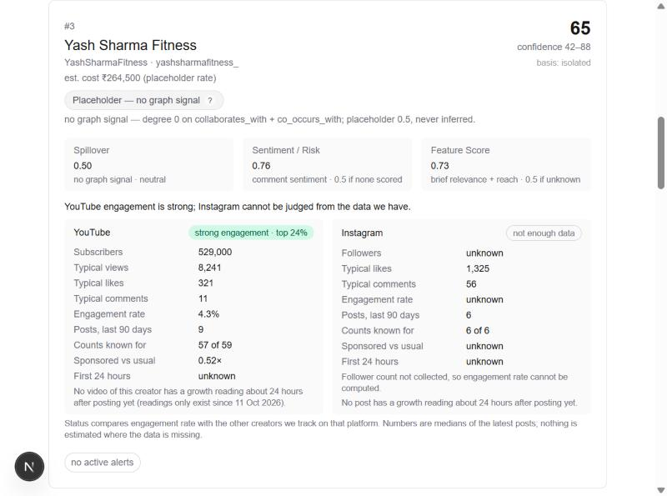
The web app: scores with their basis, per platform
Real screenshot
Each result shows a 0 to 100 score, a confidence range and the basis of its spillover part.
New: platform status
YouTube and Instagram side by side: audience, typical views and likes, engagement, first-day growth. Where data is missing it says unknown.
Fixed
Creators with no collected posts now rank below creators with data.
Influencer-Brand Matching via GAIL & Graph Spillover | Review 2 | 28 Oct 2026
12
Notes:
This is the real dashboard. Each recommendation shows its 0 to 100 score, confidence range and the basis of the spillover part. The new button shows YouTube and Instagram side by side, with unknown shown honestly where we have no data. In this example the creator is strong on YouTube, Instagram cannot be judged, and the graph has no signal so the spillover is neutral. Creators with no collected posts now rank below creators with data.

Slide 13
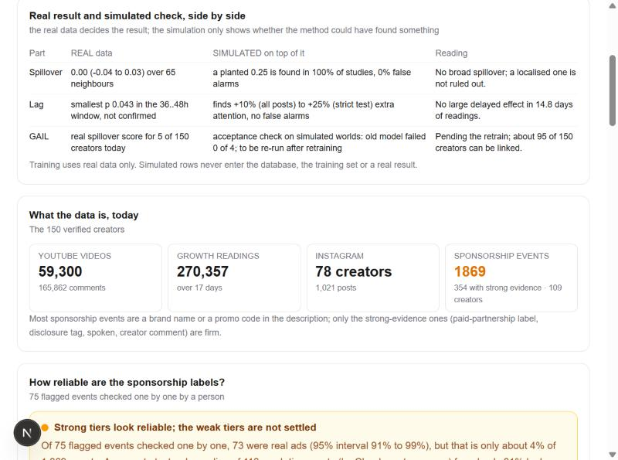
Real results and simulated checks, side by side
In the app
Analysis tab, Live results: the real result, the simulated check on top of it, and what it means.
The rule
Simulated rows never enter the database, the training set or a real result. Training uses real data only.
Influencer-Brand Matching via GAIL & Graph Spillover | Review 2 | 28 Oct 2026
13
Notes:
Every claim in the app is shown twice: what the real data says, and what a simulation says about whether our method could have found something. They are never mixed, and training uses real data only.

Slide 14
What the data cannot tell us
1
Small labelled set
159 independent examples limit what any model can learn; results are exploratory.
2
Mostly 'same brand' links
576 of 605 shared-brand pairs are inside the 150, only 7 real collaborations.
3
Short history of growth
17 days of 2-hour readings; Instagram counts missing for 403 posts (60 filled a day).
4
Weak-tier labels
81% of events; true precision between about 60% and 95% until more are checked.
5
Hinglish sentiment
only moderate agreement (+0.45); human labels are pending.
Influencer-Brand Matching via GAIL & Graph Spillover | Review 2 | 28 Oct 2026
14
Notes:
Say these before the committee asks. They are real limits, not bugs. The central one is that real spillover looks absent in our data and our graph mostly encodes shared brands.

Slide 15
What comes next
Next step | Why | Who
Retrain GAIL; held-out scoring and acceptance check | turns the data work into model results | Eesha, then Shimona
Train also on the direct effect of sponsored posts | about 1,400 more events: the biggest jump in labels | Eesha
Per-platform normalisation, 5 random seeds, cross-fitting | recovers dropped pairs; steadier estimates | Eesha
More Instagram counts and human label checks | fixes the weakest data and the weak labels | Shimona
Docker for frontend and backend | one-command demo, with the final model | Shimona
Influencer-Brand Matching via GAIL & Graph Spillover | Review 2 | 28 Oct 2026
15
Notes:
Next phase. The strongest lever is a bigger set of training targets from data we already hold, such as the direct effect of each sponsored post on the sponsoring creator's own audience. Then robust statistics, more Instagram counts, human label checks, and Docker for one-command demos.

Slide 16
Thank you
A complete pipeline, from data to a web app.
A graph that links 95 of 150 creators.
Tests that would have caught a broad spillover, and do not find one.
A clear plan for what is left.
Questions
Notes:
Close with the takeaway: a complete, honest pipeline; a graph that now connects 95 of 150 creators; tests that say no broad spillover and that would have caught it; and a clear plan. Then take questions.

