Slide 1
UE23CS441A –Project Phase – 3
Project Progress Review #3
Project Title : Influencer-Brand Matching via GAIL & Graph Spillover
Project ID : 011
Project Guide : Dr. Vishnu Tiwari
Project Team :
Shimona Sinha (PES2UG23CS547)
Akshat Navlani (PES2UG23AM009)
Eesha Shah (PES2UG23AM034)
Abhyudyay Agrawal (PES2UG23AM003)
Notes:
Opening. We built a complete pipeline from data to a web app, and today we show what is real, what is validated and what is still open. We state the limits ourselves.

Slide 2
Outline
Abstract and Scope of the Project (1 slide)
Suggestions from Review – 1 & 2 (1 slide)
Complete pipeline/Architecture of Project (max 2 slides)
Implementation Details (for each module) (max 4 slides)
Project Demonstration (keep the demo video ready)
Test Plan and Strategy (max 2 slide)
Results and Discussion (max 2 slides)
Conclusion and Future Work
References

Slide 3
Abstract and Scope
Problem: brands pick influencers by follower count and gut feel, and miss spillover: when a creator is sponsored, the audiences of the creators connected to them react too.
What we built: a brand gives a product, budget and region; the system returns ranked creators with a 0 to 100 score, a confidence range and an explanation, in a web app and a REST API.
Research part: GAIL (Graph-Adaptive Interference Learning), a graph-attention model that learns which linked creators are exposed to a sponsorship; plus a temporal branch (comment sentiment, cross-platform lag), CLIP/BERT creator features, and a fusion layer.
Scope: 150 verified Indian fitness creators on YouTube, Instagram and Reddit, from public data collected daily. Out of scope: real sales ROI (no sales data exists), public deployment.
Framing: a careful application of known causal-ML methods to a new domain. Results are exploratory and every claim is tested, with the limits stated.
Notes:
Keep this to one minute. The key sentence is the last one: we apply known methods carefully and we say what the data can and cannot show.

Slide 4
Suggestions from Review – 1 & 2
Open item from Review 1 / 2 | Feasibility and progress now
GAIL was trained on only 10 labelled examples | Retrained on corrected labels (run 8): 323 observations, 74 exposed; GAIL-R -0.05 (-0.55 to +0.33)
Sentiment and CLIP/BERT scores were 0.5 placeholders | Real for 149 and 150 of 150 creators; Hindi-script comments use a multilingual model
Fusion weights not calibrated | Cannot be fitted (6 labelled outcomes): fixed prior 0 / 0.5 / 0.5; spillover is context, not scored, as its real test found nothing; ranges and evidence grade A to D shown
No evaluation, baselines or error analysis | Baselines run: TNet, DeepInf, INFLECT-DGNN (Eesha) and a no-graph baseline; placebo tests, simulated validation, held-out tests; no spillover detected
Graph view and Granger insight missing | Graph view exists; Granger tests run on 82 creators: each platform helps predict the other (prediction, not cause)
Cost model is a flat heuristic | Still a heuristic (category rate); no rate-card table yet
Integration, performance, Docker | Tests pass (ML 340, backend 141, ingestion 126), build passes, Docker run and verified; load test still to do
Items are the open points listed after Review 1 and in the team's Pending Work list. [to fill: add the panel's own remarks if different]
Notes:
These are the open items we carried out of Review 1 and 2. Be ready to say which are done (the first four), which are partly done, and which are not done: the rate card, the load test and Docker. Granger is done (82 creators; Instagram posts help predict YouTube comments, F 1.49, p 0.004, and the reverse, F 2.02, p 0.002; prediction, not cause).

Slide 5
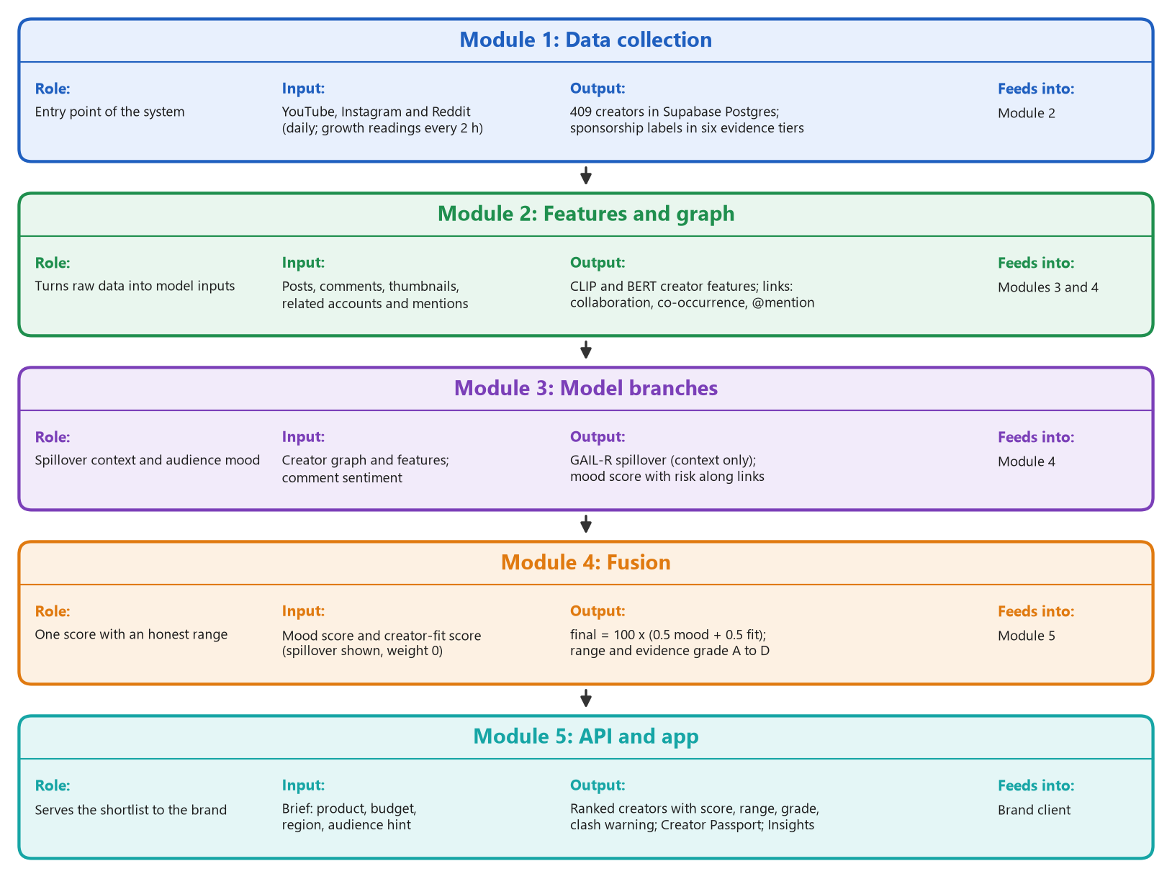
Complete pipeline / Architecture of Project (1 of 2)
Notes:
Walk the five modules top to bottom: collection (YouTube, Instagram and Reddit), feature staging, the GNN dual framework, fusion, and the API. Spillover is shown as context and does not move the score; the fusion is 0.5 mood plus 0.5 creator fit. The module-by-module implementation follows on the next slides.

Slide 6
Implementation: Modules 1-2, data and features
Technology: YouTube Data API v3 read every 2 h by Supabase pg_cron; Instagram via OpenCLI and a Chrome extension (read-only, 130 page loads a day); Reddit page JSON; Supabase Postgres; Python 3.12.
Owner check: every Instagram post is matched to the account that really posted it; foreign posts are detached (with a backup).
Sponsorship detector: rules on text, six evidence tiers from official label to brand mention; spoken sponsors read from captions; negations ('not a paid promotion') ignored.
Label reliability: each event scored by the human-checked precision of its tier.
for post in new_posts:
owner = owner_from_og_text(post)
if owner != post.creator:
backup(post); detach(post)
tier = highest of:
official_label > spoken >
creator_comment > disclosure_tag >
brand_and_code > brand_mention
if tier and not negated(text):
is_sponsored = True
p_ad = shrunk_precision(tier)
Notes:
Modules 1 and 2. The point to land: the data is collected automatically every day, and every correction is backed up so it can be undone.

Slide 7
Implementation: Module 3, graph and GAIL
Technology: GAIL-R: a two-stage, cross-fitted R-learner with one effect slope per relation, attention kept close to uniform, a placebo penalty on the pre-period lift, and creator-level bootstrap intervals. It builds on Wu & Yuan (2025); the placebo penalty and the validation are ours.
Graph: creators are nodes; links are collaboration, Reddit co-mention, shared brand (1,226) and @mention (154); 95 of 150 creators linked.
Targets: a neighbour's engagement lift around each sponsored post, lift = (after - before) / (before + 1), median-based, clipped to +/-5, clustered by 30-day windows (run 8: 323 observations, 74 exposed to a sponsored collaborator and 249 comparison).
Honesty tests: within-neighbour placebo test, dose-response, direct effect, simulated validation.
Extensions (tested in simulation): attention trained on the causal loss (E4) and a correction for sponsored posts our rules miss (E5).
emb = GAT(features, edges)
w_ij = softmax(sim(emb_i, emb_j))
exposure_j = sum_i treated_i * w_ij
e_j = propensity(features_j)
y_j = head(emb_j, exposure_j)
loss = mse(y_hat, lift)
+ lambda * propensity_regulariser
evaluate on held-out creators only;
never quote the in-sample effect
Notes:
Module 3. GAIL is Eesha's model. Our contribution is the data that feeds it and the tests that check it. Say that GAIL was retrained on the corrected labels (run 8), and that we judge it only on held-out creators and on the planted-effect benchmark. Wu and Yuan (2025) is the closest prior method: two-stage orthogonal learning with attention interference. Their paper has no placebo or pre-trend check; that is our addition. E4 and E5 are our two extensions: in simulation the causal loss, not the attention itself, is what recovers the effect (error 0.06 against 0.39 for plain training), and the missed-label correction cuts the error at 70% detection from 0.107 to 0.026. On real data it leaves the result at about zero.

Slide 8
Implementation: temporal branch and features
Sentiment: RoBERTa (English) per comment; a multilingual XLM-R model for Hindi-script comments; safety = P(positive) + 0.5 P(neutral), pulled to 0.5 for creators with few comments.
Lag detection: event study on growth readings every 2 h: activity after an Instagram post against the same creator's own rate, with a placebo from random times of the same hour of day.
Creator features: CLIP on thumbnails and BERT on text, matched to the brand's product brief.
Positive control: a YouTube upload must lift that channel's own views, or the method is broken.
for event in instagram_posts:
for window k in -48h .. +48h (12 h):
excess_k = rate_k / own_rate - 1
null = same statistic at random
times, same hour of day
p_k = share(null >= excess_k)
detected only if
min(p_after) < 0.05 / 4
control: upload -> own views
must be detected first
Notes:
The temporal branch. Sentiment is tested per language. Lag uses a placebo and a positive control so that a null result is believable.

Slide 9
Implementation: Modules 4-5, fusion and app
Fusion: final = 100 x (0.5 sentiment + 0.5 features), minus 10 when sentiment is below 0.3; spillover is shown as context, not scored; the confidence range combines each branch's uncertainty in quadrature.
Backend: FastAPI + SQLModel on Supabase; /recommendations, /alerts, /feature-store, /platform-profiles.
Frontend: Next.js 16 and TypeScript: brief form, ranked dashboard with evidence grade and clash warning, Creator Passport, Insights (evidence room), a graph you can drag with a Ripple view, monitoring, analysis tab; influencer photos.
New: Docker image for the backend and frontend; creators with no data rank below those with data.
final = 100 * (0.5*sentiment
+ 0.5*features)
if sentiment < 0.3: final -= 10
spillover: shown, weight 0
half_width = sqrt(sum(w_i * u_i)^2)
range = final +/- half_width
rank by (has_posts, final)
show basis: trained | inferred |
isolated
Notes:
Fusion and the app. The weights are a stated prior because there are not enough labelled outcomes to fit them, and the app shows each score with its basis and range.

Slide 10
Project Demonstration
Demo flow (about 4 minutes):
1. Brand brief: 'Whey protein, fitness', budget 3,00,000, region India
2. Ranked list with score, range and basis badge
3. 'YouTube vs Instagram status' for a creator
4. Explainability: how the score is built
5. Monitoring alerts with creator names
6. Creator Passport: mood gap, speed, sponsored response, clash flag
7. Insights: spillover result, method check, power
8. Graph: drag a dot, try Ripple
Paste screenshot: ranked creators
Paste screenshot: Creator Passport
Paste screenshot: Insights page
Paste screenshot: graph and Ripple
Backup: recorded demo video
Notes:
Run this live from the app. The screenshots are real. Keep the backend started a minute before the demo, because the CLIP and BERT models load on startup.

Slide 11
Test Plan and Strategy (1 of 2)
Test type | What is covered | Tool | Result (1 Nov)
Unit: backend | scoring, fusion, filters, feature store, alerts, Passport, photos | pytest | 141 pass
Unit: ML and scripts | GAIL, GAIL-R, placebo, estimators, lag, simulations, Passport maths | pytest | 340 pass
Unit: ingestion | detector, standing-code fix, daily job, Reddit, snapshots | pytest | 126 pass
Frontend | type-check, lint, production build | tsc, ESLint, Next.js | pass, 8 pages
Integration and Docker | brief to dashboard to Passport in a browser; Docker build, health check, pages | browser, Docker | checked
Data validation | owner audit, duplicates, human label checks, backups | SQL, scripts | see results
Statistical validation | placebo test, dose-response, simulated planted effects | Python, numpy | see results
Environment and roles: tests run on the developers' laptops against a shared Supabase database; Abhyudyay runs the testing (GAIL, API, fusion, Passport) and the result re-runs, Shimona the data and analysis checks, Eesha the GAIL model checks, Akshat the infrastructure and gate scripts. All tools are open source.
Notes:
Why these methods: unit tests protect each module, the browser check protects the integration, and the data and statistical validation protect the claims, which matter most in a project with little labelled data.

Slide 12
Test Plan and Strategy (2 of 2)
Activities and timeline
Tests were written with each module in Oct 2026 and all suites run before every push.
Data fixes are tested by re-measuring (counts, duplicates, links) and every change keeps a backup table.
Simulated checks plant a known effect on the real data to test the methods themselves.
Benefits
Cheap to repeat, catches regressions, makes claims checkable.
Drawbacks and gaps
No load or performance test of the API yet.
No security test and no CI pipeline on GitHub (local gate script only).
Inside Docker the GAIL and creator-fit scores fall back to 0.5 (model files are not in the image); the full models run outside Docker.
GAIL is judged by a planted-effect benchmark and held-out creators: the spillover term does not help on unseen creators.
Human label checks cover only 4% of events.
Paste screenshot: test run output (pytest and build)
Notes:
Be open about the gaps: load and security tests are not done, and inside Docker the model-based scores are neutral.

Slide 13
Results and Discussion (1 of 2): data, labels, graph
Strong evidence tiers are almost always right (73 of 75 checked one by one, 91 to 99%), but that is only 4% of events; a text-only reading of weak tiers finds 61%, so their precision lies between about 60% and 95%.
Graph links grew from 17 to 95 of 150 creators; most are 'same brand' links (only 7 real collaboration pairs), so we call the graph exploratory.
Data (409 creators, 150 closely tracked): 113,754 YouTube videos, 957,457 comments, 2,860 Instagram posts, 3,031 sponsorship events (470 standing affiliate-code videos removed on 1 Nov).
Notes:
Expected: reliable labels. Observed: strong tiers yes, weak tiers uncertain. The deviation is honest and we corrected an earlier 91% figure that mixed assumed rows with checked ones.

Slide 14
Results and Discussion (2 of 2): spillover, lag, baselines
Real-data test | Result
Within-neighbour placebo (65) | +0.00 (-0.04 to +0.03)
Stronger tie, more spillover? | trend -0.05
Sponsored vs usual video | views x0.98
GAIL-R, run 8 (74 exposed) | -0.05 (-0.55 to +0.33)
Lag, Instagram to YouTube | p = 0.041, not confirmed
Ranking vs random (37 creators) | no baseline beats random
Large spillover is ruled out; small spillover cannot be seen with 74 exposed observations (our test could see about a 1.5 times rise). GAIL-R ten-seed average +0.01.
Reasons: few exposed observations, many @mention-linked; small effects would be missed.
Simple baselines (followers, engagement rate, past effect) did not beat random, and GAIL did not beat them on held-out creators.
Published models run by Eesha (TNet, DeepInf, INFLECT-DGNN) did not beat a no-graph baseline on our benchmark; GAIL-R with the placebo penalty did (3 replicates, 390-creator graph).
Notes:
Read the left chart as a SIMULATED check: a planted effect on the real network. The right table is real data only. The honest summary is that we find no broad spillover, and the power check says our test could only have seen a large one.

Slide 15
Novelties: what is new in our work
Novelty | What it does | Result
Same creator on both platforms | YouTube vs Instagram posts within 24 h, placebo-adjusted | 657 pairs, 49 creators; adjusted gap +0.18
Mood gap | Instagram minus YouTube comment mood, with a worst-case error bound | 14 of 85 flagged
Sponsored response | A sponsored post against the same creator's organic posts | YouTube views -5.8%, no clear penalty
Missing-platform estimate | Guess a creator's Instagram level from YouTube, as a range | rank agreement 0.78 vs 0.52 for size alone
Attention speed, ad fatigue | Share of week-one views in 24 h; do sponsored posts weaken | 59% in 24 h; fatigue not detected
Competitor-clash flag | Warns if a creator promoted a rival brand in the last 120 days | 64 creators flagged
Creator Passport, evidence grade | One record per creator; grade A to D says how well we know them | 409 passports, grade on every score
Descriptive results with stated limits: Instagram is thin, the clash flag is an automatic warning (the idea is not new), and no result here claims spillover.
Notes:
These are the parts that are ours. Each has a limit stated next to it. The Creator Passport collects them per creator; the evidence grade tells a brand how well we know that creator.

Slide 16
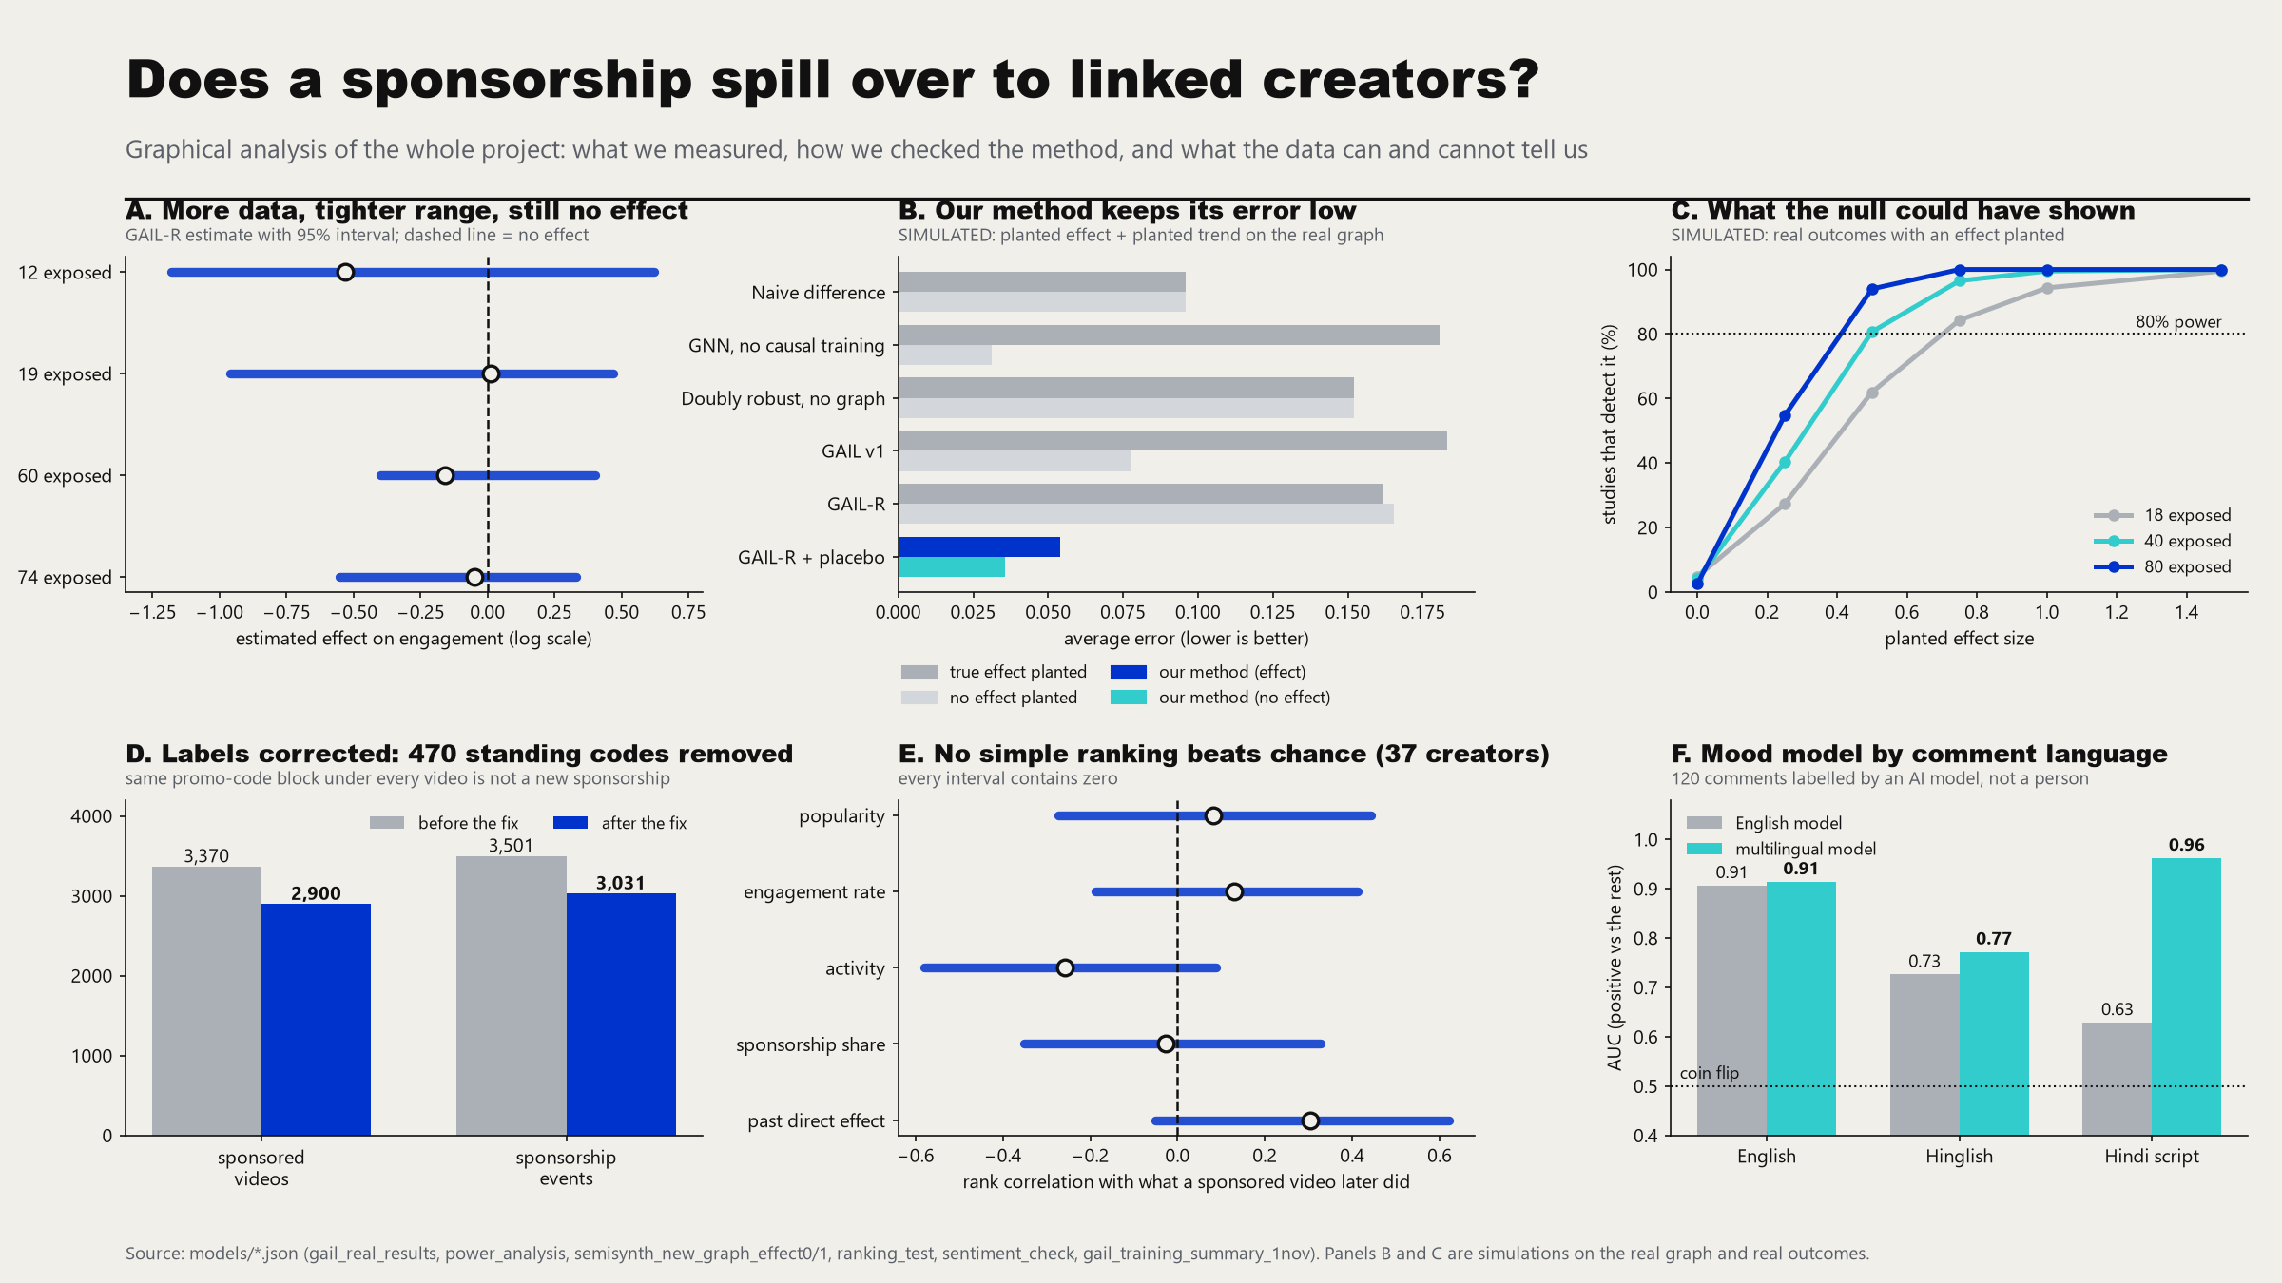
Graphical analysis of the whole project
Notes:
Six panels: the spillover result with its range, the method check on a known effect (simulated), what the test could have detected (simulated), the label fix, the ranking test, and the mood model by language.

Slide 17
Timeline – Update on Tasks
Period | Tasks | Status
Aug 2026 | Schema, ingestion, graph, feature store, first GAIL run, Review 1 (closed 26 Aug) | Done
Sep 2026 | Fusion layer, live API and web app, GAIL trained on 10 examples | Done
Early Oct | Temporal branch (sentiment, lag), CLIP/BERT features, calibration report, filters, linking, Analysis tab | Done
11-26 Oct | Daily collection, 24-month YouTube history, labels and brands, links, placebo and simulated validation | Done
27 Oct | Platform status in the app, handoff, training files exported | Done
28 Oct - 1 Nov | GAIL-R and placebo penalty, label fix (470 standing codes), GAIL retrained (run 8), novelties, Creator Passport, Insights page, app redesign, Docker run, fusion 0 / 0.5 / 0.5 | Done
After review | Load test, human label checks, per-rupee ranking, GPU run with more seeds, thesis, deployable build | Planned
Dates are monthly milestones from the project plan and the repository history.
Notes:
The project is complete as a pipeline and GAIL has been retrained on the corrected labels. The open items are the hardening tasks that come after: load test, more human label checks, per-rupee ranking, a GPU run with more seeds, and the thesis.

Slide 18
Team Contributions
Shimona Sinha PES2UG23CS547
Eesha Shah PES2UG23AM034
Data, analysis, novelties, app
GAIL model, causal inference, paper
Data fixing, re-collection, sponsorship labels
Spillover analyses; cross-platform novelties; fusion
Frontend, backend endpoints, Docker setup
GAIL v1 training and testing on the new data
GAIL v1 and GAIL-R, graph inside the model
Causal inference and spillover modelling
GAIL training; published baselines and comparison
Paper
Akshat Navlani PES2UG23AM009
Abhyudyay Agrawal PES2UG23AM003
Backend, data pipeline, infrastructure
Testing, graph in the app
Graph schema and edges in the database
GAIL implementation, spillover training, placebo
Instagram scraping, ingestion, backend API
Docker, health checks, build gate; Creator Passport
All testing: GAIL, API, fusion, Passport
Result re-runs; graph checks
Frontend redesign and testing; graph in the app
Novelty: ad fatigue and disclosure
Notes:
Four areas: data and analysis, the GAIL model, backend and infrastructure, and testing with the graph in the app. This is the team's agreed split of 1 Nov. The git history shows most backend and ingestion commits under Akshat; be ready to say who answers for which part.

Slide 19
Conclusion and Future work
Conclusion
A complete pipeline from daily data collection to a web app with ranked, explained scores.
Better data: 113,754 videos, 957,457 comments, 3,031 sponsorship events (standing affiliate codes removed), 74 exposed observations.
New: Creator Passport, evidence grade, clash warning and a graph you can explore.
Honest validation: the real data shows no broad spillover and simulations show our tests would have found one.
Known limits are stated, not hidden.
Future work
Install and test the retrained GAIL; a GPU run with more seeds.
Train also on the direct effect of sponsored posts.
More Instagram counts and human label checks; rate card; rank by expected engagement per rupee.
Load test and security pass; thesis.
Notes:
Close with the takeaway: a complete, honest pipeline, a clearer graph, and a clear plan.

Slide 20
References
[1] P. Velickovic et al., "Graph attention networks," in Proc. ICLR, 2018.
[2] M. Fey and J. E. Lenssen, "Fast graph representation learning with PyTorch Geometric," in ICLR Workshop on Representation Learning on Graphs and Manifolds, 2019.
[3] J. Qiu, J. Tang, H. Ma, Y. Dong, K. Wang, and J. Tang, "DeepInf: Social influence prediction with deep learning," in Proc. ACM SIGKDD, 2018, pp. 2110-2119.
[4] S. Kim, J.-Y. Jiang, J. Han, and W. Wang, "InfluencerRank: Discovering effective influencers via graph convolutional attentive recurrent neural networks," in Proc. ICWSM, vol. 17, no. 1, 2023, doi: 10.1609/icwsm.v17i1.22162.
[5] M. G. Hudgens and M. E. Halloran, "Toward causal inference with interference," J. Amer. Statist. Assoc., vol. 103, no. 482, pp. 832-842, 2008.
[6] P. R. Rosenbaum and D. B. Rubin, "The central role of the propensity score in observational studies for causal effects," Biometrika, vol. 70, no. 1, pp. 41-55, 1983.
[7] J. M. Robins, A. Rotnitzky, and L. P. Zhao, "Estimation of regression coefficients when some regressors are not always observed," J. Amer. Statist. Assoc., vol. 89, no. 427, pp. 846-866, 1994.
[8] V. Chernozhukov et al., "Double/debiased machine learning for treatment and structural parameters," Econometrics J., vol. 21, no. 1, pp. C1-C68, 2018.
[9] A. Radford et al., "Learning transferable visual models from natural language supervision," in Proc. ICML, PMLR 139, 2021, pp. 8748-8763.
[10] J. Devlin, M.-W. Chang, K. Lee, and K. Toutanova, "BERT: Pre-training of deep bidirectional transformers for language understanding," in Proc. NAACL-HLT, 2019, pp. 4171-4186.
[11] A. Conneau et al., "Unsupervised cross-lingual representation learning at scale," in Proc. ACL, 2020, pp. 8440-8451.
[12] C. W. J. Granger, "Investigating causal relations by econometric models and cross-spectral methods," Econometrica, vol. 37, no. 3, pp. 424-438, 1969.
[13] Y. Wu and Y. Yuan, "Estimating heterogeneous causal effect on networks via orthogonal learning," arXiv:2509.18484, 2025.
Notes:
References are in IEEE style. Page numbers are omitted where we were not certain of them.

Slide 21
Thank You

