Slide 1
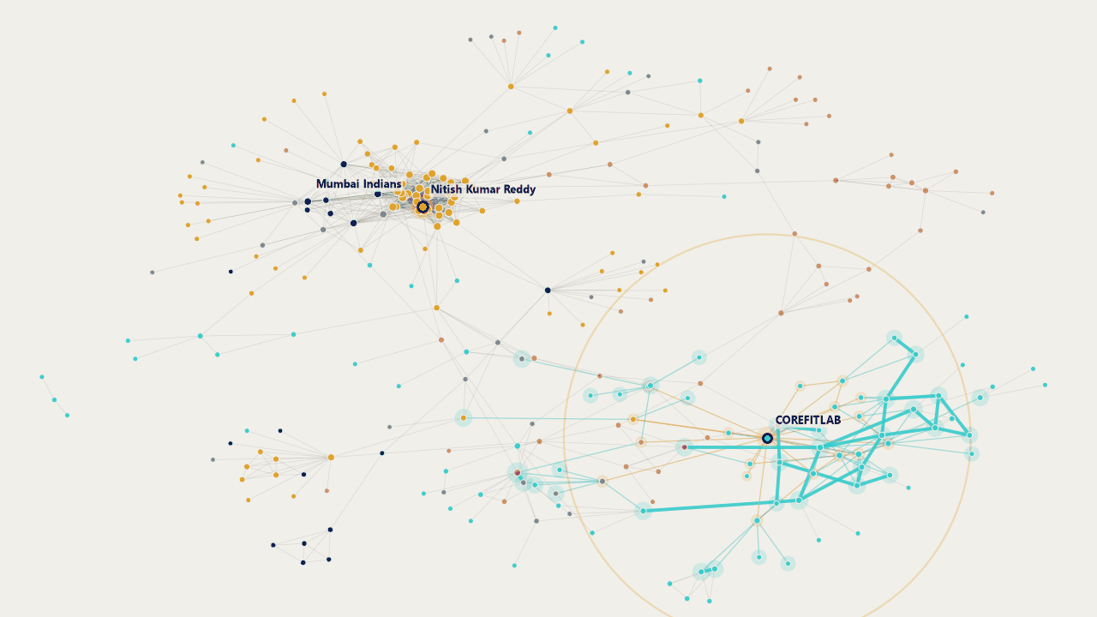
Notes:
Our creator graph: 275 linked creators and their real links. The ripple shows how far a chain of links reaches; it is an illustration of the pathways, not an effect.

Slide 2

UE23CS441A
CAPSTONE PROJECT
PHASE – 3
Project Title : Influencer-Brand Matching via GAIL & Graph Spillover
Project ID : 011
Project Guide : Dr. Vishnu Tiwari
Notes:
Opening. A complete pipeline from data to a web app. Today we show what is real, what is validated and what is still open, and we state the limits ourselves.

Slide 3
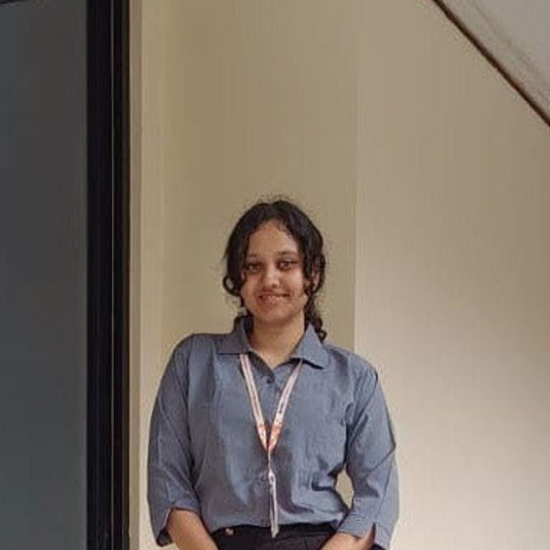
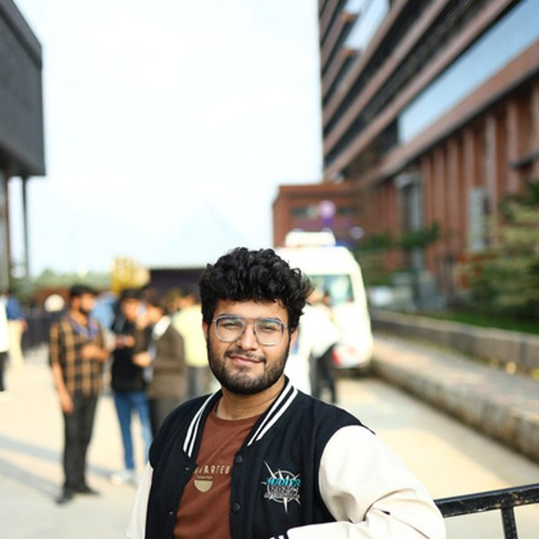

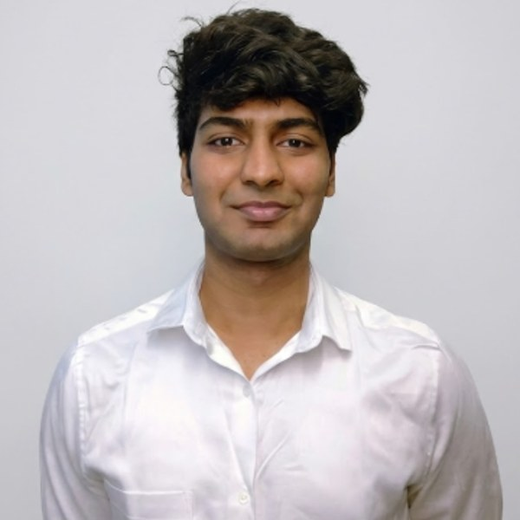
Our team
Shimona Sinha
Akshat Navlani
Eesha Shah
Abhyudyay Agrawal
PES2UG23CS547
PES2UG23AM009
PES2UG23AM034
PES2UG23AM003

Slide 4
# | Item
01 | Abstract and scope of the project
02 | Architecture diagram / complete pipeline
03 | Summary of Capstone Project Phase – 2 (suggestions)
04 | Proposed approach and algorithms
05 | Detailed explanation of the modules developed
06 | Project demonstration
07 | Test plan and strategy
08 | Performance metrics, comparison with baselines, novelties
09 | Contribution of each team member
10 | Remaining work, timeline and Gantt chart
11 | GitHub repository and tools
12 | References
Agenda

Slide 5
Abstract and Scope
Problem: brands pick influencers by follower count and gut feel, and miss spillover: when a creator is sponsored, the audiences of the creators connected to them may react too.
What we built: a brand gives a product, budget and region; the system returns ranked creators with a 0 to 100 score, a confidence range, an evidence grade and warnings, in a web app and a REST API.
Research part: GAIL / GAIL-R, a graph model that tests whether a sponsorship spills over to linked creators, with placebo checks; a mood branch (comment sentiment, cross-platform lag); CLIP/BERT creator features; a fusion layer; and a Creator Passport that compares both platforms.
Scope: 409 Indian creators (150 closely tracked) on YouTube, Instagram and Reddit, from public data collected daily. Out of scope: real sales ROI (no sales data exists), public deployment.
Framing: a careful application of known causal-ML methods to a new domain. Results are exploratory and every claim is tested, with the limits stated.
Notes:
One minute. The key sentence is the last one: we apply known methods carefully and we say what the data can and cannot show.

Slide 6
Suggestions from Review – 1 & 2
Open item from Review 1 / 2 | Where it stands now (1 Nov)
GAIL was trained on only 10 labelled examples | Retrained on corrected labels (run 8): 323 observations, 74 exposed; GAIL-R -0.05 (-0.55 to +0.33)
Sentiment and CLIP/BERT scores were 0.5 placeholders | Real for 149 and 150 of 150 tracked creators; Hindi-script comments use a multilingual model
Fusion weights not calibrated | Cannot be fitted (6 labelled outcomes): fixed prior 0 / 0.5 / 0.5; spillover is context, not scored; range and evidence grade A to D shown
No evaluation, baselines or error analysis | Baselines run (TNet, DeepInf, INFLECT-DGNN, no-graph); placebo tests, simulated validation, held-out tests; no spillover detected
Graph view and Granger insight missing | Graph view with a Ripple mode; Granger tests on 82 creators: each platform helps predict the other (prediction, not cause)
Cost model is a flat heuristic | Still a heuristic (reach x a placeholder rate); no rate-card table yet
Integration, performance, Docker | Tests pass (ML 340, backend 142, ingestion 126), build passes, Docker run and verified; load test still to do
Notes:
These are the open items carried out of Review 1 and 2. Done: GAIL retrain, placeholders, baselines, graph view, Docker. Partly done: fusion weights (a stated prior). Not done: rate card, load test.

Slide 7
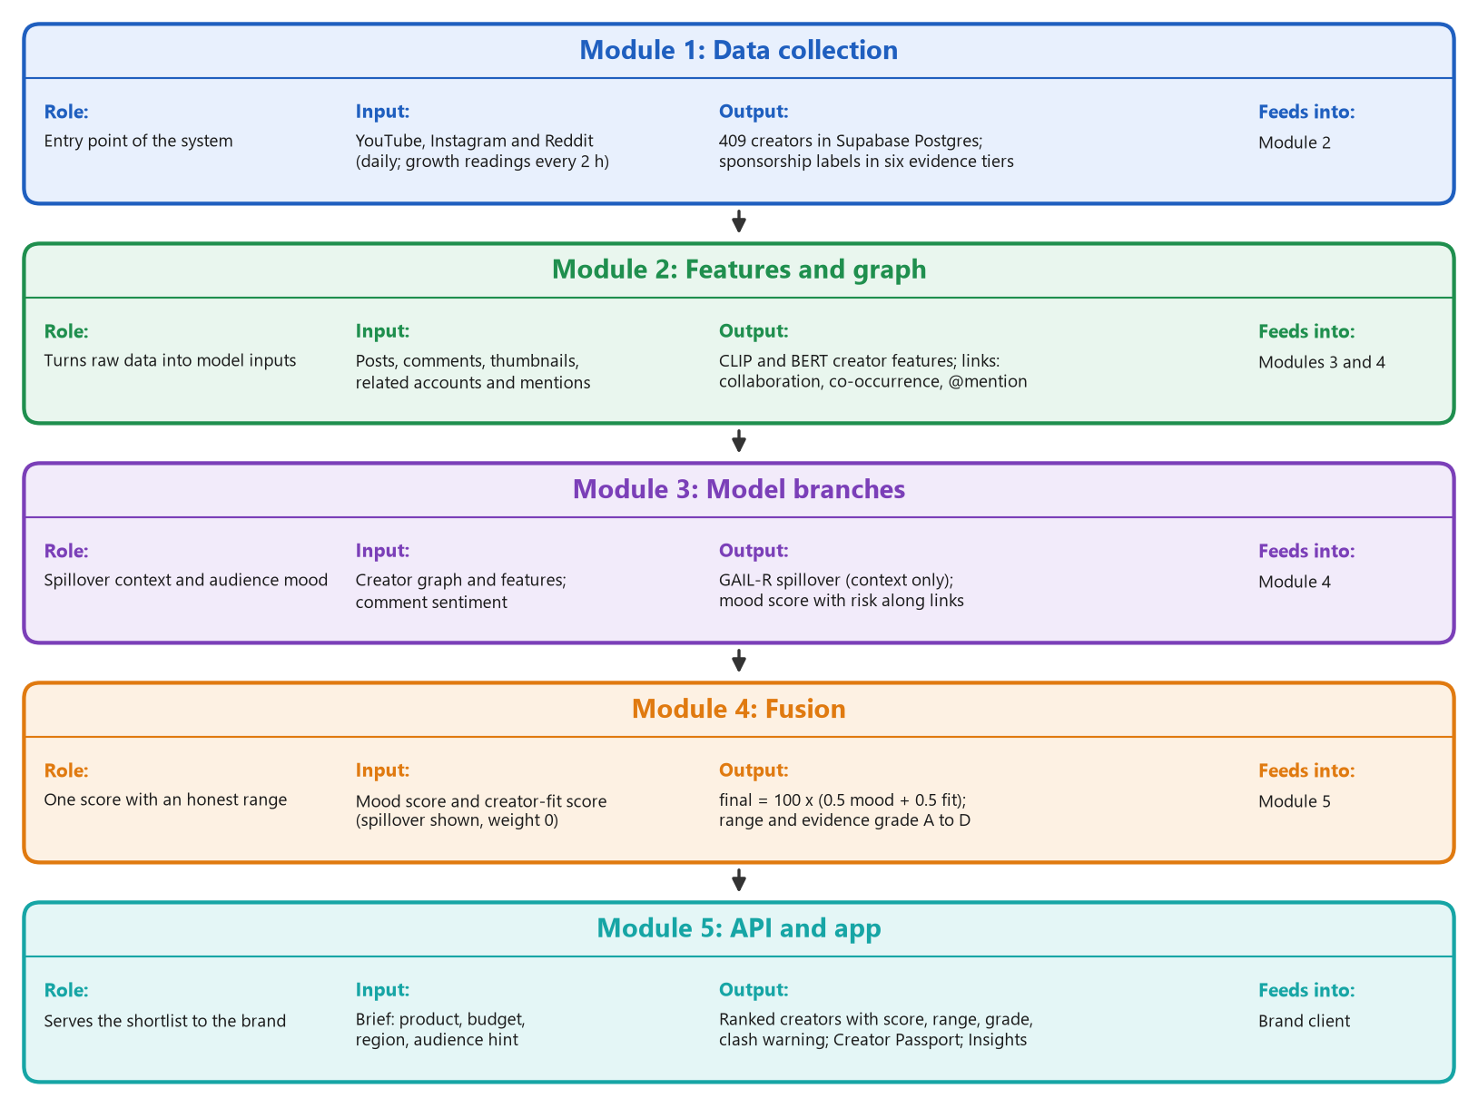
Architecture
diagram /
complete pipeline
of project
Notes:
Five modules top to bottom: collection, features and graph, model branches, fusion, API and app. Spillover is shown as context; the score is 0.5 mood plus 0.5 creator fit.

Slide 8
Architecture: what changed (2 of 2)
Module | Diagram said (Review 2) | Now (1 Nov 2026)
1 Data collection | YouTube, Instagram, Reddit; historical partnerships | 409 creators; 113,754 videos, 957,457 comments, 2,860 Instagram posts; 470 standing affiliate-code videos removed
2 Features and graph | raw records to feature vectors, is_stub flag | CLIP/BERT features, graph links (collaboration, co-occurrence, @mention, shared brand), Creator Passport data
3 Model branches | GAIL on 340 + 1,414 edges; sentiment 0.5 | GAIL-R with placebo penalty, retrained (run 8): -0.05 (-0.55 to +0.33); sentiment real; lag tests
4 Fusion | 0.4 spillover + 0.3 sentiment + 0.3 features | 0 / 0.5 / 0.5 (spillover is context); range and evidence grade A to D
5 API and app | /recommendations, /alerts | adds /passport, /scenario, /platform-profiles; 8 pages incl. Passport, Insights, graph with Ripple; Docker
Notes:
What changed since the Review 2 diagram: more data, labels corrected, GAIL-R, a different score formula, and a bigger app.

Slide 9
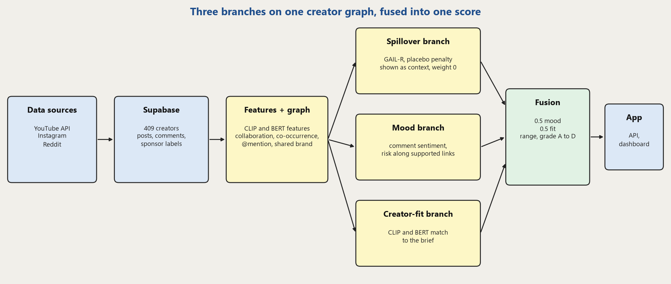
Proposed Approach: Model Architecture
Three branches on the same creator graph: GAIL-R estimates spillover (shown as context), the mood branch estimates brand-safety risk, the creator-fit branch matches the brief. They are fused late, so each can be tested alone.
Every score carries its basis (trained, inferred, placeholder, isolated), a range and an evidence grade; missing inputs fall back to labelled placeholders.

Slide 10
Proposed Approach: Algorithms
GAIL-R (spillover branch)
Mood branch
Fusion layer
Graph of creators; relations: collaboration, co-occurrence, @mention, shared brand
Stage 1: predict the normal engagement and the normal exposure, cross-fitted
Stage 2: one slope per relation explains what is left; attention kept near uniform
Placebo penalty: no 'effect' before the event; creator-level bootstrap range
RoBERTa (English) and XLM-R (Hindi script) comment sentiment: safety = P(pos) + 0.5 P(neu), shrunk to 0.5
Shock below the 20th percentile of safety, spread 2 hops with decay 0.5 along supported links
Lag tests with permutation p-values; Granger F-test per lag, Fisher's method
final = 100 x (0.5 mood + 0.5 fit), minus 10 if mood < 0.3
Spillover weight 0: shown as context, not scored
Range: each branch's half-width combined in quadrature
Evidence grade A to D; basis label per branch

Slide 11
Implementation: Modules 1-2, data and features
Technology: YouTube Data API v3 read every 2 h by Supabase pg_cron; Instagram via OpenCLI and a Chrome extension (read-only, 130 page loads a day); Reddit page JSON; Supabase Postgres; Python 3.12.
Owner check: every Instagram post is matched to the account that really posted it; foreign posts are detached (with a backup).
Sponsorship detector: rules on text, six evidence tiers from official label to brand mention; spoken sponsors read from captions; negations ignored.
Standing-code fix (1 Nov): the same promo block under every video is not a new sponsorship; 470 videos of 17 creators un-flagged, with a backup and an undo.
for post in new_posts:
owner = owner_from_og_text(post)
if owner != post.creator:
backup(post); detach(post)
tier = highest of:
official_label > spoken >
creator_comment > disclosure_tag >
brand_and_code > brand_mention
if tier and not negated(text):
is_sponsored = True
# standing codes (1 Nov)
if weak_tier and brand_in_half_of_
videos_within_30_days: unflag
Notes:
Modules 1 and 2. Data is collected automatically every day and every correction is backed up so it can be undone.

Slide 12
Implementation: Module 3, graph and GAIL-R
Technology: PyTorch and PyTorch Geometric. GAIL-R is a two-stage, cross-fitted R-learner with one effect slope per relation, a placebo penalty and creator-level bootstrap. It builds on Wu & Yuan (2025); the placebo penalty and the validation are ours.
Graph: creators are nodes; links are collaboration, co-occurrence, @mention and shared brand.
Targets: a neighbour's engagement lift around each sponsored post, median-based; run 8: 323 observations (74 exposed, 249 comparison).
Honesty tests: placebo pre-trend test, dose-response, direct effect, planted-effect benchmark, power analysis, held-out creators.
y_res = y - m_hat # engagement minus normal
loss = (y_res - (E - e_hat) * slopes)^2
+ shrink * (E - uniform)^2
+ w * placebo_penalty(effect, pre_lift)
ATT = mean effect on exposed
interval: resample whole creators
judge on held-out creators and on a
planted-effect benchmark; never quote
the in-sample effect
Notes:
Module 3. GAIL is Eesha's model. Wu and Yuan (2025) is the closest prior method; the placebo penalty and the validation on the real graph are our additions.

Slide 13
Implementation: temporal branch and features
Sentiment: RoBERTa (English) per comment; a multilingual XLM-R model for Hindi-script comments; safety = P(positive) + 0.5 P(neutral), pulled to 0.5 for creators with few comments.
Lag detection: event study on growth readings every 2 h: activity after an Instagram post against the same creator's own rate, with a placebo from random times of the same hour of day.
Creator features: CLIP on thumbnails and BERT on text, matched to the brand's product brief.
Positive control: a YouTube upload must lift that channel's own views, or the method is broken.
for event in instagram_posts:
for window k in -48h .. +48h (12 h):
excess_k = rate_k / own_rate - 1
null = same statistic at random
times, same hour of day
p_k = share(null >= excess_k)
detected only if
min(p_after) < 0.05 / 4
control: upload -> own views
must be detected first
Notes:
The temporal branch. Sentiment is tested per language. Lag uses a placebo and a positive control so that a null result is believable.

Slide 14
Implementation: Modules 4-5, fusion and app
Fusion: final = 100 x (0.5 sentiment + 0.5 features), minus 10 when sentiment is below 0.3; spillover is shown as context, not scored; the confidence range combines each branch's uncertainty in quadrature.
Backend: FastAPI + SQLModel on Supabase; /recommendations, /alerts, /feature-store, /platform-profiles.
Frontend: Next.js 16 and TypeScript: brief form, ranked dashboard with evidence grade and clash warning, Creator Passport, Insights (evidence room), a graph you can drag with a Ripple view, monitoring, analysis tab; influencer photos.
New: Docker image for the backend and frontend; creators with no data rank below those with data.
final = 100 * (0.5*sentiment
+ 0.5*features)
if sentiment < 0.3: final -= 10
spillover: shown, weight 0
half_width = sqrt(sum(w_i * u_i)^2)
range = final +/- half_width
rank by (has_posts, final)
show basis: trained | inferred |
isolated
Notes:
Fusion and the app. The weights are a stated prior because there are not enough labelled outcomes to fit them, and the app shows each score with its basis and range.

Slide 15
Project Demonstration
Demo flow (about 4 minutes):
1. Brand brief: 'Whey protein, fitness', budget 3,00,000, region India
2. Ranked list with score, range and basis badge
3. 'YouTube vs Instagram status' for a creator
4. Explainability: how the score is built
5. Monitoring alerts with creator names
6. Creator Passport: mood gap, speed, sponsored response, clash flag
7. Insights: spillover result, method check, power
8. Graph: drag a dot, try Ripple
Paste screenshot: ranked creators
Paste screenshot: Creator Passport
Paste screenshot: Insights page
Paste screenshot: graph and Ripple
Backup: recorded demo video
Notes:
Run this live from the app. The screenshots are real. Keep the backend started a minute before the demo, because the CLIP and BERT models load on startup.

Slide 16
Test Plan and Strategy (1 of 2)
Test type | What is covered | Tool | Result (1 Nov)
Unit: backend | scoring, fusion, filters, feature store, alerts, Passport, photos | pytest | 142 pass
Unit: ML and scripts | GAIL, GAIL-R, placebo, estimators, lag, simulations, Passport maths | pytest | 340 pass
Unit: ingestion | detector, standing-code fix, daily job, Reddit, snapshots | pytest | 126 pass
Frontend | type-check, lint, production build | tsc, ESLint, Next.js | pass, 8 pages
Integration and Docker | brief to dashboard to Passport in a browser; Docker build, health check, pages | browser, Docker | checked
Data validation | owner audit, duplicates, human label checks, backups | SQL, scripts | see results
Statistical validation | placebo test, dose-response, simulated planted effects | Python, numpy | see results
Environment and roles: tests run on the developers' laptops against a shared Supabase database; Abhyudyay runs the testing (GAIL, API, fusion, Passport) and the result re-runs, Shimona the data and analysis checks, Eesha the GAIL model checks, Akshat the infrastructure and gate scripts. All tools are open source.
Notes:
Why these methods: unit tests protect each module, the browser check protects the integration, and the data and statistical validation protect the claims, which matter most in a project with little labelled data.

Slide 17
Test Plan and Strategy (2 of 2)
Activities and timeline
Tests were written with each module in Oct 2026 and all suites run before every push.
Data fixes are tested by re-measuring (counts, duplicates, links) and every change keeps a backup table.
Simulated checks plant a known effect on the real data to test the methods themselves.
Benefits
Cheap to repeat, catches regressions, makes claims checkable.
Drawbacks and gaps
No load or performance test of the API yet.
No security test and no CI pipeline on GitHub (local gate script only).
Inside Docker the GAIL and creator-fit scores fall back to 0.5 (model files are not in the image); the full models run outside Docker.
GAIL is judged by a planted-effect benchmark and held-out creators: the spillover term does not help on unseen creators.
Human label checks cover only 4% of events.
Paste screenshot: test run output (pytest and build)
Notes:
Be open about the gaps: load and security tests are not done, and inside Docker the model-based scores are neutral.

Slide 18
Results and Discussion (1 of 2): data, labels, graph
Strong evidence tiers are almost always right (73 of 75 checked one by one, 91 to 99%), but that is only 4% of events; a text-only reading of weak tiers finds 61%, so their precision lies between about 60% and 95%.
Graph links grew from 17 to 95 of 150 creators; most are 'same brand' links (only 7 real collaboration pairs), so we call the graph exploratory.
Data (409 creators, 150 closely tracked): 113,754 YouTube videos, 957,457 comments, 2,860 Instagram posts, 3,031 sponsorship events (470 standing affiliate-code videos removed on 1 Nov).
Notes:
Expected: reliable labels. Observed: strong tiers yes, weak tiers uncertain. The deviation is honest and we corrected an earlier 91% figure that mixed assumed rows with checked ones.

Slide 19
Results and Discussion (2 of 2): spillover, lag, baselines
Real-data test | Result
Within-neighbour placebo (65) | +0.00 (-0.04 to +0.03)
Stronger tie, more spillover? | trend -0.05
Sponsored vs usual video | views x0.98
GAIL-R, run 8 (74 exposed) | -0.05 (-0.55 to +0.33)
Lag, Instagram to YouTube | p = 0.041, above the 0.0125 bar; more data needed
Ranking vs random (37 creators) | no baseline beats random
Large spillover is ruled out; small spillover cannot be seen with 74 exposed observations (our test could see about a 1.5 times rise). GAIL-R ten-seed average +0.01.
Reasons: few exposed observations, many @mention-linked; small effects would be missed.
Simple baselines (followers, engagement rate, past effect) did not beat random, and GAIL did not beat them on held-out creators.
Published models run by Eesha (TNet, DeepInf, INFLECT-DGNN) did not beat a no-graph baseline on our benchmark; GAIL-R with the placebo penalty did (3 replicates, 390-creator graph).
Notes:
Read the left chart as a SIMULATED check: a planted effect on the real network. The right table is real data only. The honest summary is that we find no broad spillover, and the power check says our test could only have seen a large one.

Slide 20
Novelties: what is new in our work
Novelty | What it does | Result
Same creator on both platforms | YouTube vs Instagram posts within 24 h, placebo-adjusted | 657 pairs, 49 creators; Instagram higher by 0.18 (log) after removing a 0.25 placebo gap
Mood gap | Instagram minus YouTube comment mood, with a worst-case error bound | 14 of 85 flagged
Sponsored response | A sponsored post against the same creator's organic posts | YouTube views -5.8%, no clear penalty
Missing-platform estimate | Guess a creator's Instagram level from YouTube, as a range | rank agreement 0.78 vs 0.52 for size alone
Attention speed, ad fatigue | Share of week-one views in 24 h; do sponsored posts weaken | 59% in 24 h; fatigue not detected (borderline, p = 0.056)
Competitor-clash flag | Warns if a creator promoted a rival brand in the last 120 days | 64 creators flagged
Creator Passport, evidence grade | One record per creator; grade A to D says how well we know them | 409 passports, grade on every score
Descriptive results with stated limits: Instagram is thin, the clash flag is an automatic warning (the idea is not new), and no result here claims spillover.
Notes:
These are the parts that are ours. Each has a limit stated next to it. The Creator Passport collects them per creator; the evidence grade tells a brand how well we know that creator.

Slide 21
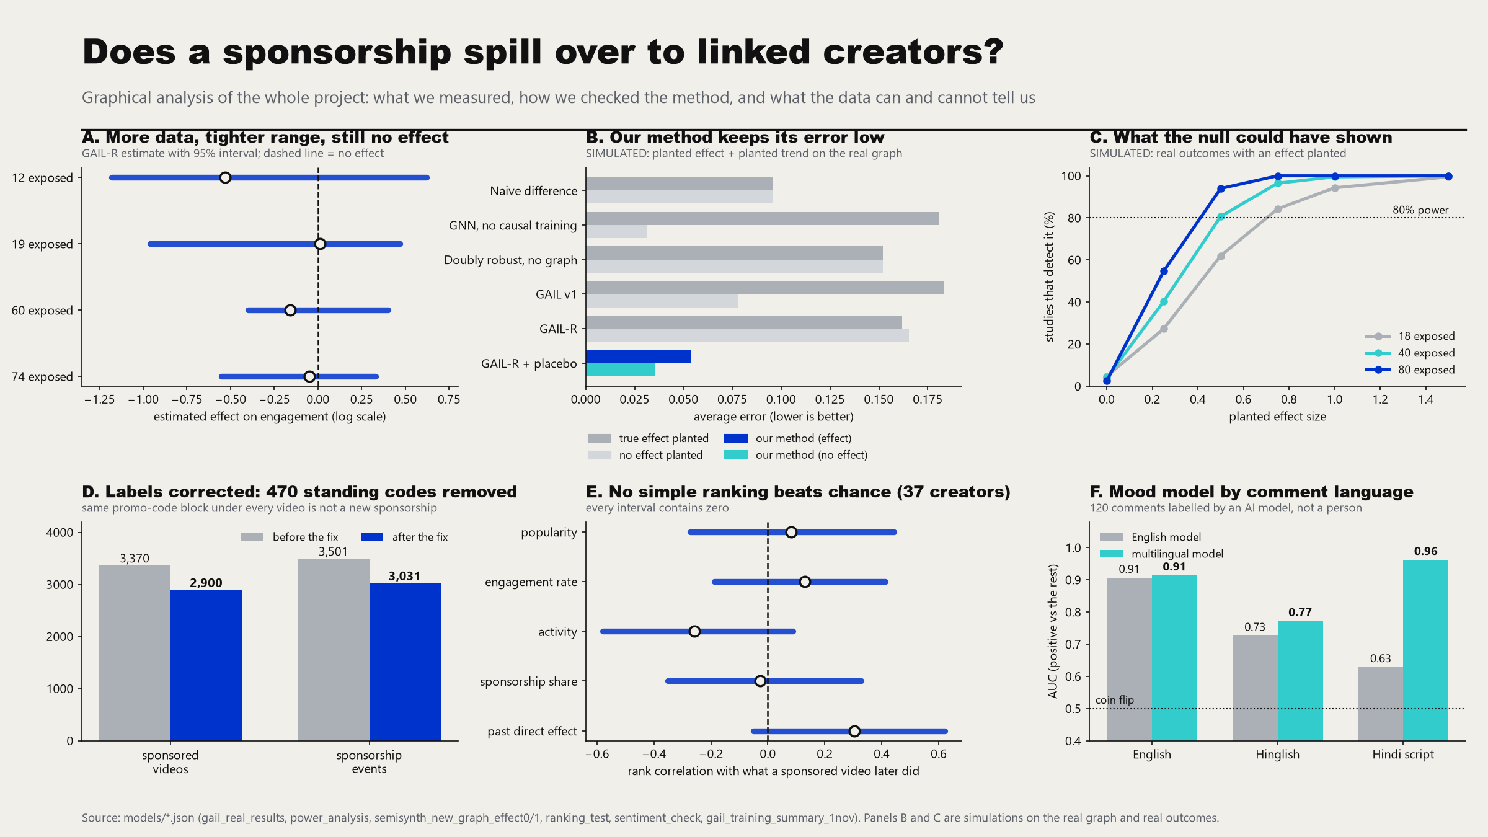
Graphical analysis of the whole project
Notes:
Six panels: the spillover result with its range, the method check on a known effect (simulated), what the test could have detected (simulated), the label fix, the ranking test, and the mood model by language.

Slide 22
Timeline – Update on Tasks
Period | Tasks | Status
Aug 2026 | Schema, ingestion, graph, feature store, first GAIL run, Review 1 (closed 26 Aug) | Done
Sep 2026 | Fusion layer, live API and web app, GAIL trained on 10 examples | Done
Early Oct | Temporal branch (sentiment, lag), CLIP/BERT features, calibration report, filters, linking, Analysis tab | Done
11-26 Oct | Daily collection, 24-month YouTube history, labels and brands, links, placebo and simulated validation | Done
27 Oct | Platform status in the app, handoff, training files exported | Done
28 Oct - 1 Nov | GAIL-R and placebo penalty, label fix (470 standing codes), GAIL retrained (run 8), novelties, Creator Passport, Insights page, app redesign, Docker run, fusion 0 / 0.5 / 0.5 | Done
After review | Load test, human label checks, per-rupee ranking, GPU run with more seeds, thesis, deployable build | Planned
Dates are monthly milestones from the project plan and the repository history.
Notes:
The project is complete as a pipeline and GAIL has been retrained on the corrected labels. The open items are the hardening tasks that come after: load test, more human label checks, per-rupee ranking, a GPU run with more seeds, and the thesis.

Slide 23
Team Contributions
Shimona Sinha PES2UG23CS547
Eesha Shah PES2UG23AM034
Data, analysis, novelties, app
GAIL model, causal inference, paper
Data fixing, re-collection, sponsorship labels
Spillover analyses; cross-platform novelties; fusion
Frontend, backend endpoints, Docker setup
GAIL v1 training and testing on the new data
GAIL v1 and GAIL-R, graph inside the model
Causal inference and spillover modelling
GAIL training; published baselines and comparison
Paper
Akshat Navlani PES2UG23AM009
Abhyudyay Agrawal PES2UG23AM003
Backend, data pipeline, infrastructure
Testing, graph in the app
Graph schema and edges in the database
GAIL implementation, spillover training, placebo
Instagram scraping, ingestion, backend API
Docker, health checks, build gate; Creator Passport
All testing: GAIL, API, fusion, Passport
Result re-runs; graph checks
Frontend redesign and testing; graph in the app
Novelty: ad fatigue and disclosure
Notes:
Four areas: data and analysis, the GAIL model, backend and infrastructure, and testing with the graph in the app. This is the team's agreed split of 1 Nov. The git history shows most backend and ingestion commits under Akshat; be ready to say who answers for which part.

Slide 24
Conclusion and Future work
Conclusion
A complete pipeline from daily data collection to a web app with ranked, explained scores.
Better data: 113,754 videos, 957,457 comments, 3,031 sponsorship events (standing affiliate codes removed), 74 exposed observations.
New: Creator Passport, evidence grade, clash warning and a graph you can explore.
Honest validation: the real data shows no broad spillover and simulations show our tests would have found one.
Known limits are stated, not hidden.
Future work
Install and test the retrained GAIL; a GPU run with more seeds.
Train also on the direct effect of sponsored posts.
More Instagram counts and human label checks; rate card; rank by expected engagement per rupee.
Load test and security pass; thesis.
Notes:
Close with the takeaway: a complete, honest pipeline, a clearer graph, and a clear plan.

Slide 25
References
[1] P. Velickovic et al., "Graph attention networks," in Proc. ICLR, 2018.
[2] M. Fey and J. E. Lenssen, "Fast graph representation learning with PyTorch Geometric," in ICLR Workshop on Representation Learning on Graphs and Manifolds, 2019.
[3] J. Qiu, J. Tang, H. Ma, Y. Dong, K. Wang, and J. Tang, "DeepInf: Social influence prediction with deep learning," in Proc. ACM SIGKDD, 2018, pp. 2110-2119.
[4] S. Kim, J.-Y. Jiang, J. Han, and W. Wang, "InfluencerRank: Discovering effective influencers via graph convolutional attentive recurrent neural networks," in Proc. ICWSM, vol. 17, no. 1, 2023, doi: 10.1609/icwsm.v17i1.22162.
[5] M. G. Hudgens and M. E. Halloran, "Toward causal inference with interference," J. Amer. Statist. Assoc., vol. 103, no. 482, pp. 832-842, 2008.
[6] P. R. Rosenbaum and D. B. Rubin, "The central role of the propensity score in observational studies for causal effects," Biometrika, vol. 70, no. 1, pp. 41-55, 1983.
[7] J. M. Robins, A. Rotnitzky, and L. P. Zhao, "Estimation of regression coefficients when some regressors are not always observed," J. Amer. Statist. Assoc., vol. 89, no. 427, pp. 846-866, 1994.
[8] V. Chernozhukov et al., "Double/debiased machine learning for treatment and structural parameters," Econometrics J., vol. 21, no. 1, pp. C1-C68, 2018.
[9] A. Radford et al., "Learning transferable visual models from natural language supervision," in Proc. ICML, PMLR 139, 2021, pp. 8748-8763.
[10] J. Devlin, M.-W. Chang, K. Lee, and K. Toutanova, "BERT: Pre-training of deep bidirectional transformers for language understanding," in Proc. NAACL-HLT, 2019, pp. 4171-4186.
[11] A. Conneau et al., "Unsupervised cross-lingual representation learning at scale," in Proc. ACL, 2020, pp. 8440-8451.
[12] C. W. J. Granger, "Investigating causal relations by econometric models and cross-spectral methods," Econometrica, vol. 37, no. 3, pp. 424-438, 1969.
[13] Y. Wu and Y. Yuan, "Estimating heterogeneous causal effect on networks via orthogonal learning," arXiv:2509.18484, 2025.
Notes:
References are in IEEE style. Page numbers are omitted where we were not certain of them.

Slide 26
SDK / API / Tools / Technologies
1. Data and infrastructure
2. ML core
Python 3.12 (ingestion, analyses) · OSS
Supabase Postgres (pooler) · OSS core + hosted
psycopg2-binary 2.9.12 · SQLModel 0.0.39 · OSS
YouTube Data API v3 · hosted; OpenCLI + Chrome extension (Instagram) · LICENSED
pg_cron snapshot timer every 2 h
PyTorch 2.6.0 (CPU) · PyTorch Geometric 2.8.0 · OSS
transformers 5.14.1: RoBERTa, XLM-R, CLIP, BERT · OSS
numpy 2.5.3 · scipy 1.18.1 · pandas 3.0.6 · OSS
GAIL / GAIL-R, placebo and simulation code: project-owned
3. Backend
4. Frontend, build and documents
FastAPI 0.141.1 + Uvicorn 0.52.1 · 11 routers · OSS
Pydantic 2.13.4 + pydantic-settings 2.15.0 · OSS
pytest: 142 backend + 340 ML + 126 ingestion tests · OSS
Next.js 16.3.0 · React 19.2.8 · TypeScript 5 · Tailwind v4 · OSS
d3-force for the creator graph; hand-drawn SVG charts · OSS
Node.js 24.19 · Docker Desktop compose · LICENSED
python-pptx, reportlab, matplotlib for the deck, PDFs and figures · OSS

Slide 27
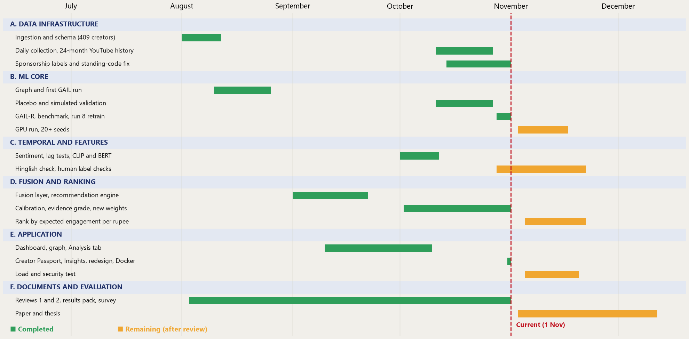
Gantt Chart
Notes:
Green is done, amber is remaining after the review. Bars are monthly milestones from the project plan and the repository history, not exact days.

Slide 28
GitHub Repo
github.com/akshatnavlani/Capstone
Branch | Track | Contents
main | - | Docs and the merged baseline
track-a-data-infra | A Data infra | YouTube / Instagram / Reddit ingestion, database migrations
track-b-ml-core | B ML core | GAIL model, training, causal inference, graph schema, unit tests
track-c-fusion-backend | C Fusion and backend | FastAPI app, fusion layer, scoring and recommendation routers
track-d-frontend-app | D Frontend app | Next.js dashboard and explainability UI
review-1 | Review 1 and 2 | All tracks merged for the earlier reviews
review2-eesha-model | Eesha | GAIL model code and checkpoint for the corrected data
review2-shimona-temporal | Shimona (latest) | Everything merged: GAIL-R, novelties, Passport, Insights, Docker, redesign; the branch to demo from

Slide 29
Thank You

