Slide 1
UE23CS441A –Project Phase – 3
Project Progress Review #3
Project Title : Influencer-Brand Matching via GAIL & Graph Spillover
Project ID : 011
Project Guide : Dr. Vishnu Tiwari
Project Team :
Shimona Sinha (PES2UG23CS547)
Akshat Navlani (PES2UG23AM009)
Eesha Shah (PES2UG23AM034)
Abhyudyay Agrawal (PES2UG23AM003)
Notes:
Opening. We built a complete pipeline from data to a web app, and today we show what is real, what is validated and what is still open. We state the limits ourselves.

Slide 2
Outline
Abstract and Scope of the Project (1 slide)
Suggestions from Review – 1 & 2 (1 slide)
Complete pipeline/Architecture of Project (max 2 slides)
Implementation Details (for each module) (max 4 slides)
Project Demonstration (keep the demo video ready)
Test Plan and Strategy (max 2 slide)
Results and Discussion (max 2 slides)
Conclusion and Future Work
References

Slide 3
Abstract and Scope
Problem: brands pick influencers by follower count and gut feel, and miss spillover: when a creator is sponsored, the audiences of the creators connected to them react too.
What we built: a brand gives a product, budget and region; the system returns ranked creators with a 0 to 100 score, a confidence range and an explanation, in a web app and a REST API.
Research part: GAIL (Graph-Adaptive Interference Learning), a graph-attention model that learns which linked creators are exposed to a sponsorship; plus a temporal branch (comment sentiment, cross-platform lag), CLIP/BERT creator features, and a fusion layer.
Scope: 150 verified Indian fitness creators on YouTube, Instagram and Reddit, from public data collected daily. Out of scope: real sales ROI (no sales data exists), public deployment.
Framing: a careful application of known causal-ML methods to a new domain. Results are exploratory and every claim is tested, with the limits stated.
Notes:
Keep this to one minute. The key sentence is the last one: we apply known methods carefully and we say what the data can and cannot show.

Slide 4
Suggestions from Review – 1 & 2
Open item from Review 1 / 2 | Feasibility and progress now
GAIL was trained on only 10 labelled examples | 159 independent examples, 95 of 150 creators linked; retraining is the next step (Eesha)
Sentiment and CLIP/BERT scores were 0.5 placeholders | Real for 149 and 150 of 150 creators; Hindi-script comments use a multilingual model
Fusion weights not calibrated | Cannot be fitted (only 10 labelled outcomes): fixed prior 0.4/0.3/0.3, calibration report written
No evaluation, baselines or error analysis | Placebo tests, simulated validation and a held-out ranking test built; GAIL row pending
Graph view and Granger insight missing | Graph view exists; Granger causality not done (planned)
Cost model is a flat heuristic | Still a heuristic (category rate); no rate-card table yet
Integration, performance, Docker | 390 automated tests pass, build passes; load test and Docker run still to do
Items are the open points listed after Review 1 and in the team's Pending Work list. [to fill: add the panel's own remarks if different]
Notes:
These are the open items we carried out of Review 1 and 2. Be ready to say which are done (the first four), which are partly done, and which are not done: Granger, the rate card, the load test and Docker.

Slide 5
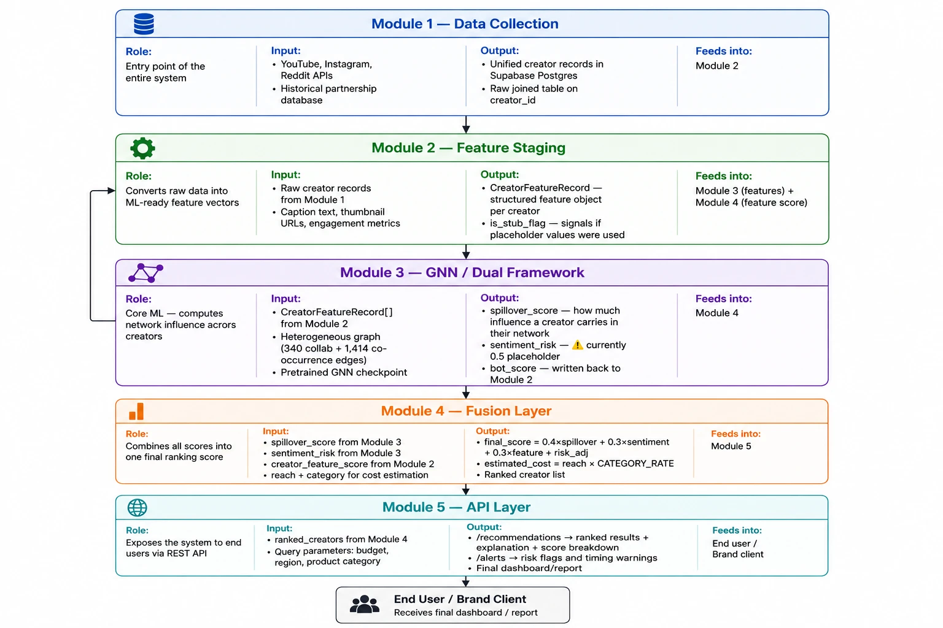
Complete pipeline / Architecture of Project (1 of 2)
Notes:
Walk the five modules top to bottom: collection, feature staging, the GNN dual framework, fusion, and the API. The next slide lists what changed in each module since this diagram was drawn.

Slide 6
Architecture: what changed since the diagram (2 of 2)
Module | Diagram says | Now (27 Oct 2026)
1 Data collection | YouTube, Instagram, Reddit; historical partnerships | 24 months of YouTube (59,300 videos), growth readings every 2 h, daily Instagram with owner checks
2 Feature staging | raw records to feature vectors, is_stub flag | CLIP/BERT features real for 150 of 150; sponsorship events with evidence tiers and a score table
3 GNN / dual framework | 340 collaboration + 1,414 co-occurrence edges; sentiment 0.5 | adds shared-brand (1,226) and @mention (154) links: 95 of 150 linked; sentiment real; lag test built
4 Fusion | 0.4 spillover + 0.3 sentiment + 0.3 features | same formula; all inputs real except spillover until GAIL is retrained
5 API layer | /recommendations, /alerts | adds /platform-profiles and /feature-store/edges/mentions; creators with data rank first
Notes:
This slide keeps the architecture diagram honest: the structure is unchanged, the content of each module is much richer.

Slide 7
Implementation: Modules 1-2, data and features
Technology: YouTube Data API v3 read every 2 h by Supabase pg_cron; Instagram via OpenCLI and a Chrome extension (read-only, 130 page loads a day); Reddit page JSON; Supabase Postgres; Python 3.12.
Owner check: every Instagram post is matched to the account that really posted it; foreign posts are detached (with a backup).
Sponsorship detector: rules on text, six evidence tiers from official label to brand mention; spoken sponsors read from captions; negations ('not a paid promotion') ignored.
Label reliability: each event scored by the human-checked precision of its tier.
for post in new_posts:
owner = owner_from_og_text(post)
if owner != post.creator:
backup(post); detach(post)
tier = highest of:
official_label > spoken >
creator_comment > disclosure_tag >
brand_and_code > brand_mention
if tier and not negated(text):
is_sponsored = True
p_ad = shrunk_precision(tier)
Notes:
Modules 1 and 2. The point to land: the data is collected automatically every day, and every correction is backed up so it can be undone.

Slide 8
Implementation: Module 3, graph and GAIL
Technology: PyTorch Geometric: a graph-attention (GAT) backbone, an exposure module, a propensity model and a spillover head (Eesha's GAIL).
Graph: creators are nodes; links are collaboration, Reddit co-mention, shared brand (1,226) and @mention (154); 95 of 150 creators linked.
Targets: a neighbour's engagement lift around each sponsored post, lift = (after - before) / (before + 1), median-based, clipped to +/-5, clustered by 30-day windows into 159 independent examples.
Honesty tests: within-neighbour placebo test, dose-response, direct effect, simulated validation.
emb = GAT(features, edges)
w_ij = softmax(sim(emb_i, emb_j))
exposure_j = sum_i treated_i * w_ij
e_j = propensity(features_j)
y_j = head(emb_j, exposure_j)
loss = mse(y_hat, lift)
+ lambda * propensity_regulariser
evaluate on held-out creators only;
never quote the in-sample effect
Notes:
Module 3. GAIL is Eesha's model. Our contribution is the data that feeds it and the tests that check it. Say that the training retrain is next, and that we judge it only on held-out creators.

Slide 9
Implementation: temporal branch and features
Sentiment: RoBERTa (English) per comment; a multilingual XLM-R model for Hindi-script comments; safety = P(positive) + 0.5 P(neutral), pulled to 0.5 for creators with few comments.
Lag detection: event study on growth readings every 2 h: activity after an Instagram post against the same creator's own rate, with a placebo from random times of the same hour of day.
Creator features: CLIP on thumbnails and BERT on text, matched to the brand's product brief.
Positive control: a YouTube upload must lift that channel's own views, or the method is broken.
for event in instagram_posts:
for window k in -48h .. +48h (12 h):
excess_k = rate_k / own_rate - 1
null = same statistic at random
times, same hour of day
p_k = share(null >= excess_k)
detected only if
min(p_after) < 0.05 / 4
control: upload -> own views
must be detected first
Notes:
The temporal branch. Sentiment is tested per language. Lag uses a placebo and a positive control so that a null result is believable.

Slide 10
Implementation: Modules 4-5, fusion and app
Fusion: final = 100 x (0.4 spillover + 0.3 sentiment + 0.3 features), minus 10 when sentiment is below 0.3; the confidence range combines each branch's uncertainty in quadrature.
Backend: FastAPI + SQLModel on Supabase; /recommendations, /alerts, /feature-store, /platform-profiles.
Frontend: Next.js 16 and TypeScript: brief form, ranked dashboard with basis badges, per-platform status, explainability graph, monitoring, analysis tab.
New: YouTube vs Instagram status per creator; creators with no data rank below those with data.
final = 100 * (0.4*spillover
+ 0.3*sentiment
+ 0.3*features)
if sentiment < 0.3: final -= 10
half_width = sqrt(sum(w_i * u_i)^2)
range = final +/- half_width
rank by (has_posts, final)
show basis: trained | inferred |
isolated
Notes:
Fusion and the app. The weights are a stated prior because there are not enough labelled outcomes to fit them, and the app shows each score with its basis and range.

Slide 11
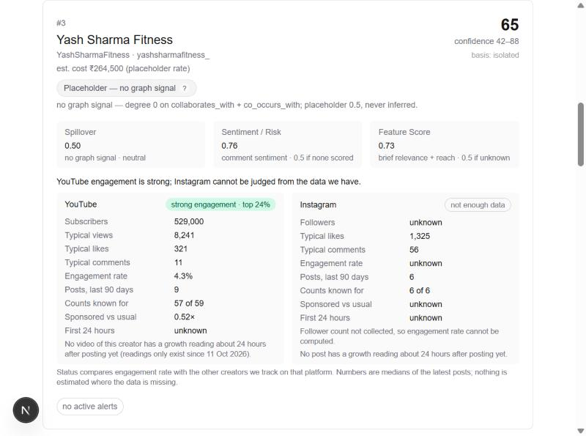
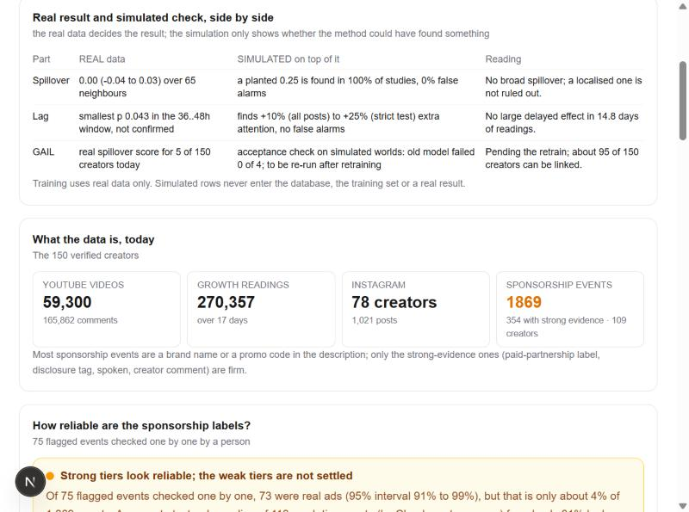
Project Demonstration
Demo flow (about 4 minutes):
1. Brand brief: 'Whey protein, fitness', budget 3,00,000
2. Ranked list with score, range and basis badge
3. 'YouTube vs Instagram status' for a creator
4. Explainability: how the score is built
5. Monitoring alerts with creator names
6. Analysis tab: real result next to the simulated check
Ranked result with per-platform status
Analysis tab: real vs simulated
[to fill: demo video recorded and checked]
Notes:
Run this live from the app. The screenshots are real. Keep the backend started a minute before the demo, because the CLIP and BERT models load on startup.

Slide 12
Test Plan and Strategy (1 of 2)
Test type | What is covered | Tool | Result (27 Oct)
Unit: backend | scoring, filters, feature store, alerts, platform profile | pytest | 120 pass
Unit: ML and scripts | estimators, label model, lag, ranking, simulations | pytest | 150 pass
Unit: ingestion | detector, daily job budget and blocks, Reddit, snapshots | pytest | 120 pass
Frontend | type-check, lint, production build | tsc, ESLint, Next.js | pass, 7 pages
Integration (manual) | brief to dashboard to platform status, in a real browser | browser | checked
Data validation | owner audit, duplicates, human label checks, backups | SQL, scripts | see results
Statistical validation | placebo test, dose-response, simulated planted effects | Python, numpy | see results
Environment and roles: tests run on the developers' laptops against a shared Supabase database; Shimona tests data, temporal analysis and the app, Eesha the GAIL model, Akshat the infrastructure and gate scripts, [to fill: Abhyudyay's role]. All tools are open source.
Notes:
Why these methods: unit tests protect each module, the browser check protects the integration, and the data and statistical validation protect the claims, which matter most in a project with little labelled data.

Slide 13
Test Plan and Strategy (2 of 2)
Activities and timeline
Tests were written with each module in Oct 2026 and all suites run before every push.
Data fixes are tested by re-measuring (counts, duplicates, links) and every change keeps a backup table.
Simulated checks plant a known effect on the real data to test the methods themselves.
Benefits
Cheap to repeat, catches regressions, makes claims checkable.
Drawbacks and gaps
No load or performance test of the API yet.
No security test and no CI pipeline on GitHub (local gate script only).
Docker image never run (Docker is not installed on the laptop).
GAIL itself is tested only after the retrain; its simulated acceptance check failed 0 of 4 on the old model.
Human label checks cover only 4% of events.
Notes:
Be open about the gaps: load, security and Docker are not done. The GAIL acceptance check is rerun on the new checkpoint.

Slide 14
Results and Discussion (1 of 2): data, labels, graph
Strong evidence tiers are almost always right (73 of 75 checked one by one, 91 to 99%), but that is only 4% of events; a text-only reading of weak tiers finds 61%, so their precision lies between about 60% and 95%.
Graph links grew from 17 to 95 of 150 creators; most are 'same brand' links (only 7 real collaboration pairs), so we call the graph exploratory.
Data: 59,300 YouTube videos, 270,357 growth readings, 1,857 sponsorship events.
Notes:
Expected: reliable labels. Observed: strong tiers yes, weak tiers uncertain. The deviation is honest and we corrected an earlier 91% figure that mixed assumed rows with checked ones.

Slide 15
Results and Discussion (2 of 2): spillover, lag, baselines
Real-data test | Result
Within-neighbour placebo (65) | +0.00 (-0.04 to +0.03)
Stronger tie, more spillover? | trend -0.05
Sponsored vs usual video | views x0.98
Lag, Instagram to YouTube | p = 0.043, not confirmed
Ranking vs random (37 creators) | no baseline beats random
Expected a measurable spillover; observed none broad. The simulated check shows the test would catch an effect of 0.25 or more every time and the naive method raises false alarms, so the null is informative.
Reasons for the deviation: small labelled set (159 examples), graph mostly 'same brand', 17 days of growth readings; a localised effect (about 20% of neighbours) would be missed.
Compared with simple baselines (follower count, engagement rate, past effect) none beat random; GAIL's row follows the retrain.
Notes:
Read the left chart as a SIMULATED check: a planted effect on the real network. The right table is real data only. The honest summary is that we find no broad spillover and we can show our test would have found one.

Slide 16
Timeline – Update on Tasks
Period | Tasks | Status
Aug 2026 | Schema, ingestion, graph, feature store, first GAIL run, Review 1 (closed 26 Aug) | Done
Sep 2026 | Fusion layer, live API and web app, GAIL trained on 10 examples | Done
Early Oct | Temporal branch (sentiment, lag), CLIP/BERT features, calibration report, filters, linking, Analysis tab | Done
11-26 Oct | Daily collection, 24-month YouTube history, labels and brands, links, placebo and simulated validation | Done
27 Oct | Platform status in the app, handoff, training files exported | Done
28 Oct+ | GAIL retraining and held-out scoring (Eesha), fusion refresh | In progress
After review | Docker run, load test, human label checks, thesis, deployable build | Planned
Dates are monthly milestones from the project plan and the repository history.
Notes:
The project is complete as a pipeline. The open items are the final GAIL retraining and the hardening tasks that come after.

Slide 17
Conclusion and Future work
Conclusion
A complete pipeline from daily data collection to a web app with ranked, explained scores.
Better data: 59,300 videos, 1,857 labelled events, 95 of 150 creators linked, 159 training examples.
Honest validation: the real data shows no broad spillover and simulations show our tests would have found one.
Known limits are stated, not hidden.
Future work
Retrain GAIL, then held-out scoring, acceptance check and fusion refresh.
Train also on the direct effect of sponsored posts (about 1,400 more events).
Per-platform normalisation, five random seeds, cross-fitting.
More Instagram counts and human label checks; Granger causality; rate card.
Docker, load test and security pass; thesis.
Notes:
Close with the takeaway: a complete, honest pipeline, a clearer graph, and a clear plan.

Slide 18
References
[1] P. Velickovic et al., "Graph attention networks," in Proc. ICLR, 2018.
[2] M. Fey and J. E. Lenssen, "Fast graph representation learning with PyTorch Geometric," in ICLR Workshop on Representation Learning on Graphs and Manifolds, 2019.
[3] J. Qiu, J. Tang, H. Ma, Y. Dong, K. Wang, and J. Tang, "DeepInf: Social influence prediction with deep learning," in Proc. ACM SIGKDD, 2018, pp. 2110-2119.
[4] S. Kim, J.-Y. Jiang, J. Han, and W. Wang, "InfluencerRank: Discovering effective influencers via graph convolutional attentive recurrent neural networks," in Proc. ICWSM, vol. 17, no. 1, 2023, doi: 10.1609/icwsm.v17i1.22162.
[5] M. G. Hudgens and M. E. Halloran, "Toward causal inference with interference," J. Amer. Statist. Assoc., vol. 103, no. 482, pp. 832-842, 2008.
[6] P. R. Rosenbaum and D. B. Rubin, "The central role of the propensity score in observational studies for causal effects," Biometrika, vol. 70, no. 1, pp. 41-55, 1983.
[7] J. M. Robins, A. Rotnitzky, and L. P. Zhao, "Estimation of regression coefficients when some regressors are not always observed," J. Amer. Statist. Assoc., vol. 89, no. 427, pp. 846-866, 1994.
[8] V. Chernozhukov et al., "Double/debiased machine learning for treatment and structural parameters," Econometrics J., vol. 21, no. 1, pp. C1-C68, 2018.
[9] A. Radford et al., "Learning transferable visual models from natural language supervision," in Proc. ICML, PMLR 139, 2021, pp. 8748-8763.
[10] J. Devlin, M.-W. Chang, K. Lee, and K. Toutanova, "BERT: Pre-training of deep bidirectional transformers for language understanding," in Proc. NAACL-HLT, 2019, pp. 4171-4186.
[11] A. Conneau et al., "Unsupervised cross-lingual representation learning at scale," in Proc. ACL, 2020, pp. 8440-8451.
[12] C. W. J. Granger, "Investigating causal relations by econometric models and cross-spectral methods," Econometrica, vol. 37, no. 3, pp. 424-438, 1969.
Notes:
References are in IEEE style. Page numbers are omitted where we were not certain of them.

Slide 19
Thank You

