Slide 1
Financial News
Sentiment Analysis
FinBERT application with a trained TF-IDF baseline
Akshat Agarwal
Roll 202401100100028 · CS-5A
KIET Group of Institutions, Ghaziabad
Faculty: Kriti Sharma
Unit 4 · Deep Learning Project
Notes:
The application classifies short English financial statements. The project trains the conventional baseline and uses downloaded FinBERT weights without additional transformer training. Sources: https://huggingface.co/ProsusAI/finbert ; https://huggingface.co/datasets/takala/financial_phrasebank ; https://arxiv.org/abs/1810.04805 ; https://arxiv.org/abs/1908.10063. Project evidence: outputs/dataset_audit.json, models/baseline_metadata.json, outputs/evaluation.json.

Slide 2
Financial sentiment classification
Input: a short English financial statement
Output: positive, negative, or neutral
Statement | Intended sentiment
Profit increased and the outlook improved. | Positive
The company expects an operating loss. | Negative
The annual report will appear on Friday. | Neutral
Sentiment describes financial language. It does not predict stock returns.
02
Notes:
The examples are self-authored demonstrations with intended interpretations. They are not independent benchmark labels. Financial sentiment concerns the statement and entity described, rather than a guaranteed market reaction.

Slide 3
Application and model roles
Layer | Role
Streamlit interface | Text input, CSV upload, result inspection and export
Shared validation | Blank rows, input length and named class mapping
Pretrained FinBERT | Financial transformer inference with all three scores
Trained baseline | TF-IDF features and logistic regression
Both model routes return the same named labels and result schema.
03
Notes:
Text and CSV input share validation and prediction logic. FinBERT loads once for reuse. The baseline stores TF-IDF and logistic regression in one fitted pipeline. Sources: https://huggingface.co/ProsusAI/finbert ; https://huggingface.co/datasets/takala/financial_phrasebank ; https://arxiv.org/abs/1810.04805 ; https://arxiv.org/abs/1908.10063. Project evidence: outputs/dataset_audit.json, models/baseline_metadata.json, outputs/evaluation.json.

Slide 4
Financial PhraseBank is imbalanced
4,836
clean examples
50Agree subset
English financial news
Three sentiment labels
Macro F1 gives each class equal weight despite the neutral majority.
04
Notes:
The raw 50Agree subset has 4,846 rows: neutral 2,879, positive 1,363 and negative 604. This chart uses the cleaned canonical rows recorded by the preparation script. The agreement threshold concerns annotators. The other agreement subsets overlap and cannot act as independent test sets. Sources: https://huggingface.co/ProsusAI/finbert ; https://huggingface.co/datasets/takala/financial_phrasebank ; https://arxiv.org/abs/1810.04805 ; https://arxiv.org/abs/1908.10063. Project evidence: outputs/dataset_audit.json, models/baseline_metadata.json, outputs/evaluation.json.

Slide 5
Data audit and saved partitions
6 matching duplicate occurrences removed
4 conflicting-label rows quarantined
Partition | Examples | Purpose
Training | 3,385 | Fit vocabulary and classifier
Validation | 725 | Select logistic regression settings
Test | 726 | Final held-out baseline metrics
Stratified 70/15/15 target split, seed 42. No normalized sentence overlap.
05
Notes:
Partition counts come directly from outputs/dataset_audit.json. Preparation handles normalized duplicate text before splitting. No fitted TF-IDF vocabulary sees validation or test text. Random partitions do not establish temporal or company-level independence. Sources: https://huggingface.co/ProsusAI/finbert ; https://huggingface.co/datasets/takala/financial_phrasebank ; https://arxiv.org/abs/1810.04805 ; https://arxiv.org/abs/1908.10063. Project evidence: outputs/dataset_audit.json, models/baseline_metadata.json, outputs/evaluation.json.

Slide 6
FinBERT and Unit 4 concepts
Tokenization
WordPiece tokens and special tokens convert each statement into model input IDs.
Contextual transformer encoder
BERT uses self-attention to construct representations that depend on surrounding tokens.
Classification head
Three logits become softmax scores. The largest named score selects a label.
This project uses pretrained FinBERT weights without further fine-tuning.
06
Notes:
FinBERT is based on BERT base, with a three-class sequence classification head. The model card reports 12 encoder layers, hidden size 768 and 12 attention heads. The project uses pretrained weights without further fine-tuning. Its model configuration supplies named label mapping. Sources: https://huggingface.co/ProsusAI/finbert ; https://huggingface.co/datasets/takala/financial_phrasebank ; https://arxiv.org/abs/1810.04805 ; https://arxiv.org/abs/1908.10063. Project evidence: outputs/dataset_audit.json, models/baseline_metadata.json, outputs/evaluation.json.

Slide 7
Baseline training
Component | Configuration
TF-IDF | Word unigrams and bigrams, sublinear term frequency
Vocabulary limits | Minimum document frequency 2, maximum 0.98
Logistic regression | Balanced classes, maximum 2,000 iterations
Validation search | C in 0.5, 1, 2 and 4
Selected C = 2 Vocabulary = 11,138 features
The saved pipeline keeps its fitted vocabulary and classifier together.
07
Notes:
All candidates fit only the training split. The project chooses C using validation macro F1, then evaluates the selected saved pipeline on the held-out test partition. Sources: https://huggingface.co/ProsusAI/finbert ; https://huggingface.co/datasets/takala/financial_phrasebank ; https://arxiv.org/abs/1810.04805 ; https://arxiv.org/abs/1908.10063. Project evidence: outputs/dataset_audit.json, models/baseline_metadata.json, outputs/evaluation.json.

Slide 8
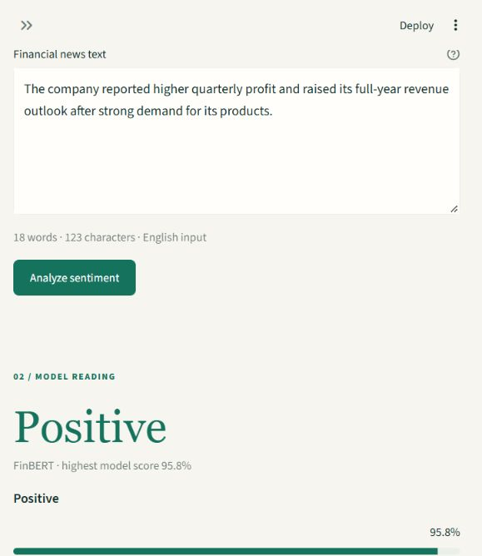
Text and CSV demonstration
Single text
Inspect the label and all three model scores.
Batch CSV
Choose the text column and export each result with its row status.
Live app
financial-sentiment-akshatog.streamlit.app
CSV limits: 2 MB and 500 rows. Blank or invalid rows keep a visible status.
08
Notes:
Live demo: analyse a positive financial example, compare the baseline, then upload data/examples/demo_news.csv and download results. The CSV includes an intentionally blank row. Scores are model outputs rather than calibrated guarantees. FinBERT rejects text exceeding 512 tokenizer tokens including special tokens.

Slide 9
Held-out baseline results
726 test examples. Baseline training and selection exclude these rows.
09
Notes:
Test partition: 726 examples. Both displayed models use exactly the same held-out partition. The majority predictor always returns the most common training label. Raw metrics: {"baseline":{"accuracy":0.7575757575757576,"macro_f1":0.7194077658852299},"majority":{"accuracy":0.59366391184573,"macro_f1":0.24834341688274272}}. Sources: https://huggingface.co/ProsusAI/finbert ; https://huggingface.co/datasets/takala/financial_phrasebank ; https://arxiv.org/abs/1810.04805 ; https://arxiv.org/abs/1908.10063. Project evidence: outputs/dataset_audit.json, models/baseline_metadata.json, outputs/evaluation.json.

Slide 10
Baseline errors by class
Actual / predicted | Negative | Neutral | Positive
Negative | 62 | 17 | 12
Neutral | 14 | 359 | 58
Positive | 12 | 63 | 129
Class F1
Negative 69.3%
Neutral 82.5%
Positive 64.0%
121 of 176 errors confuse positive and neutral statements.
10
Notes:
The confusion matrix uses actual labels in rows and predicted labels in columns. It comes directly from outputs/evaluation.json. Per-class performance must be considered alongside overall accuracy. Sources: https://huggingface.co/ProsusAI/finbert ; https://huggingface.co/datasets/takala/financial_phrasebank ; https://arxiv.org/abs/1810.04805 ; https://arxiv.org/abs/1908.10063. Project evidence: outputs/dataset_audit.json, models/baseline_metadata.json, outputs/evaluation.json.

Slide 11
FinBERT diagnostic and prior exposure
88.2%
PhraseBank diagnostic accuracy
Macro F1: 87.5% on 726 examples
Prior training exposure affects this result
A new local split cannot remove exposure during the checkpoint’s original training.
Thirty source-linked sentences await human label review.
11
Notes:
The ProsusAI/finbert model card explicitly states Financial PhraseBank sentiment fine-tuning. Our local split cannot establish that any PhraseBank row was unseen by the published checkpoint. Therefore this metric is a diagnostic with prior training exposure and is not a fair unseen-data comparison against the trained baseline. Sources: https://huggingface.co/ProsusAI/finbert ; https://huggingface.co/datasets/takala/financial_phrasebank ; https://arxiv.org/abs/1810.04805 ; https://arxiv.org/abs/1908.10063. Project evidence: outputs/dataset_audit.json, models/baseline_metadata.json, outputs/evaluation.json.

Slide 12
Limitations and next experiment
Input limits
English financial sentences are the intended domain. Mixed statements and missing context can change the label.
Evidence limits
Random PhraseBank partitions do not establish performance on future news. Model scores lack calibration.
Next experiment
Freeze source-linked human labels on new financial statements, then evaluate both models once.
12
Notes:
Future work needs independently sourced financial sentences, human labels frozen before predictions, overlap checks, and evaluation once. FinBERT weights use CC BY-NC-SA 4.0 and PhraseBank CC BY-NC-SA 3.0, according to their current cards. Original project code has a separate MIT license. Sources: https://huggingface.co/ProsusAI/finbert ; https://huggingface.co/datasets/takala/financial_phrasebank ; https://arxiv.org/abs/1810.04805 ; https://arxiv.org/abs/1908.10063. Project evidence: outputs/dataset_audit.json, models/baseline_metadata.json, outputs/evaluation.json.

