Slide 1

HackWIE-INNOVATORS
THEME: ENVIRONMENT

Slide 2
introduction
We are experiencing a radical increase in Air Pollution in all over our surrounding. To stop radical increase in Air pollution we should plant more number of trees and stop deforestation but in urban & industrial areas there are no lands left for plantation. So, For urban and industrial areas we came up with an idea to resolve such problems.
In this project we are keeping an integrated machine between the two lane of an expressway to form energy and a machine for air purification.
The energy will be formed and get stored in the battery by the rotation of turbine mill which will rotate every time when vehicle passes by the setup and than the stored energy will be used by Air purifier which is integrated in the setup. Above the air purifier machine street light will be placed to lighten the road.

Slide 3
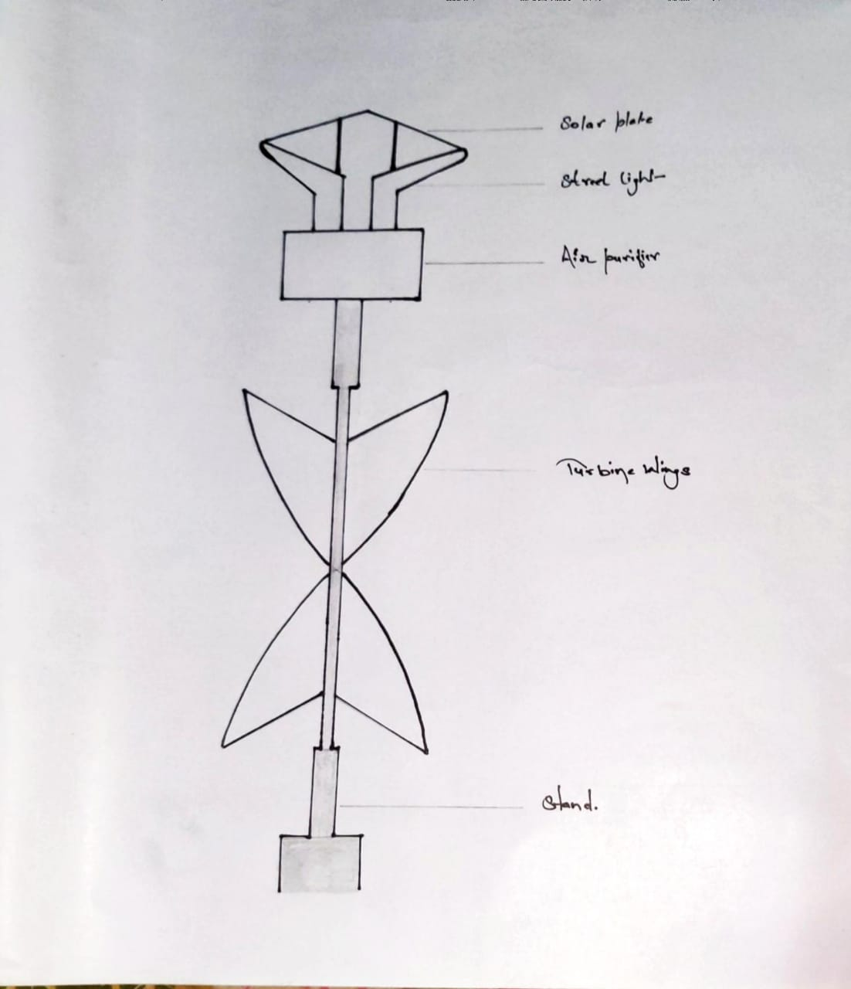
Prototype
Solar plate
Street light
Air purifier
Rotating Turbine
Pole

Slide 4
components
Vertical-Axis wind turbine (VAWT)
3 Stage HEPA Air filter.
DC to AC converting invertor.
Valve regulated lead acid battery (SLA) -12V, 12Ah
Philips dusk to dawn A19 60W street light.
Solar Panel.

Slide 5
Vertical-axis wind turbine (VAWT)
The Vertical-Axis Wind Turbine (VAWT) is a wind turbine that has its main rotational axis oriented in the vertical direction.
VAWTs were innovative designs that have not proven as effective in general as HAWTs, but they have a few good features, including quiet operation.
Because they are not as efficient as HAWTs, they are rarely used in large units. Most VAWTs are smaller units that can be located in residential and commercial locations because they are much quieter than the horizontal-axis turbines.
Vertical-axis wind turbines can produce electrical power at lower speeds and at a variety of changing speeds. Because they vary widely in speed, the AC generators they use do not produce a constant output. Usually, the output goes to an inverter that converts it to standard AC (either single-phase or three-phase). Another option is to use DC as the output.
Vertical-axis wind turbines can generate the voltage at low wind speeds, and they do not have to change direction to catch the usable wind.

Slide 6
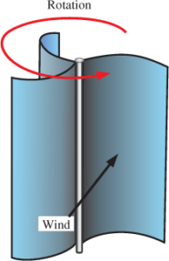
Vetical-axis wind turbine (vawt)

Slide 7
3 Stage HEPA Air filter
Stages 1: Particulate Pre-filters Two particulate pre-filters remove visible particles therefore protecting the carbon and HEPA filters are extended changing the pre-filters on a regular basis. The first stage is an inexpensive 1/2 inch deep pad filter used for capturing larger particles. The second stage filter is a pleated filter, which captures most remaining visible particles. The first and second stage filters come in 30 and 12 per case respectively.
Stage 2: Carbon Filtration The third stage is an optional filter available for all Aerospace Air Scrubbers. The carbon filter removes odors and captures gases and organic compounds from smoke, molds coatings and paints through an adsorption process. This 2" filter is 100% filled with carbon. If you are concerned about odors put this 100% filled carbon filter in your unit and feel secure and eliminate the odor.
Stage 3: HEPA Filtration 99.97% Aerospace Air Scrubbers all feature a 99.97% final stage of filtration. The HEPA filter captures microscopic particulates at .03 microns. This level of filtration often eliminates the need for final cleanup and dust removal after construction and remodeling jobs. 99.99% efficient filters are also available.

Slide 8
Dc to ac converting invertor
Generator is a machine that converts mechanical energy into electrical energy. It works based on principle of faraday law of electromagnetic induction. The faradays law states that whenever a conductor is placed in a varying magnetic field, EMF is induced and this induced EMF is equal to the rate of change of flux linkages. This EMF can be generated when there is either relative space or relative time variation between the conductor and magnetic field. So the important elements of a generator are:
Magnetic field
Motion of conductor in magnetic field
Working of Generators:
Generators are basically coils of electric conductors, normally copper wire, that are tightly wound onto a metal core and are mounted to turn around inside an exhibit of large magnets. An electric conductor moves through a magnetic field, the magnetism will interface with the electrons in the conductor to induce a flow of electrical current inside it.

Slide 9
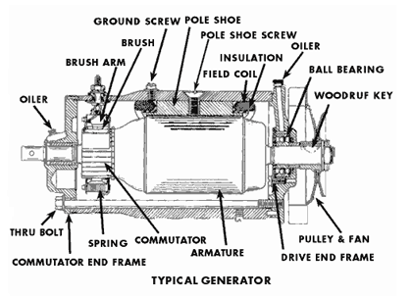
Dc to ac converting invertor

Slide 10
Valve regulated lead acid battery (sla)
A valve regulated lead–acid (VRLA) battery, commonly known as a sealed lead–acid (SLA) battery, is a type of lead-acid battery characterized by a limited amount of electrolyte ("starved" electrolyte) absorbed in a plate separator or formed into a gel; proportioning of the negative and positive plates so that oxygen recombination is facilitated within the cell; and the presence of a relief valve that retains the battery contents independent of the position of the cells.

Slide 11
Philips dusk to dawn a19 60w street light
It is equipped with a built in light sensor that turns the lights on automatically when the sun goes down and turns the light off when the sun rises. Suitable for indoor or outdoor use. These Dusk to Dawn Sensor bulbs provide 800 Lumen’s of soft white light, equivalent to 60-watt incandescent with 75% less energy use. With 2700-Kelvin soft white light.

Slide 12
Solar panel
A solar panel works by allowing photons, or particles of light, to knock electrons free from atoms, generating a flow of electricity. Solar panels actually comprise many, smaller units called photovoltaic cells. (Photovoltaic simply means they convert sunlight into electricity.) Many cells linked together make up a solar panel.
Each photovoltaic cell is basically a sandwich made up of two slices of semi-conducting material, usually silicon — the same stuff used in microelectronics.
To work, photovoltaic cells need to establish an electric field. Much like a magnetic field, which occurs due to opposite poles, an electric field occurs when opposite charges are separated. To get this field, manufacturers "dope" silicon with other materials, giving each slice of the sandwich a positive or negative electrical charge.
Specifically, they seed phosphorous into the top layer of silicon, which adds extra electrons, with a negative charge, to that layer. Meanwhile, the bottom layer gets a dose of boron, which results in fewer electrons, or a positive charge. This all adds up to an electric field at the junction between the silicon layers. Then, when a photon of sunlight knocks an electron free, the electric field will push that electron out of the silicon junction.
A couple of other components of the cell turn these electrons into usable power. Metal conductive plates on the sides of the cell collect the electrons and transfer them to wires. At that point, the electrons can flow like any other source of electricity.

Slide 13
Major outcomes through the project
Energy generation.
Energy utilization.
Energy conservation.
Air purification.

Slide 14
advantages
It’ll be great help for urban areas in Delhi, Mumbai, Chennai, Kolkata, Bengaluru, Lucknow, Jaipur to get rid of air pollution from vehicles on the road side.
The setup won’t consume additional energy.
No additional space required to install the setup.
No any harm with such setup.

Slide 15
disadvantage
Installation costs are high.

Slide 16
Team-innovators
Akshat Kumar Agrawal
Chandranil Bollam
Ramnika Banerjee
Sourav Rungta

Slide 17
Thank you
End of the slide

