Slide 1
UPI TRANSACTION ANALYSIS
Fraud Risk & Operational Insights from 100,000+ Digital Payment Transactions
Data Analytics Capstone Project | Excel • SQL • Python • Statistics • Power BI

Slide 2
Business Context
The Platform
The Challenge
A rapidly growing UPI digital payments platform managing:
• 10,000 customers
• 500 merchants
• 12,000 registered devices
• 100,000 transactions analyzed
As the platform scaled, management needed answers to:
Are certain segments at higher fraud risk?
Where do transaction failures occur?
How effective are current fraud controls?
How can performance be monitored going forward?

Slide 3
Methodology
A 5-stage analytics pipeline, each stage validating the one before it
01
02
03
04
05
Excel
SQL
Python
Statistics
Power BI
Data validation across
7 source tables
→
Schema design +
130K row ingestion
→
EDA + feature
engineering
→
7 hypothesis tests
(T-test, ANOVA, χ²)
→
2 interactive
dashboards
Every step was tested end-to-end against the real dataset before moving to the next — no untested code or unverified numbers.

Slide 4
THE HEADLINE FINDING
Rooted Devices Are a Critical Fraud Risk
NON-ROOTED DEVICES
ROOTED DEVICES
1.4%
20.7%
fraud rate
fraud rate — 15x higher
Confirmed with a Chi-square test of independence: χ² = 5,825.1, p < 0.0001, Cramér's V = 0.24 (moderate-to-strong effect). This was the only statistically significant risk factor found across 7 hypothesis tests covering region, device type, merchant category, and payment channel.

Slide 5
Additional Insights
1
Failures Are Systemic
5.9% failure rate is nearly uniform across channels, regions, and device types (ANOVA/χ² not significant) — pointing to distributed infrastructure issues, not one fixable bug.
2
Fraud Concentrates in Specific Merchants
Top 10 highest-risk merchants show 7.0%–10.6% fraud rates — up to 5x the 2.0% platform average.
3
Strong but Incomplete Fraud Resolution
87.6% of fraud alerts resolved (avg. 1.46 days) — but 248 alerts (12.4%) remain open and will scale with growth.
4
Explosive Platform Growth
Monthly transactions grew from 1 (Oct 2020) to 18,000+ (Jul 2025) — exponential, not linear growth.

Slide 6
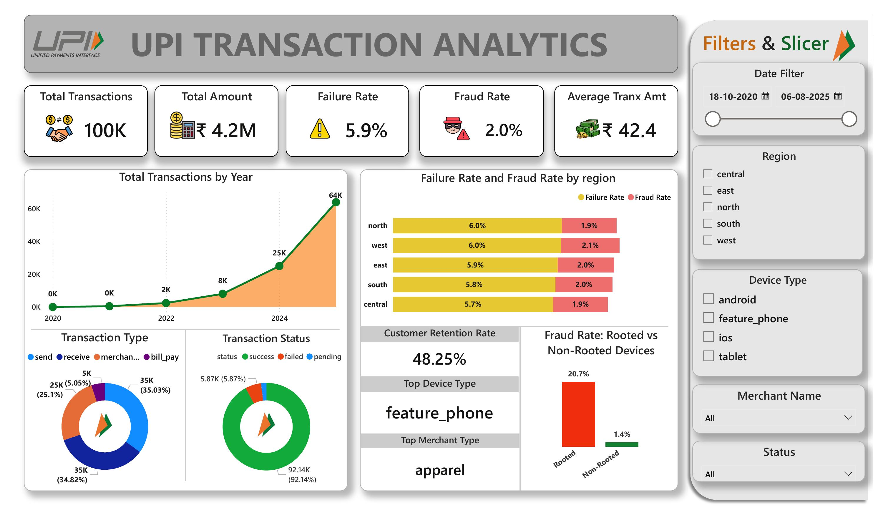
Executive Dashboard
Platform health at a glance — 5 core KPIs, growth trend, and the headline fraud finding

Slide 7
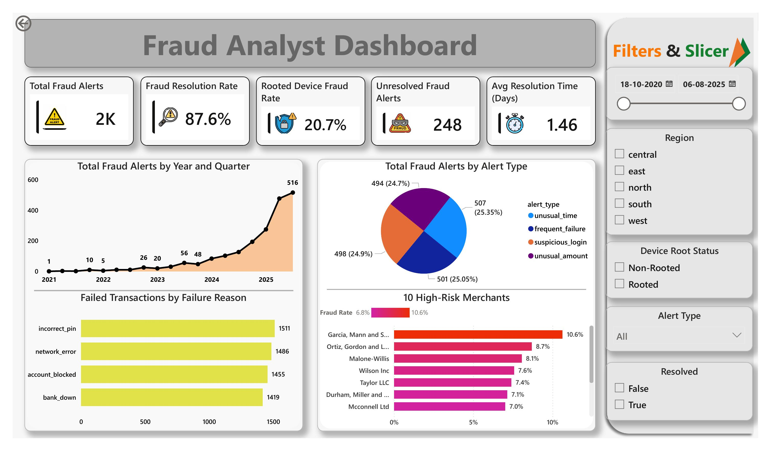
Fraud Analyst Dashboard
Drill-down view: alert trends, root-cause analysis, and high-risk merchant ranking

Slide 8
Strategic Recommendations
CRITICAL
HIGH
MEDIUM
Deploy device root-detection
+ step-up authentication
Targeted review of top 10
high-risk merchants
Cross-functional transaction
reliability initiative
Est. impact: up to 93% reduction in rooted-device fraud (from ~656 to ~44 fraudulent transactions in current data)
Est. impact: meaningfully reduces merchant-driven fraud by bringing 7–10.6% outliers toward the 2.0% platform average
Est. impact: each 1pt reduction in failure rate recovers ~1,000 transactions per 100K processed, scaling with growth

Slide 9
Limitations & Future Scope
Limitations
Future Scope
Aug 2025 is a partial month — not a real activity decline
Retention rate (48.25%) includes never-active customers in its denominator
Only device root status was a significant fraud predictor — other factors need richer features to model
~5-year window may not capture longer seasonal cycles
Real-time, multi-factor device-risk scoring (beyond root status alone)
Time-series forecasting for infrastructure capacity planning
Root-cause ownership mapping for failure reasons by team
A/B pilot of step-up authentication before full rollout

Slide 10
Thank You
Questions & Discussion

