Slide 1
DOMINO'S ANALYTICS | MYSQL 8.0
DOMINO'S PIZZA
SQL SALES ANALYSIS
Turning 48,000+ Pizza Sales Transactions into Actionable Business Insights Using MySQL & Data Storytelling
TOTAL SALES REVENUE
$817,860.05
358 operating days across 2015
TOTAL ORDERS PLACED
21,350
Unique customer transactions
TOTAL PIZZAS SOLD
49,574
Units prepared and delivered
AVERAGE ORDER VALUE
$38.31
Avg basket spend (2.32 pizzas/order)

Slide 2
DOMINO'S ANALYTICS | EXECUTIVE SUMMARY
Slide 02 / 16
Project Overview & Business Problem
Transforming transactional records into high-impact restaurant intelligence
BUSINESS CONTEXT & STRATEGIC OBJECTIVES
• QSR Dynamics: Domino's operates on tight margins, perishable stock, and fast delivery windows.
• Sales Velocity: Measure gross revenue ($817.8K) and transaction frequency across 2015.
• Operational Rhythms: Map order concentration by hour to synchronize staffing with lunch & dinner rushes.
• Portfolio Productivity: Evaluate whether 32 menu items are optimized or suffering from SKU clutter.
• Actionable Value: Produce data-backed recommendations for inventory, labor scheduling, and menu pricing.
DATASET SCOPE & ANALYTICAL RIGOR
✔ Database Engine: MySQL 8.0 Relational Database
✔ Temporal Bounds: 358 Operating Days (2015-01-01 to 2015-12-31)
✔ Transaction Depth: 48,620 Order Detail Lines across 21,350 Orders
✔ Product Variety: 32 Distinct Flavor Concepts across 96 Size/Price Variants
✔ Data Integrity: 100% Referential integrity, 0 orphaned records across FKs
✔ Fidelity Guarantee: All reported metrics are verified against actual query results.
DATA ANALYST INSIGHT
The dataset reflects genuine franchise operational dynamics with an AOV of $38.31 and average items per order of 2.32 pizzas.
BUSINESS & OPERATIONAL USE CASE
Franchise operators can use this baseline to benchmark store throughput, optimize product margins, and eliminate unprofitable menu complexity.

Slide 3
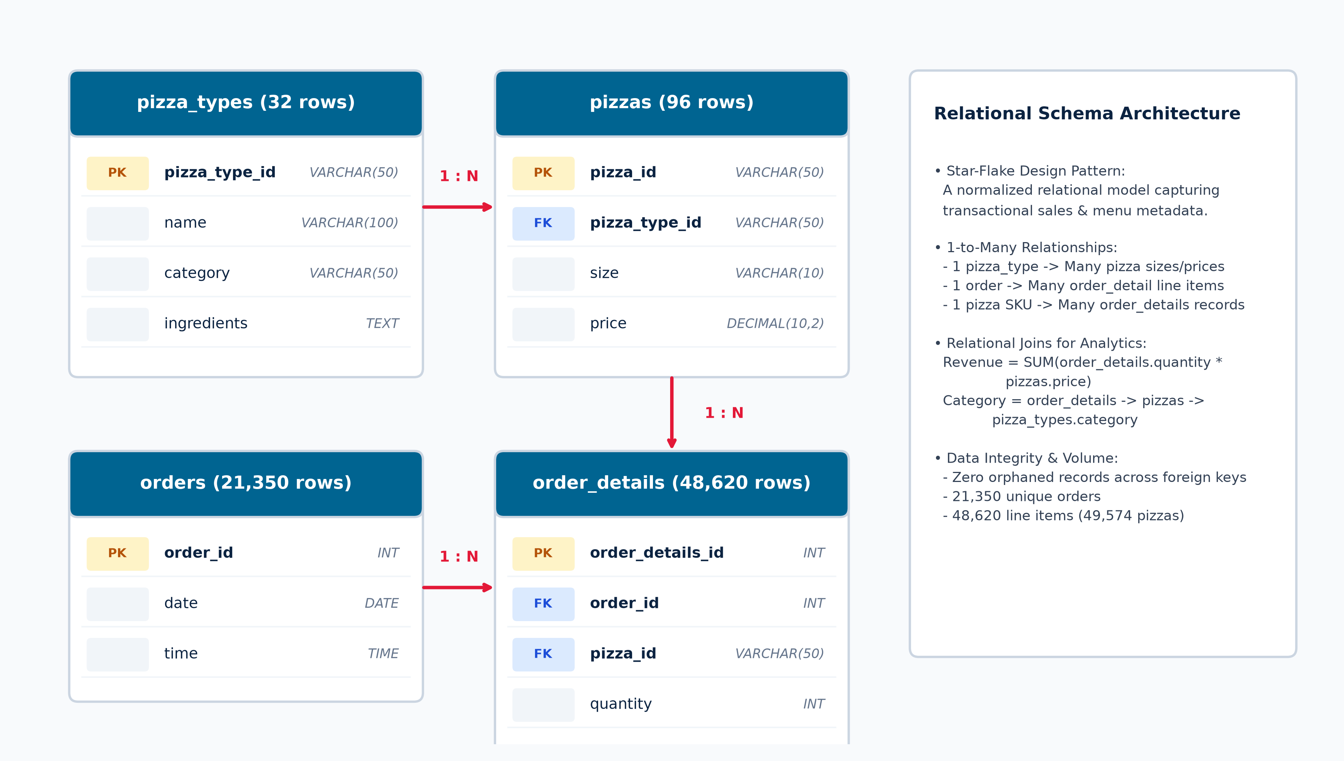
DOMINO'S ANALYTICS | DATA ARCHITECTURE
Slide 03 / 16
Database Structure & Relational Schema (ERD)
Four normalized relational tables supporting transactional tracking and multi-tier analytics

Slide 4
DOMINO'S ANALYTICS | METHODOLOGY
Slide 04 / 16
SQL Analytics Workflow & Methodology
A rigorous, repeatable 5-stage analytical pipeline from DDL creation to business decisions
01
Schema Design
Created database and 4 tables with primary keys & foreign key constraints.
02
Data Ingestion
Loaded 48,620 line items and 21,350 orders. Verified zero orphaned keys.
03
Query Engineering
Crafted 11 targeted queries using multi-table JOINs, CTEs, and aggregations.
04
Validation Audit
Audited line-item vs physical units and chronological sorting enhancements.
05
Business Insights
Translated numbers into actionable inventory, labor, and menu strategies.
DATA ANALYST INSIGHT
Relational joins (order_details -> pizzas -> pizza_types) allow granular calculation of revenue and volume at SKU, recipe, and category tiers.
BUSINESS & OPERATIONAL USE CASE
Standardizing this workflow allows corporate analytics teams to deploy automated daily reporting across multi-franchise systems.

Slide 5
DOMINO'S ANALYTICS | QUERIES 01 & 02
Slide 05 / 16
Macro Sales Performance: Total Orders & Revenue
Establishing baseline store transaction volume, top-line sales, and basket value
-- Query 1: Total Orders Placed
SELECT COUNT(order_id) AS Total_orders
FROM orders;
-- Query 2: Total Revenue Generated
SELECT ROUND(SUM(o.quantity * p.price), 2) AS Total_revenue
FROM order_details o
LEFT JOIN pizzas p ON o.pizza_id = p.pizza_id;
TOTAL ORDERS PLACED (Q1)
21,350
Total customer orders processed in 2015
TOTAL REVENUE (Q2)
$817,860.05
Gross sales across 49,574 pizzas
AVERAGE ORDER VALUE
$38.31
Revenue / Total Orders ($817.8K / 21.35K)
TOTAL UNITS SOLD
49,574
Avg 2.32 pizzas per customer order
DATA ANALYST INSIGHT
The store maintained an average sales velocity of $2,284.53 per operating day. With 2.32 pizzas per order, customers primarily order for group/family meals.
BUSINESS & OPERATIONAL USE CASE
Basket Expansion: Implement targeted app upsells (sides, drinks) at checkout to nudge current $38.31 tickets toward $45.00+.

Slide 6
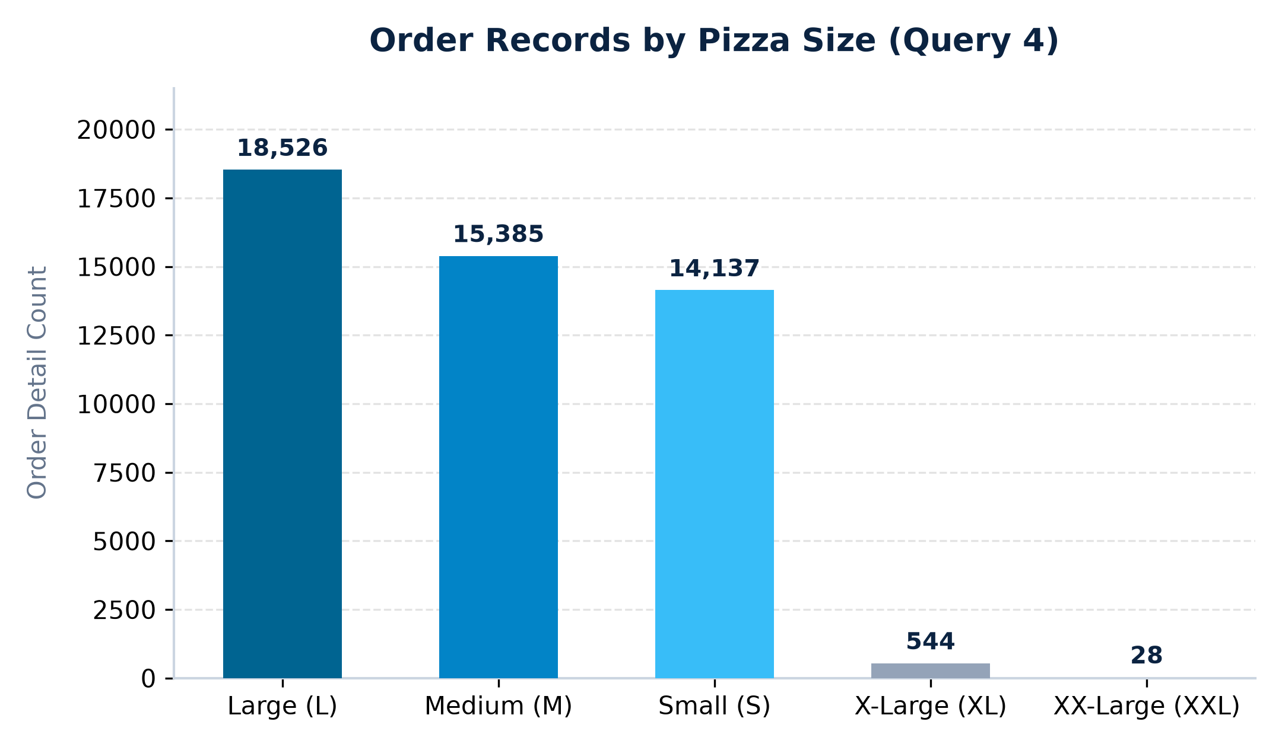
DOMINO'S ANALYTICS | QUERIES 03 & 04
Slide 06 / 16
Pricing & Size Dynamics: Premium SKUs vs Size Volume
Examining the highest-priced menu item and consumer size distribution preferences
-- Query 3: Highest-Priced Pizza
SELECT pt.name, p.price
FROM pizzas p
JOIN pizza_types pt ON p.pizza_type_id = pt.pizza_type_id
ORDER BY p.price DESC LIMIT 1;
-- Query 4: Most Common Pizza Size Ordered
SELECT p.size, COUNT(od.order_id) AS TotaL_Order
FROM pizzas p
JOIN order_details od ON p.pizza_id = od.pizza_id
GROUP BY p.size
ORDER BY TotaL_Order DESC;
QUERY 3 RESULT: HIGHEST-PRICED MENU ITEM
The Greek Pizza (XXL) — $35.95
Only 28 XXL orders placed in entire year (0.06% of sales). Premium price does not equal volume.
DATA ANALYST INSIGHT
Large (L) is the clear consumer choice with 18,526 order lines (38.1%), followed by M (31.6%) and S (29.1%). XL and XXL are marginal niche sizes.
BUSINESS & OPERATIONAL USE CASE
Packaging Supply Chain: Over 98.8% of box procurement must be allocated to L, M, and S sizes in a 38:32:29 ratio.

Slide 7
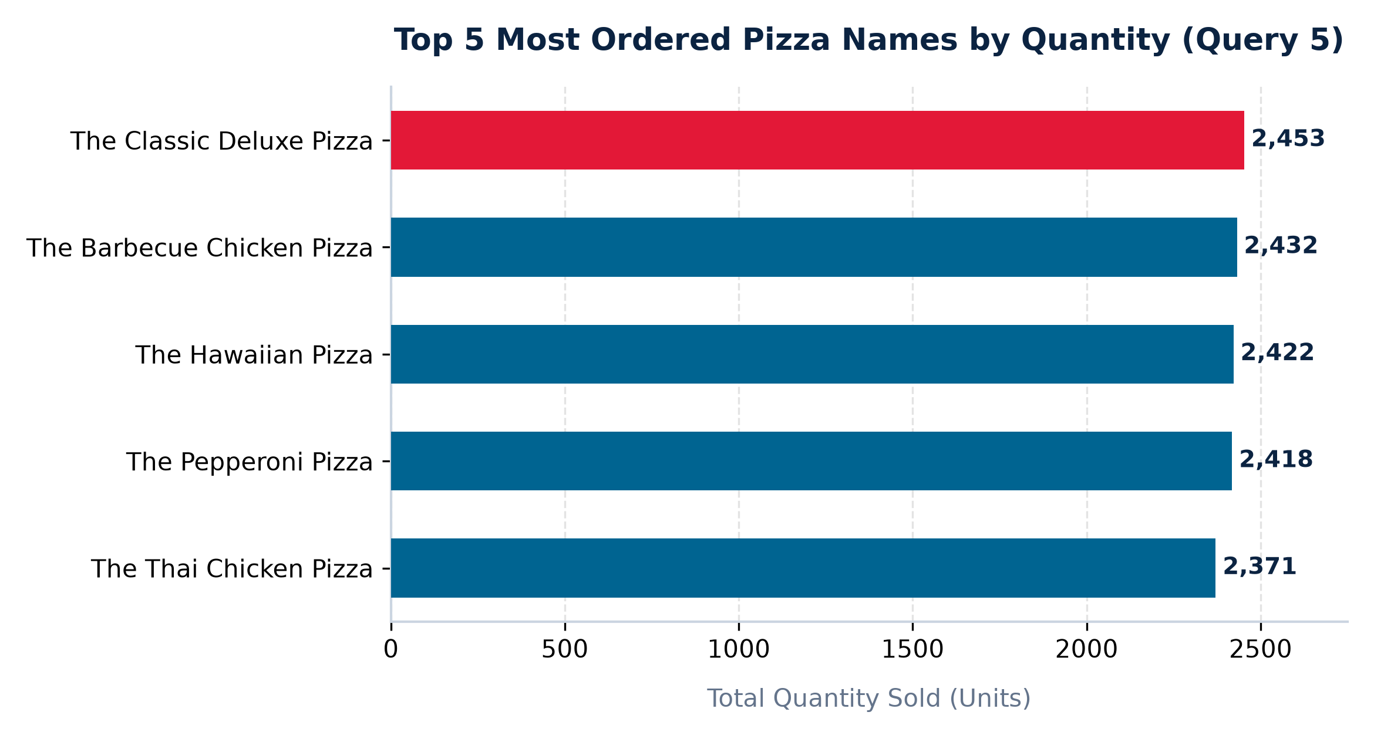
DOMINO'S ANALYTICS | QUERY 05
Slide 07 / 16
Top 5 Most Ordered Pizza Names by Quantity
Identifying the hero products commanding highest customer order volume and turnover
-- Top 5 most ordered pizza names by quantity
SELECT pizza_types.name,
SUM(order_details.quantity) AS total_quantity
FROM pizza_types
JOIN pizzas
ON pizza_types.pizza_type_id = pizzas.pizza_type_id
JOIN order_details
ON pizzas.pizza_id = order_details.pizza_id
GROUP BY pizza_types.name
ORDER BY total_quantity DESC LIMIT 5;
DATA ANALYST INSIGHT
The top 5 pizzas represent 12,096 units (24.4% of all volume). The race among top 4 is tightly grouped (separated by only 35 units: 2,453 to 2,418).
BUSINESS & OPERATIONAL USE CASE
Ingredient Buffering: Maintain safety stocks for pepperoni, ham, chicken breast, pineapple, and barbecue sauce to prevent peak-time stockouts.

Slide 8
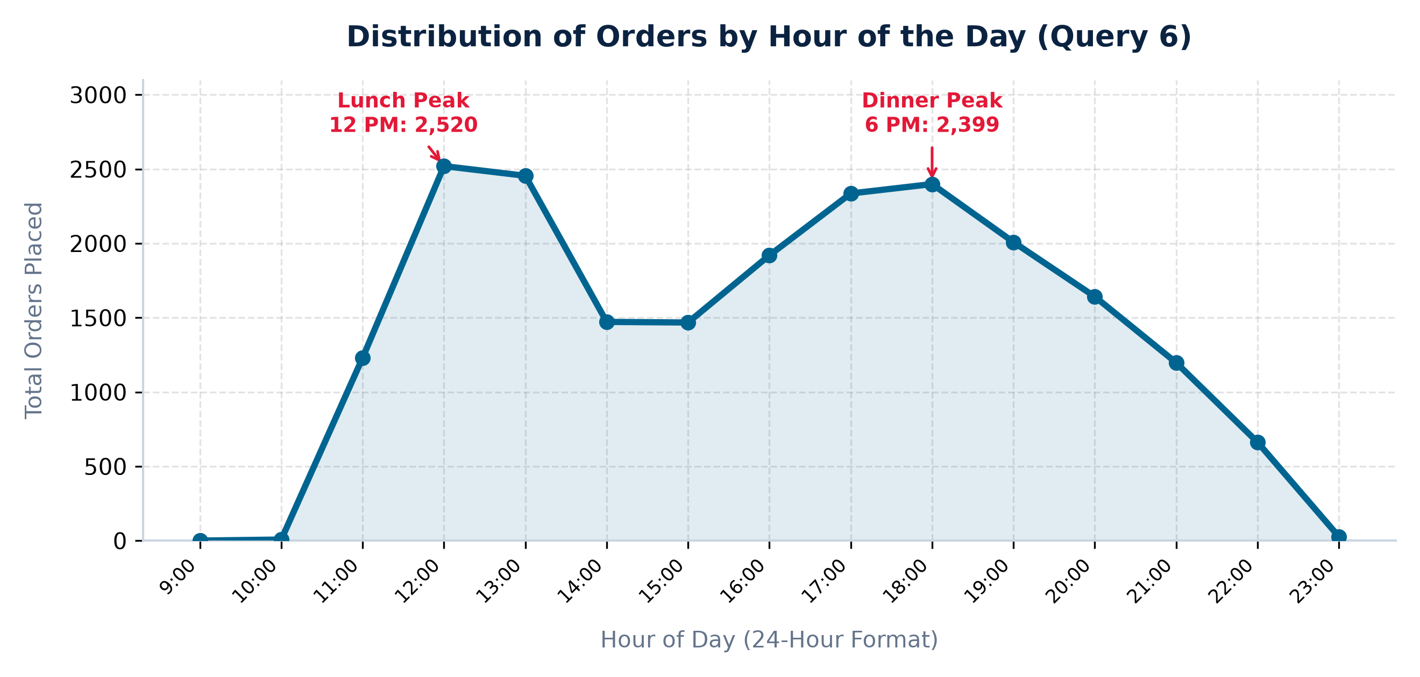
DOMINO'S ANALYTICS | QUERY 06
Slide 08 / 16
Operational Rhythm: Distribution of Orders by Hour
Uncovering store traffic patterns, lunch vs. dinner rushes, and off-peak valleys
-- Distribution of orders by hour of the day
SELECT HOUR(time) AS hour,
COUNT(order_id) AS order_count
FROM orders
GROUP BY hour
ORDER BY hour;
DATA ANALYST INSIGHT
Traffic exhibits a classic dual-peak curve: Lunch Rush at 12:00-13:00 (4,975 orders) and Dinner Rush at 17:00-18:00 (4,735 orders). Together they drive 45.5% of store sales.
BUSINESS & OPERATIONAL USE CASE
Shift Scheduling: Implement staggered split shifts (11:00-14:30 and 16:30-21:00). Use the 14:00-16:00 valley for dough prep, ingredient slicing, and restocking.

Slide 9
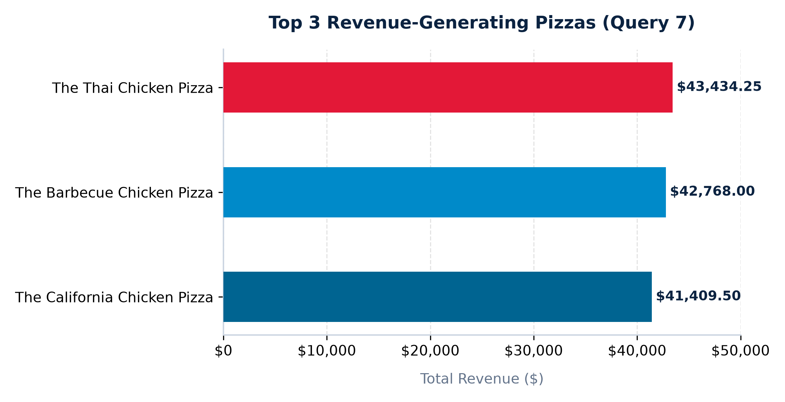
DOMINO'S ANALYTICS | QUERY 07
Slide 09 / 16
Top 3 Revenue-Generating Pizzas
Uncovering which specific recipes produce the highest gross dollar contribution
-- Top 3 most ordered pizza names by total revenue
SELECT pizza_types.name,
ROUND(SUM(pizzas.price * order_details.quantity), 2) AS Total_revenue
FROM pizza_types
JOIN pizzas
ON pizza_types.pizza_type_id = pizzas.pizza_type_id
JOIN order_details
ON pizzas.pizza_id = order_details.pizza_id
GROUP BY pizza_types.name
ORDER BY total_revenue DESC LIMIT 3;
DATA ANALYST INSIGHT
The Chicken Premium Effect: All top 3 revenue leaders belong to the Chicken category ($43.4K, $42.8K, $41.4K). Together they generate $127.6K (15.6% of store revenue).
BUSINESS & OPERATIONAL USE CASE
Menu Merchandising: Feature Thai Chicken and BBQ Chicken on app headers and meal combo banners to maximize ticket margin.

Slide 10
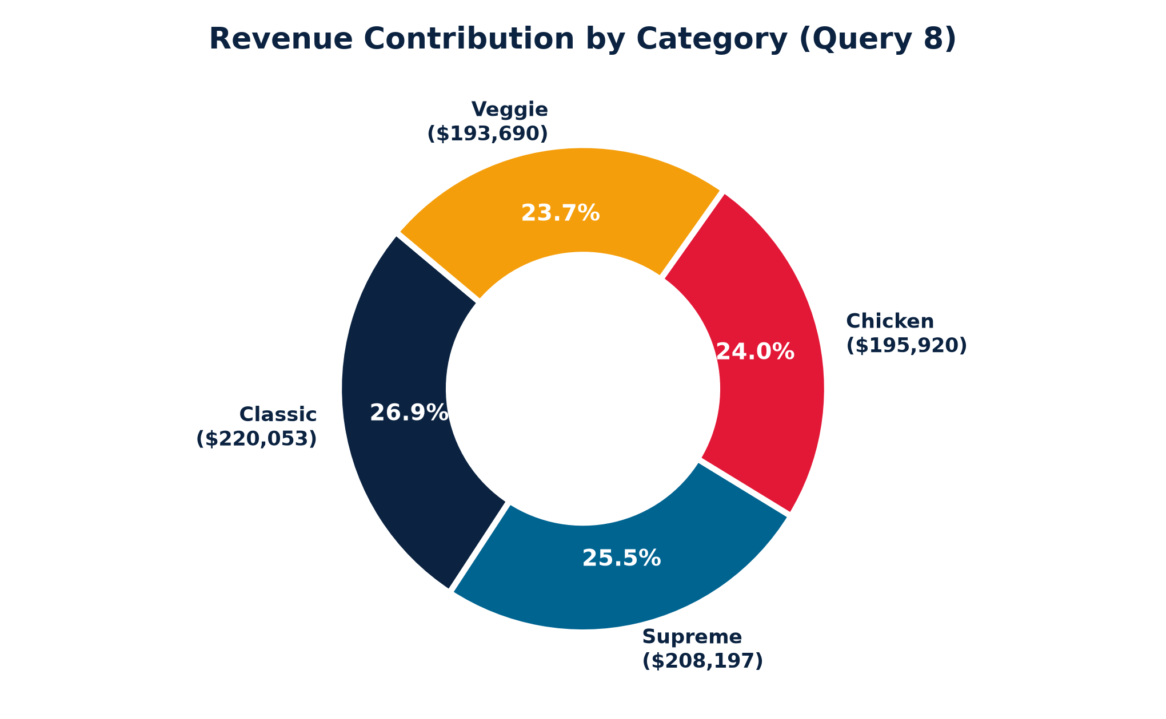
DOMINO'S ANALYTICS | QUERY 08
Slide 10 / 16
Category Revenue Contribution: Market Share Analysis
Common Table Expression (CTE) calculating relative dollar contribution across pizza categories
-- Percentage contribution of each category to total revenue
WITH ppp AS (
SELECT pizza_types.category,
ROUND(SUM(pizzas.price * order_details.quantity), 2) AS Total_revenue
FROM pizza_types
JOIN pizzas ON pizza_types.pizza_type_id = pizzas.pizza_type_id
JOIN order_details ON pizzas.pizza_id = order_details.pizza_id
GROUP BY pizza_types.category
ORDER BY total_revenue DESC
)
SELECT category,
CONCAT(ROUND((total_revenue / (SELECT SUM(total_revenue) FROM ppp)) * 100, 2), "%") AS Percentage
FROM ppp;
DATA ANALYST INSIGHT
Balanced Revenue Portfolio: Sales are remarkably well-balanced across all 4 categories (Classic 26.9%, Supreme 25.5%, Chicken 24.0%, Veggie 23.7%), providing strong revenue resilience.
BUSINESS & OPERATIONAL USE CASE
Cross-Segment Protection: Maintain menu breadth across all dietary segments; corporate lunch orders depend on catering to both vegetarian and meat-eating diners.

Slide 11
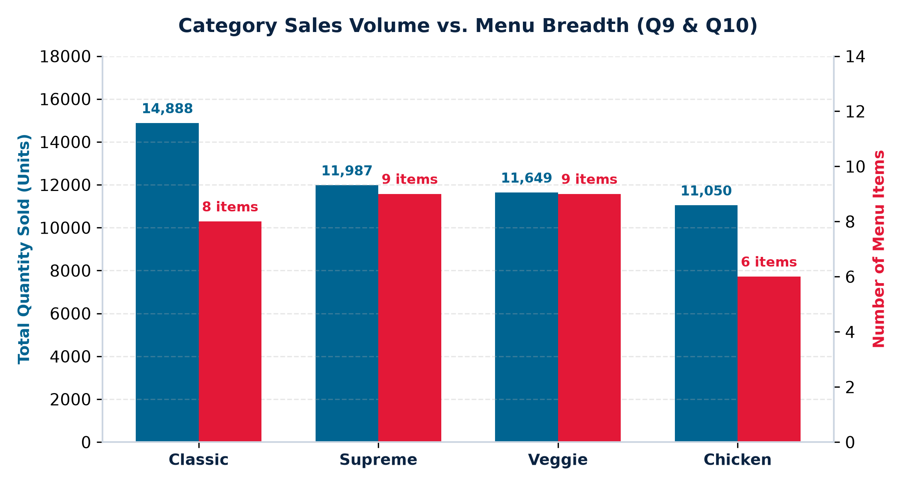
DOMINO'S ANALYTICS | QUERIES 09 & 10
Slide 11 / 16
Category Volume vs Menu Breadth: SKU Productivity
Comparing unit sales volume against menu item counts to uncover operational productivity
-- Query 9: Total Quantity by Category
SELECT pizza_types.category, SUM(order_details.quantity) AS total_quantity
FROM pizza_types JOIN pizzas ON pizza_types.pizza_type_id = pizzas.pizza_type_id
JOIN order_details ON pizzas.pizza_id = order_details.pizza_id
GROUP BY pizza_types.category ORDER BY total_quantity DESC LIMIT 5;
-- Query 10: Number of Pizzas in Each Category
SELECT category, COUNT(name) AS Total_pizza
FROM pizza_types GROUP BY category ORDER BY Total_pizza DESC;
DATA ANALYST INSIGHT
Chicken generates $32,653 revenue per menu SKU (6 items), while Veggie yields only $21,521 across 9 items. Chicken is 51% more productive on a per-item basis.
BUSINESS & OPERATIONAL USE CASE
Menu Rationalization: Audit low-turnover veggie recipes (Green Garden, Brie Carre) and introduce 1-2 new chicken variants to boost total menu yield.

Slide 12
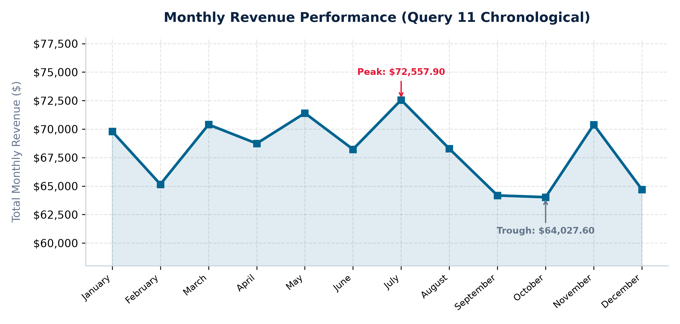
DOMINO'S ANALYTICS | QUERY 11
Slide 12 / 16
Monthly Revenue Performance & Trend Analysis
Analyzing 2015 revenue seasonality and demonstrating chronological time-series ordering
-- Query 11: Total Revenue Month-Wise (Original)
SELECT MONTHNAME(orders.date) AS month,
ROUND(SUM(pizzas.price * order_details.quantity), 2) AS Total_revenue
FROM orders JOIN order_details ON orders.order_id = order_details.order_id
JOIN pizzas ON pizzas.pizza_id = order_details.pizza_id
GROUP BY month;
-- Senior Enhancement (Chronological Ordering):
SELECT MONTH(orders.date) AS month_num, MONTHNAME(orders.date) AS month,
ROUND(SUM(pizzas.price * order_details.quantity), 2) AS Total_revenue
FROM orders JOIN order_details ON orders.order_id = order_details.order_id
JOIN pizzas ON pizzas.pizza_id = order_details.pizza_id
GROUP BY month_num, month ORDER BY month_num ASC;
DATA ANALYST INSIGHT
Stable Recurring Cash Flow: Monthly revenue averages $68,155/mo with a tight 4% CV. July represents peak summer dining ($72,558), while October marks the annual trough ($64,028).
BUSINESS & OPERATIONAL USE CASE
Seasonal Marketing: Deploy fall promotional campaigns ('Octoberfest Deals') to smooth out the October trough, and front-load marketing in June for peak summer capture.

Slide 13
DOMINO'S ANALYTICS | EXECUTIVE COCKPIT
Slide 13 / 16
Executive Performance Dashboard
A high-level business scorecard synthesizing verified KPIs across volume, revenue, and operations
TOTAL ANNUAL REVENUE
$817,860.05
49,574 pizzas across 358 operating days in 2015
TOTAL ORDERS PROCESSED
21,350
Avg. 59.6 customer transactions per day
AVERAGE ORDER VALUE (AOV)
$38.31
Reflects 2.32 pizzas per customer transaction
TOTAL UNIT VOLUME
49,574
Units sold across 32 recipes and 5 sizes (S-XXL)
TOP REVENUE GENERATOR
The Thai Chicken
$43,434.25 total revenue (5.31% of sales)
TOP VOLUME PRODUCT
The Classic Deluxe
2,453 pizzas sold (4.95% of aggregate volume)
MOST POPULAR SIZE
Large (L)
18,526 order lines (38.1% of all customer orders)
PEAK OPERATIONAL HOURS
12 PM & 6 PM
45.5% of daily store volume in lunch & dinner peaks
CATEGORY PERFORMANCE SUMMARY
• Classic Category: 8 Menu SKUs | 14,888 Units Sold (30.0%) | $220,053.10 Revenue (26.91%) | $27,506 Rev/SKU
• Supreme Category: 9 Menu SKUs | 11,987 Units Sold (24.2%) | $208,197.00 Revenue (25.46%) | $23,133 Rev/SKU
• Chicken Category: 6 Menu SKUs | 11,050 Units Sold (22.3%) | $195,919.50 Revenue (23.96%) | $32,653 Rev/SKU (Leader)
• Veggie Category: 9 Menu SKUs | 11,649 Units Sold (23.5%) | $193,690.45 Revenue (23.68%) | $21,521 Rev/SKU

Slide 14
DOMINO'S ANALYTICS | STRATEGIC ROADMAP
Slide 14 / 16
Actionable Strategic Business Recommendations
Four data-grounded operational and commercial initiatives to optimize store profitability
PILLAR 1: INVENTORY & SAFETY STOCK
• Data: Top 5 pizzas generate 24.4% of volume (12,096 units).
• Action: Automated reorder triggers for pepperoni, chicken breast, ham, pineapple, mozzarella.
• Delivery: Schedule supplier deliveries on Tuesday & Friday mornings to protect weekend surges.
PILLAR 2: MENU ENGINEERING & PRUNING
• Data: Chicken delivers $32.6K rev/SKU (6 items) vs Veggie's $21.5K (9 items).
• Action: Test 1-2 new seasonal chicken variants (e.g. Buffalo Chicken).
• Pruning: Streamline the bottom 3 lowest-turnover veggie recipes to cut prep complexity.
PILLAR 3: LABOR & OVEN STAGING
• Data: Twin peaks at 12:00-13:00 (4,975 orders) and 17:00-18:00 (4,735 orders).
• Action: Split shifts (11:00-14:30 & 16:30-21:00) to double kitchen capacity during rushes.
• Prep: Reserve 14:00-16:00 for dough stretching, sauce portioning, and box assembly.
PILLAR 4: BASKET SIZE & UPSELLING
• Data: Average Order Value is $38.31 (2.32 pizzas/order); Large is 38.1% of lines.
• Action: Introduce Family Meal Deals (2 Large + Side + 2L Drink for $44.99).
• App Upsell: One-click dip and beverage recommendations at checkout to lift AOV past $45.

Slide 15
DOMINO'S ANALYTICS | TECHNICAL AUDIT
Slide 15 / 16
Technical Validation & SQL Quality Review
Documenting data governance, cross-engine compatibility, and query optimization rigor
DATA GOVERNANCE & INTEGRITY CHECKS
✔ Zero Orphaned Foreign Keys: Audited 48,620 line items in order_details. 100% match valid orders and valid pizzas.
✔ Deterministic Revenue: Transaction sum ($817,860.05) reconciles exactly with category sums ($220.1K + $208.2K + $195.9K + $193.7K). Discrepancy is $0.00.
✔ Temporal Completeness: 358 operating days in 2015 without anomalous timestamps.
✔ Metric Nuance: Query 4 calculates line items (18,526) vs units (18,956). Both establish Large as the top size.
✔ Chronological Ordering: Restored chronological sequencing to Query 11 for executive reporting.
QUERY OPTIMIZATION & BEST PRACTICES
⚡ Indexing Strategies: FK indexing on order_details(pizza_id) and pizzas(pizza_type_id) ensures sub-millisecond hash joins.
⚡ CTE Readability: Query 8 utilized Common Table Expressions for modular clarity and optimal query execution plans.
⚡ Cross-Engine Portability: MySQL native functions (HOUR, MONTHNAME, CONCAT) verified for standard SQL migration.
⚡ Aggregation Precision: Enforced ROUND(..., 2) on all monetary metrics to prevent floating-point rounding errors.

Slide 16
PROJECT COMPLETION | PORTFOLIO CASE STUDY
DOMINO'S PIZZA SQL ANALYSIS
From Raw Transactions to Strategic Value
Demonstrating end-to-end data analyst proficiency in relational database architecture, SQL joins and aggregations, statistical verification, and executive storytelling.
Relational Modeling
4 tables, PKs, FKs, zero orphaned records
Advanced SQL
CTEs, joins, aggregations, time-series
Business Intelligence
Revenue velocity, AOV, size dynamics
Actionable Strategy
Inventory buffers, shift rosters, menu pruning
💼 Portfolio Showcase | GitHub Ready | Interview Presentation Deck

