Slide 1

Web Development with Django
Presenter: Akshat Soni

Slide 2




About Me
Postgraduate Cybersecurity @Deakin
Career Ambassador @DeakinTALENT
Ex-Software Engineer @GlobalLogic
Aspiring Security Professional

Slide 3
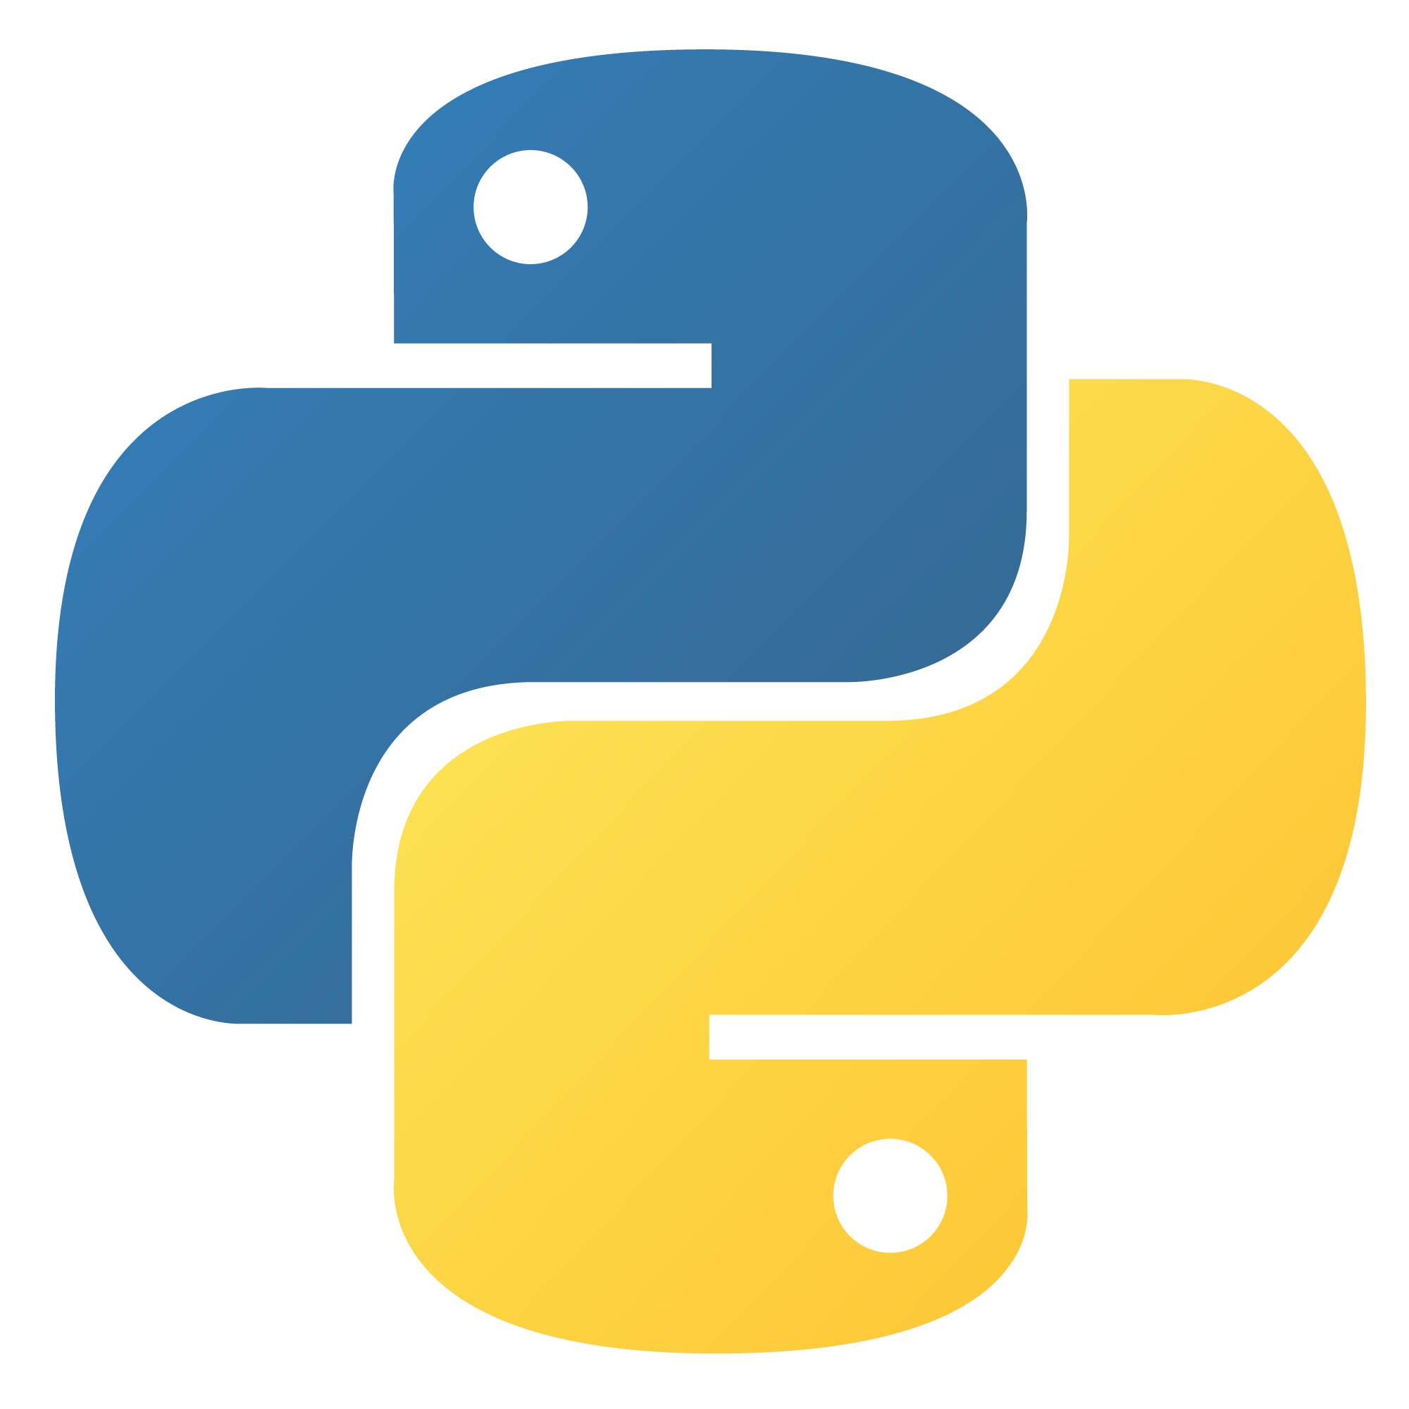
Why Python?
You might use Python for Web Development:
Fundamental Knowledge of Python
Easy to learn
Readability

Slide 4
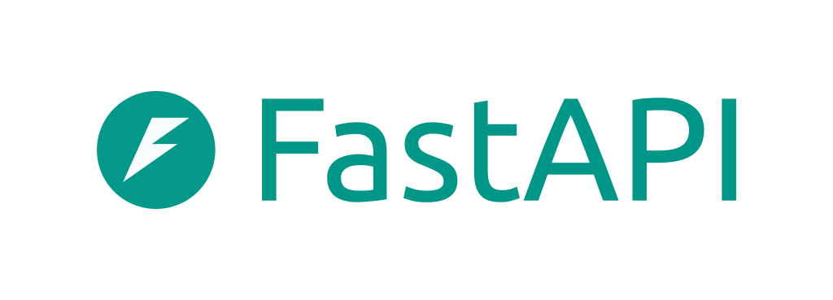


Frameworks
Django
CherryPy

Slide 5
About Django
First Released: July 2005
High-Level Python Framework
Open Source (Since 2005)
MVT Architecture
Maintained by Django Software Foundation

Slide 6
Why not Flask?
Suitable for Small-scale Projects
No Batteries
Development Speed
No Security Features

Slide 7
Why love Django?
Support for ORM (Object-Relational Mapper)
Built-in Admin Dashboard
Easy to adapt
Security Features
Community Support

Slide 8
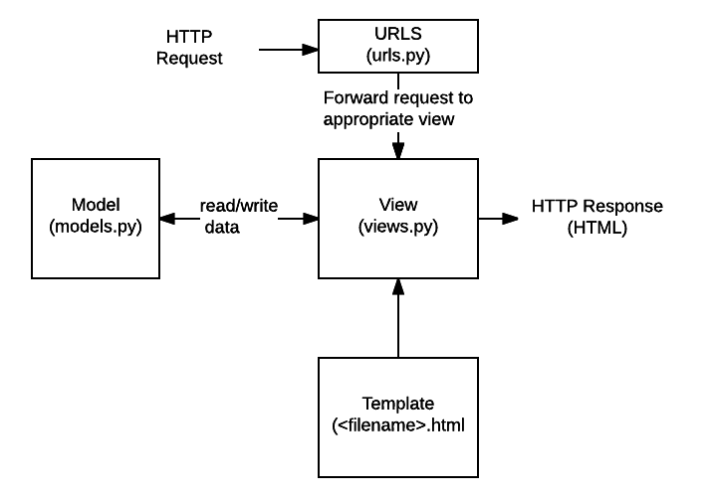
Django Architecture

Slide 9
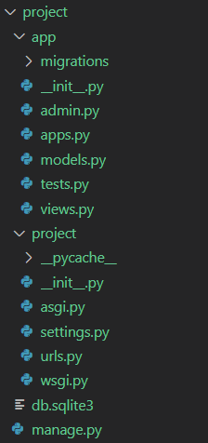
Folder Structure

Slide 10
Demo 1
Installation

Slide 11
Demo 2
HTML Rendering

Slide 12
Demo 3
API Development

Slide 13
What Just Happened?
What’s Django?
Why Django?
Other Frameworks?
Demos

Slide 14
Important Links
https://www.djangoproject.com/
https://github.com/django/django
https://www.youtube.com/@CodingEntrepreneurs/videos

Slide 15
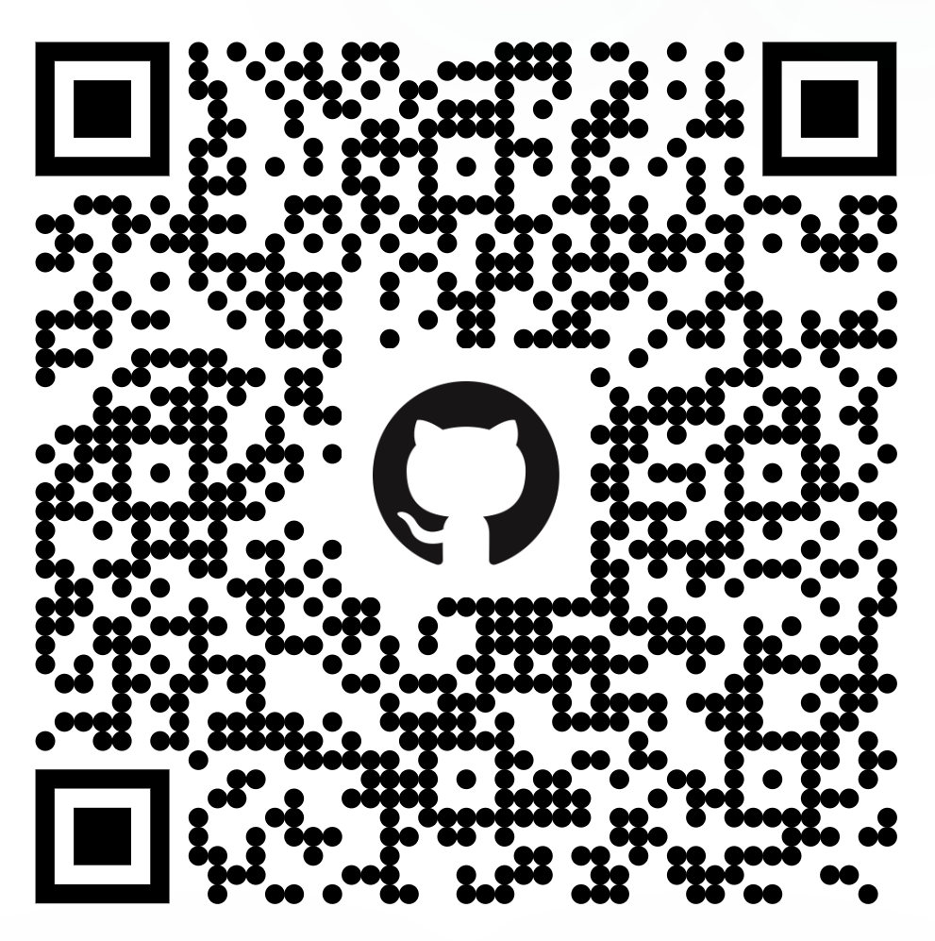
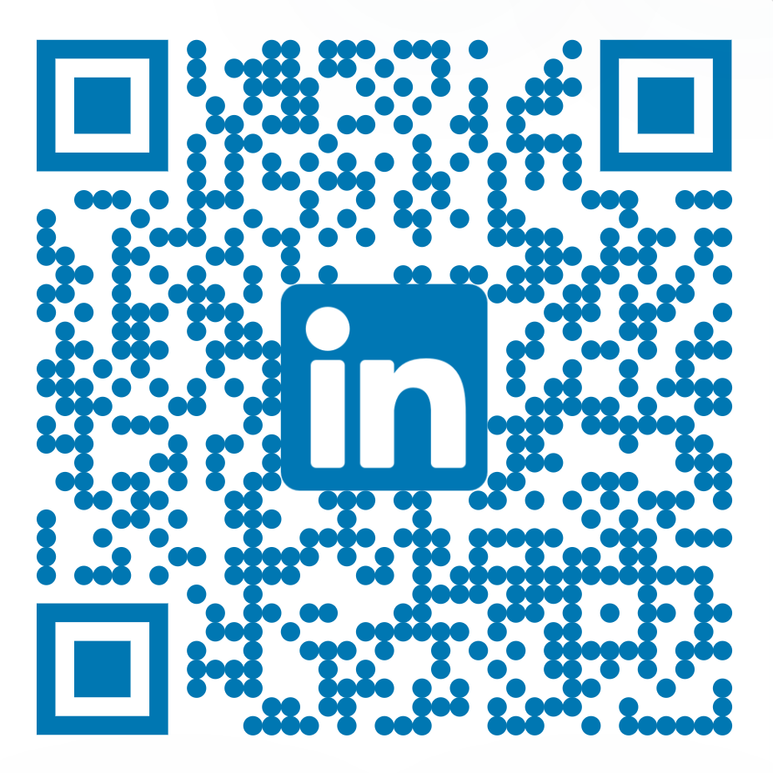
Thank You
Q&A Time

