Slide 1
CBDCs
Hyperledger Fabric for Central Bank’s Digital Currency
Nitu Choudhary
Akshat Srivastava
Milankumar Patel
Tushar Tiwari

Slide 2

AGENDA
What are CBDCs?
Key Features of CBDCs
Why Hyperledger Fabric?
Logical Architecture
Technical Architecture
Demo
Future Considerations
Benefits
Possible Consequences

Slide 3

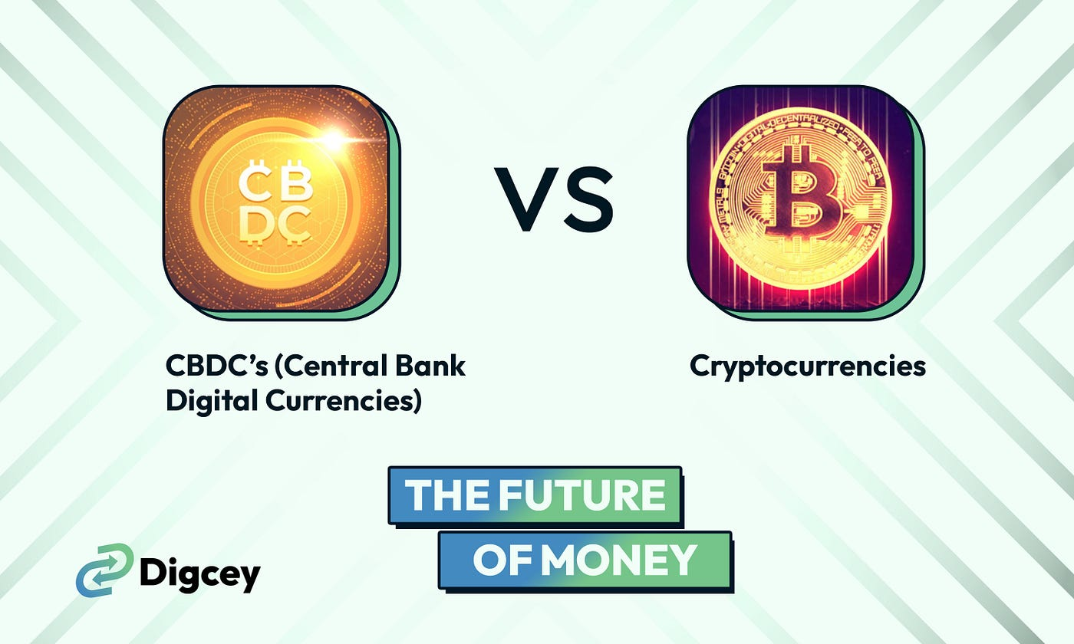
WHAT ARE CBDCs?
Central Bank Digital Currencies (CBDCs) are digital forms of central bank money that serve as legal tender. Unlike cryptocurrencies like Bitcoin, CBDCs are issued and regulated by central banks.
Features | Cryptocurrency | CBDCs
Issuance & Control | Typically decentralized and not controlled by an entity | Issued and regulated by a country's central bank
Purpose & Design | Designed to operate as alternative forms of money, independent of traditional financial system | Designed to complement existing fiat currencies, integrating with existing financial system
Anonymity & Privacy | Provides varied levels of anonymity and privacy | Less anonymity and can be traced

Slide 4

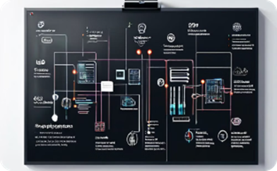



KEY FEATURES
Security
Interoperability
Transparency
Programmability
Efficiency

Slide 5

WHY HYPERLEDGER FABRIC?
Permissioned Networks: Ensures that only authorized participants can join the network, aligning with regulatory requirements for CBD
Customizable Smart Contracts: Allows central banks to tailor the digital currency's functionality to their specific needs.
High Throughput: Capable of handling large volumes of transactions, essential for national-scale digital currencies.
Private Channels: Provides customizable and private channels for peers to communicate securely and privately

Slide 6
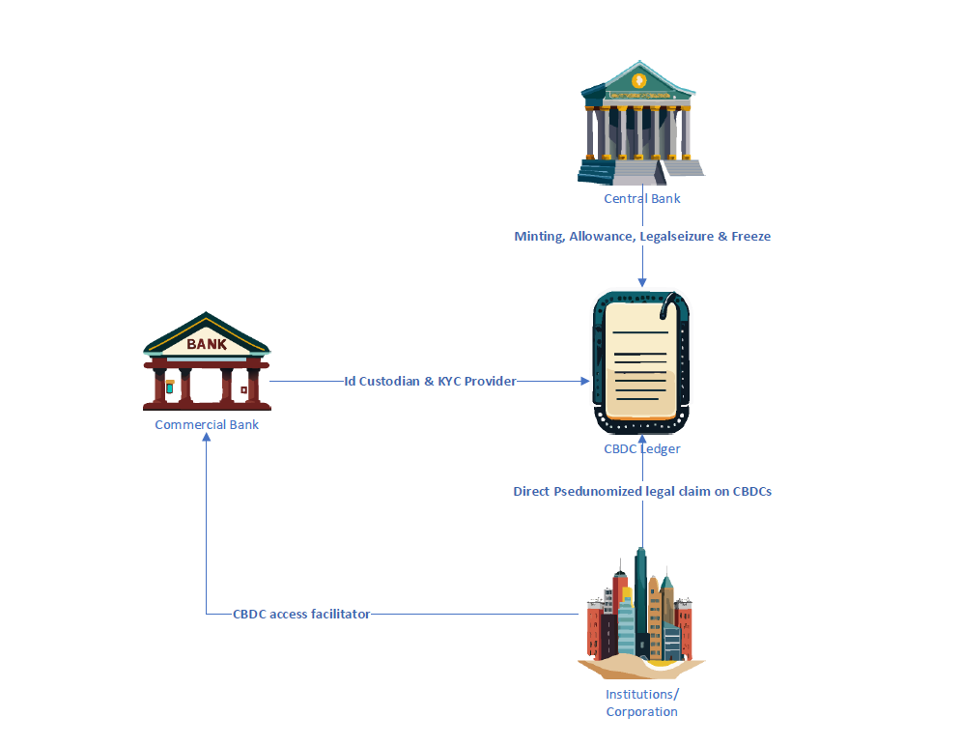
LOGICAL ARCHITECTURE

Slide 7
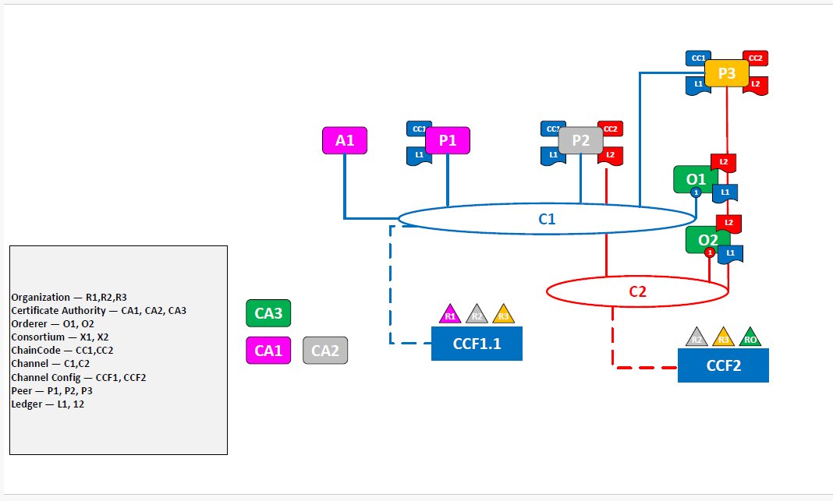
TECHNICAL ARCHITECTURE

Slide 8
DEMO

Slide 9
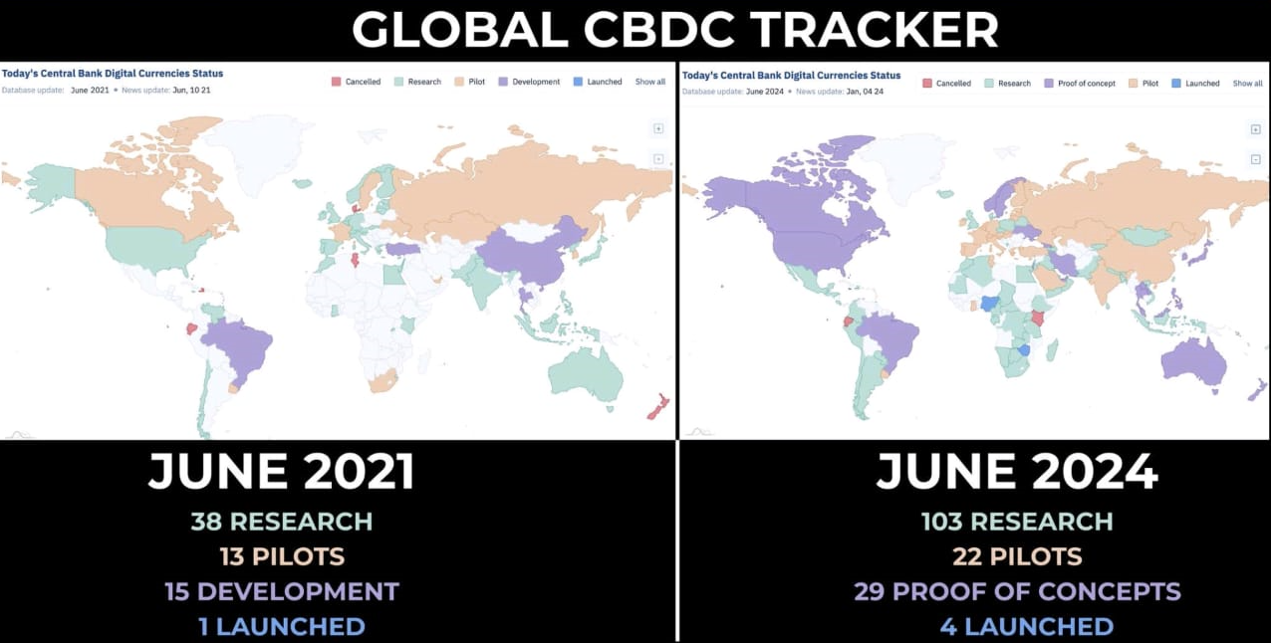

FUTURE CONSIDERATIONS

Slide 10

BENEFITS
Enhanced Security
Faster Transactions
Improved Transparency
Traceability
Cost-effective & Environment Friendly

Slide 11

POSSIBLE CONSEQUENCES
Stepping on the toe
Viability
Zero Anonymity
Retail CBDCs: Not a
child’s play

Slide 12
Thank you!
FEEL FREE TO ASK QUESTIONS!
Nitu Choudhary
Akshat Srivastava
Milankumar Patel
Tushar Tiwari

