Slide 1
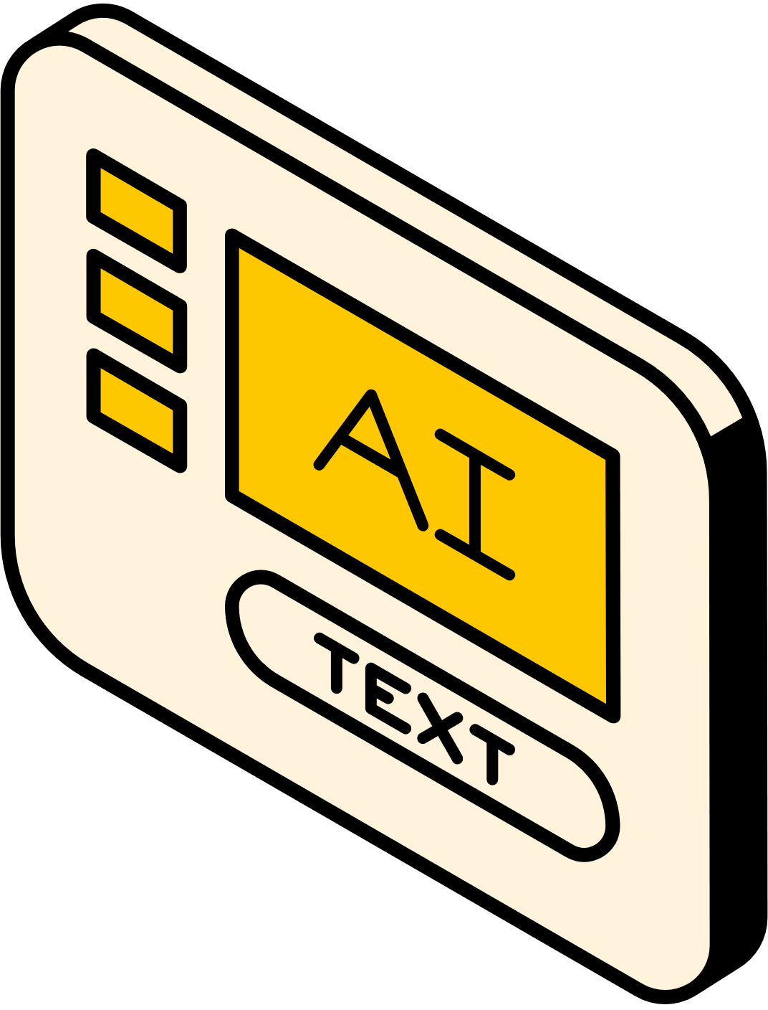
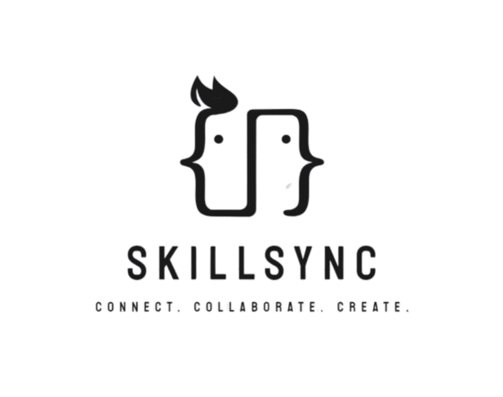
SKILLSYNC
PRESENTED BY:
AKSHAT SHRIVASTAV
SANIDHYA SHUKLA
DEVRAJ GOSWAMI
MD DILSHAD ALAM
SAATVIK AGNIHOTRI

Slide 2
PRESENTATION OUTLINE
Problem Statement
Introduction
Tech Stack
Proposed Solution

Slide 3

PROBLEM STATEMENT
Developers often face challenges in finding the right collaborators for their projects, as existing platforms fail to efficiently connect them based on specific skills. This leads to time-consuming and often ineffective searches for partners with complementary expertise, hindering project progress and success.

Slide 4
INTRODUCTION
DEVELOPERS FACE SIGNIFICANT CHALLENGES IN FINDING COLLABORATORS WITH COMPLEMENTARY SKILLS.
TRADITIONAL NETWORKING AND JOB PLATFORMS ARE INEFFICIENT FOR MATCHING DEVELOPERS BASED ON SPECIFIC TECHNICAL NEEDS.
THERE’S A LACK OF A DEDICATED PLATFORM THAT SEAMLESSLY CONNECTS DEVELOPERS FOR PROJECT COLLABORATION, ESPECIALLY IN REMOTE OR FREELANCE ENVIRONMENTS

Slide 5
TECH STACK
Firebase
React Native
LangChain
Node.js
Clerk
Olama

Slide 6
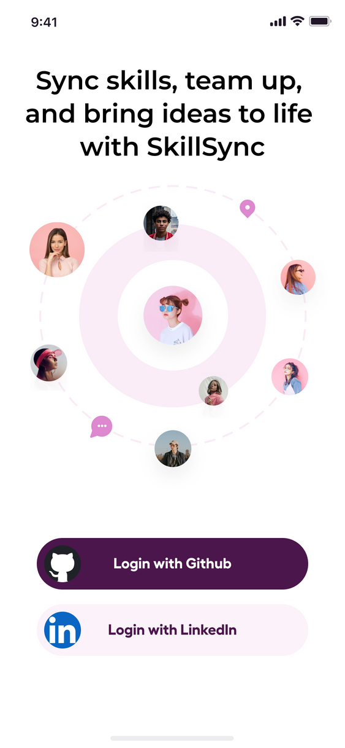
PROPOSED SOLUTION
Swipe-Based Matching
AI-Integrated Skill Verification
Smart Recommendation
System
IN-APP Collaboration Tools
Unique Rating System

Slide 7
